Slide 2
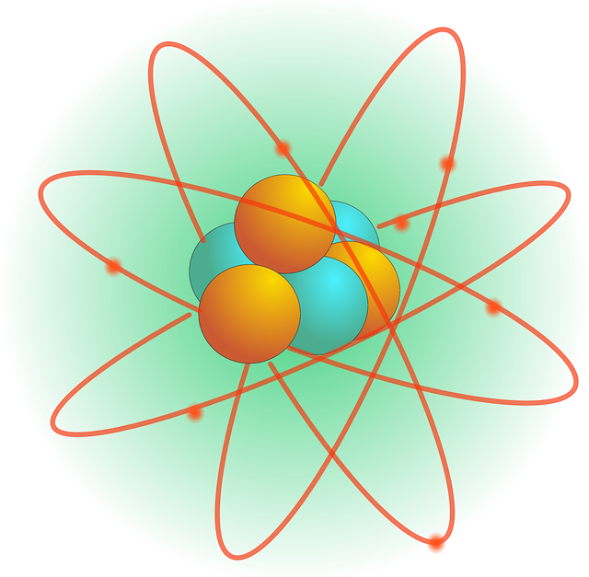
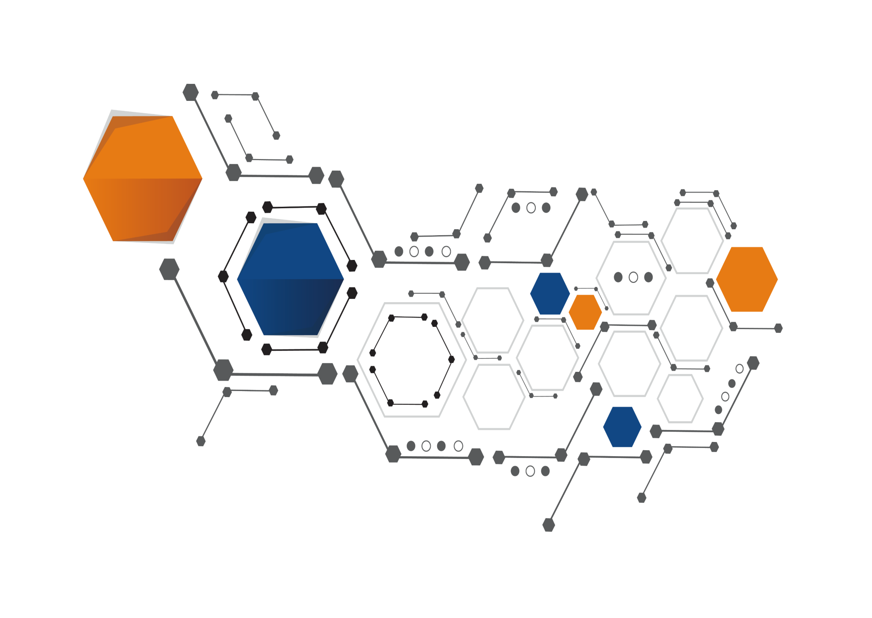
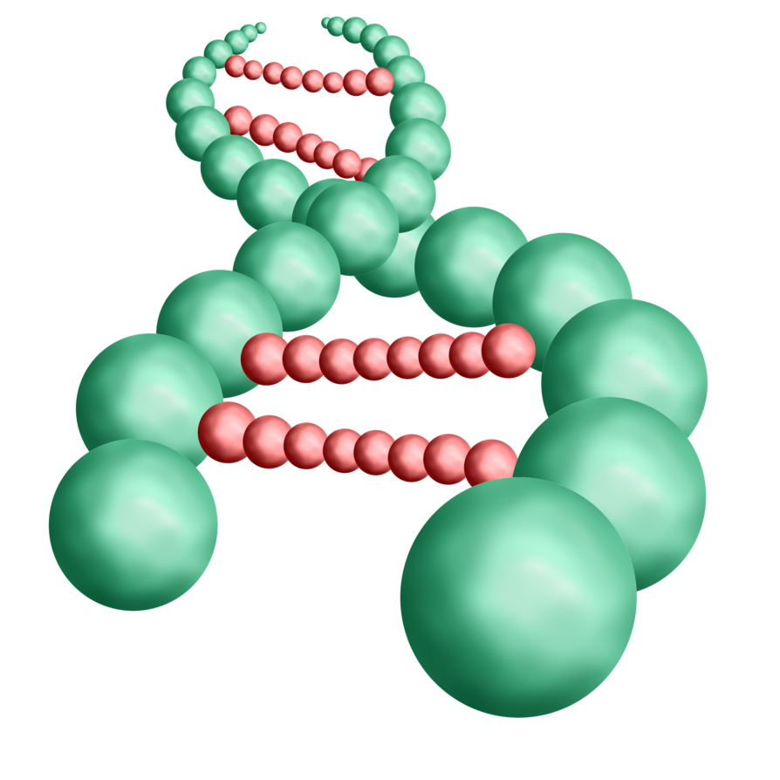
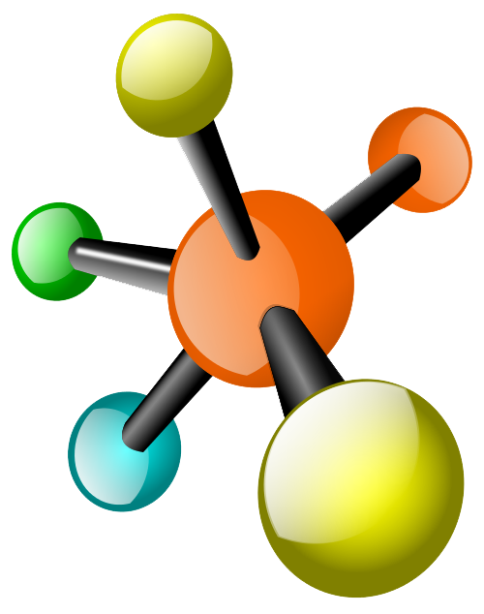
Science … Ab Hogi Asaan
BY NIHARIKA RATHORE
Use Code Y431 for max 77% Discount

Slide 4
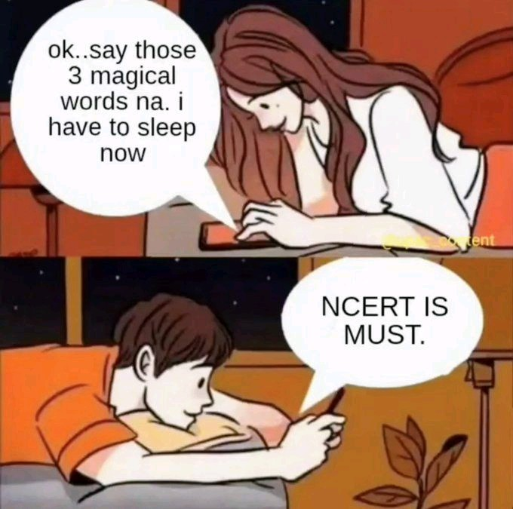

Slide 6
SCIENCE BY NIHARIKA RATHORE
Y431
USE CODE FOR 77% DISCOUNT
Time – 5:45 pm
1. What is the minimum distance (in metres) required to hear an echo?
(a) 10
(b) 13
(c) 17
(d) 21

Slide 7
SCIENCE BY NIHARIKA RATHORE
Y431
USE CODE FOR 77% DISCOUNT
Time – 5:45 pm
Answer (c);
Echo is a reflection of sound that arrives at the listener with a delay after the direct sound.The reflecting object must be more than 17m from the sound source for echo to be perceived by a person located at the source.

Slide 8
SCIENCE BY NIHARIKA RATHORE
Y431
USE CODE FOR 77% DISCOUNT
Time – 5:45 pm
2. Why does a Black board appears black in colour?
(a) It reflects black colour
(b) It absorbs black colour
(c) It reflects all colours
(d) It absorbs all the colours

Slide 9
SCIENCE BY NIHARIKA RATHORE
Y431
USE CODE FOR 77% DISCOUNT
Time – 5:45 pm
Answer: (d);
A black board appears black because it absorbs all the colors of white light and reflects none.

Slide 10
SCIENCE BY NIHARIKA RATHORE
Y431
USE CODE FOR 77% DISCOUNT
Time – 5:45 pm
3. Which of the following instrument is used to measure Soil Water Tension?
(a) Photometer
(b) Pyrometer
(c) Psychrometer
(d) Tensiometer

Slide 11
SCIENCE BY NIHARIKA RATHORE
Y431
USE CODE FOR 77% DISCOUNT
Time – 5:45 pm
Answer: (d);
A tensiometer in soil science is a measuring instrument used to determine the Soil water tension. Such tensiometers are used in irrigation scheduling to help farmers and other irrigation managers to determine when to water. It can also be used in the scientific study of soils and plants.

Slide 12
SCIENCE BY NIHARIKA RATHORE
Y431
USE CODE FOR 77% DISCOUNT
Time – 5:45 pm
4. What is the SI unit of Force?
(a) Pascal
(b) Boyle
(c) Newton
(d) Watt

Slide 13
SCIENCE BY NIHARIKA RATHORE
Y431
USE CODE FOR 77% DISCOUNT
Time – 5:45 pm
Answer: (c);
The SI unit of Force is Newton. One Newton is equal to 1 kilogram meter per second squared.

Slide 14
SCIENCE BY NIHARIKA RATHORE
Y431
USE CODE FOR 77% DISCOUNT
Time – 5:45 pm
5. Which one of the following is a bad Thermal Conductor?
(a) Aluminium
(b) Copper
(c) Glass
(d) Silver

Slide 15
SCIENCE BY NIHARIKA RATHORE
Y431
USE CODE FOR 77% DISCOUNT
Time – 5:45 pm
Answer: (c);
Glass is bad thermal conductor and is a good insulator. It has tightly held electrons which did not allow heat to flow through it.

Slide 16
SCIENCE BY NIHARIKA RATHORE
Y431
USE CODE FOR 77% DISCOUNT
Time – 5:45 pm
6. Who invented first working laser?
(a) A. H. Taylor
(b) W. K. Roentgeen
(c) T. H. Maiman
(d) Fred Morrission

Slide 17
SCIENCE BY NIHARIKA RATHORE
Y431
USE CODE FOR 77% DISCOUNT
Time – 5:45 pm
Answer: (c);
LASER (LIGHT AMPLIFICATION BY STIMULATED EMMISSION OF RADIATION) is a device that emits light through a process of optical amplification based on the stimulated emission of electromagnetic radiation.
The first laser was built in 1960 by Theodore H. Maiman.

Slide 18
SCIENCE BY NIHARIKA RATHORE
Y431
USE CODE FOR 77% DISCOUNT
Time – 5:45 pm
7. Meter in a vehicle that calculates distance covered by the vehicle is called
(a) Speedometer
(b) Odometer
(c) Thermometer
(d) Kilometre

Slide 19
SCIENCE BY NIHARIKA RATHORE
Y431
USE CODE FOR 77% DISCOUNT
Time – 5:45 pm
Answer: (b);
An odometer or odograph is an instrument for measuring the distance travelled by a vehicle, such as a bicycle or car. The device may be electronic, mechanical, or a combination of the two.

Slide 20
SCIENCE BY NIHARIKA RATHORE
Y431
USE CODE FOR 77% DISCOUNT
Time – 5:45 pm
8. What is the SI unit of pressure?
(a) Newton
(b) Weber
(c) Pascal
(d) Henry

Slide 21
SCIENCE BY NIHARIKA RATHORE
Y431
USE CODE FOR 77% DISCOUNT
Time – 5:45 pm
Answer: (c);
The SI unit for pressure is the pascal (Pa), equal to one newton per square metre (N/m², or kg.m⁻¹.s⁻²). This name for the unit was added in 1971. It is named after the French polymath Blaise Pascal.

Slide 22
SCIENCE BY NIHARIKA RATHORE
Y431
USE CODE FOR 77% DISCOUNT
Time – 5:45 pm
9. Reflection from a smooth surface like that of a mirror is called __ reflection.
(a) Regular
(b) Irregular
(c) Diffused
(d) Fused

Slide 23
SCIENCE BY NIHARIKA RATHORE
Y431
USE CODE FOR 77% DISCOUNT
Time – 5:45 pm
Answer: (a);
When a beam pass of parallel light rays is incident on a smooth and plane surface, the reflected rays will also be parallel. This type of reflection is called Regular Reflection.

Slide 24
SCIENCE BY NIHARIKA RATHORE
Y431
USE CODE FOR 77% DISCOUNT
Time – 5:45 pm
10. What is the unit of resistance?
(a) Ohm
(b) Farad
(c) Henry
(d) Weber

Slide 25
SCIENCE BY NIHARIKA RATHORE
Y431
USE CODE FOR 77% DISCOUNT
Time – 5:45 pm
Answer: (a);
The ohm (symbol: Ω) is the SI derived unit of electrical resistance, named after German physicist Georg Simon Ohm.

Slide 26
SCIENCE BY NIHARIKA RATHORE
Y431
USE CODE FOR 77% DISCOUNT
Time – 5:45 pm
11. Gravitational force is maximum at which of the following place?
(a) At equator
(b) At tropic of cancer
(c) At tropic of Capricorn
(d) At poles

Slide 27
SCIENCE BY NIHARIKA RATHORE
Y431
USE CODE FOR 77% DISCOUNT
Time – 5:45 pm
Answer: (d);
The value of Gravitational Force range from a minimum of 9.78 metre per second squared at the Equator to a maximum of 9.83 metre per second squared at the poles. Hence Gravitational Force is maximum at poles.

Slide 28
SCIENCE BY NIHARIKA RATHORE
Y431
USE CODE FOR 77% DISCOUNT
Time – 5:45 pm
12. Which of the following device is used to measure humidity?
(a) Hydrometer
(b) Hygrometer
(c) Psycho Meter
(d) Anemometer

Slide 29
SCIENCE BY NIHARIKA RATHORE
Y431
USE CODE FOR 77% DISCOUNT
Time – 5:45 pm
Answer: (b);
A hygrometer is an instrument used for measuring the water vapour (humidity) in the atmosphere.

Slide 30
SCIENCE BY NIHARIKA RATHORE
Y431
USE CODE FOR 77% DISCOUNT
Time – 5:45 pm
13. Which of the following is not a vector quantity?
(a) Momentum
(b) Displacement
(c) Torque
(d) Speed

Slide 31
SCIENCE BY NIHARIKA RATHORE
Y431
USE CODE FOR 77% DISCOUNT
Time – 5:45 pm
Answer: (d);
Speed is the distance travelled by object in a certain interval of time. Speed is not dependent on direction hence it is a scalar quantity. While Displacement, Momentum and Torque has both magnitude and direction, so they are vector quantity.

Slide 32
SCIENCE BY NIHARIKA RATHORE
Y431
USE CODE FOR 77% DISCOUNT
Time – 5:45 pm
14. At what temperature (in Fahrenheit) pure water freezes?
(a) 32
(b) 0
(c) 48
(d) 37

Slide 33
SCIENCE BY NIHARIKA RATHORE
Y431
USE CODE FOR 77% DISCOUNT
Time – 5:45 pm
Answer: (b);
The temperature at which a liquid freezes is called the Freezing Point. The freezing point of water is 32°F.

Slide 34
SCIENCE BY NIHARIKA RATHORE
Y431
USE CODE FOR 77% DISCOUNT
Time – 5:45 pm
15. What is the other name of Galileo's law of falling bodies?
(a) Law of motion
(b) Newton's first law
(c) Newton's second law
(d) Newton's third law

Slide 35
SCIENCE BY NIHARIKA RATHORE
Y431
USE CODE FOR 77% DISCOUNT
Time – 5:45 pm
Answer: (b);
Newton's first law is other name of Galileo's law of Falling bodies. According to Law of Fall "The distance travelled by falling body is directly proportional to the square of the time it takes to fall". This latter claim states that a body in motion will continue its motion so long as no factor disturbs that motion. This principle is called the principle of inertia which is basis of Newton's first law.

Slide 36
SCIENCE BY NIHARIKA RATHORE
Y431
USE CODE FOR 77% DISCOUNT
Time – 5:45 pm
16. Which of the following device is best suited for measuring the temperature inside metallurgical furnaces?
(a) Pyrometer
(b) Thermocouple
(c) Thermometer
(d) Thermistor

Slide 37
SCIENCE BY NIHARIKA RATHORE
Y431
USE CODE FOR 77% DISCOUNT
Time – 5:45 pm
Answer: (a);
A pyrometer is a type of remote-sensing thermometer used to measure the temperature of a surface and inside metallurgical furnaces.

Slide 38
SCIENCE BY NIHARIKA RATHORE
Y431
USE CODE FOR 77% DISCOUNT
Time – 5:45 pm
17. In a qualitative way, the tendency of undisturbed objects to stay at rest or to keep moving with the same velocity is called __
(a) Force
(b) Acceleration
(c) Friction
(d) Inertia

Slide 39
SCIENCE BY NIHARIKA RATHORE
Y431
USE CODE FOR 77% DISCOUNT
Time – 5:45 pm
Answer: (d);
In a qualitative way, a property of matter by which it remains at rest or in uniform motion in the same straight line unless acted upon by some external force is called Inertia. In other words, the tendency of undisturbed objects to stay at rest or to keep moving with the same velocity is called Inertia.

Slide 40
SCIENCE BY NIHARIKA RATHORE
Y431
USE CODE FOR 77% DISCOUNT
Time – 5:45 pm
Q18. The time taken by a oscillation is called its?
(a) Maximum speed
(b) Average speed
(c) Time period pendulum to complete one
(d) Time interval

Slide 41
SCIENCE BY NIHARIKA RATHORE
Y431
USE CODE FOR 77% DISCOUNT
Time – 5:45 pm
Answer: (c);
The time taken by a pendulum to complete one oscillation is called its Time Period.

Slide 42
SCIENCE BY NIHARIKA RATHORE
Y431
USE CODE FOR 77% DISCOUNT
Time – 5:45 pm
19. If the mass of an object is 60 kgs, what will be its weight on the moon? (N-Newton)
(a) 60 N
(b) 600 N
(c) 100 N
(d) 10 N

Slide 43
SCIENCE BY NIHARIKA RATHORE
Y431
USE CODE FOR 77% DISCOUNT
Time – 5:45 pm
Answer: (c);
If the mass of an object is 60 kgs, 100N will be its weight on the moon.

Slide 44
SCIENCE BY NIHARIKA RATHORE
Y431
USE CODE FOR 77% DISCOUNT
Time – 5:45 pm
20. The side mirrors of vehicles are of which type of mirrors?
(a) Convex
(b) Concave
(c) Plane
(d) Inverted

Slide 45
SCIENCE BY NIHARIKA RATHORE
Y431
USE CODE FOR 77% DISCOUNT
Time – 5:45 pm
Answer: (a);
The convex mirror produces an upright image of any object and offers a wide viewing area as compared to the plane mirror. The usage of this type of mirror can be perceived on the car rear-view mirror, side-view mirror and even the motorcycles.

Slide 46
SCIENCE BY NIHARIKA RATHORE
Y431
USE CODE FOR 77% DISCOUNT
Time – 5:45 pm
21. If the speed of an object moving along a straight line is constant, its motion is said to be
(a) Uniform
(b) Periodic
(c) Circular
(d) Non-uniform

Slide 47
SCIENCE BY NIHARIKA RATHORE
Y431
USE CODE FOR 77% DISCOUNT
Time – 5:45 pm
Answer: (a);
If the speed of an object moving along a straight line is constant, its motion is said to be uniform motion.

Slide 48
SCIENCE BY NIHARIKA RATHORE
Y431
USE CODE FOR 77% DISCOUNT
Time – 5:45 pm
22. Strength of a force is usually expressed by its
(a) Motion
(b) Direction
(c) Interaction
(d) Magnitude

Slide 49
SCIENCE BY NIHARIKA RATHORE
Y431
USE CODE FOR 77% DISCOUNT
Time – 5:45 pm
Answer: (d);
The strength of a force is usually expressed by its Magnitude.

Slide 50
SCIENCE BY NIHARIKA RATHORE
Y431
USE CODE FOR 77% DISCOUNT
Time – 5:45 pm
23. If objects appear enlarged and inverted in a rear view mirror, then which type of mirror is used?
(a) Concave
(b) Convex
(c) Cylindrical
(d) Plane

Slide 51
SCIENCE BY NIHARIKA RATHORE
Y431
USE CODE FOR 77% DISCOUNT
Time – 5:45 pm
Answer: (a);
Concave mirrors are used to provide a magnified and inverted image in rear view mirror.

Slide 52
SCIENCE BY NIHARIKA RATHORE
Y431
USE CODE FOR 77% DISCOUNT
Time – 5:45 pm
24. Soap bubble attains spherical shape due to
(a) Inertia
(b) Pressure
(c) Surface tension
(d) Viscosity

Slide 53
SCIENCE BY NIHARIKA RATHORE
Y431
USE CODE FOR 77% DISCOUNT
Time – 5:45 pm
Answer: (c);
The Surface tension of water provides the necessary wall tension for the formation of bubbles with soap water. The tendency to minimize that wall tension pulls the bubbles into spherical shape.

Slide 54
SCIENCE BY NIHARIKA RATHORE
Y431
USE CODE FOR 77% DISCOUNT
Time – 5:45 pm
25. Speed of light is maximum in
(a) Vacuum
(b) Solids
(c) Liquids
(d) Gases

Slide 55
SCIENCE BY NIHARIKA RATHORE
Y431
USE CODE FOR 77% DISCOUNT
Time – 5:45 pm
Answer: (a);
In absolute vacuum, there are no particles, no material medium, nothing. So, there is no reflection, refraction, diffraction, etc. That is why light travels the fastest in vacuum.

Slide 56
SCIENCE BY NIHARIKA RATHORE
Y431
USE CODE FOR 77% DISCOUNT
Time – 5:45 pm
26. What is the SI unit of electric current?
(a) Newton
(b) Joule
(c) Ampere
(d) Watt

Slide 57
SCIENCE BY NIHARIKA RATHORE
Y431
USE CODE FOR 77% DISCOUNT
Time – 5:45 pm
Answer: (c);
The SI unit for measuring an electric current is the ampere, which is the flow of electric charge across a surface at the rate of one coulomb per second. Electric current is measured using a device called an ammeter.

Slide 58
SCIENCE BY NIHARIKA RATHORE
Y431
USE CODE FOR 77% DISCOUNT
Time – 5:45 pm
27. Which among the following determines the pitch of a sound?
(a) Amplitude
(b) Frequency
(c) Loudness
(d) Wavelength

Slide 59
SCIENCE BY NIHARIKA RATHORE
Y431
USE CODE FOR 77% DISCOUNT
Time – 5:45 pm
Answer: (b);
While frequency measures the cycle rate of the physical waveform, pitch is how high or low it sounds when you hear it. Pitch and Frequency are related to each other. A high pitch sound corresponds to a high frequency sound wave and a low pitch sound corresponds to a low frequency sound wave.

Slide 60
SCIENCE BY NIHARIKA RATHORE
Y431
USE CODE FOR 77% DISCOUNT
Time – 5:45 pm
28. Which phenomena shows the particle nature of light?
(a) Diffraction
(b) Interference
(c) Photoelectric effect
(d) Polarization

Slide 61
SCIENCE BY NIHARIKA RATHORE
Y431
USE CODE FOR 77% DISCOUNT
Time – 5:45 pm
Answer: (c);
The photoelectric effect is an phenomenon in which the emission of electrons occurs when a beam of light strikes a metal or a cathode surface. For emissions of electrons frequency of incident light is required to be greater than a minimum value called Threshold Frequency. Thus, show particle nature of light.

Slide 62
SCIENCE BY NIHARIKA RATHORE
Y431
USE CODE FOR 77% DISCOUNT
Time – 5:45 pm
29. Electric Motor converts __ energy to mechanical energy
(a) Sound
(b) Mechanical
(c) Chemical
(d) Electrical

Slide 63
SCIENCE BY NIHARIKA RATHORE
Y431
USE CODE FOR 77% DISCOUNT
Time – 5:45 pm
Answer: (d);
An electric motor is an electrical machine that converts electrical energy into mechanical energy.

Slide 64
SCIENCE BY NIHARIKA RATHORE
Y431
USE CODE FOR 77% DISCOUNT
Time – 5:45 pm
30. Optical fibre works on which of the following principle of light?
(a) Reflection
(b) Refraction
(c) Diffraction
(d) Total internal reflection

Slide 65
SCIENCE BY NIHARIKA RATHORE
Y431
USE CODE FOR 77% DISCOUNT
Time – 5:45 pm
Answer: (d);
Optical fibre work on the principle of Total Internal Reflection of Light. In optical fibre, when light traveling in an optically dense medium hits a boundary at a steep angle (larger than the critical angle for the boundary), the light is completely reflected. This is called total internal reflection.

Slide 66
SCIENCE BY NIHARIKA RATHORE
Y431
USE CODE FOR 77% DISCOUNT
Time – 5:45 pm
31. Why does water tank appear shallower when from the top?
(a) Due to reflection
(b) Due to refraction
(c) Due to diffraction
(d) Due to total internal reflection

Slide 67
SCIENCE BY NIHARIKA RATHORE
Y431
USE CODE FOR 77% DISCOUNT
Time – 5:45 pm
Answer: (b);
Water Tank appear shallower when viewed from the top due to refraction of light. This virtual depth is known as Apparent depth.

Slide 68
SCIENCE BY NIHARIKA RATHORE
Y431
USE CODE FOR 77% DISCOUNT
Time – 5:45 pm
32. Which colour is formed when Red and Green are mixed?
(a) Light blue
(b) Yellow
(c) White
(d) Grey

Slide 69
SCIENCE BY NIHARIKA RATHORE
Y431
USE CODE FOR 77% DISCOUNT
Time – 5:45 pm
Answer: (b);
Yellow colour is formed when Red and Green are mixed.

Slide 70
SCIENCE BY NIHARIKA RATHORE
Y431
USE CODE FOR 77% DISCOUNT
Time – 5:45 pm
33. UV rays coming from Sun, majorly causes which cancer?
(a) Lungs cancer
(b) Liver cancer
(c) Mouth cancer
(d) Skin cancer

Slide 71
SCIENCE BY NIHARIKA RATHORE
Y431
USE CODE FOR 77% DISCOUNT
Time – 5:45 pm
Answer: (d);
Ultraviolet (UV) radiation from the sun or sunbeds is the main cause of skin cancer.

Slide 72
SCIENCE BY NIHARIKA RATHORE
Y431
USE CODE FOR 77% DISCOUNT
Time – 5:45 pm
34. Which of the following is not a vector quantity?
(a) Acceleration
(b) Electric current
(c) Force
(d) Velocity

Slide 73
SCIENCE BY NIHARIKA RATHORE
Y431
USE CODE FOR 77% DISCOUNT
Time – 5:45 pm
Answer: (b);
It may seem that current is a vector because it have a magnitude and a direction. But the thing is, a vector always obey the law of addition of vectors. Since current doesn't obey it and it follows algebraic addition, current is a scalar.

Slide 74
SCIENCE BY NIHARIKA RATHORE
Y431
USE CODE FOR 77% DISCOUNT
Time – 5:45 pm
35. The phenomena of raising the outer edge of the curved roads, above the inner edge to provide necessary centripetal force to the vehicles to take a safe turn is called
(a) Banking of roads
(b) Cornering of roads
(c) Elevation of roads
(d) Tempering of roads

Slide 75
SCIENCE BY NIHARIKA RATHORE
Y431
USE CODE FOR 77% DISCOUNT
Time – 5:45 pm
Answer: (a);
The phenomenon of raising outer edge of the curved road above the inner edge is to provide necessary centripetal force to the vehicles to take a safer turn and the curved road is called Banking of Roads.

Slide 76
SCIENCE BY NIHARIKA RATHORE
Y431
USE CODE FOR 77% DISCOUNT
Time – 5:45 pm
36. Convex mirror is generally used in ___
(a) Solar cookers
(b) Opthalmoscope
(c) Reflector for head light
(d) Rear view mirror

Slide 77
SCIENCE BY NIHARIKA RATHORE
Y431
USE CODE FOR 77% DISCOUNT
Time – 5:45 pm
Answer: (d);
A convex mirror provides for a larger field of view than a plane mirror. They are used whenever a mirror with a large field of view is needed. For example, the passenger-side rear view mirror on a car is convex.

Slide 78
SCIENCE BY NIHARIKA RATHORE
Y431
USE CODE FOR 77% DISCOUNT
Time – 5:45 pm
37. The bending of light when it passes around a corner or a slit is due to
(a) Reflection
(b) Refraction
(c) Diffraction
(d) Total internal reflection

Slide 79
SCIENCE BY NIHARIKA RATHORE
Y431
USE CODE FOR 77% DISCOUNT
Time – 5:45 pm
Answer: (c);
Diffraction is defined as the bending of light around the corners of an obstacle or aperture into the region of geometrical shadow of the obstacle.

Slide 80
SCIENCE BY NIHARIKA RATHORE
Y431
USE CODE FOR 77% DISCOUNT
Time – 5:45 pm
38. What is the reason for formation of Mirage in desert?
(a) Refraction of light
(b) Reflection of light
(c) Total internal reflection of light
(d) Both Refraction and Total internal reflection of light

Slide 81
SCIENCE BY NIHARIKA RATHORE
Y431
USE CODE FOR 77% DISCOUNT
Time – 5:45 pm
Answer: (d);
Mirage formation is a result of the refraction and the total internal reflection of light in the air.

Slide 82
SCIENCE BY NIHARIKA RATHORE
Y431
USE CODE FOR 77% DISCOUNT
Time – 5:45 pm
39. It is difficult to fix a nail on a freely suspended wooden frame. Which law supports this statement?
(a) Law of inertia
(b) Newton's second law
(c) Newton's third law
(d) Pascal's law

Slide 83
SCIENCE BY NIHARIKA RATHORE
Y431
USE CODE FOR 77% DISCOUNT
Time – 5:45 pm
Answer: (c);
It is difficult to fix a nail on a freely suspended wooden frame because when the wooden frame is not resting against a support, the frame and nails both move forward on being hit with a hammer. However, when the frame is held firmly against al support, and the nail is hit, an equal reaction of the support drives the nail into the frame. Thus based on Newton's Third Law of Motion.

Slide 84
SCIENCE BY NIHARIKA RATHORE
Y431
USE CODE FOR 77% DISCOUNT
Time – 5:45 pm
40. Which one of the following is not a property of electromagnetic waves?
(a) Electromagnetic waves do not show interference and diffraction
(b) Oscillating electric field and magnetic field are perpendicular to each other
(c) Electromagnetic waves are transverse waves
(d) Electromagnetic waves do not require a medium to propagate

Slide 85
SCIENCE BY NIHARIKA RATHORE
Y431
USE CODE FOR 77% DISCOUNT
Time – 5:45 pm
Answer: (a);
Electromagnetic oscillating electric and magnetic fields oscillating at waves are propagated by right angles to each other. They are not deflected by electric or magnetic field. They can show interference or diffraction, are transverse waves, may be polarized and need no medium of propagation.

Slide 86
SCIENCE BY NIHARIKA RATHORE
Y431
USE CODE FOR 77% DISCOUNT
Time – 5:45 pm
41. What was invented by Zacharias Jansen?
(a) Jet Engine
(b) Radium
(c) Microscope
(d) Electric Lamp

Slide 87
SCIENCE BY NIHARIKA RATHORE
Y431
USE CODE FOR 77% DISCOUNT
Time – 5:45 pm
Answer: (c);
Zacharias Janssen was a Dutch spectacle-maker from Middelburg associated with the invention of the first Optical telescope. He is also credited for inventing the first truly compound microscope.

Slide 88
SCIENCE BY NIHARIKA RATHORE
Y431
USE CODE FOR 77% DISCOUNT
Time – 5:45 pm
42. Supercooling is cooling of liquid
(a) Below melting point
(b) Below freezing point
(c) At melting point
(d) Above melting point

Slide 89
SCIENCE BY NIHARIKA RATHORE
Y431
USE CODE FOR 77% DISCOUNT
Time – 5:45 pm
Answer: (b);
Supercooling is the process of chilling a liquid below its freezing point, without it becoming solid.

Slide 90
SCIENCE BY NIHARIKA RATHORE
Y431
USE CODE FOR 77% DISCOUNT
Time – 5:45 pm
43. When light passes from one medium to another, this phenomenon of change in its direction is called
(a) Refraction
(b) Diffraction
(c) Propagation
(d) No option is correct

Slide 91
SCIENCE BY NIHARIKA RATHORE
Y431
USE CODE FOR 77% DISCOUNT
Time – 5:45 pm
Answer: (a);
Refraction is the bending of light as it passes from one medium to another. The bending is caused by the differences in density between the two substances.

Slide 92
SCIENCE BY NIHARIKA RATHORE
Y431
USE CODE FOR 77% DISCOUNT
Time – 5:45 pm
44. Who invented world's first true radar?
(a) Fred Morrison
(b) A. H. Taylor and Leo C. Young
(c) Van Tassel
(d) W. K. Roentgen

Slide 93
SCIENCE BY NIHARIKA RATHORE
Y431
USE CODE FOR 77% DISCOUNT
Time – 5:45 pm
Answer: (b);
AH Taylor and Leo C Young are inventor of first true radar.

Slide 94
SCIENCE BY NIHARIKA RATHORE
Y431
USE CODE FOR 77% DISCOUNT
Time – 5:45 pm
45. What is the SI unit of intensity of sound?
(a) Decibel
(b) Newton
(c) Hertz
(d) Tesla

Slide 95
SCIENCE BY NIHARIKA RATHORE
Y431
USE CODE FOR 77% DISCOUNT
Time – 5:45 pm
Answer: (a);
Decibel(dB) is the SI unit of intensity of sound.

Slide 96
SCIENCE BY NIHARIKA RATHORE
Y431
USE CODE FOR 77% DISCOUNT
Time – 5:45 pm
46. Which colour is formed when Blue and Green are mixed?
(a) Cyan
(b) Brown
(c) Black
(d) Violet

Slide 97
SCIENCE BY NIHARIKA RATHORE
Y431
USE CODE FOR 77% DISCOUNT
Time – 5:45 pm
Answer: (a);
When blue and green colour combine, the result is cyan.

Slide 98
SCIENCE BY NIHARIKA RATHORE
Y431
USE CODE FOR 77% DISCOUNT
Time – 5:45 pm
47. What is the SI unit of Power?
(a) Boyle
(b) Watt
(c) Newton
(d) Pascal

Slide 99
SCIENCE BY NIHARIKA RATHORE
Y431
USE CODE FOR 77% DISCOUNT
Time – 5:45 pm
Answer: (b);
SI unit of power is watts. A watt is the power that it takes to do one joule of work in one second.

Slide 100
SCIENCE BY NIHARIKA RATHORE
Y431
USE CODE FOR 77% DISCOUNT
Time – 5:45 pm
48. For which of the following game, players must have the knowledge of Pascal's law?
(a) Climbing
(b) Paragliding
(c) Rafting
(d) Scuba diving

Slide 101
SCIENCE BY NIHARIKA RATHORE
Y431
USE CODE FOR 77% DISCOUNT
Time – 5:45 pm
Answer: (d);
Pascal's principle states that "a change in the pressure of an enclosed incompressible fluid is conveyed undiminished to every part of the fluid and to the surfaces of its container." For every 10m depth the pressure on the diver increases by 1 atm so at a depth of 10 meters under water, pressure is twice the atmospheric pressure at sea level. Thus, during Scuba diving players must have the knowledge of Pascal's law.

Slide 102
SCIENCE BY NIHARIKA RATHORE
Y431
USE CODE FOR 77% DISCOUNT
Time – 5:45 pm
49. What is the value of the Least Distance of Distinct vision (in cm) for a normal human being?
(a) 2.5
(d) 60
(c) 58
(b) 25

Slide 103
SCIENCE BY NIHARIKA RATHORE
Y431
USE CODE FOR 77% DISCOUNT
Time – 5:45 pm
Answer: (b);
Least distance of distinct vision is defined as the minimum distance between the eye lens and the object to form a clear image. For a healthy human eye, the least distance of distinct vision is 25 cm, however it varies with age.

Slide 104
SCIENCE BY NIHARIKA RATHORE
Y431
USE CODE FOR 77% DISCOUNT
Time – 5:45 pm
50. Who invented the Centigrade scale?
(a) Anders Celsius
(b) Daniel Gabriel Fahrenheit
(c) William Thomson
(d) Wright Brothers

Slide 105
SCIENCE BY NIHARIKA RATHORE
Y431
USE CODE FOR 77% DISCOUNT
Time – 5:45 pm
Answer: (a);
In 1742, Swedish astronomer, Anders Celsius invented the Celsius (Centigrade) temperature scale, which was named after the inventor.

Slide 106
SCIENCE BY NIHARIKA RATHORE
Y431
USE CODE FOR 77% DISCOUNT
Time – 5:45 pm
51. Which of the following is the smallest bone in the human body?
(a) Vomer
(b) Stapes
(c) Malleus
(d) Incus

Slide 107
SCIENCE BY NIHARIKA RATHORE
Y431
USE CODE FOR 77% DISCOUNT
Time – 5:45 pm
Answer (b);
The stapes is the lightest stirrup-shaped bone and the smallest bone in the human body found in the middle of humans ears. While femur is the largest bone in the human body.

Slide 108
SCIENCE BY NIHARIKA RATHORE
Y431
USE CODE FOR 77% DISCOUNT
Time – 5:45 pm
52. The temperature of the human body
(a) Decreases in winters
(b) Increases in summers
(c) Neither decreases in winters nor increases in summers
(d) increases in winters

Slide 109
SCIENCE BY NIHARIKA RATHORE
Y431
USE CODE FOR 77% DISCOUNT
Time – 5:45 pm
Answer: (c);
The temperature of the human body neither decreases in winters nor increases in summers. The usual temperature of the human body is 98.4° F or 37°C and is controlled by the hypothalamus in the brain.

Slide 110
SCIENCE BY NIHARIKA RATHORE
Y431
USE CODE FOR 77% DISCOUNT
Time – 5:45 pm
53. What function does blood perform in the body?
(a) Takes oxygen to all parts
(b) Maintains liquidity
(c) Helps in digestion
(d) Helps in erection

Slide 111
SCIENCE BY NIHARIKA RATHORE
Y431
USE CODE FOR 77% DISCOUNT
Time – 5:45 pm
Answer: (a);
Blood perform many important functions within the body including supply of oxygen to tissues (bound to haemoglobin, which is carried in red cells), the supply of nutrients such as glucose, amino acids and fatty acids.

Slide 112
SCIENCE BY NIHARIKA RATHORE
Y431
USE CODE FOR 77% DISCOUNT
Time – 5:45 pm
54. Bamboo is classified as
(a) Tree
(b) Grass
(c) Shrub
(d) Herb

Slide 113
SCIENCE BY NIHARIKA RATHORE
Y431
USE CODE FOR 77% DISCOUNT
Time – 5:45 pm
Answer: (b);
Bomboo or Bambusa sp. is a member of grass family- Poaceae. More than 10 genera and 1,450 species are known, which are flowering perennial monocot plants.

Slide 114
SCIENCE BY NIHARIKA RATHORE
Y431
USE CODE FOR 77% DISCOUNT
Time – 5:45 pm
55. Which of the following helps us in protecting from infection
(a) R.B.C.
(c) Blood plasma
(b) W.B.C.
(d) Haemoglobin

Slide 115
SCIENCE BY NIHARIKA RATHORE
Y431
USE CODE FOR 77% DISCOUNT
Time – 5:45 pm
Answer: (b);
White blood corpuscles (WBCs) are disease fighting cells found in blood. When our blood in infected by any harmful bacteria or virus at any in the body, white bloods corpuscles reaches there and eats up or destroys these harmful outsiders.

Slide 116
SCIENCE BY NIHARIKA RATHORE
Y431
USE CODE FOR 77% DISCOUNT
Time – 5:45 pm
56. Which one of the following is the richest source of protein?
(a) Rice
(b) Groundnut
(c) Apple
(d) None of the above

Slide 117
SCIENCE BY NIHARIKA RATHORE
Y431
USE CODE FOR 77% DISCOUNT
Time – 5:45 pm
Answer: (b);
As per the question, groundnut is the richest source of protein. Rice is the best source of carbohydrate and apple is known for the richness of antioxidants.

Slide 118
SCIENCE BY NIHARIKA RATHORE
Y431
USE CODE FOR 77% DISCOUNT
Time – 5:45 pm
57. The scientific study of insects is known as:
(a) Ichthyology
(b) Entomology
(c) Parasitology
(d) Malacology

Slide 119
SCIENCE BY NIHARIKA RATHORE
Y431
USE CODE FOR 77% DISCOUNT
Time – 5:45 pm
Answer: (b);
Ichthyology - Study of fish.
Entomology - Scientific study of insects.
Parasitology - Study of parasitic organisms.
Malacology - Study of molluscs.

Slide 120
SCIENCE BY NIHARIKA RATHORE
Y431
USE CODE FOR 77% DISCOUNT
Time – 5:45 pm
58. What is hydroponics?
(a) plant without soil enrichment
(b) Grafting plant
(c) Study of vegetables
(d) Soil conservation

Slide 121
SCIENCE BY NIHARIKA RATHORE
Y431
USE CODE FOR 77% DISCOUNT
Time – 5:45 pm
Answer: (a);
Hydroponics is a subset of hydroculture and is a method of growing plant using mineral nutrients solutions in water without soil.

Slide 122
SCIENCE BY NIHARIKA RATHORE
Y431
USE CODE FOR 77% DISCOUNT
Time – 5:45 pm
59. Dolphins are classified in
(a) Fish
(b) Amphibians
(c) Reptile
(d) Mammals

Slide 123
SCIENCE BY NIHARIKA RATHORE
Y431
USE CODE FOR 77% DISCOUNT
Time – 5:45 pm
Answer: (d):
Dolphins are highly intelligent marine mammals and are part of the family of toothed whales. India has declared Ganga Dolphin as the national aquatic animal of India.

Slide 124
SCIENCE BY NIHARIKA RATHORE
Y431
USE CODE FOR 77% DISCOUNT
Time – 5:45 pm
60. Turmeric is obtained from which part of the plant:
(a) Root
(b) Stem
(c) Fruit
(d) Flower bud

Slide 125
SCIENCE BY NIHARIKA RATHORE
Y431
USE CODE FOR 77% DISCOUNT
Time – 5:45 pm
Answer: (b);
Turmeric is obtained from the stem of the plant.

Slide 126
SCIENCE BY NIHARIKA RATHORE
Y431
USE CODE FOR 77% DISCOUNT
Time – 5:45 pm
61. Which one of the following animals stores water in the intestine?
(a) Moloch
(b) Camel
(c) Zebra
(d) Uromastix

Slide 127
SCIENCE BY NIHARIKA RATHORE
Y431
USE CODE FOR 77% DISCOUNT
Time – 5:45 pm
Answer: (b);
Camels have some special abilities which enable it to walk for a long distance over sandy desert hills when there is neither water nor vegetation. That is why it is called "Ship of Desert". A camel can drink more than 100 litre of water at once and they store it in their intestine for future needs.

Slide 128
SCIENCE BY NIHARIKA RATHORE
Y431
USE CODE FOR 77% DISCOUNT
Time – 5:45 pm
62. Opium is obtained from
(a) Dried leaves
(b) Roots
(c) Latex from unripe fruit
(d) Flower

Slide 129
SCIENCE BY NIHARIKA RATHORE
Y431
USE CODE FOR 77% DISCOUNT
Time – 5:45 pm
Answer: (c);
Opium is the dried latex. The dried latex is obtained from the unripe fruit, by making shallow cuts.

Slide 130
SCIENCE BY NIHARIKA RATHORE
Y431
USE CODE FOR 77% DISCOUNT
Time – 5:45 pm
63. Which part of the animal cell is called power house?
(a) Cell wall
(b) Nucleus
(c) Mitochondria
(d) Entire cell

Slide 131
SCIENCE BY NIHARIKA RATHORE
Y431
USE CODE FOR 77% DISCOUNT
Time – 5:45 pm
Answer: (c);
Mitochondria are sometimes described as "the powerhouse of the cell" as they generate energy.

Slide 132
SCIENCE BY NIHARIKA RATHORE
Y431
USE CODE FOR 77% DISCOUNT
Time – 5:45 pm
64. The number of bones in an adult human body is
(a) 204
(b) 206
(c) 208
(d) 210

Slide 133
SCIENCE BY NIHARIKA RATHORE
Y431
USE CODE FOR 77% DISCOUNT
Time – 5:45 pm
Answer: (b);
The skeleton of an adult human body consists of 206 bones. It is composed of 213 bones in a child, which decreases to 206 bones by adulthood after some bones have fused together.

Slide 134
SCIENCE BY NIHARIKA RATHORE
Y431
USE CODE FOR 77% DISCOUNT
Time – 5:45 pm
65. The total volume of blood in a normal adult human being is
(a) 5-6 litres
(b) 3-4 litres
(c) 8-10 litres
(d) 10-12 litres

Slide 135
SCIENCE BY NIHARIKA RATHORE
Y431
USE CODE FOR 77% DISCOUNT
Time – 5:45 pm
Answer: (a);
Blood is a special connective tissue consisting of a fluid matrix, plasma, and formed elements. The total volume of blood in normal adult human being is 5-6 litres.

Slide 136
SCIENCE BY NIHARIKA RATHORE
Y431
USE CODE FOR 77% DISCOUNT
Time – 5:45 pm
66. The process by which blood is purified in human body is called
(a) Dialysis
(b) Haemolysis
(c) Osmosis
(d) Paralysis

Slide 137
SCIENCE BY NIHARIKA RATHORE
Y431
USE CODE FOR 77% DISCOUNT
Time – 5:45 pm
Answer: (a);
Dialysis is a process for removing waste and excess water from the blood and is used primarily as an artificial replacement for lost kidney function in people with kidney failure. Dialysis filters out unwanted and fluids from the blood.

Slide 138
SCIENCE BY NIHARIKA RATHORE
Y431
USE CODE FOR 77% DISCOUNT
Time – 5:45 pm
67. The major chemical compound found in human kidney stones is:
(a) Urea
(b) Calcium carbonate
(c) Calcium oxalate
(d) Calcium sulphate

Slide 139
SCIENCE BY NIHARIKA RATHORE
Y431
USE CODE FOR 77% DISCOUNT
Time – 5:45 pm
Answer: (c);
A major constituent of human kidney stones is calcium oxalate.

Slide 140
SCIENCE BY NIHARIKA RATHORE
Y431
USE CODE FOR 77% DISCOUNT
Time – 5:45 pm
68. Sickle-cell anemia is a disease caused due to the abnormality in
(a) white blood cells
(b) red blood cells
(c) Thrombocytes
(d) blood plasma composition

Slide 141
SCIENCE BY NIHARIKA RATHORE
Y431
USE CODE FOR 77% DISCOUNT
Time – 5:45 pm
Answer: (b);
Sickle cell anemia is an inherited blood disorder that causes chronic anemia, periodic episodes of pain, and other complications. In sickle cell anemia the red blood cells become rigid and shaped like crescents, or sickles, rather than being flexible and round. This change in shape prevents red blood cells from getting into small blood vessels. As a result, the tissues do not get enough oxygen. Lack of oxygen can cause pain and damage in the arms, legs, and organs (e.g., spleen, kidney, brain).

Slide 142
SCIENCE BY NIHARIKA RATHORE
Y431
USE CODE FOR 77% DISCOUNT
Time – 5:45 pm
69. Which one of the following vitamins is responsible for blood clotting?
(a) C
(b) K
(c) E
(d) D

Slide 143
SCIENCE BY NIHARIKA RATHORE
Y431
USE CODE FOR 77% DISCOUNT
Time – 5:45 pm
Answer: (b);
Blood is a fluid connective tissue which coagulates in few minutes after ejecting from the body which called as blood clots. In process of blood clotting Vitamin K are involved.

Slide 144
SCIENCE BY NIHARIKA RATHORE
Y431
USE CODE FOR 77% DISCOUNT
Time – 5:45 pm
70. Match List I with List II and select the correct answer from the code given below the lists:
List I List II
(Disease) (Cause)
A. Nightblindness 1. Vitamin D
B. Rickets 2. Vitamin C
C. Scurvy 3. Vitamin B
D. Beri-beri 4. Vitamin A
Code:
A B C D
(a) 1 2 3 4
(b) 3 4 1 2
(c) 4 1 2 3
(d) 2 3 4 1

Slide 145
SCIENCE BY NIHARIKA RATHORE
Y431
USE CODE FOR 77% DISCOUNT
Time – 5:45 pm
Answer: (c);
Night blindness is caused due to deficiency of vitamin A,
Rickets caused due to deficiency of vitamin D,
Scurvy is caused by deficiency of vitamin C and
Beri-Beri is result of deficiency of Vitamin B1.

Slide 146
SCIENCE BY NIHARIKA RATHORE
Y431
USE CODE FOR 77% DISCOUNT
Time – 5:45 pm
71. Which one of the following is not a plant hormone?
(a) Cytokinin
(b) Ethylene
(c) Insulin
(d) Gibberellin

Slide 147
SCIENCE BY NIHARIKA RATHORE
Y431
USE CODE FOR 77% DISCOUNT
Time – 5:45 pm
Answer: (c);
A hormone produced in the pancreas by islets of Langerhans, which regulates the amount of glucose in the blood. The lack of insulin causes diabetes.

Slide 148
SCIENCE BY NIHARIKA RATHORE
Y431
USE CODE FOR 77% DISCOUNT
Time – 5:45 pm
72. Plants which grow on saline soils are
(a) Xerophytes
(b) Hydrophytes
(c) Halophytes
(d) Succulents

Slide 149
SCIENCE BY NIHARIKA RATHORE
Y431
USE CODE FOR 77% DISCOUNT
Time – 5:45 pm
Answer: (c);
Hydrophytes or aquatic plants are plants that have adapted to live in an aquatic environment (saltwater or freshwater). The are also referred as macrophytes. These plants require special adaptations for living submerged in water or at the water's surface. Plants growing on saline soils or water are called halophytes.

Slide 150
SCIENCE BY NIHARIKA RATHORE
Y431
USE CODE FOR 77% DISCOUNT
Time – 5:45 pm
73. Fish generally breathe through
(a) Skin
(b) Nose
(c) Gills
(d) Fins

Slide 151
SCIENCE BY NIHARIKA RATHORE
Y431
USE CODE FOR 77% DISCOUNT
Time – 5:45 pm
Answer: (c);
Fish use gills to breath and gills can only bring in oxygen when moist. Out of water, a fish's gills dries out and then the fish dies.

Slide 152
SCIENCE BY NIHARIKA RATHORE
Y431
USE CODE FOR 77% DISCOUNT
Time – 5:45 pm
74. The sugar present in DNA is:
(a) Glucose
(b) Fructose
(c) Deoxyribose
(d) Ribose

Slide 153
SCIENCE BY NIHARIKA RATHORE
Y431
USE CODE FOR 77% DISCOUNT
Time – 5:45 pm
Answer: (c);
The deoxyribose is sugar found in DNA. It is a variant of five carbon sugar called ribose. The DNA is an informational molecule found mainly in the nucleus of the cell.

Slide 154
SCIENCE BY NIHARIKA RATHORE
Y431
USE CODE FOR 77% DISCOUNT
Time – 5:45 pm
75. How many pairs of ribs are there in a human body?
(a) 12
(b) 10
(c) 14
(d) 11

Slide 155
SCIENCE BY NIHARIKA RATHORE
Y431
USE CODE FOR 77% DISCOUNT
Time – 5:45 pm
Answer: (a);
The human rib cage is made up of 12 paired (total 24 ribbone) rib bones. Each are symmetrically paired in right and left side. The ribs are flat, thin bones that together with the sternum make up the ribcage. The ribs provide protection for vital organs in the upper body, including the heart and lungs.

Slide 156
SCIENCE BY NIHARIKA RATHORE
Y431
USE CODE FOR 77% DISCOUNT
Time – 5:45 pm
76. What is the name of variant of NAG missile that is developed to be launched from Helicopter?
(a) H-NAG (b) Aero-NAG
(c) HELINA (d) None of these

Slide 157
SCIENCE BY NIHARIKA RATHORE
Y431
USE CODE FOR 77% DISCOUNT
Time – 5:45 pm
Answer (b);
Neutron is a neutral particle which has no electrical charge. It was discovered by Chadwick in 1932.

Slide 158
SCIENCE BY NIHARIKA RATHORE
Y431
USE CODE FOR 77% DISCOUNT
Time – 5:45 pm
77. In which year DRDO was established?
DRDO की स्थापना किस वर्ष हुई थी?
(a) 1960
(b) 1985
(c) 1990
(d) 1958

Slide 159
SCIENCE BY NIHARIKA RATHORE
Y431
USE CODE FOR 77% DISCOUNT
Time – 5:45 pm
Answer: (b);
Change of water into the vapour is called a physical change.

Slide 160
SCIENCE BY NIHARIKA RATHORE
Y431
USE CODE FOR 77% DISCOUNT
Time – 5:45 pm
78. DRDO is under the administrative control of which ministry?
(a) Ministry of Defense
(b) Ministry of Home Affairs
(c) Prime Minister Office (PMO)
(d) None of the above

Slide 161
SCIENCE BY NIHARIKA RATHORE
Y431
USE CODE FOR 77% DISCOUNT
Time – 5:45 pm
Answer: (c);
Among non-metals, diamond is the hardest whereas, among the metals, platinum is the hardest.

Slide 162
SCIENCE BY NIHARIKA RATHORE
Y431
USE CODE FOR 77% DISCOUNT
Time – 5:45 pm
79. Which one of the following us used in these lamps:
These days yellow lamps are frequently used as street light.
(a) Sodium
(b) Neon
(c) Hydrogen
(d) Nitrogen

Slide 163
SCIENCE BY NIHARIKA RATHORE
Y431
USE CODE FOR 77% DISCOUNT
Time – 5:45 pm
Answer: (a);
There are 2 types of street light bulbs are used by municipalities. They are sodium vapor and mercury vapor bulbs.
The mercury vapor bulbs are usually a white ambient light and sodium on orange/yellow light.

Slide 164
SCIENCE BY NIHARIKA RATHORE
Y431
USE CODE FOR 77% DISCOUNT
Time – 5:45 pm
80. In which of the following industries is mica used as a raw material
(a) Iron and steel
(b) Toys
(c) Glass and pottery
(d) Electrical

Slide 165
SCIENCE BY NIHARIKA RATHORE
Y431
USE CODE FOR 77% DISCOUNT
Time – 5:45 pm
Answer: (d);
Mica is good conductor of heat and bad conductor of electricity so mica use in electrical industry.

Slide 166
SCIENCE BY NIHARIKA RATHORE
Y431
USE CODE FOR 77% DISCOUNT
Time – 5:45 pm
81. Which of the following is mainly used for the production of Aluminum?
(a) Hematite
(b) Lignite
(c) Bauxite
(d) Magnetite

Slide 167
SCIENCE BY NIHARIKA RATHORE
Y431
USE CODE FOR 77% DISCOUNT
Time – 5:45 pm
Answer: (c);
Bauxite is an ore of Aluminum, which is found in the form of Hydrated Aluminium Oxides.

Slide 168
SCIENCE BY NIHARIKA RATHORE
Y431
USE CODE FOR 77% DISCOUNT
Time – 5:45 pm
82. Solder used in soldering metal pieces consists of any alloy of:
(a) Tin and Zinc
(b) Tin and Lead
(c) Tin, Zinc and Copper
(d) Tin, Lead and Zinc

Slide 169
SCIENCE BY NIHARIKA RATHORE
Y431
USE CODE FOR 77% DISCOUNT
Time – 5:45 pm
Answer: (b);
The common composition of solder is 32% Tin, 68% Lead. This combination has a low melting point and is useful for soldering components that are sensitive to heat.

Slide 170
SCIENCE BY NIHARIKA RATHORE
Y431
USE CODE FOR 77% DISCOUNT
Time – 5:45 pm
83. Which of the following did not contain carbon?
(a) Diamond
(b) Graphite
(c) Coal
(d) None of these

Slide 171
SCIENCE BY NIHARIKA RATHORE
Y431
USE CODE FOR 77% DISCOUNT
Time – 5:45 pm
Answer: (d);
All the three are consist of carbon.

Slide 172
SCIENCE BY NIHARIKA RATHORE
Y431
USE CODE FOR 77% DISCOUNT
Time – 5:45 pm
84. Which one of the following fuels causes minimum air pollution?
(a) Kerosene oil
(b) Hydrogen
(c) Coal
(d) Diesel

Slide 173
SCIENCE BY NIHARIKA RATHORE
Y431
USE CODE FOR 77% DISCOUNT
Time – 5:45 pm
Answer: (b);
Hydrogen is the purest combustion fuel. Water is generated from burning of Hydrogen. While coal, kerosene oil and diesel are known as fossil fuel which generates, Carbon dioxide and many other harmful gases when it burns.

Slide 174
SCIENCE BY NIHARIKA RATHORE
Y431
USE CODE FOR 77% DISCOUNT
Time – 5:45 pm
85. Which gas is used in the purification of drinking water?
(a) Helium
(b) Chlorine
(c) Fluorine
(d) Carbon Dioxide

Slide 175
SCIENCE BY NIHARIKA RATHORE
Y431
USE CODE FOR 77% DISCOUNT
Time – 5:45 pm
Answer: (b);
Chlorine is presently an important chemical for water purification (such as in water treatment plants), disinfectants and in bleach.

Slide 176
SCIENCE BY NIHARIKA RATHORE
Y431
USE CODE FOR 77% DISCOUNT
Time – 5:45 pm
86. Which is used as laughing gas is
(a) Nitrous Oxide
(b) Nitrogen dioxide
(c) Nitrogen Trioxide
(d) Nitrogen Tetra Oxide

Slide 177
SCIENCE BY NIHARIKA RATHORE
Y431
USE CODE FOR 77% DISCOUNT
Time – 5:45 pm
Answer: (a);
Nitrous Oxide (N2O) is also known as laughing gas. It is a colourless gas with a sweet odour and taste. It is also used as the anesthetic gas.

Slide 178
SCIENCE BY NIHARIKA RATHORE
Y431
USE CODE FOR 77% DISCOUNT
Time – 5:45 pm
86. What is Nila thotha?
(a) Copper Sulphate
(b) Calcium Sulphate
(c) Iron Sulphate
(d) Sodium Sulphate

Slide 179
SCIENCE BY NIHARIKA RATHORE
Y431
USE CODE FOR 77% DISCOUNT
Time – 5:45 pm
Answer: (a);
Nila thotha is a compound of Copper and Its chemical formula is CuSO4 5H₂O.

Slide 180
SCIENCE BY NIHARIKA RATHORE
Y431
USE CODE FOR 77% DISCOUNT
Time – 5:45 pm
87. Which is the fundamental element of all organic compounds?
(a) Nitrogen
(b) Oxygen
(c) Carbon
(d) Neon

Slide 181
SCIENCE BY NIHARIKA RATHORE
Y431
USE CODE FOR 77% DISCOUNT
Time – 5:45 pm
Answer: (c);
The organic compounds are a large class of chemical compounds in which one or more atoms of carbon are covalently linked atoms of other elements, most commonly Hydrogen, Oxygen or Nitrogen.

Slide 182
SCIENCE BY NIHARIKA RATHORE
Y431
USE CODE FOR 77% DISCOUNT
Time – 5:45 pm
88. Which acid is found in Vinegar?
(a) Lactic Acid
(b) Citric Acid
(c) Malic Acid
(d) Acetic Acid

Slide 183
SCIENCE BY NIHARIKA RATHORE
Y431
USE CODE FOR 77% DISCOUNT
Time – 5:45 pm
Answer: (d);
Acetic acid is the chief component of vinegar. Vinegar is liquid consisting mainly of acetic acid (CH3COOH) and water.

Slide 184
SCIENCE BY NIHARIKA RATHORE
Y431
USE CODE FOR 77% DISCOUNT
Time – 5:45 pm
89. To avoid 'knocking of the engine of a car, which one of the following is used as an anti-knocking agent?
(a) Ethyl alcohol
(b) Butane
(c) Lead Tetra Ethyl
(d) White Petrol

Slide 185
SCIENCE BY NIHARIKA RATHORE
Y431
USE CODE FOR 77% DISCOUNT
Time – 5:45 pm
Answer: (c);
Tetraethyl Lead (CH3CH:)4Pb is the chief antiknock agent for automotive gasoline or petrol.

Slide 186
SCIENCE BY NIHARIKA RATHORE
Y431
USE CODE FOR 77% DISCOUNT
Time – 5:45 pm
90. In a car battery, electrolyte substance used is
(a) Hydrochloric acid
(b) Sulphuric acid
(c) Nitric acid
(d) Distilled water

Slide 187
SCIENCE BY NIHARIKA RATHORE
Y431
USE CODE FOR 77% DISCOUNT
Time – 5:45 pm
Answer: (b);
Electrolyte substance used in a car battery is Sulphuric acid (H2SO4). It is a strong acid.

Slide 188
SCIENCE BY NIHARIKA RATHORE
Y431
USE CODE FOR 77% DISCOUNT
Time – 5:45 pm
91. The energy, found in dry cell is
(a) Mechanical energy
(b) Electric energy
(c) Chemical energy
(d) Magnetic energy

Slide 189
SCIENCE BY NIHARIKA RATHORE
Y431
USE CODE FOR 77% DISCOUNT
Time – 5:45 pm
Answer: (c);
The best example of changing into electric energy from chemical energy is primary cells or batteries, the dry cell is also made up in this phenomenon.

Slide 190
SCIENCE BY NIHARIKA RATHORE
Y431
USE CODE FOR 77% DISCOUNT
Time – 5:45 pm
Q92. A pungent smell often present near the urinals is due to
(a) Sulphur-di-oxide
(b) Chlorine
(c) Ammonia
(d) Urea

Slide 191
SCIENCE BY NIHARIKA RATHORE
Y431
USE CODE FOR 77% DISCOUNT
Time – 5:45 pm
Answer: (c);
Urine odour is caused by the presence of Ammonia. Urine is an aqueous solution of greater than 95% water.

Slide 192
SCIENCE BY NIHARIKA RATHORE
Y431
USE CODE FOR 77% DISCOUNT
Time – 5:45 pm
93. Which chemical substance is used for making rat poison?
(a) Ethyl Alcohol
(b) Methyl Isocyanate
(c) Potassium Cyanide
(d) Ethyl Isocyanide

Slide 193
SCIENCE BY NIHARIKA RATHORE
Y431
USE CODE FOR 77% DISCOUNT
Time – 5:45 pm
Answer: (c);
Potassium Cyanide (KCN) or Zinc Phosphide is a highly toxic chemical used as a rodenticide a poison to kill the mouse.

Slide 194
SCIENCE BY NIHARIKA RATHORE
Y431
USE CODE FOR 77% DISCOUNT
Time – 5:45 pm
94. Which gas is used in fire extinguisher?
(a) Carbon dioxide
(b) Hydrogen
(c) Oxygen
(d) Sulphur dioxide

Slide 195
SCIENCE BY NIHARIKA RATHORE
Y431
USE CODE FOR 77% DISCOUNT
Time – 5:45 pm
Answer: (a);
Carbon dioxide gas is used in a fire extinguisher to control small fires, often in emergency situations.

Slide 196
SCIENCE BY NIHARIKA RATHORE
Y431
USE CODE FOR 77% DISCOUNT
Time – 5:45 pm
95. Which one of the following is used in the manufacture of soaps?
(a) Vegetable oil
(b) Mobil oil
(c) Kerosene oil
(d) Cutting oil

Slide 197
SCIENCE BY NIHARIKA RATHORE
Y431
USE CODE FOR 77% DISCOUNT
Time – 5:45 pm
Answer: (a);
Soap is a combination of animal fat or plant oil and caustic soda. Many vegetable fats including olive oil, palm kernel oil and coconut oil are also used in soap making.

Slide 198
SCIENCE BY NIHARIKA RATHORE
Y431
USE CODE FOR 77% DISCOUNT
Time – 5:45 pm
96. Milk openly placed for sometime becomes sour due to
(a) Carbonic acid
(b) Lactic acid
(c) Citric acid
(d) Acetic acid

Slide 199
SCIENCE BY NIHARIKA RATHORE
Y431
USE CODE FOR 77% DISCOUNT
Time – 5:45 pm
Answer: (b);
Milk contains a sugar called lactose. It also contains harmless bacteria called lactobacillus, which uses glucose for energy and creates lactic acid as a by product. It is the lactic acid which makes the milk sour. The presence of lactic acid or lactate in milk is due to the fermentation of lactose caused mainly by lactic bacteria.

Slide 200
SCIENCE BY NIHARIKA RATHORE
Y431
USE CODE FOR 77% DISCOUNT
Time – 5:45 pm
97. Which one of the following substances is used in the preservation of food stuff?
(a) Citric Acid
(b) Potassium Chloride
(c) Sodium Benzoate
(d) Sodium Chloride

Slide 201
SCIENCE BY NIHARIKA RATHORE
Y431
USE CODE FOR 77% DISCOUNT
Time – 5:45 pm
Answer: (c);
The chemical formula of Sodium Benzoate is NaC7H5O2. It is widely used as food preservative.

Slide 202
SCIENCE BY NIHARIKA RATHORE
Y431
USE CODE FOR 77% DISCOUNT
Time – 5:45 pm
98. Which one of the following gases, released from biogas plant is used as a fuel gas?
(a) Butane
(b) Propane
(c) Methane
(d) Ethane

Slide 203
SCIENCE BY NIHARIKA RATHORE
Y431
USE CODE FOR 77% DISCOUNT
Time – 5:45 pm
Answer: (c);
Methane is the principal gas in biogas. It is also the main component of natural gas, a fossil fuel, can be used to replace natural gas in many applications including cooking, heating, steam production, etc.

Slide 204
SCIENCE BY NIHARIKA RATHORE
Y431
USE CODE FOR 77% DISCOUNT
Time – 5:45 pm
99. Which of the following is a fossil fuel?
(a) Alcohol
(b) Ether
(c) Water gas
(d) Natural gas

Slide 205
SCIENCE BY NIHARIKA RATHORE
Y431
USE CODE FOR 77% DISCOUNT
Time – 5:45 pm
Answer: (d);
Fossil fuels, including coal, oil and natural gas are currently the world's primary energy sources.

Slide 206
SCIENCE BY NIHARIKA RATHORE
Y431
USE CODE FOR 77% DISCOUNT
Time – 5:45 pm
100. The deficiency of vitamin-B6 in man causes by
(A) Rickets
(B) Scurvy
(C) Beri-beri
(D) Anaemia

Slide 207
SCIENCE BY NIHARIKA RATHORE
Y431
USE CODE FOR 77% DISCOUNT
Time – 5:45 pm
Ans. (D)
Exp: The deficiency of vitamin B6 cause the disease Anaemia. The chemical names of vitamin B6 are pyridoxine and pyridoxamine. Anaemia is a RBC disorder, where the RBC shape get distorted from oval to sickle cell.

