Slide 1
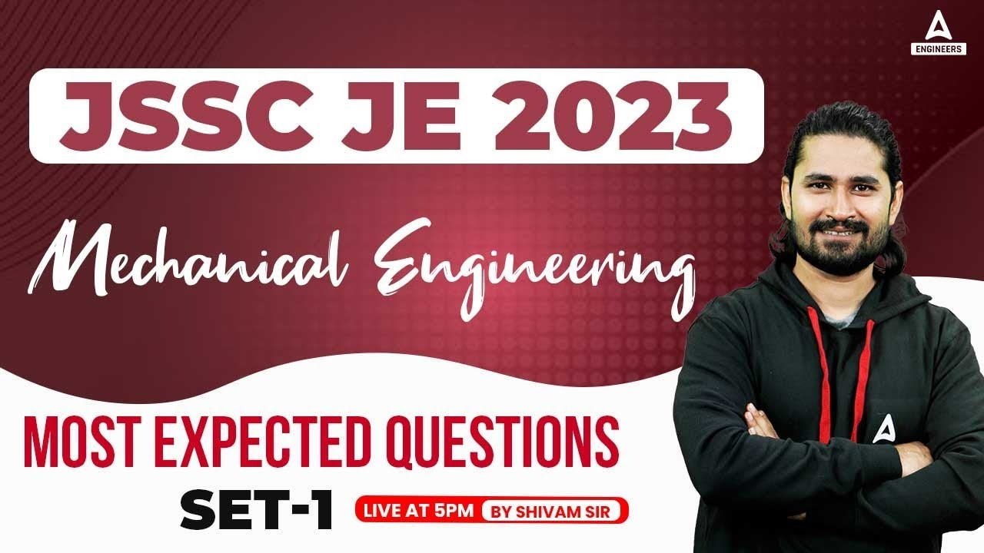
15

Slide 2


Slide 3


JSSC JE 2023 | Mechanical Engineers | Most Expected QuestionsSet-14
Mechanical Engineering
  Q : The value of an Extensive property is essentially dependent on.
  Mass of system
  Interaction of system with its surrounding
  Path followed by system is going from one state to other
  Nature of boundaries, rigid and flexible
For 78% Discount
Use Code : “Y166”
For Complete theory and concepts join our Mahapack Batch, Use Code Y166 For 78% of Discount

Slide 4

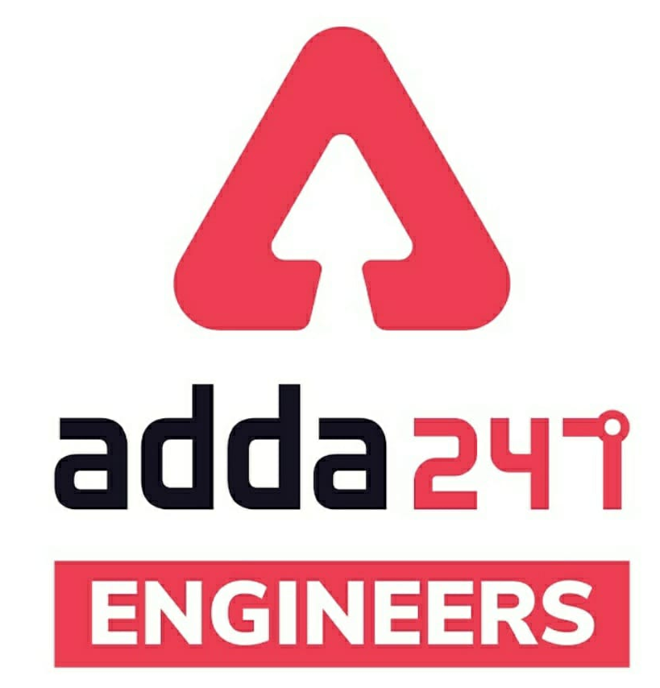

JSSC JE Exam 2023 | Mechanical Engineering | Most Expected Questions
Mechanical Soormas
Anuj Kanoujiya
Ritick Konwar
Ajit Singh
Pragya Srivastava
Subir
Ravi Raj
Mechanical Warrior
Rahul Kumar
Ravi Singh
Shivani Singh
Shubham Shukla
Dilip Gupta
Kunal Kisku
Nivas Gupta
MS D2E
Warif
Amit Kumar
Mohit Kumar
Raj Yadav
Ruby Prajapati
Mechanical Queen
Aashik Hussain
Prashant Bhauriya
Mayur
Ankit Mongre
Anil Gola
Roman Reigns
for
Code : “Y166”

Slide 5
JSSC JE Exam 2023 | Mechanical Engineering | Most Expected Questions
Mechanical Soormas
Shubham Gaur
Pankaj Mahato
Hardik Pal
Manadeep
Rajat Bobade
Vikas Dev Pandey
Ajay Kumar
Rajesh Rohila
Ajay Suna
Kuntal Maji
Pawan Singh Rana
Akhilesh Gupta
Alok Kumar
Rupam Kumari
Somnath Das
Sourav Das
Krishna India
Ranveer Das
Jignesh Shah
Mohit Kashyap
Rati Srivastava
Akash Nishad
for
Code : “Y166”

Slide 6

JSSC JE 2023 | Mechanical Engineers | Most Expected QuestionsSet-15
Mechanical Engineering
For 78% Discount
Use Code : “Y166”
For Complete theory and concepts join our Mahapack Batch, Use Code Y166 For 78% of Discount

Slide 7
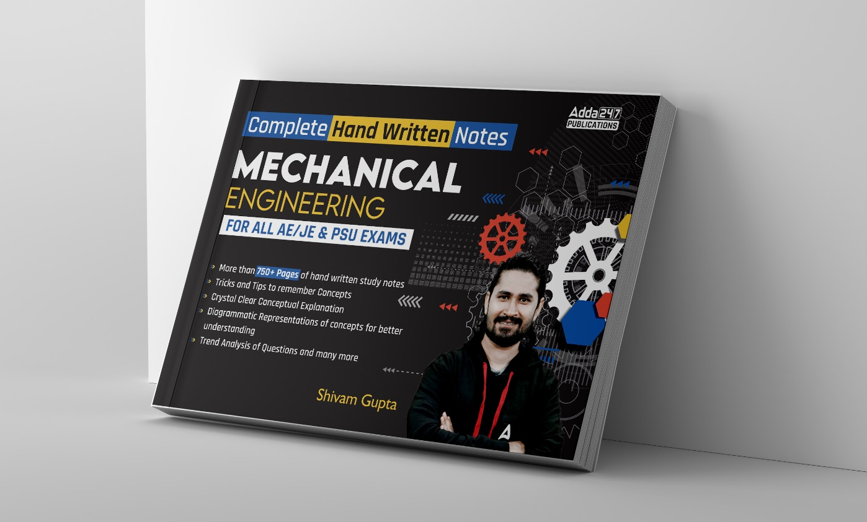
JSSC JE 2023 | Mechanical Engineers | Most Expected QuestionsSet-15
Mechanical Engineering
For 78% Discount
Use Code : “Y166”
For Complete theory and concepts join our Mahapack Batch, Use Code Y166 For 78% of Discount

Slide 8

JSSC JE 2023 | Mechanical Engineers | Most Expected QuestionsSet-15
Mechanical Engineering
For 78% Discount
Use Code : “Y166”
For Complete theory and concepts join our Mahapack Batch, Use Code Y166 For 78% of Discount

Slide 9
JSSC JE 2023 | Mechanical Engineers | Most Expected QuestionsSet-15
Mechanical Engineering
Q : In highly rarefied gases, the concept of which of the following loses validity-?
Thermodynamic equilibrium
Continuum
Stability
Macroscopic view point
For 78% Discount
Use Code : “Y166”
For Complete theory and concepts join our Mahapack Batch, Use Code Y166 For 78% of Discount

Slide 10
JSSC JE 2023 | Mechanical Engineers | Most Expected QuestionsSet-15
Mechanical Engineering
  Q : The mass and energy of which of the following always remain constant! ?
  a) Closed system
  b) Open system
  c) Non-Isolated system
  d) Universe
For 78% Discount
Use Code : “Y166”
For Complete theory and concepts join our Mahapack Batch, Use Code Y166 For 78% of Discount

Slide 11
JSSC JE 2023 | Mechanical Engineers | Most Expected QuestionsSet-15
Mechanical Engineering
  Q: Thermodynamic equilibrium gets satisfied, if the following equilibrium is satisfied!
  Thermal
  Mechanical
  Chemical
  All of these
For 78% Discount
Use Code : “Y166”
For Complete theory and concepts join our Mahapack Batch, Use Code Y166 For 78% of Discount

Slide 12
JSSC JE 2023 | Mechanical Engineers | Most Expected QuestionsSet-15
Mechanical Engineering
Q: A Pressure transducer measures a pressure of 1mm Hg which is equal to_
1.336 bar
13.3 Pa
133 Pa
13.3 kPa
For 78% Discount
Use Code : “Y166”
For Complete theory and concepts join our Mahapack Batch, Use Code Y166 For 78% of Discount

Slide 13
JSSC JE 2023 | Mechanical Engineers | Most Expected QuestionsSet-15
Mechanical Engineering
Q : If a closed system is undergoing an irreversible process the entropy of the system.
Must increase
Always remains constant
Must decrease
Can increase,decrease or remain constant
For 78% Discount
Use Code : “Y166”
For Complete theory and concepts join our Mahapack Batch, Use Code Y166 For 78% of Discount

Slide 14
JSSC JE 2023 | Mechanical Engineers | Most Expected QuestionsSet-15
Mechanical Engineering
Q: A 70kg person walks on snow with total foot imprint area of 500cm². What pressure does he exert on snow_?
0.5 kPa
12.5 kPa
13.73 kN/m²
137.3 kN/m²
For 78% Discount
Use Code : “Y166”
For Complete theory and concepts join our Mahapack Batch, Use Code Y166 For 78% of Discount

Slide 15
JSSC JE 2023 | Mechanical Engineers | Most Expected QuestionsSet-15
Mechanical Engineering
Q: An isolated thermodynamic system executes a process.choose the correct statement from the following!
No heat is transferred
No work is transferred
No mass flow across the boundary of the system
All of the above
For 78% Discount
Use Code : “Y166”
For Complete theory and concepts join our Mahapack Batch, Use Code Y166 For 78% of Discount

Slide 16
JSSC JE 2023 | Mechanical Engineers | Most Expected QuestionsSet-15
Mechanical Engineering
Q. Which one of the following lubricants is most suitable for drawing mild steel wires_?
A. Mustered oil
B. Water
C. Lime-water
D. Kerosene
For 78% Discount
Use Code : “Y166”
For Complete theory and concepts join our Mahapack Batch, Use Code Y166 For 78% of Discount

Slide 17
JSSC JE 2023 | Mechanical Engineers | Most Expected QuestionsSet-15
Mechanical Engineering
Q.Which parameter can get affected by the ratio of specific heats in the study of fluid mechanics_
Capilarity
Surface tension
Bulk modulus
Newtonian fluid
For 78% Discount
Use Code : “Y166”
For Complete theory and concepts join our Mahapack Batch, Use Code Y166 For 78% of Discount

Slide 18
JSSC JE 2023 | Mechanical Engineers | Most Expected QuestionsSet-15
Mechanical Engineering
Q.The Buoyant force in downward direction on a piece of metal weighing 90 N in air and 38 N in water and 22 N in gycerin will be____.
A. 52 N
B. 2.5N
C. 2.5 N
D. 0 N
For 78% Discount
Use Code : “Y166”
For Complete theory and concepts join our Mahapack Batch, Use Code Y166 For 78% of Discount

Slide 19
JSSC JE 2023 | Mechanical Engineers | Most Expected QuestionsSet-15
Mechanical Engineering
Q.The ultimate strength of Carbide in tension as compared to HSS will be
More.
Less
Same
None of the above
For 78% Discount
Use Code : “Y166”
For Complete theory and concepts join our Mahapack Batch, Use Code Y166 For 78% of Discount

Slide 20
JSSC JE 2023 | Mechanical Engineers | Most Expected QuestionsSet-15
Mechanical Engineering
Q.Round the clock Ramesh has done 86.4 KJ of work to uplift the water from ground floor to top floor. The power required to done that job will be_
1 KW
0.01 KW
1 W
10 W
For 78% Discount
Use Code : “Y166”
For Complete theory and concepts join our Mahapack Batch, Use Code Y166 For 78% of Discount

Slide 21
JSSC JE 2023 | Mechanical Engineers | Most Expected QuestionsSet-15
Mechanical Engineering
Q. The variation of stress in the simple bending of beams is ________.!
A. parabolic
B. elliptical
C. hyperbolical
D. linear
For 78% Discount
Use Code : “Y166”
For Complete theory and concepts join our Mahapack Batch, Use Code Y166 For 78% of Discount

Slide 22
JSSC JE 2023 | Mechanical Engineers | Most Expected QuestionsSet-15
Mechanical Engineering
For 78% Discount
Use Code : “Y166”
For Complete theory and concepts join our Mahapack Batch, Use Code Y166 For 78% of Discount

Slide 23
JSSC JE 2023 | Mechanical Engineers | Most Expected QuestionsSet-15
Mechanical Engineering
For 78% Discount
Use Code : “Y166”
For Complete theory and concepts join our Mahapack Batch, Use Code Y166 For 78% of Discount

Slide 24
JSSC JE 2023 | Mechanical Engineers | Most Expected QuestionsSet-15
Mechanical Engineering
HW. In the rolling process, roll separating force can be decreased by.
A. reducing the roll diameter
B. increasing the roll diameter
C. providing back-up rolls
D. increasing the friction between the rolls and the metal
For 78% Discount
Use Code : “Y166”
For Complete theory and concepts join our Mahapack Batch, Use Code Y166 For 78% of Discount

