Slide 1
14

Slide 3
JSSC JE 2023 | Mechanical Engineers | Most Expected QuestionsSet-13
Mechanical Engineering
HW : Center of pressure of any body will always be located
At center of gravity
Below Center of gravity
Above center of gravity
Anywhere below or on center of gravity
For 78% Discount
Use Code : “Y166”
For Complete theory and concepts join our Mahapack Batch, Use Code Y166 For 78% of Discount

Slide 4
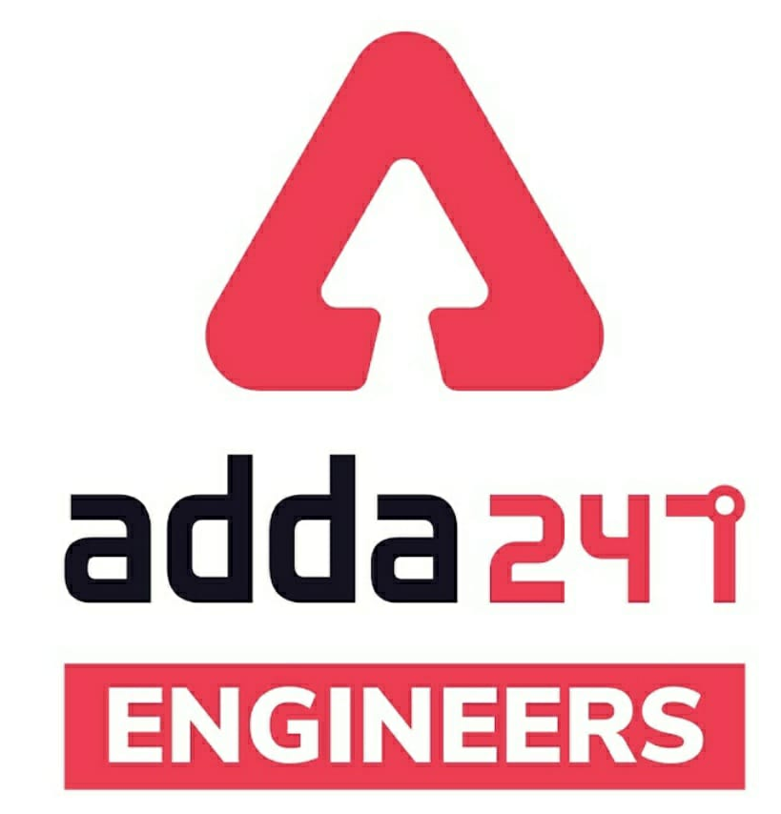
JSSC JE Exam 2023 | Mechanical Engineering | Most Expected Questions
Mechanical Soormas
Amarjyoti
Mohit Kumar
Pankaj Mahato
Shubham Gaur
Akhilesh Maurya
Rajat Bobde
Ela Sahoo
Narender Sura
Rati Srivastava
Nandan Mehta
for
Code : “Y166”

Slide 5
JSSC JE 2023 | Mechanical Engineers | Most Expected QuestionsSet-14
Mechanical Engineering
For 78% Discount
Use Code : “Y166”
For Complete theory and concepts join our Mahapack Batch, Use Code Y166 For 78% of Discount

Slide 6
JSSC JE 2023 | Mechanical Engineers | Most Expected QuestionsSet-14
Mechanical Engineering
For 78% Discount
Use Code : “Y166”
For Complete theory and concepts join our Mahapack Batch, Use Code Y166 For 78% of Discount

Slide 7
JSSC JE 2023 | Mechanical Engineers | Most Expected QuestionsSet-14
Mechanical Engineering
For 78% Discount
Use Code : “Y166”
For Complete theory and concepts join our Mahapack Batch, Use Code Y166 For 78% of Discount

Slide 8
JSSC JE 2023 | Mechanical Engineers | Most Expected QuestionsSet-14
Mechanical Engineering
Q. Cadmium and Zinc are ………………… material-?
Cold worked
Hot worked
Both A & B
None of the above
For 78% Discount
Use Code : “Y166”
For Complete theory and concepts join our Mahapack Batch, Use Code Y166 For 78% of Discount

Slide 9
JSSC JE 2023 | Mechanical Engineers | Most Expected QuestionsSet-14
Mechanical Engineering
Q. Which of the following process is not a metal cutting process!?
Parting
Boaring
Turning
Knurling
For 78% Discount
Use Code : “Y166”
For Complete theory and concepts join our Mahapack Batch, Use Code Y166 For 78% of Discount

Slide 10
JSSC JE 2023 | Mechanical Engineers | Most Expected QuestionsSet-14
Mechanical Engineering
Q. In which of the following cutting tool operations , will the spindle speed be Maximum-?
A. Knurling
B. Honning
C. Taper turning
D. Thread cutting
For 78% Discount
Use Code : “Y166”
For Complete theory and concepts join our Mahapack Batch, Use Code Y166 For 78% of Discount

Slide 11
JSSC JE 2023 | Mechanical Engineers | Most Expected QuestionsSet-14
Mechanical Engineering
Q : In vapour compression refrigeration system which process does not exist!
Adiabatic compression
P = C Heat addition
P = C Heat Rection
Isentropic expansion
For 78% Discount
Use Code : “Y166”
For Complete theory and concepts join our Mahapack Batch, Use Code Y166 For 78% of Discount

Slide 12
JSSC JE 2023 | Mechanical Engineers | Most Expected QuestionsSet-14
Mechanical Engineering
Q. An inventor says that his new concept of an engine, while working between temperature limits of 27°C and 327°C rejects 45% of heat absorbed from the source. His engine is then equivalent to which one of the following engines_?
(a) Carnot engine
(b) Diesel engine
(c) An impossible engine
(d) Ericsson engine
For 78% Discount
Use Code : “Y166”
For Complete theory and concepts join our Mahapack Batch, Use Code Y166 For 78% of Discount

Slide 13
JSSC JE 2023 | Mechanical Engineers | Most Expected QuestionsSet-14
Mechanical Engineering
Q. An oil of specific gravity 0.9 has viscosity of 0.28 stokes at 38°C. What will be its viscosity in Ns/m²_ ?
(a) 0.2520
(b) 0.0311
(c) 0.0252
(d) 0.0206
For 78% Discount
Use Code : “Y166”
For Complete theory and concepts join our Mahapack Batch, Use Code Y166 For 78% of Discount

Slide 14
JSSC JE 2023 | Mechanical Engineers | Most Expected QuestionsSet-14
Mechanical Engineering
Q. A streamline is a line!
which is along path of the particle
which is always parallel to the main direction of flow
(c) along which there is no flow
(d) on which tangent drawn at any point gives the direction of velocity
For 78% Discount
Use Code : “Y166”
For Complete theory and concepts join our Mahapack Batch, Use Code Y166 For 78% of Discount

Slide 15
JSSC JE 2023 | Mechanical Engineers | Most Expected QuestionsSet-14
Mechanical Engineering
Q. A hydraulic press has a ram of 20 cm diameter and a plunger of 5 cm diameter. The force required at the plunger to lift a weight of $16×{10}^{4}$ N shall be!
(a) $256×{10}^{4} N$
(b) $64×{10}^{4} N$
(c) $4×{10}^{4} N$
(d) $1×{10}^{4} N$
For 78% Discount
Use Code : “Y166”
For Complete theory and concepts join our Mahapack Batch, Use Code Y166 For 78% of Discount

Slide 16
JSSC JE 2023 | Mechanical Engineers | Most Expected QuestionsSet-14
Mechanical Engineering
Q : The value of an Extensive property is essentially dependent on.
Mass of system
Interaction of system with its surrounding
Path followed by system is going from one state to other
Nature of boundaries, rigid and flexible
For 78% Discount
Use Code : “Y166”
For Complete theory and concepts join our Mahapack Batch, Use Code Y166 For 78% of Discount

Slide 17
JSSC JE 2023 | Mechanical Engineers | Most Expected QuestionsSet-14
Mechanical Engineering
Q : In highly rarefied gases, the concept of which of the following loses validity-?
Thermodynamic equilibrium
Continuum
Stability
Macroscopic view point
For 78% Discount
Use Code : “Y166”
For Complete theory and concepts join our Mahapack Batch, Use Code Y166 For 78% of Discount

Slide 18
JSSC JE 2023 | Mechanical Engineers | Most Expected QuestionsSet-14
Mechanical Engineering
Q : The mass and energy of which of the following always remain constant! ?
a) Closed system
b) Open system
c) Non-Isolated system
d) Universe
For 78% Discount
Use Code : “Y166”
For Complete theory and concepts join our Mahapack Batch, Use Code Y166 For 78% of Discount

Slide 19
JSSC JE 2023 | Mechanical Engineers | Most Expected QuestionsSet-14
Mechanical Engineering
Q: Thermodynamic equilibrium gets satisfied, if the following equilibrium is satisfied!
Thermal
Mechanical
Chemical
All of these
For 78% Discount
Use Code : “Y166”
For Complete theory and concepts join our Mahapack Batch, Use Code Y166 For 78% of Discount

Slide 20
JSSC JE 2023 | Mechanical Engineers | Most Expected QuestionsSet-14
Mechanical Engineering
Q: A Pressure transducer measures a pressure of 1mm Hg which is equal to_
1.336 bar
13.3 Pa
133 Pa
13.3 kPa
For 78% Discount
Use Code : “Y166”
For Complete theory and concepts join our Mahapack Batch, Use Code Y166 For 78% of Discount

Slide 21
JSSC JE 2023 | Mechanical Engineers | Most Expected QuestionsSet-14
Mechanical Engineering
Q : If a closed system is undergoing an irreversible process the entropy of the system.
Must increase
Always remains constant
Must decrease
Can increase,decrease or remain constant
For 78% Discount
Use Code : “Y166”
For Complete theory and concepts join our Mahapack Batch, Use Code Y166 For 78% of Discount

Slide 22
JSSC JE 2023 | Mechanical Engineers | Most Expected QuestionsSet-14
Mechanical Engineering
Q: A 70kg person walks on snow with total foot imprint area of 500cm². What pressure does he exert on snow_?
0.5 kPa
12.5 kPa
13.73 kN/m²
137.3 kN/m²
For 78% Discount
Use Code : “Y166”
For Complete theory and concepts join our Mahapack Batch, Use Code Y166 For 78% of Discount

Slide 23
JSSC JE 2023 | Mechanical Engineers | Most Expected QuestionsSet-14
Mechanical Engineering
Q: An isolated thermodynamic system executes a process.choose the correct statement from the following!
No heat is transferred
No work is transferred
No mass flow across the boundary of the system
All of the above
For 78% Discount
Use Code : “Y166”
For Complete theory and concepts join our Mahapack Batch, Use Code Y166 For 78% of Discount

Slide 24
JSSC JE 2023 | Mechanical Engineers | Most Expected QuestionsSet-14
Mechanical Engineering
Q. Which one of the following lubricants is most suitable for drawing mild steel wires_?
A. Mustered oil
B. Water
C. Lime-water
D. Kerosene
For 78% Discount
Use Code : “Y166”
For Complete theory and concepts join our Mahapack Batch, Use Code Y166 For 78% of Discount

Slide 25
JSSC JE 2023 | Mechanical Engineers | Most Expected QuestionsSet-14
Mechanical Engineering
For 78% Discount
Use Code : “Y166”
For Complete theory and concepts join our Mahapack Batch, Use Code Y166 For 78% of Discount

Slide 26
JSSC JE 2023 | Mechanical Engineers | Most Expected QuestionsSet-14
Mechanical Engineering
For 78% Discount
Use Code : “Y166”
For Complete theory and concepts join our Mahapack Batch, Use Code Y166 For 78% of Discount

Slide 27
JSSC JE 2023 | Mechanical Engineers | Most Expected QuestionsSet-14
Mechanical Engineering
HW. In the rolling process, roll separating force can be decreased by.
A. reducing the roll diameter
B. increasing the roll diameter
C. providing back-up rolls
D. increasing the friction between the rolls and the metal
For 78% Discount
Use Code : “Y166”
For Complete theory and concepts join our Mahapack Batch, Use Code Y166 For 78% of Discount

