Slide 4
SSC JE | JSSC JE | NHPC JE | DDA JE | DFCCIL | IB JIO | By Abhishek Sir
Q1. By interchanging the given two signs and numbers which of the following equation will be not correct?
× and ÷, 2 and 6
I. 7 – 4 × 3 ÷ 6 + 2 = 8
II. 6 – 8 × 2 + 9 ÷ 3 = 5
(a) Only II
(b) Neither I nor II
(c) Only I
(d) Both I and II

Slide 5
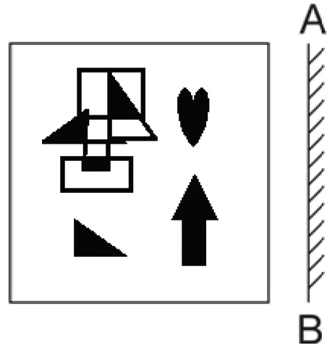
SSC JE | JSSC JE | NHPC JE | DDA JE | DFCCIL | IB JIO | By Abhishek Sir
Q2. Select the correct mirror image of the given figure when the mirror is placed at AB as shown.
(a) (b) (c) (d)

Slide 6
SSC JE | JSSC JE | NHPC JE | DDA JE | DFCCIL | IB JIO | By Abhishek Sir
Q3. Select the set in which the numbers are related in the same way as are the numbers of the following sets.
(NOTE : Operations should be performed on the whole numbers, without breaking down the numbers into its constituent digits. E.g. 13 – Operations on 13 such as adding /subtracting /multiplying etc. to 13 can be performed. Breaking down 13 into 1 and 3 and then performing mathematical operations on 1 and 3 is not allowed)
(70, 14, 56)
(88, 30, 58)
(a) (44, 24, 23)
(b) (59, 36, 25)
(c) (52, 19, 33)
(d) (38, 16, 24)

Slide 7
SSC JE | JSSC JE | NHPC JE | DDA JE | DFCCIL | IB JIO | By Abhishek Sir
Q4. Select the option that is related to the third number in the same way as the second number is related to the first number and the sixth number is related to the fifth number.
8 : 128 :: 6 : ? :: 11 : 242
(a) 64
(b) 72
(c) 68
(d) 70

Slide 8
SSC JE | JSSC JE | NHPC JE | DDA JE | DFCCIL | IB JIO | By Abhishek Sir
Q5. After interchanging the given two numbers and two signs what will be the values of equation (I) and (II) respectively?
– and ×, 6 and 4
I. 7 × 6 + 8 ÷ 2 – 4
II. 4 – 7 × 6 + 8 ÷ 2
(a) 27, 42
(b) 27, 47
(c) 27, 49
(d) 25, 40

Slide 9
SSC JE | JSSC JE | NHPC JE | DDA JE | DFCCIL | IB JIO | By Abhishek Sir
Q6. In the following question below are given some statements followed by some conclusions based on those statements. Taking the given statements to be true even if they seem to be at variance from commonly known facts. Read all the conclusions and then decide which of the given conclusion logically follows the given statements.
Statements:
I. Some F are D.
II. No A is D.
Conclusion:
I. Some F are A.
II. No D is A.
III. Some F are not A.
(a) Neither conclusion follows
(b) Both conclusions II and III follows
(c) Only conclusion I follows
(d) Only conclusion III follows

Slide 10
SSC JE | JSSC JE | NHPC JE | DDA JE | DFCCIL | IB JIO | By Abhishek Sir
Q7. Select the option that is related to the fifth number in the same way as the second number is related to the first number and the fourth number is related to the third number.
7 : 25 :: 4 : 4 :: 3 : ?
(a) 5
(b) 4
(c) 1
(d) 7

Slide 11
SSC JE | JSSC JE | NHPC JE | DDA JE | DFCCIL | IB JIO | By Abhishek Sir
Q8. Select the option that represents the correct order of the given words as they would appear in an English dictionary.
1- Sennet
2- Sennight
3- Sennit
4- Seniority
5- Senna
(a) 4, 5, 1, 2, 3
(b) 5, 4, 2, 1, 3
(c) 4, 5, 2, 1, 3
(d) 4, 5, 1, 3, 2

Slide 12
SSC JE | JSSC JE | NHPC JE | DDA JE | DFCCIL | IB JIO | By Abhishek Sir
Q9. Select the option that is related to the third word in the same way as the second word is related to the first word.
(The words must be considered as meaningful English words and must not be related to each other based on the number of letters/number of consonants/vowels in the word.)
Movie : Director :: Orchestra : ?
(a) Choreographer
(b) Conductor
(c) Dancer
(d) Audience

Slide 13
SSC JE | JSSC JE | NHPC JE | DDA JE | DFCCIL | IB JIO | By Abhishek Sir
Q10. Select the figure from among the given options that can replace the question mark (?) in the following series.
(a) (b) (c) (d)

Slide 14
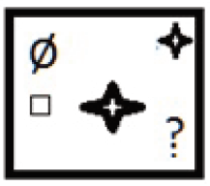
SSC JE | JSSC JE | NHPC JE | DDA JE | DFCCIL | IB JIO | By Abhishek Sir
Q11. Select the that will come next in the following figure series.
(a) (b) (c) (d)

Slide 15
SSC JE | JSSC JE | NHPC JE | DDA JE | DFCCIL | IB JIO | By Abhishek Sir
Q12. Which of the following terms will replace the question mark (?) in the given series?
AVTE CTRG ERPI GPNK?
(a) INLM
(b) MINL
(c) ILNM
(d) INJM

Slide 16
SSC JE | JSSC JE | NHPC JE | DDA JE | DFCCIL | IB JIO | By Abhishek Sir
Q13. If A ÷ B means that A is the brother of B, A × B means that A is the sister of B, A – B means that A is the father of B then which of the following expression shows that P is the paternal uncle of R?
यदि A ÷ B का अर्थ है कि A, B का भाई है, A × B का अर्थ है कि A, B की बहन है, A - B का अर्थ है कि A, B का पिता है, तो निम्नलिखित में से कौन सा अभिव्यक्ति दर्शाता है कि P, का चाचा है आर?
(a) P – R ÷ Q
(b) P ÷ R × Q
(c) P × R – Q
(d) P ÷ R – Q

Slide 17
SSC JE | JSSC JE | NHPC JE | DDA JE | DFCCIL | IB JIO | By Abhishek Sir
Q14. Which two numbers, from amongst the given options, should be interchanged to make the given equation correct?
(6)² - 20 + (28 $÷$ 7) – [($\sqrt{4}$) × 8] + (2)² = 40
(a) 6 and 8
(b) 7 and 2
(c) 2 and 8
(d) 20 and 8

Slide 18
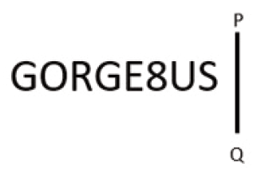
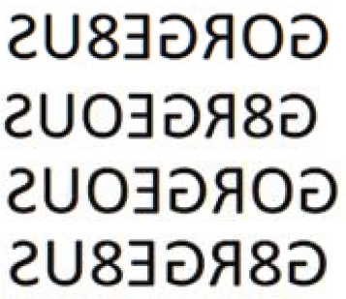
SSC JE | JSSC JE | NHPC JE | DDA JE | DFCCIL | IB JIO | By Abhishek Sir
Q15. Select the correct mirror image of the given combination when the mirror is placed at ‘PQ’ as shown below.
(a)
(b)
(c)
(d)

Slide 19
SSC JE | JSSC JE | NHPC JE | DDA JE | DFCCIL | IB JIO | By Abhishek Sir
Q16. A + B means ‘A is the father of B’
A – B means ‘A is the mother of B’
A % B means ‘A is the brother of B’
A # B means ‘A is the daughter of B’
If P + Q % R % S # T – U , then how is Q related to U?
(a) Brother
(b) Brother-in-law
(c) Father
(d) Son

Slide 20
SSC JE | JSSC JE | NHPC JE | DDA JE | DFCCIL | IB JIO | By Abhishek Sir
Q17. Read the given statement(s) and conclusions carefully. Assuming that the information given in the statements is true, even if it appears to be at variance with commonly known facts, decide which of the given conclusions logically follow(s) from the statement(s).
Statements:
Some ships are cups.
No cup is a stool.
All windows are cups.
Conclusions:
I. Some ships being windows is a possibility.
II. No window is a stool.
III. All cups are windows.
IV. No ship is a stool.
(a) Only Conclusions I, II and IV follow
(b) Only Conclusions II and III follow
(c) Only Conclusions I and II follow
(d) Only Conclusion I follows

Slide 21
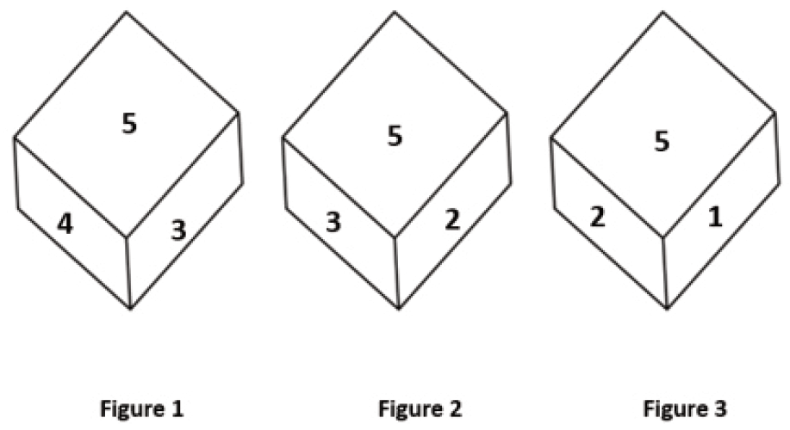
SSC JE | JSSC JE | NHPC JE | DDA JE | DFCCIL | IB JIO | By Abhishek Sir
Q18. Three different positions of the same dice are shown. Find the number on the face opposite the face showing ‘5’.
(a) 2
(b) 1
(c) 6
(d) 3

Slide 22
SSC JE | JSSC JE | NHPC JE | DDA JE | DFCCIL | IB JIO | By Abhishek Sir
Q19. In a certain code language, 'CHILDREN' is written as ‘FKLOGUHQ’ and ‘SCHOOL’ is written as ‘VFKRRO’, how will 'CLASSROOM' be written in that language?
एक निश्चित कूट भाषा में, 'CHILDREN' को 'FKLOGUHQ' और 'SCHOOL' को 'VFKRRO' लिखा जाता है, उस भाषा में 'CLASSROOM' को कैसे लिखा जाएगा?
(a) EMCTTTQQO
(b) EMCTTURRP
(c) FOEWWURRP
(d) FODVVURRP

Slide 23
SSC JE | JSSC JE | NHPC JE | DDA JE | DFCCIL | IB JIO | By Abhishek Sir
Q20. In the following question, select the missing number from the given series.
41, 54, 67, 80, 93, ?
(a) 106
(b) 108
(c) 105
(d) 110

Slide 24
SSC JE | JSSC JE | NHPC JE | DDA JE | DFCCIL | IB JIO | By Abhishek Sir
Q21. In the following question, four number pairs are given. In each pair the number on left side of (–) is related to the number of the right side of (-) with some Logic/Rule/Relation. Three pairs are similar on basis of same Logic/Rule/Relation.
Select the odd one out from the given alternatives. (NOTE: Operations should be performed on the whole numbers, without breaking down the numbers into its constituent digits. E.g.13 – Operations on 13 such as adding /subtracting /multiplying etc. to 13 can be performed. Breaking down 13 into 1 and 3 and then performing mathematical operations on 1 and 3 is not allowed)
(a) 17 – 31
(b) 13 – 25
(c) 15 – 27
(d) 9 – 15

Slide 25
SSC JE | JSSC JE | NHPC JE | DDA JE | DFCCIL | IB JIO | By Abhishek Sir
Q22. In a certain code language, 'INBOX’ is written as 'MRYCL' and 'EMAIL' is written as 'NVZOR'. How will 'DRAFT' be written in that language?
(a) UGZWI
(b) WIZGU
(c) IWZGU
(d) IWGZU

Slide 26
SSC JE | JSSC JE | NHPC JE | DDA JE | DFCCIL | IB JIO | By Abhishek Sir
Q23. Three of the following four letter-clusters are alike in a certain way and one is different.
Pick the odd one out.
(a) TQR
(b) MJK
(c) IFG
(d) NKI

Slide 27
SSC JE | JSSC JE | NHPC JE | DDA JE | DFCCIL | IB JIO | By Abhishek Sir
Q24. Which of the following letter-clusters will replace the question mark (?) and complete the following letter-cluster series?
LE, OJ, UO, DT, ?
(a) PZ
(b) QY
(c) PX
(d) PY

Slide 28
SSC JE | JSSC JE | NHPC JE | DDA JE | DFCCIL | IB JIO | By Abhishek Sir
Q25. Select the option that is related to the fifth letter-cluster in the same way as the second letter-cluster is related to the first letter-cluster and the fourth letter-cluster is related to the third letter-cluster.
GAIN : HBKP :: ACHE : BDJG :: CAKE : ?
(a) DBNH
(b) DBMH
(c) DBNG
(d) DBMG

