Slide 4
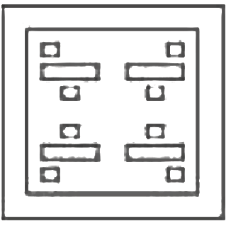
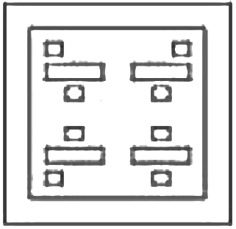
SSC JE | JSSC JE | NHPC JE | DDA JE | DFCCIL | IB JIO | By Abhishek Sir
Q41. The sequence of folding a piece of paper and the manner is which the folded paper has been cut is shown in the following figures. How would this paper look when unfolded?
(a) (b) (c) (d)

Slide 5
SSC JE | JSSC JE | NHPC JE | DDA JE | DFCCIL | IB JIO | By Abhishek Sir
Q42. Select the option that is related to the third letter – cluster in the same way as the second letter – cluster is related to the first letter – cluster.
MODERATE : HTWVIZOJ : : LIMITEDS : ?
(a) GNNRGVYX
(b) GONRHVYY
(c) GNNQHVYX
(d) GONRGVYY

Slide 6
SSC JE | JSSC JE | NHPC JE | DDA JE | DFCCIL | IB JIO | By Abhishek Sir
Q43. Six friends Govind, Sarayu, Rakul, Smitam Hema and Geervan are standing in a row. There are two persons between Sarayu and Hema. Rakul is between Hema and Smita. Only one person is standing before Govind. Geervan is between Govind and Hema. Is third from the back end of the row. Which two persons are standing between Sarayu and Hema?
(a) Govind and Geervan
(b) Smita and Rakul
(c) Geervan and Smita
(d) Govind and Rakul
छह दोस्त गोविंद, सरयू, रकुल, स्मितम हेमा और गीरवन एक पंक्ति में खड़े हैं। सरयू और हेमा के बीच दो व्यक्ति हैं। रकुल, हेमा और स्मिता के बीच में है। गोविंद के सामने केवल एक व्यक्ति खड़ा है। गीरवन गोविंद और हेमा के बीच है। पंक्ति के पिछले सिरे से तीसरे स्थान पर है। सरयू और हेमा के बीच कौन से दो व्यक्ति खड़े हैं?

Slide 7
SSC JE | JSSC JE | NHPC JE | DDA JE | DFCCIL | IB JIO | By Abhishek Sir
Q43. Six friends Govind, Sarayu, Rakul, Smitam Hema and Geervan are standing in a row. There are two persons between Sarayu and Hema. Rakul is between Hema and Smita. Only one person is standing before Govind. Geervan is between Govind and Hema. Is third from the back end of the row. Which two persons are standing between Sarayu and Hema?
(a) Govind and Geervan
(b) Smita and Rakul
(c) Geervan and Smita
(d) Govind and Rakul

Slide 8
SSC JE | JSSC JE | NHPC JE | DDA JE | DFCCIL | IB JIO | By Abhishek Sir
Q44. Select the letter – cluster that can replace the question mark (?) in the following series.
DMGU, AJDO, XGAI, ?, RAUA
(a) UEXE
(b) UDXE
(c) VDYE
(d) VEYE

Slide 9
SSC JE | JSSC JE | NHPC JE | DDA JE | DFCCIL | IB JIO | By Abhishek Sir
Q45. Arrange the following words in a meaningful order.
1. Foundation Ceremony
2. Profit
3. Planning
4. Sale
5. Construction
(a) 3, 2, 4, 5, 1
(b) 3, 1, 5, 4, 2
(c) 3, 1, 4, 5, 2
(d) 3, 2, 1, 5, 4

Slide 10
SSC JE | JSSC JE | NHPC JE | DDA JE | DFCCIL | IB JIO | By Abhishek Sir
Q46. Which two signs need to be interchanged to make the given equation correct?
616 – 56 + 328 $÷$ 14 × 23 = 17
(a) × and $÷$
(b) + and -
(c) × and +
(d) – and $÷$

Slide 11
SSC JE | JSSC JE | NHPC JE | DDA JE | DFCCIL | IB JIO | By Abhishek Sir
Q47. Select the option in which the given figure (x) is embedded (Rotation is not allowed).
(a) (b) (c) (d)

Slide 12
SSC JE | JSSC JE | NHPC JE | DDA JE | DFCCIL | IB JIO | By Abhishek Sir
Q48. Select the option that is related to the third number in the same way as the second number is related to the first number.
14 : 112 : : 18 : ?
(a) 162
(b) 148
(c) 180
(d) 198

Slide 13
SSC JE | JSSC JE | NHPC JE | DDA JE | DFCCIL | IB JIO | By Abhishek Sir
Q49. Read the given statements and conclusions carefully. Assuming that the information given in the statements is true, even if it appears to be at variance with commonly known facts, decide which of the given conclusions logically follow(s) from the statements.
Statements:
Some markers are boards.
All the boards are printers.
Conclusion:
I. All the printers are boards
II. All markers are printers.
(a) Only conclusion I follows
(b) Only conclusion II follows
(c) Both conclusions I and II follow
(d) Neither conclusion I nor II follows

Slide 14
SSC JE | JSSC JE | NHPC JE | DDA JE | DFCCIL | IB JIO | By Abhishek Sir
Q50. Select the option in which the words share the same relationship as that shared by the given pair of words.
Austria : Vienna
(a) Egypt : Cairo
(b) Canada : Praia
(c) Chile : Berlin
(d) Ireland : Jakarta

Slide 15
SSC JE | JSSC JE | NHPC JE | DDA JE | DFCCIL | IB JIO | By Abhishek Sir
Q1. In the following question, select the related word from the given alternatives.
Smash : Badminton : : ? : ?
(a) Board : Chess
(b) Bowled : Cricket
(c) Ball : Golf
(d) Stick : Polo

Slide 16
SSC JE | JSSC JE | NHPC JE | DDA JE | DFCCIL | IB JIO | By Abhishek Sir
Q2. In the following question, select the related word pair from the given alternatives.
School : Student : : ? : ?
(a) Hospital : Bed
(b) Judge : Court
(c) Shop : Selling
(d) Prison : Convict

Slide 17
SSC JE | JSSC JE | NHPC JE | DDA JE | DFCCIL | IB JIO | By Abhishek Sir
Q3. In the following question, select the related word from the given alternatives.
Temperature : Degree : : Area : ?
(a) Watt
(b) Hectare
(c) Kilogram
(d) Ampere

Slide 18
SSC JE | JSSC JE | NHPC JE | DDA JE | DFCCIL | IB JIO | By Abhishek Sir
Q4. In the following question, select the related letter pair from the given alternatives.
LACK : GWXG : : MYST : ?
(a) TCPH
(b) HUNP
(c) TUMC
(d) HUMT

Slide 19
SSC JE | JSSC JE | NHPC JE | DDA JE | DFCCIL | IB JIO | By Abhishek Sir
Q5. In the following question, select the related letters from the given alternatives.
PIT : UNY : : FAX : ?
(a) LGB
(b) KEB
(c) KFC
(d) LAE

Slide 20
SSC JE | JSSC JE | NHPC JE | DDA JE | DFCCIL | IB JIO | By Abhishek Sir
Q6. In the following question, select the related letters from the given alternatives.
FK : CI : : GL : ?
(a) AH
(b) RV
(c) KP
(d) DJ

Slide 21
SSC JE | JSSC JE | NHPC JE | DDA JE | DFCCIL | IB JIO | By Abhishek Sir
Q7. In the following question, select the related number pair from the given alternatives.
45 : 90 : : ? : ?
(a) 48 : 96
(b) 24 : 50
(c) 12 : 50
(d) 31 : 63

Slide 22
SSC JE | JSSC JE | NHPC JE | DDA JE | DFCCIL | IB JIO | By Abhishek Sir
Q8. In the following question, select the related number from the given alternatives.
62 : 155 : : 74 : ?
(a) 185
(b) 165
(c) 170
(d) 190

Slide 23
SSC JE | JSSC JE | NHPC JE | DDA JE | DFCCIL | IB JIO | By Abhishek Sir
Q9. In the following question, select the related number from the given alternatives.
41 : 5 : : 23 : ?
(a) 5
(b) 3
(c) 8
(d) 9

Slide 24
SSC JE | JSSC JE | NHPC JE | DDA JE | DFCCIL | IB JIO | By Abhishek Sir
Q10. In the following question, select the odd word from the given alternatives.
(a) Sitar
(b) Violin
(c) Harmonium
(d) Guitar

Slide 25
SSC JE | JSSC JE | NHPC JE | DDA JE | DFCCIL | IB JIO | By Abhishek Sir
Q11. In the following question, select the odd word from the given alternatives.
(a) Rice
(b) Wheat
(c) Maize
(d) Potato

Slide 26
SSC JE | JSSC JE | NHPC JE | DDA JE | DFCCIL | IB JIO | By Abhishek Sir
Q12. In the following question, select the odd word from the given alternatives.
(a) Cuboid
(b) Cone
(c) Triangle
(d) Cube

Slide 27
SSC JE | JSSC JE | NHPC JE | DDA JE | DFCCIL | IB JIO | By Abhishek Sir
Q13. In the following question, select the odd letters from the given alternatives.
(a) NJFB
(b) KGCZ
(c) BXTP
(d) LHDZ

Slide 28
SSC JE | JSSC JE | NHPC JE | DDA JE | DFCCIL | IB JIO | By Abhishek Sir
Q14. In the following question, select the odd letters from the given alternatives.
(a) RLFZ
(b) KDXR
(c) PJDX
(d) TNHB

Slide 29
SSC JE | JSSC JE | NHPC JE | DDA JE | DFCCIL | IB JIO | By Abhishek Sir
Q15. In the following question, select the odd letters from the given alternatives.
(a) XAD
(b) ILO
(c) TWZ
(d) FIM

Slide 30
SSC JE | JSSC JE | NHPC JE | DDA JE | DFCCIL | IB JIO | By Abhishek Sir
Q16. In the following question, select the odd number from the given alternatives.
(a) 13 – 5
(b) 15 – 7
(c) 12 – 6
(d) 14 – 6

Slide 31
SSC JE | JSSC JE | NHPC JE | DDA JE | DFCCIL | IB JIO | By Abhishek Sir
Q17. In the following question, select the odd number pair from the given alternatives.
(a) 93 – 97
(b) 84 – 88
(c) 54 – 58
(d) 29 – 35

Slide 32
SSC JE | JSSC JE | NHPC JE | DDA JE | DFCCIL | IB JIO | By Abhishek Sir
Q18. In the following question, select the odd number pair from the given alternatives.
(a) 11 – 13
(b) 17 – 19
(c) 23 – 31
(d) 31 – 37

Slide 33
SSC JE | JSSC JE | NHPC JE | DDA JE | DFCCIL | IB JIO | By Abhishek Sir
Q19. Arrange the given words in the sequence in which they occur in the dictionary.
1. Reality
2. Receptive
3. Rebound
4. Realism
5. Realize
(a) 45132
(b) 41532
(c) 41523
(d) 45123

Slide 34
SSC JE | JSSC JE | NHPC JE | DDA JE | DFCCIL | IB JIO | By Abhishek Sir
Q20. Arrange the given words in the sequence in which they occur in the dictionary.
1. Shapely
2. Shoddy
3. Shelve
4. Short
5. Sharp
(a) 15234
(b) 51234
(c) 15324
(d) 51324

Slide 35
SSC JE | JSSC JE | NHPC JE | DDA JE | DFCCIL | IB JIO | By Abhishek Sir
Q21. Arrange the given words in the sequence in which they occur in the dictionary.
1. Stern
2. Startle
3. Steep
4. Storm
5. Stick
(a) 23451
(b) 23154
(c) 23145
(d) 23415

Slide 36
SSC JE | JSSC JE | NHPC JE | DDA JE | DFCCIL | IB JIO | By Abhishek Sir
Q22. A series is given with one term missing. Select the correct alternative from the given ones that will complete the series.
APRQ, ZLQM, YHPI, XDOE, ?
(a) VXNZ
(b) WXOA
(c) VXMB
(d) WZNA

Slide 37
SSC JE | JSSC JE | NHPC JE | DDA JE | DFCCIL | IB JIO | By Abhishek Sir
Q23. A series is given with one term missing. Select the correct alternative from the given ones that will complete the series.
RIM, UNT, XSA, AXH, ?
(a) CBM
(b) DCO
(c) DBN
(d) CCO

Slide 38
SSC JE | JSSC JE | NHPC JE | DDA JE | DFCCIL | IB JIO | By Abhishek Sir
Q24. A series is given with one term missing. Select the correct alternative from the given ones that will complete the series.
FC, DA, BY, ZW, ?
(a) YU
(b) XU
(c) YV
(d) XV

Slide 39
SSC JE | JSSC JE | NHPC JE | DDA JE | DFCCIL | IB JIO | By Abhishek Sir
Q25. In the following question, select the missing number from the given alternatives.
14, 35, 87.5, ?, 546.875
(a) 218.75
(b) 262.5
(c) 192.75
(d) 178.5

Slide 40
SSC JE | JSSC JE | NHPC JE | DDA JE | DFCCIL | IB JIO | By Abhishek Sir
Q26. In the following question, select the missing number from the given alternatives..
43, 21.5, 21.5, 43, ?, 1376
(a) 172
(b) 138
(c) 124
(d) 194

Slide 41
SSC JE | JSSC JE | NHPC JE | DDA JE | DFCCIL | IB JIO | By Abhishek Sir
Q27. In the following question, select the missing number from the given alternatives.
81, 23, 104, 127, 231, ?
(a) 392
(b) 440
(c) 324
(d) 358

Slide 42
SSC JE | JSSC JE | NHPC JE | DDA JE | DFCCIL | IB JIO | By Abhishek Sir
Q28. E is taller than D, C is taller than E, A is taller than E and B is taller than C. Who is the second shortest?
E, D से लंबा है, C, E से लंबा है, A, E से लंबा है और B, C से लंबा है। दूसरा सबसे छोटा कौन है?
(a) D
(b) E
(c) A
(d) C

Slide 43
SSC JE | JSSC JE | NHPC JE | DDA JE | DFCCIL | IB JIO | By Abhishek Sir
Q29. D's mother's father is C's father's father-in-law. How are C and D related if D is male and C female?
D की माँ के पिता C के पिता के ससुर हैं। यदि D पुरुष है और C महिला है तो C और D कैसे संबंधित हैं?
(a) D is C's wife's brother
(b) C is sister of D’s wife
(b) D is C's brother
(d) C is mother of D's wife

Slide 44
SSC JE | JSSC JE | NHPC JE | DDA JE | DFCCIL | IB JIO | By Abhishek Sir
Q30. From the given alternative words select the word which cannot be formed using the letters of the given word.
WAVELENGTH
(a) wheat
(b) valet
(c) halve
(d) given

Slide 45
SSC JE | JSSC JE | NHPC JE | DDA JE | DFCCIL | IB JIO | By Abhishek Sir
Q31. If MORTALS is coded as LNQSZKR, then how will BIN be coded as?
(a) YRM
(b) AHM
(c) DKP
(d) CJO

Slide 46
SSC JE | JSSC JE | NHPC JE | DDA JE | DFCCIL | IB JIO | By Abhishek Sir
Q32. In a certain code language, 6532 means 'change the TV channel', 8965 means 'give back the change' and 1246 means 'channel the inner energy'. Find the code for 'channel’.
एक निश्चित कोड भाषा में, 6532 का अर्थ है 'टीवी चैनल बदलें', 8965 का अर्थ है 'परिवर्तन वापस दें' और 1246 का अर्थ है 'आंतरिक ऊर्जा को चैनल करें'। 'चैनल' के लिए कोड खोजें।
(a) 3
(b) 5
(c) 6
(d) 2

Slide 47
SSC JE | JSSC JE | NHPC JE | DDA JE | DFCCIL | IB JIO | By Abhishek Sir
Q33. In a certain code language, '+' represents '-', '-' represents 'x', 'x' represents '÷' and '÷' represents '+'. Find out the answer to the following question.
950 x 50 + 8 - 5 ÷ 20 = ?
(a) 4
(b) 58
(c) -32
(d) -1

Slide 48
SSC JE | JSSC JE | NHPC JE | DDA JE | DFCCIL | IB JIO | By Abhishek Sir
Q34. If 7 @ 3 = 8, 10 @ 2 = 16 and 70 @ 40 = 60, then find the value of 7 @ 5 = ?
(a) 35
(b) 4
(c) 2
(d) 75

Slide 49
SSC JE | JSSC JE | NHPC JE | DDA JE | DFCCIL | IB JIO | By Abhishek Sir
Q35. If A * B means A is mother of B, A + B means A is sister of B and If A % B means A is daughter of B, then what does G % H * I + J mean?
यदि A * B का अर्थ है कि A, B की माँ है, A + B का अर्थ है A, B की बहन है और यदि A % B का अर्थ है कि A, B की बेटी है, तो G % H * I + J का क्या अर्थ है?
(a) G is sister of J
(b) G is mother of J
(c) G is daughter of J
(d) G is sister of J's wife

Slide 50
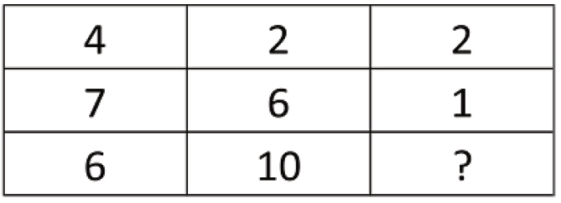
SSC JE | JSSC JE | NHPC JE | DDA JE | DFCCIL | IB JIO | By Abhishek Sir
Q36. Select the missing number from the given responses
(a) 3
(b) 4
(c) 1
(d) -4

Slide 51
SSC JE | JSSC JE | NHPC JE | DDA JE | DFCCIL | IB JIO | By Abhishek Sir
Q37. Which of the following terms follows the trend of the given list?
OOOXOO, OOOOXO, OOOOOX, XOOOOO, OXOOOO, ____________.
(a) OOXOOO
(b) OXOOOO
(c) OOOXOO
(d) OOOOXO

Slide 52
SSC JE | JSSC JE | NHPC JE | DDA JE | DFCCIL | IB JIO | By Abhishek Sir
Q38. A women leaves her hut and walks 2 km West, then she turns North and walks 7 km, then she turns East and walks 1 km, then she turns South and walks 3 km, then she turns to her left and walks 1 km to reach the well. Where is this well with respect to her hut?
एक महिला अपनी झोपड़ी छोड़ती है और 2 किमी पश्चिम की ओर चलती है, फिर वह उत्तर की ओर मुड़ती है और 7 किमी चलती है, फिर वह पूर्व की ओर मुड़ती है और 1 किमी चलती है, फिर वह दक्षिण की ओर मुड़ती है और 3 किमी चलती है, फिर वह अपने बाईं ओर मुड़ती है और पहुंचने के लिए 1 किमी चलती है अच्छी तरह से। उसकी झोंपड़ी के सन्दर्भ में यह कुआँ कहाँ है?
(a) 4 km South
(b) 10 km North
(c) 10 km South
(d) 4 km North

Slide 53
SSC JE | JSSC JE | NHPC JE | DDA JE | DFCCIL | IB JIO | By Abhishek Sir
Q39. Two siblings start from home to go to their respective schools. The brother goes 6 km West, then turns right and goes 3 km and reaches his school. The sister goes 2 km South, then 4 km East, then turns left and goes 5 km and reaches her school. Where is the sister's school with respect to the brother's school?
दो भाई-बहन अपने-अपने स्कूल जाने के लिए घर से निकलते हैं। भाई 6 किमी पश्चिम की ओर जाता है, फिर दाएँ मुड़ता है और 3 किमी जाता है और अपने स्कूल पहुँचता है। बहन 2 किमी दक्षिण की ओर जाती है, फिर 4 किमी पूर्व की ओर जाती है, फिर बाएं मुड़ती है और 5 किमी जाती है और अपने स्कूल पहुंचती है। भाई के स्कूल के सापेक्ष बहन का स्कूल कहाँ है?
(a) 10 km West
(b) 10 km East
(c) 2 km East
(d) 2 km West

Slide 54
SSC JE | JSSC JE | NHPC JE | DDA JE | DFCCIL | IB JIO | By Abhishek Sir
Q40. In the question two statements are given, followed by two conclusions, I and II. You have to consider the statements to be true even if it seems to be at variance from commonly known facts. You have to decide which of the given conclusions, if any, follows from the given statements.
Statement I: No soldiers are french
Statement II: All europeans are french
Conclusion I: Some french are europeans
Conclusion II: Some soldiers are Europeans
(a) Only conclusion I follows
(b) Only conclusion II follows
(c) Both conclusions I and II follow
(d) Neither conclusion I nor conclusion II follows

Slide 55
SSC JE | JSSC JE | NHPC JE | DDA JE | DFCCIL | IB JIO | By Abhishek Sir
Q41. In the question three statements are given, followed by three conclusions, I, II and III. You have to consider the statements to be true even if it seems to be at variance from commonly known facts. You have to decide which of the given conclusions, if any, follows from the given statements.
Statement I: All passes are valleys
Statement II: Some passes are mountains
Statement III: Some hills are mountains as well as valleys
Conclusion I: Some hills are passes
Conclusion II: Some mountains are valleys
Conclusion III: All valleys are hills
(a) Only conclusion I follows
(b) Only conclusion II follows
(c) Only conclusions I and II follow
(d) All conclusions I, II and III follow

Slide 56
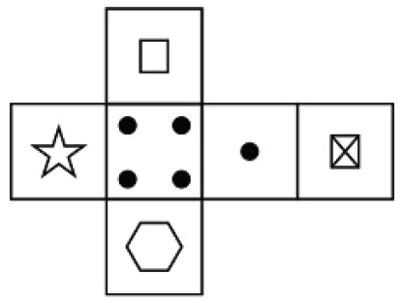
SSC JE | JSSC JE | NHPC JE | DDA JE | DFCCIL | IB JIO | By Abhishek Sir
Q42. Which of the following cube in the answer figure cannot be made based on the unfolded cube in the question figure?
(a) (b) (c) (d)

Slide 57
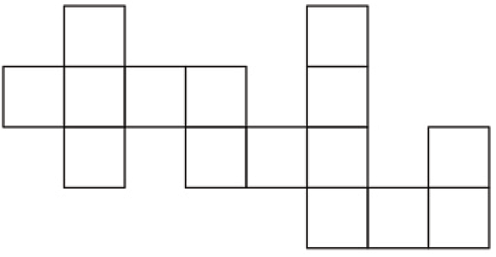
SSC JE | JSSC JE | NHPC JE | DDA JE | DFCCIL | IB JIO | By Abhishek Sir
Q43. Which of the following answer figure patterns can be combined to make the question figure?
(a) (b)
(c) (d)

Slide 58
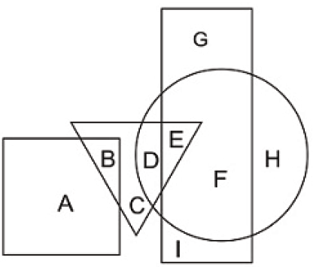
SSC JE | JSSC JE | NHPC JE | DDA JE | DFCCIL | IB JIO | By Abhishek Sir
Q44. In the following figure, square represents Dentists, triangle represents Collectors, circle represents Indians and rectangle represents Women, Which set of letters represents Indians who are either collectors or women?
(a) DEF (b) GFH
(c) IEF (d) CDE

Slide 59
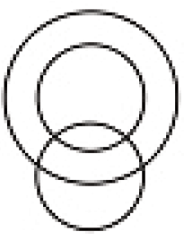
SSC JE | JSSC JE | NHPC JE | DDA JE | DFCCIL | IB JIO | By Abhishek Sir
Q45. Which of the following Venn diagrams represents the relationship between Gold, Silver and Gold coins?
(a) (b) (c) (d)

Slide 60
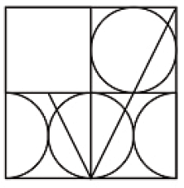
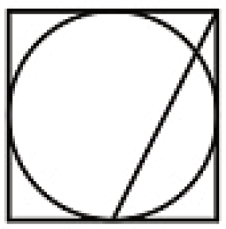
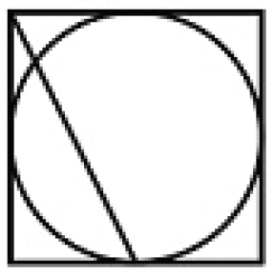
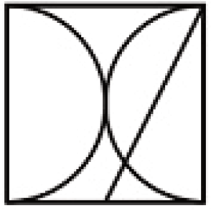
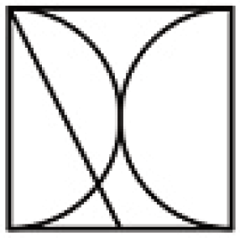
SSC JE | JSSC JE | NHPC JE | DDA JE | DFCCIL | IB JIO | By Abhishek Sir
Q46. Which answer figure will complete the pattern in the question figure?
(a) (b) (c) (d)

Slide 61
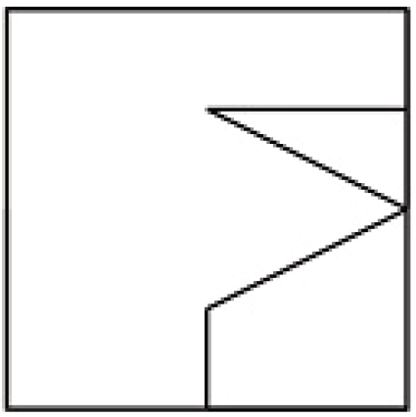
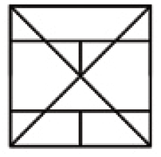
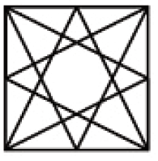
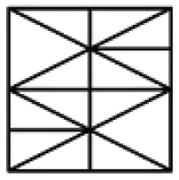
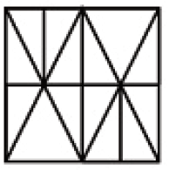
SSC JE | JSSC JE | NHPC JE | DDA JE | DFCCIL | IB JIO | By Abhishek Sir
Q47. From the given answer figures, select the one in which the question figure is hidden/embedded.
(a) (b) (c) (d)

Slide 62
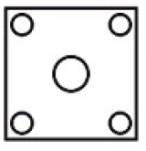
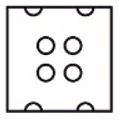
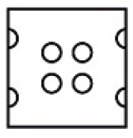
SSC JE | JSSC JE | NHPC JE | DDA JE | DFCCIL | IB JIO | By Abhishek Sir
Q48. A piece of paper is folded and punched as shown below in the question figures. From the given answer figures, indicate how it will appear when opened.
(a) (b) (c) (d)

Slide 63
SSC JE | JSSC JE | NHPC JE | DDA JE | DFCCIL | IB JIO | By Abhishek Sir
Q49. If a mirror is placed on the line MN, then which of the answer figures is the right image of the given figure?
(a) (b) (c) (d)

Slide 64
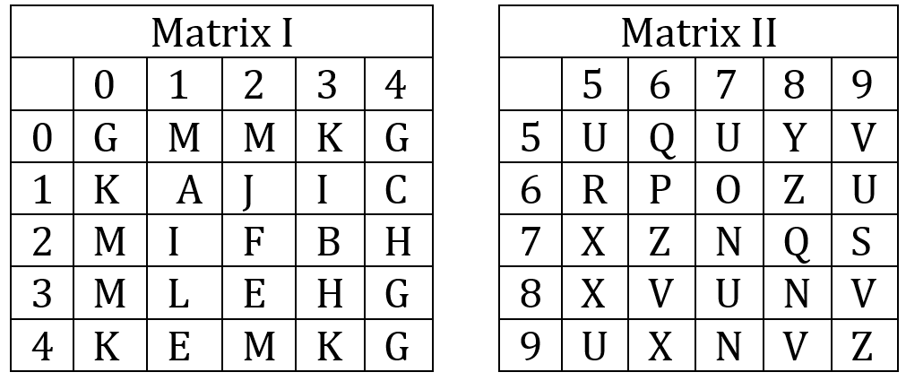
SSC JE | JSSC JE | NHPC JE | DDA JE | DFCCIL | IB JIO | By Abhishek Sir
Q50. A word is represented by only one set of numbers as given in any one of the alternatives. The sets of numbers given in the alternatives are represented by two classes of alphabets as shown in the given two matrices. The columns and rows of Matrix – I are numbered from 0 to 4 and that of Matrix – II are numbered from 5 to 9. A letter from these matrices can be represented first by its row and next by its column, for example ‘E’ can be represented by 41, 32 etc and ‘U’ can be represented by 95.87 etc. Similarly, you have to identify the set for the word ‘MAXI’.
(a) 02,34,67,89 (b) 01,56,32,98
(c) 30,11,96,13 (d) 34,76,43,01

