Slide 1
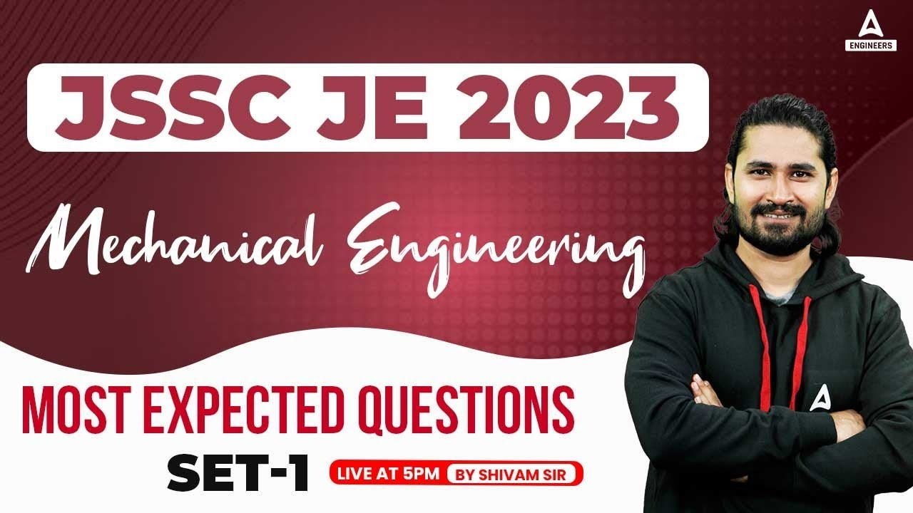
4

Slide 2


Slide 3


JSSC JE 2023 | Mechanical Engineers | Most Expected QuestionsSet-3
Mechanical Engineering
Q.Which one of the following governors is used to drive a gramophone_?
A. Watt governor
B. Porter governor
C. Pickering governor
D. Hartnell governor
For 78% Discount
Use Code : “Y166”
For Complete theory and concepts join our Mahapack Batch, Use Code Y166 For 78% of Discount

Slide 4

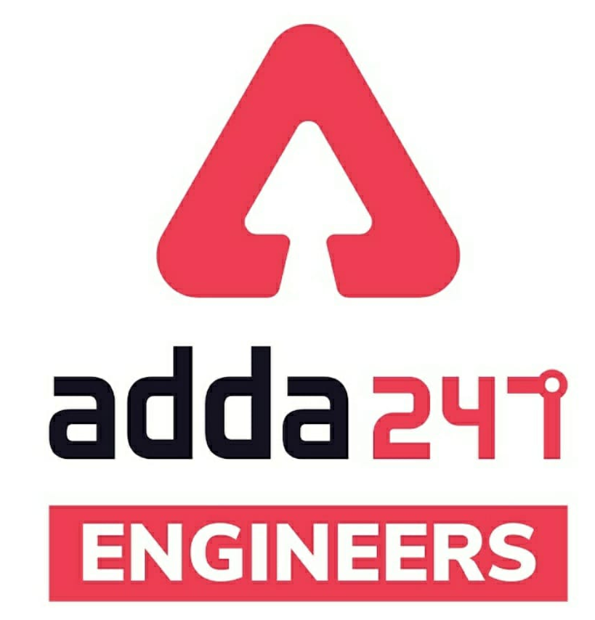

JSSC JE Exam 2023 | Mechanical Engineering | Most Expected Questions
Mechanical Soormas
Anuj Kanoujiya
Ritick Konwar
MS D2E
Pannelal Kushwaha
Pranshu Dada
Pragya Srivastava
Ayush Suthar
Dilip Gupta
Mohit Kumar
Ravi Raj
Subir
AP
Aashik Hussain
Rahul Kumar
Aman Kumar
Raj Yadav
Pankaj Mahato
Ajay Kumar
Rahul Kumar
Shivani Singh
Raj J
Ruby Prajapati
Naresh Rock
Amar Jyoti
Alok Kumar
Manadeep
Rounak Nautiyal
Ajit Singh
for
Code : “Y166”

Slide 5
JSSC JE Exam 2023 | Mechanical Engineering | Most Expected Questions
Mechanical Soormas
Shubhi Tiwari
Warif
Krishna India
Rajat Bobde
Jannatul Siddiqui
Vikas Dev Pandey
Rajesh Rohila
Pawan Singh Rana
Nandan Mehta
Ajay Kumar
Narender Sura
Ela Sahoo
Saurabh Kumar Ratanpur
Pintu Mahato
Rupam Kumari
Mayur
Nivas Gupta
Ravi Prakash Maurya
Kunal Kisku
Jignesh Shah
for
Code : “Y166”

Slide 6

JSSC JE 2023 | Mechanical Engineers | Most Expected QuestionsSet-3
Mechanical Engineering
For 78% Discount
Use Code : “Y166”
For Complete theory and concepts join our Mahapack Batch, Use Code Y166 For 78% of Discount

Slide 7
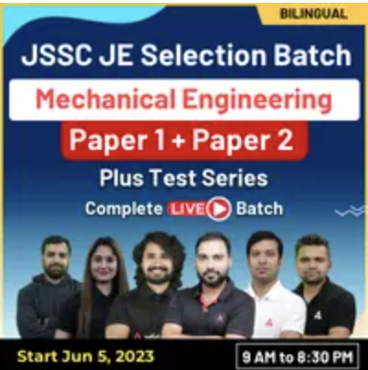
JSSC JE 2023 | Mechanical Engineers | Most Expected QuestionsSet-3
Mechanical Engineering
For 78% Discount
Use Code : “Y166”
Course Highlights
350+ hours of Live Technical Classes
130+ hours of Live Non-Technical Classes
Access to Recorded Videos
Latest Pattern of JSSC JE
Question Practice Session
For Complete theory and concepts join our Mahapack Batch, Use Code Y166 For 78% of Discount

Slide 8
JSSC JE 2023 | Mechanical Engineers | Most Expected QuestionsSet-3
Mechanical Engineering
Q.Which one of the following is a gravity controlled type governor_?
A. Hartnell governor
B. Hartung governor
C. Watt governor
D. Pickering governor
For 78% Discount
Use Code : “Y166”
For Complete theory and concepts join our Mahapack Batch, Use Code Y166 For 78% of Discount

Slide 9
JSSC JE 2023 | Mechanical Engineers | Most Expected QuestionsSet-3
Mechanical Engineering
Q.When the sleeve of a Porter governor moves upwards, the governor speed.
A. Increases
B. Decreases
C. Remains unaffected
D. First increases and then decreases
For 78% Discount
Use Code : “Y166”
For Complete theory and concepts join our Mahapack Batch, Use Code Y166 For 78% of Discount

Slide 10
JSSC JE 2023 | Mechanical Engineers | Most Expected QuestionsSet-3
Mechanical Engineering
Q.In continuous casting process, the mould is generally made of______._
A. Cast iron
B. Bronze
C. Graphite
D. Tungsten carbide
For 78% Discount
Use Code : “Y166”
For Complete theory and concepts join our Mahapack Batch, Use Code Y166 For 78% of Discount

Slide 11
JSSC JE 2023 | Mechanical Engineers | Most Expected QuestionsSet-3
Mechanical Engineering
Q.which of the following is combination of casting and forging process-?
A. Investment casting
B. Squeeze casting
C. Slush casting
D. Vacuum casting
For 78% Discount
Use Code : “Y166”
For Complete theory and concepts join our Mahapack Batch, Use Code Y166 For 78% of Discount

Slide 12
JSSC JE 2023 | Mechanical Engineers | Most Expected QuestionsSet-3
Mechanical Engineering
Q.Notches are used to measure.
A. Flow rate
B. Velocity
C. Pressure
D. All above
For 78% Discount
Use Code : “Y166”
For Complete theory and concepts join our Mahapack Batch, Use Code Y166 For 78% of Discount

Slide 13
JSSC JE 2023 | Mechanical Engineers | Most Expected QuestionsSet-3
Mechanical Engineering
Q.The weir with thick crest is known as-
A. drowned weir
B. board crested weir
C. suppressed weir
D. cippoletti weir
For 78% Discount
Use Code : “Y166”
For Complete theory and concepts join our Mahapack Batch, Use Code Y166 For 78% of Discount

Slide 14
JSSC JE 2023 | Mechanical Engineers | Most Expected QuestionsSet-3
Mechanical Engineering
Q.Which of the following type of viscous damping will give periodic motion to the vibration body.
A. under damping
B. Critical damping
C. Over damping
D. All of the above
For 78% Discount
Use Code : “Y166”
For Complete theory and concepts join our Mahapack Batch, Use Code Y166 For 78% of Discount

Slide 15
JSSC JE 2023 | Mechanical Engineers | Most Expected QuestionsSet-3
Mechanical Engineering
Q.A vibrating system with viscous damping will return to its equilibrium position in shortest time if it is _______.
A. Critically damped
B. Over damped
C. Under damped
D. No damping provided
For 78% Discount
Use Code : “Y166”
For Complete theory and concepts join our Mahapack Batch, Use Code Y166 For 78% of Discount

Slide 16
JSSC JE 2023 | Mechanical Engineers | Most Expected QuestionsSet-3
Mechanical Engineering
Q.One kg of steam sample contains 80% dry steam of steam then, ¡t’s dryness fraction is-
A. 0.125
B. 0.8
C. 0.2
D. 0.5
For 78% Discount
Use Code : “Y166”
For Complete theory and concepts join our Mahapack Batch, Use Code Y166 For 78% of Discount

Slide 17
JSSC JE 2023 | Mechanical Engineers | Most Expected QuestionsSet-3
Mechanical Engineering
Q.On P-T diagram, triple point is a _______ _
A. straight line
B. inclined line
C. point
D. curved line
For 78% Discount
Use Code : “Y166”
For Complete theory and concepts join our Mahapack Batch, Use Code Y166 For 78% of Discount

Slide 18
JSSC JE 2023 | Mechanical Engineers | Most Expected QuestionsSet-3
Mechanical Engineering
Pinhole porosity is a defect occurs because of_?
Oxygen gas
Nitrogen gas
Hydrogen gas
All of the above
For 78% Discount
Use Code : “Y166”
For Complete theory and concepts join our Mahapack Batch, Use Code Y166 For 78% of Discount

Slide 19

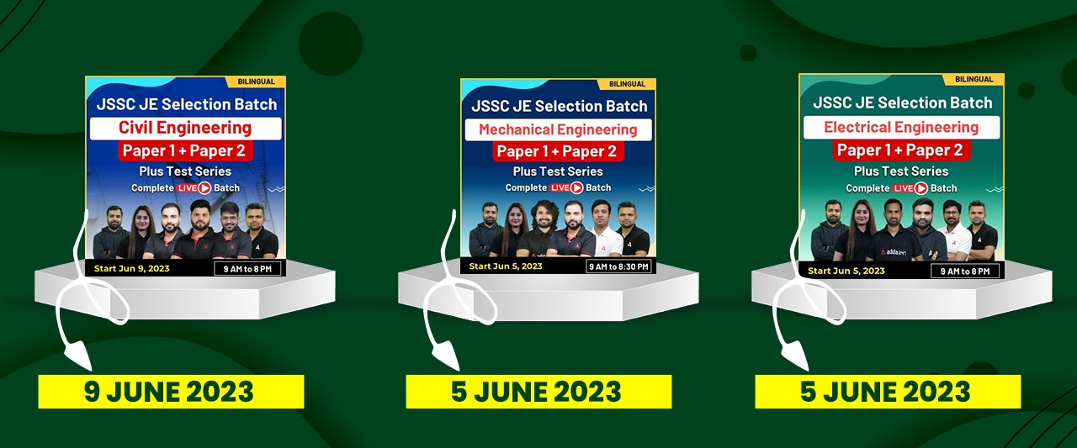
2023 AE/JE Aspirants | List of all upcoming Vacancies | By Shivam Sir
For Complete theory and concepts join our Mahapack Batch, Use Code Y166 For 78% of Discount

Slide 20

2023 AE/JE Aspirants | List of all upcoming Vacancies | By Shivam Sir
For Complete theory and concepts join our Mahapack Batch, Use Code Y166 For 78% of Discount

Slide 21
JSSC JE 2023 | Mechanical Engineers | Most Expected QuestionsSet-3
Mechanical Engineering
HW. Fixed position layout is also known as_
A. analytical layout
B. synthetic layout
C. static product layout
D. none of these
For 78% Discount
Use Code : “Y166”
For Complete theory and concepts join our Mahapack Batch, Use Code Y166 For 78% of Discount

