Slide 4
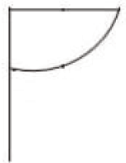
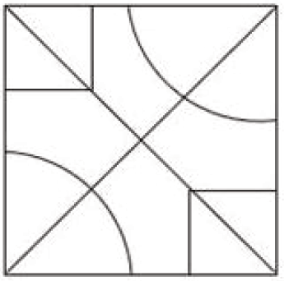
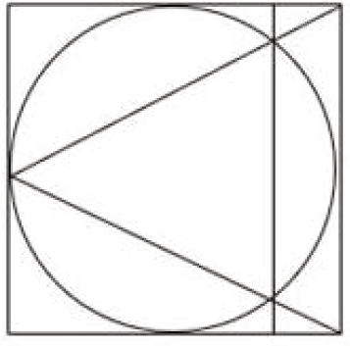
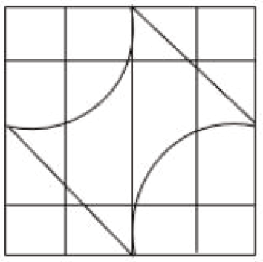
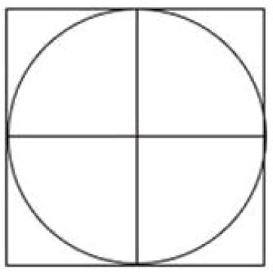
SSC JE 2023 | Reasoning Classes | By Abhishek Sir
Q1. Select the option in which the given figure is embedded (rotation is NOT allowed). (SSC JE 2022)
(a) (b) (c) (d)

Slide 5
SSC JE 2023 | Reasoning Classes | By Abhishek Sir
Q2. Select the option that is related to the ﬁfth term in the same way as the second term is related to the ﬁrst term and the fourth term is related to the third term. (SSC JE 2022)
JACKAL: LAKCAJ :: MENTOR : ROTNEM :: CRAZINESS : ?
(a) SSENIZARC
(b) SSENZIARC
(c) SSEINAZRC
(d) SSENAIZRC

Slide 6
SSC JE 2023 | Reasoning Classes | By Abhishek Sir
Q3. In a certain code language, ‘FABRIC’ is written as ‘UZYIRX’ and ‘DANGER’ is written as ‘WZMTVI’. How will ‘ABACUS’ be written in that language? (SSC JE 2022)
(a) ZYZXFH
(b) YZYXFH
(c) ZYZFXH
(d) ZYZXHF

Slide 7
SSC JE 2023 | Reasoning Classes | By Abhishek Sir
Q4. Select the set in which the numbers are NOT related in the same way as are the numbers of the given set.
(NOTE: Operations should be performed on the whole numbers, without breaking down the numbers into its constituent digits. E.g. 13 – Operations on 13 such as adding /subtracting/multiplying etc. to 13 can be performed. Breaking down 13 into 1 and 3 and then performing mathematical operations on 1 and 3 is not allowed) (SSC JE 2022)
(11, 14, 77)
(a) (15, 14, 105)
(b) (13, 16, 104)
(c) (12, 15, 90)
(d) (14, 12, 86)

Slide 8
SSC JE 2023 | Reasoning Classes | By Abhishek Sir
Q5. Arrange the following in a logical and meaningful order. (SSC JE 2022)
1. USA
2. Switzerland
3. Australia
4. India
5. China
(a) 1, 5, 4, 3, 2
(b) 5, 4, 1, 3, 2
(c) 1, 5, 4, 2, 3
(d) 5, 1, 4, 2, 3

Slide 9
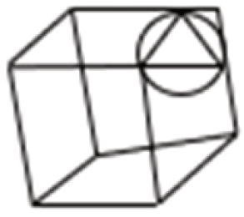
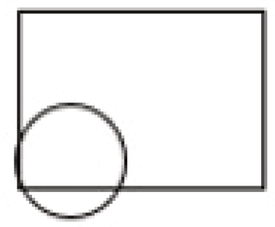
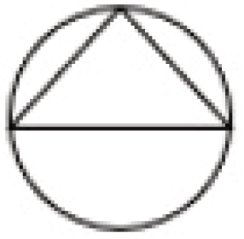
SSC JE 2023 | Reasoning Classes | By Abhishek Sir
Q6. Select the option that is embedded in the given figure (rotation is NOT allowed). (SSC JE 2022)
(a) (b) (c) (d)

Slide 10
SSC JE 2023 | Reasoning Classes | By Abhishek Sir
Q7. Select the option that is related to the third number in the same way as the second number is related to the ﬁrst number and the sixth number is related to the ﬁfth number. (SSC JE 2022)
53 : 2915 :: 69 : ? :: 64 : 4224
(a) 5015
(b) 4924
(c) 4765
(d) 4899

Slide 11
SSC JE 2023 | Reasoning Classes | By Abhishek Sir
Q8. Select the option that represents the letters that, when sequentially placed from left to right in the blanks below, will complete the letter series. (SSC JE 2022)
I _ F I _ N D _ F _ I N N _I F F _ N _ D
(a) I D D F I D N
(b) F F I I D N N
(c) D D F F I D N
(d) F N I F D I N

Slide 12
SSC JE 2023 | Reasoning Classes | By Abhishek Sir
Q9. In a code language, 'shall we dance today' is written as 'ned bin tru pat', 'we sing and dance’ is written as 'sid pat cam ned', 'sing a song together' is written as 'zig fah rip sid'. What is the code for the word 'and' in this language? (SSC JE 2022)
(a) pat
(b) ned
(c) cam
(d) sid

Slide 13
SSC JE 2023 | Reasoning Classes | By Abhishek Sir
Q10. Mr. Ramesh has a sister named Mrs. Kamlesh. Mrs. Kamlesh has two kids named Mr. Luv and Mr. Kush. Mr. Kush’s father’s wife’s mother is Mrs. Rupa. Mrs. Rupa’s daughter is Ms. Rekha. Mrs. Kamlesh is Ms. Rekha’s ________. (SSC JE 2022)
(a) sister
(b) mother
(c) mother’s mother
(d) daughter

Slide 14
SSC JE 2023 | Reasoning Classes | By Abhishek Sir
Q11. Which of the given letter-clusters will replace the question mark (?) in the following series? (SSC JE 2022)
DSZB, HQBD, LODF, ?, TKHJ
(a) PMGH
(b) PMFH
(c) PNFH
(d) PNGH

Slide 15
SSC JE 2023 | Reasoning Classes | By Abhishek Sir
Q12. Looking at a picture of a man, Sam said, “His father’s daughter in law is my wife.” How is Sam related to the man in the picture? (SSC JE 2022)
(a) Brother’s son
(b) Sister’s husband
(c) Brother
(d) Father’s brother’s son

Slide 16
SSC JE 2023 | Reasoning Classes | By Abhishek Sir
Q13. In a certain code language, 'PEOPLE’ is written as 'VOPOVK' and 'PUBLIC' is written as 'XRLBFK’. How will 'SECTOR' be written in that language? (SSC JE 2022)
(a) ILTCVH
(b) ILTCWH
(c) IMTCVH
(d) ROGXUH

Slide 17
SSC JE 2023 | Reasoning Classes | By Abhishek Sir
Q14. In this question, three statements are given, followed by three conclusions numbered I, II and III. Assuming the statements to be true, even if they seem to be at variance with commonly known facts, decide which of the conclusion(s) logically follow(s) from the statements. (SSC JE 2022)
Statements:
Some lights are fans.
All fans are switches.
All wires are lights.
Conclusions:
I. All wires are fans.
II. Some wires are switches.
III. Some lights are switches.
(a) Only conclusion III follows.
(b) Only conclusions I and III follow.
(c) Only conclusion I follows.
(d) Only conclusions II and III follows.

Slide 18
SSC JE 2023 | Reasoning Classes | By Abhishek Sir
Q15. Select the option that is related to the third word in the same way as the second word is related to the ﬁrst word. (The words must be considered as meaningful English words and must not be related to each other based on the number of letters/number of consonants/vowels in the word.) (SSC JE 2022)
Monotony : Variety :: Chaos : ?
(a) Struggle
(b) Problem
(c) Peace
(d) Disturbing

Slide 19
SSC JE 2023 | Reasoning Classes | By Abhishek Sir
Q16. Select the option that is related to the third term in the same way as the second term is related to the ﬁrst term and the sixth term is related to the ﬁfth term. (SSC JE 2022)
596 : 461 :: 819 : ? :: 754 : 619
(a) 661
(b) 692
(c) 684
(d) 676

Slide 20
SSC JE 2023 | Reasoning Classes | By Abhishek Sir
Q17. Which of the following interchanges of signs would make the given equation correct? (SSC JE 2022)
13 × 15 ÷ 98 + 7 -11 = 198
(a) + and ×
(b) − and ÷
(c) ÷ and +
(d) × and −

Slide 21
SSC JE 2023 | Reasoning Classes | By Abhishek Sir
Q18. Select the option that is related to the ﬁfth term in the same way as the second term is related to the ﬁrst term and the fourth term is related to the third term. (SSC JE 2022)
48 CAN : 12 EET :: 52 MUG : 7 OYM :: 35 BOX : ?
(a) 8DTD
(b) 8DSC
(c) 15DSD
(d) 8DSD

Slide 22
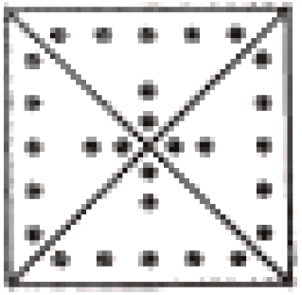
SSC JE 2023 | Reasoning Classes | By Abhishek Sir
Q19. A paper is folded and cut as shown. How will it appear when unfolded? (SSC JE 2022)
(a) (b) (c) (d)

Slide 23
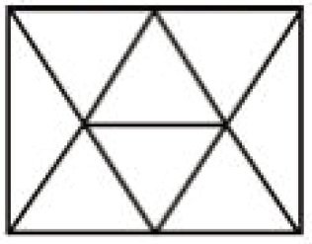
SSC JE 2023 | Reasoning Classes | By Abhishek Sir
Q20. How many triangles are there in the following figure? (SSC JE 2022)
(a) 14
(b) 12
(c) 15
(d) 13

Slide 24
SSC JE 2023 | Reasoning Classes | By Abhishek Sir
Q21. A person starts from point Z and moves 7 km towards the North. He turns right and moves 5 km, turns right, and moves 3 km, then turns right and moves 1 km. He takes a left turn and moves 4 km to reach a point X. How much and in which direction does he need to move now to reach point Z? (SSC JE 2022)
(a) 4 km West
(b) 4 km South
(c) 6 km East
(d) 7 km South

Slide 25
SSC JE 2023 | Reasoning Classes | By Abhishek Sir
Q22. Select the option that will replace the question mark (?) in the following number series. (SSC JE 2022)
100, 60, 40, 30, ?
(a) 25
(b) 75
(c) 60
(d) 45

Slide 26
SSC JE 2023 | Reasoning Classes | By Abhishek Sir
Q23. A, B, C, D, E, F and G are seven sisters of different ages. B is older than only C. A is younger than only F and D. G is older than E. How many sisters is E younger than? (SSC JE 2022)
(a) 3
(b) 2
(c) 5
(d) 4

Slide 27
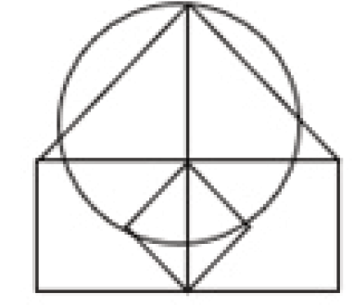
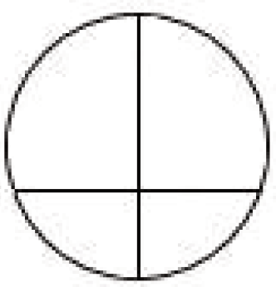
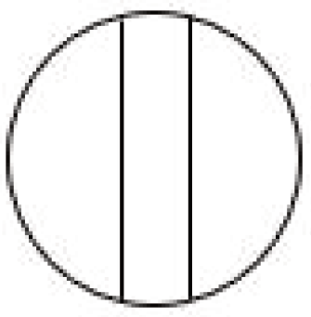
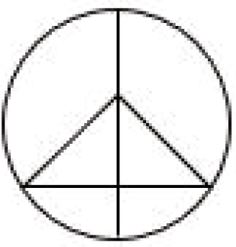
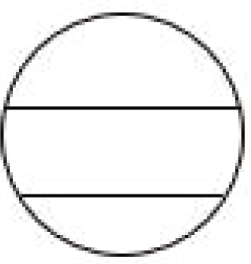
SSC JE 2023 | Reasoning Classes | By Abhishek Sir
Q24. Select the option that is embedded in the given figure (rotation is NOT allowed). (SSC JE 2022)
(a) (b) (c) (d)

Slide 28
SSC JE 2023 | Reasoning Classes | By Abhishek Sir
Q25. A, B, C, D, E, F, and G are seven students sitting around a circular table facing the centre. G is second to the left of D and is the immediate neighbour of E and F. D is not the immediate neighbour of C and E. A is the immediate neighbour of B and C. Who is the immediate neighbour of E and A both? (SSC JE 2022)
(a) G
(b) F
(c) B
(d) C

Slide 29
SSC JE 2023 | Reasoning Classes | By Abhishek Sir
Q26. Select the option that is related to the third word in the same way as the second word is related to the ﬁrst word. (The words must be considered as meaningful English words and must not be related to each other based on the number of letters/number of consonants/vowels in the word.) (SSC JE 2022)
Thunder : Roar :: Rain : ?
(a) Cloud
(b) Mud
(c) Lightening
(d) Patter

Slide 30
SSC JE 2023 | Reasoning Classes | By Abhishek Sir
Q27. Select the number from among the given options that can replace the question mark (?) in the following series. (SSC JE 2022)
1, 5, 10, 14, ?, 32, 64
(a) 20
(b) 24
(c) 22
(d) 28

Slide 31
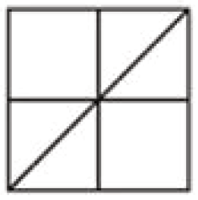
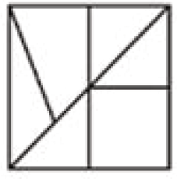
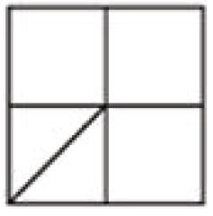
SSC JE 2023 | Reasoning Classes | By Abhishek Sir
Q28. Select the option in which the given figure is embedded (rotation is NOT allowed). (SSC JE 2022)
(a) (b) (c) (d)

Slide 32
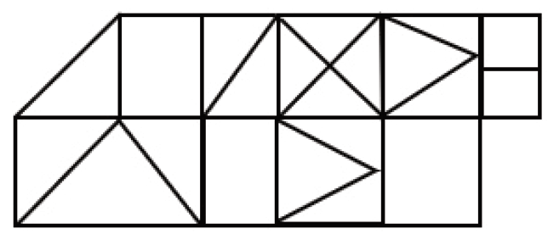
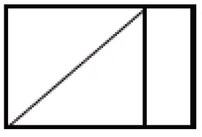
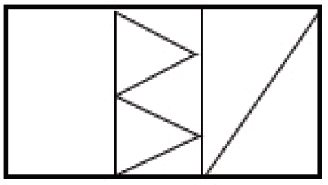
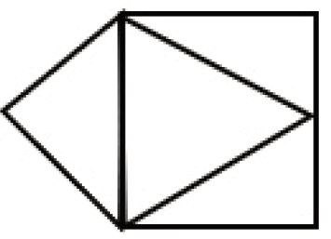
SSC JE 2023 | Reasoning Classes | By Abhishek Sir
Q29. Select the option figure which is embedded in the given figure as its part (rotation is NOT allowed). (SSC JE 2022)
(a) (b) (c) (d)

Slide 33
SSC JE 2023 | Reasoning Classes | By Abhishek Sir
Q30. Select the option that represents the letters that when placed from left to right in the blanks below will complete the letter series. (SSC JE 2022)
_FD_H_E_DC_AE_DC_A_FD_ _A
(a) EACFHHFECH
(b) ECAFHFHECH
(c) EACHFFHECH
(d) ECAHFFHECH

Slide 34
SSC JE 2023 | Reasoning Classes | By Abhishek Sir
Q31. Select the correct option that indicates the arrangement of the following words in a logical and meaningful order. (SSC JE 2022)
1.Paper
2.Pulp
3.Chop
4.Tree bark
5.Book
(a) 4, 3, 2, 5, 1
(b) 4, 2, 3, 5, 1
(c) 4, 3, 2, 1, 5
(d) 4, 2, 3, 1, 5

Slide 35
SSC JE 2023 | Reasoning Classes | By Abhishek Sir
Q32. Ronny starts from Point A and drives 10.25 km towards the east. He then takes a right turn, drives 12.75 km, turns right and drives 15 km. He then takes a right turn and drives 2.25 km. He takes a ﬁnal right turn, drives 4.75 km and stops at Point P. How far and towards which direction should he now drive in order to reach Point A again? (All turns are 90 degree turns only) (SSC JE 2022)
(a) 10.25 km, west
(b) 10.5 km, west
(c) 10.5 km, north
(d) 10.25 km, north
रोनी बिंदु A से शुरू करता है और पूर्व की ओर 10.25 किमी ड्राइव करता है। फिर वह दाएं मुड़ता है, 12.75 किमी ड्राइव करता है, दाएं मुड़ता है और 15 किमी ड्राइव करता है। फिर वह दाएं मुड़ता है और 2.25 किमी ड्राइव करता है। वह अंतिम दाएँ मुड़ता है, 4.75 किमी ड्राइव करता है और बिंदु P पर रुकता है। बिंदु A पर फिर से पहुँचने के लिए उसे अब कितनी दूर और किस दिशा में गाड़ी चलानी चाहिए? (सभी मोड़ केवल 90 डिग्री के मोड़ हैं)

Slide 36
SSC JE 2023 | Reasoning Classes | By Abhishek Sir
Q32. Ronny starts from Point A and drives 10.25 km towards the east. He then takes a right turn, drives 12.75 km, turns right and drives 15 km. He then takes a right turn and drives 2.25 km. He takes a ﬁnal right turn, drives 4.75 km and stops at Point P. How far and towards which direction should he now drive in order to reach Point A again? (All turns are 90 degree turns only) (SSC JE 2022)
(a) 10.25 km, west
(b) 10.5 km, west
(c) 10.5 km, north
(d) 10.25 km, north

Slide 37
SSC JE 2023 | Reasoning Classes | By Abhishek Sir
Q33. Select the set in which the numbers are related in the same way as are the numbers of the given sets.
(NOTE : Operations should be performed on the whole numbers, without breaking down the numbers into its constituent digits. E.g. 13 – Operations on 13 such as adding /subtracting/multiplying etc. to 13 can be performed. Breaking down 13 into 1 and 3 and then performing mathematical operations on 1 and 3 is not allowed.) (SSC JE 2022)
(45, 81, 104)
(52, 88, 111)
(a) (49, 85, 108)
(b) (34, 60, 83)
(c) (27, 59, 82)
(d) (54, 90, 110)

Slide 38
SSC JE 2023 | Reasoning Classes | By Abhishek Sir
Q34. In a certain code language, 'JEEP' is written as 'WJHL' and 'CARD' is written as 'KWDE'. How will 'LANE' be written in that language? (SSC JE 2022)
(a) LSCN
(b) LTDN
(c) LSDN
(d) LSDM

Slide 39
SSC JE 2023 | Reasoning Classes | By Abhishek Sir
Q35. Select the option that indicates the correct arrangement of the given words in a logical and meaningful order. (SSC JE 2022)
1. Book
2. Library
3. Paragraph
4. Chapter
5. Word
(a) 2,1,4,3,5
(b) 1,2,3,4,5
(c) 5,2,4,1,3
(d) 1,4,2,5,3

Slide 40
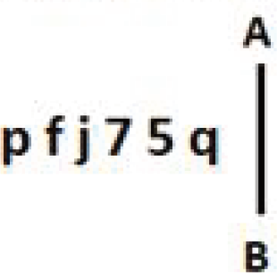
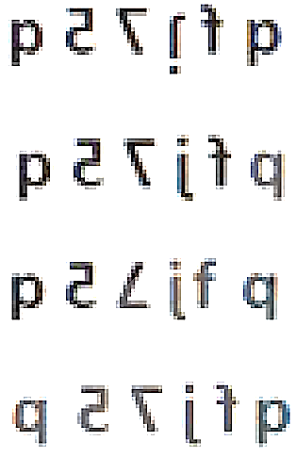
SSC JE 2023 | Reasoning Classes | By Abhishek Sir
Q36. Select the correct mirror image of the given combination when the mirror is placed at line AB as shown. (SSC JE 2022)
(a)
(b)
(c)
(d)

Slide 41
SSC JE 2023 | Reasoning Classes | By Abhishek Sir
Q37. Select the option that is related to the third word in the same way as the second word is related to the ﬁrst word. (The words must be considered as meaningful English words and must not be related to each other based on the number of letters/number of consonants/vowels in the word.) (SSC JE 2022)
Architect : Design :: Farmer : ?
(a) Crop
(b) Farm
(c) Agriculture
(d) Tractor

Slide 42
SSC JE 2023 | Reasoning Classes | By Abhishek Sir
Q38. Select the option that represents the letters that when placed from left to right in the blanks below will complete the letter series. (SSC JE 2022)
S_RQ_O_V_ _ P_S_RQ_OSV_Q_O
(a) VPRSQOVPRP
(b) VPSRQOPVRP
(c) VPSRQOVPRP
(d) VPSROQVPRP

Slide 43
SSC JE 2023 | Reasoning Classes | By Abhishek Sir
Q39. Select the option that indicates the correct arrangement of the given words in the order they appear in an English dictionary. (SSC JE 2022)
1. Acquiescent
2. Acquaintance
3. Acknowledge
4. Acquisition
5. Acquittal
6. Acrimonious
(a) 2, 3, 4, 1, 5, 6
(b) 3, 2, 4, 1, 5, 6
(c) 2, 3, 1, 4, 5, 6
(d) 3, 2, 1, 4, 5, 6

Slide 44
SSC JE 2023 | Reasoning Classes | By Abhishek Sir
Q40. Select the figure from the options that can replace the question mark (?) and complete the pattern. (SSC JE 2022)
(a) (b) (c) (d)

Slide 45
SSC JE 2023 | Reasoning Classes | By Abhishek Sir
Q41. Eight people, A, B, C, D, E, F, G, and H are seated in a row, facing north. Only 2 people sit to the right of G. Only three people sit between B and G. E sits fourth to the left of C, and is an immediate neighbour of both B and A. D is not an immediate neighbour of B. D sits third to the right of H. Who sits at the extreme right end of the row? (SSC JE 2022)
(a) F
(b) D
(c) H
(d) B
आठ व्यक्ति, A, B, C, D, E, F, G, और H एक पंक्ति में उत्तर की ओर उन्मुख होकर बैठे हैं। केवल 2 व्यक्ति G के दायें बैठे हैं। केवल तीन व्यक्ति B और G के बीच बैठे हैं। E, C के बायें से चौथे स्थान पर बैठा है, और B और A दोनों का निकटतम पडोसी है। D, B का निकटतम पडोसी नहीं है। D बैठा है H के दायें से तीसरा। पंक्ति के दायें छोर पर कौन बैठा है?

Slide 46
SSC JE 2023 | Reasoning Classes | By Abhishek Sir
Q42. Select the option that is related to the third term in the same way as the second term is related to the ﬁrst term and the sixth term is related to the ﬁfth term. (SSC JE 2022)
12 : 154 :: 20 : ? :: 32 : 1034
(a) 525
(b) 320
(c) 410
(d) 415

Slide 47
SSC JE 2023 | Reasoning Classes | By Abhishek Sir
Q43. If A denotes ‘+’, B denotes ‘×‘, C denotes ‘−’, and D denotes ‘÷’, then what will come in place of ‘?’ in the following equation? (SSC JE 2022)
(89 C 8) B ? D 81 = 729
(a) 9
(b) 729
(c) 89
(d) 81

Slide 48
SSC JE 2023 | Reasoning Classes | By Abhishek Sir
Q44. Select the option that indicates the correct arrangement of the given words in the order they appear in an English dictionary. (SSC JE 2022)
1. Conscript
2. Consecrate
3. Consign
4. Consequent
5. Conserve
6. Conscious
(a) 6, 1, 2, 4, 5, 3
(b) 1, 6, 4, 2, 3, 5
(c) 6, 1, 4, 2, 5, 3
(d) 1, 6, 2, 4, 5, 3

Slide 49
SSC JE 2023 | Reasoning Classes | By Abhishek Sir
Q45. Two statements are given, followed by two conclusions numbered I and II. Assuming the statements to be true, even if they seem to be at variance with commonly known facts, decide which of the conclusions logically follow(s) from the statements. (SSC JE 2022)
Statements:
Some cars are vans.
Some vans are trucks.
Conclusions:
I. Some cars are trucks.
II. All trucks are vans.
(a) Only conclusion I follows
(b) Both conclusions I and II follow
(c) Neither conclusion I nor II follows
(d) Only conclusion II follows

Slide 50
SSC JE 2023 | Reasoning Classes | By Abhishek Sir
Q46. Which of the following numbers will replace the question mark (?) and complete the given number series? (SSC JE 2022)
98, 69, 46, 29, 18, ?
(a) 13
(b) 12
(c) 11
(d) 14

Slide 51
SSC JE 2023 | Reasoning Classes | By Abhishek Sir
Q47. Select the combination of letters, which when sequentially placed in the blanks of the given series, will complete the series. (SSC JE 2022)
ACB_ _EPR_ _ZY
(a) DGXQ
(b) FKQX
(c) DFQX
(d) FJQX

Slide 52
SSC JE 2023 | Reasoning Classes | By Abhishek Sir
Q48. If + means ×, - means $÷$, × means -, and $÷$ means +, then what will be the value of the following? (SSC JE 2022)
$\frac{\text{(30 × 5) – 5×5 }}{4+9×2+18÷1}$ = ?
(a) 2
(b) 3
(c) 0
(d) 1

Slide 53
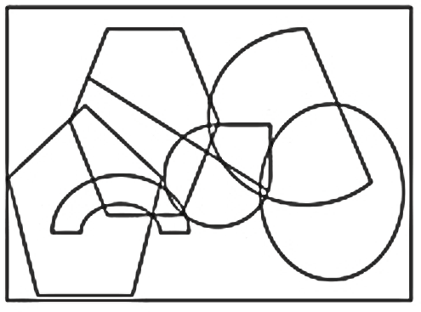
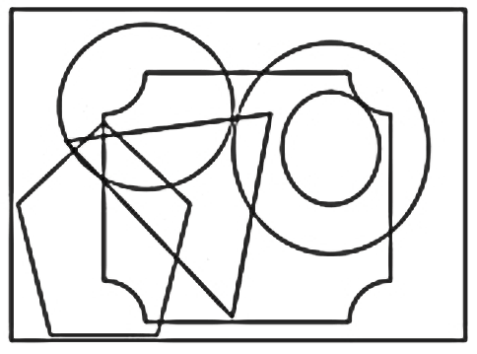
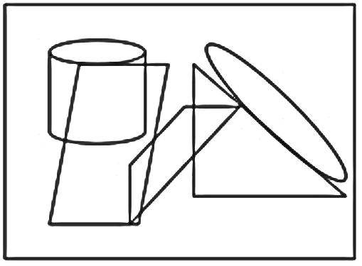
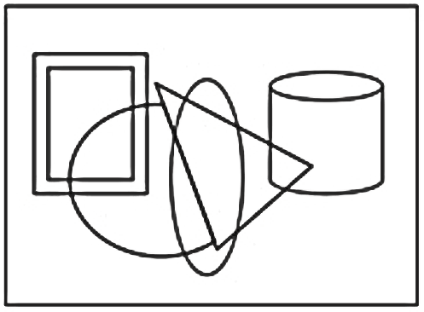
SSC JE 2023 | Reasoning Classes | By Abhishek Sir
Q49. Select the option in which the given figure is embedded (rotation is NOT allowed). (SSC JE 2022)
(a) (b) (c) (d)

Slide 54
SSC JE 2023 | Reasoning Classes | By Abhishek Sir
Q50. If A denotes ‘+’, B denotes ‘×’, C denotes ‘-’ and D denotes ‘$÷$’, then what will be the value of the following expression? (SSC JE 2022)
122 A 79 C 20 D 2 B 8 = ?
(a) 298
(b) 128
(c) 34
(d) 121

