Slide 1
10

Slide 3
JSSC JE Exam 2023 | Mechanical Engineering | Most Expected Questions
Mechanical Engineering
Q. Which of the following statement is correct-?
A. The stress is the pressure per unit area.
B. The strain is expressed in mm/mm
C. Hook's law holds good upto the breaking point.
D. Stress is directly proportional to strain within the plastic limit.
For 78% Discount
Use Code : “Y166”
For Complete theory and concepts join our Mahapack Batch, Use Code Y166 For 78% of Discount

Slide 4
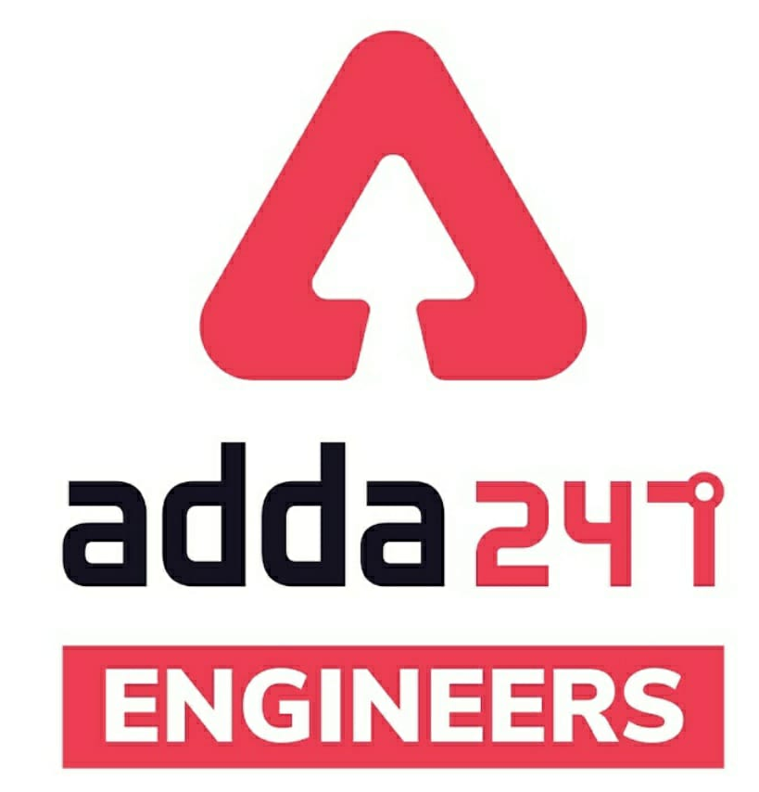
JSSC JE Exam 2023 | Mechanical Engineering | Most Expected Questions
Mechanical Soormas
Ajit Singh
Anuj Kanoujiya
Ritick Konwar
Pannelal Kushwaha
Sahil Kumar
Dilip Gupta
Ravi Raj
Kumari Arju
Sandip Mahata
Pankaj Mahato
Subir
Anchal Mishra
Lokesh Varwan
Amit Kumar
Shivani SIngh
Naresh Rock
Priyanshu Kushwaha
Nivas Gupta
MS D2E
Ruby Prajapati
Mohit Kumar
Shahzad Ali
Mechanical Queen
Pragya Srivastava
Amit Kumar
Kritika Mall
Pradeep Bedia
Ayush Suthar
for
Code : “Y166”

Slide 5
JSSC JE Exam 2023 | Mechanical Engineering | Most Expected Questions
Mechanical Soormas
Raj Yadav
Sandeep Kumar Jha
Warif
Er. Munish Kumar
Narender Sura
Om Prakash Chaurasiya
Ajaya Suna
Munda Mahato
Ela Sahoo
Rajat Bobde
Mitu Kumar
Rahul
Anil Gola
Krishna India
Kumari Manisha
AJ Jogal
Vaibhavi Srivastava
Nandan Mehta
Nitish Mishra
Amar Jyoti
Akhilesh Gupta
Pintu Mahato
Ajit Potbhare
Gautam Singh Yugarya
for
Code : “Y166”

Slide 6
JSSC JE Exam 2023 | Mechanical Engineering | Most Expected Questions
Mechanical Engineering
For 78% Discount
Use Code : “Y166”
For Complete theory and concepts join our Mahapack Batch, Use Code Y166 For 78% of Discount

Slide 7
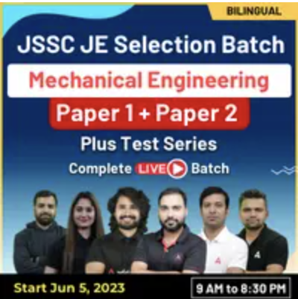
JSSC JE Exam 2023 | Mechanical Engineering | Most Expected Questions
Mechanical Engineering
For 78% Discount
Use Code : “Y166”
Course Highlights
350+ hours of Live Technical Classes
130+ hours of Live Non-Technical Classes
Access to Recorded Videos
Latest Pattern of JSSC JE
Question Practice Session
For Complete theory and concepts join our Mahapack Batch, Use Code Y166 For 78% of Discount

Slide 8
JSSC JE Exam 2023 | Mechanical Engineering | Most Expected Questions
Mechanical Engineering
Q. The air standard efficiency of an Diesel cycle compared to Dual cycle for the given compression ratio is_
A. same
B. less
C. more
D. unpredictable
For 78% Discount
Use Code : “Y166”
For Complete theory and concepts join our Mahapack Batch, Use Code Y166 For 78% of Discount

Slide 9
JSSC JE Exam 2023 | Mechanical Engineering | Most Expected Questions
Mechanical Engineering
Q. Combustion in compression ignition engines is-
A. homogeneous
B. heterogeneous
C. both A. and B.
D. laminar
For 78% Discount
Use Code : “Y166”
For Complete theory and concepts join our Mahapack Batch, Use Code Y166 For 78% of Discount

Slide 10
JSSC JE Exam 2023 | Mechanical Engineering | Most Expected Questions
Mechanical Engineering
Q. Two parallel forces 100 kN and 75 kN act on a body and have resultant of 25 kN. Then, the two forces are-
A. Like parallel forces
B. Unlike parallel forces
C. Concurrent forces
D. None of the above
For 78% Discount
Use Code : “Y166”
For Complete theory and concepts join our Mahapack Batch, Use Code Y166 For 78% of Discount

Slide 11
JSSC JE Exam 2023 | Mechanical Engineering | Most Expected Questions
Mechanical Engineering
Q. Limiting friction depends upon_
A. Materials of the body in contact
B. Weight of the body to be moved
C. Roughness of surface of contact of the two bodies
D. All of the above
For 78% Discount
Use Code : “Y166”
For Complete theory and concepts join our Mahapack Batch, Use Code Y166 For 78% of Discount

Slide 12
JSSC JE Exam 2023 | Mechanical Engineering | Most Expected Questions
Mechanical Engineering
Q. If n < (2j - 3), where n is number of members used in a frame structure and j is the number of joints used in the structure, then the frame is called-
A. Perfect frame
B. Deficient frame
C. Redundant frame
D. None of the above
For 78% Discount
Use Code : “Y166”
For Complete theory and concepts join our Mahapack Batch, Use Code Y166 For 78% of Discount

Slide 13
JSSC JE Exam 2023 | Mechanical Engineering | Most Expected Questions
Mechanical Engineering
Q. Cutting speeds for Turning with HSS on cast iron is about.
A. 20 m/min
B. 30 m/min
C. 35 m/min
D. 15 m/min
For 78% Discount
Use Code : “Y166”
For Complete theory and concepts join our Mahapack Batch, Use Code Y166 For 78% of Discount

Slide 14
JSSC JE Exam 2023 | Mechanical Engineering | Most Expected Questions
Mechanical Engineering
Q. Titanium in the steel improves the!
A. hardness
B. strength
C. resistance to corrosion of steel
D. strength and resistance to corrosion of steel
For 78% Discount
Use Code : “Y166”
For Complete theory and concepts join our Mahapack Batch, Use Code Y166 For 78% of Discount

Slide 15
JSSC JE Exam 2023 | Mechanical Engineering | Most Expected Questions
Mechanical Engineering
Q. In which of the following joining process, the filler material used is the same as the parent material..? a) Autogenous b) Homogenous c) Heterogenous d) Either homogenous or heterogenous
For 78% Discount
Use Code : “Y166”
For Complete theory and concepts join our Mahapack Batch, Use Code Y166 For 78% of Discount

Slide 16
JSSC JE Exam 2023 | Mechanical Engineering | Most Expected Questions
Mechanical Engineering
Q.Which pair of the links involves two dissimilar surface contact _
Spherical Pair
Lower pair
Higher Pair
All of the above
For 78% Discount
Use Code : “Y166”
For Complete theory and concepts join our Mahapack Batch, Use Code Y166 For 78% of Discount

Slide 18
JSSC JE Exam 2023 | Mechanical Engineering | Most Expected Questions
Mechanical Engineering
Q.Which of the following mechanisms are exact straight line mechanism except!
Peculiar mechanism
Hart mechanism
Scott-russel mechanism
Watt indicator
For 78% Discount
Use Code : “Y166”
For Complete theory and concepts join our Mahapack Batch, Use Code Y166 For 78% of Discount

Slide 19
JSSC JE Exam 2023 | Mechanical Engineering | Most Expected Questions
Mechanical Engineering
Q. The impact factor used for brittle material is -
A. Directly proportional to static deflection
B. inversely proportional to static deflection
C. Zero
D. unity
For 78% Discount
Use Code : “Y166”
For Complete theory and concepts join our Mahapack Batch, Use Code Y166 For 78% of Discount

Slide 20
JSSC JE Exam 2023 | Mechanical Engineering | Most Expected Questions
Mechanical Engineering
Q. The statistical approach for the study of geometry of motion for any specific fluid particle is given by_
Eulers theory
Renolds theory
Lagrangian theory
Newtons theory
For 78% Discount
Use Code : “Y166”
For Complete theory and concepts join our Mahapack Batch, Use Code Y166 For 78% of Discount

Slide 21
JSSC JE Exam 2023 | Mechanical Engineering | Most Expected Questions
Mechanical Engineering
Q. In the study of process we have seen Quazistatic process which is actually-
Reversible in nature
Irreversible in nature
Isothermal in nature
Adiabatic in nature
For 78% Discount
Use Code : “Y166”
For Complete theory and concepts join our Mahapack Batch, Use Code Y166 For 78% of Discount

Slide 22
JSSC JE Exam 2023 | Mechanical Engineering | Most Expected Questions
Mechanical Engineering
Q. Which of the Following isn’t an extrinsic property in real_
Entropy
Entropy generation
Viscosity
None of the above
For 78% Discount
Use Code : “Y166”
For Complete theory and concepts join our Mahapack Batch, Use Code Y166 For 78% of Discount

Slide 23
JSSC JE Exam 2023 | Mechanical Engineering | Most Expected Questions
Mechanical Engineering
Q. Any Equation of the type f( P,V,T) = 0 is known as_
Adiabatic equation
Polytropic equation
State equation
All of the above
For 78% Discount
Use Code : “Y166”
For Complete theory and concepts join our Mahapack Batch, Use Code Y166 For 78% of Discount

Slide 24
JSSC JE Exam 2023 | Mechanical Engineering | Most Expected Questions
Mechanical Engineering
Q. The difference between Specific Heat and specific Work Energy of a perfect gas is a function of!
A. absolute volume
B. differential pressure
C. absolute pressure
D. absolute temperature
For 78% Discount
Use Code : “Y166”
For Complete theory and concepts join our Mahapack Batch, Use Code Y166 For 78% of Discount

Slide 25
JSSC JE Exam 2023 | Mechanical Engineering | Most Expected Questions
Mechanical Engineering
Q. Consumable patterns are made of.
A. Polystyrene
B. Wax
C. Plaster of Paris
D. Any of the above
For 78% Discount
Use Code : “Y166”
For Complete theory and concepts join our Mahapack Batch, Use Code Y166 For 78% of Discount

Slide 26
JSSC JE Exam 2023 | Mechanical Engineering | Most Expected Questions
Mechanical Engineering
Q. Shell patterns are often used for!
A. Pipe work
B. Bends
C. Drainage fittings
D. All of the above
For 78% Discount
Use Code : “Y166”
For Complete theory and concepts join our Mahapack Batch, Use Code Y166 For 78% of Discount

Slide 27
JSSC JE Exam 2023 | Mechanical Engineering | Most Expected Questions
Mechanical Engineering
Q. The ratio of specific heat at constant pressure to the specific heat at constant volume for mixture of nitrogen carbon di oxide oxygen and air, is-
A. 1.6
B. 1.4
C. 1.2
D. 1.8
For 78% Discount
Use Code : “Y166”
For Complete theory and concepts join our Mahapack Batch, Use Code Y166 For 78% of Discount

Slide 28
JSSC JE Exam 2023 | Mechanical Engineering | Most Expected Questions
Mechanical Engineering
Q. Which of the following is the basic property of mustered oil-?
A. Can resist Limiting Friction upto certain limits
B. Never regain its original shape on release of shear stress
C. It is having the maximum viscosity
D. All of the above
For 78% Discount
Use Code : “Y166”
For Complete theory and concepts join our Mahapack Batch, Use Code Y166 For 78% of Discount

Slide 29
JSSC JE Exam 2023 | Mechanical Engineering | Most Expected Questions
Mechanical Engineering
Q. Calculate the dryness fraction of steam which has 75 kg of water in suspension with 100 kg of mixrture.
A. 0.25
B. 0.75
C. 0.125
D. 1.25
For 78% Discount
Use Code : “Y166”
For Complete theory and concepts join our Mahapack Batch, Use Code Y166 For 78% of Discount

Slide 31
Saturday Special | JSSC JE Exam 2023 | Mechanical Engineering |
Mechanical Engineering
HW. Two Shafts in parallel is subjected to torques T1 & T2 respectively. Total torque T is subjected to composite rod will be.
A. T = T1 = T2
B. T = T1 + T2
C. T = T1 * T2
D. none of the above
For 78% Discount
Use Code : “Y166”
For Complete theory and concepts join our Mahapack Batch, Use Code Y166 For 78% of Discount

