Slide 1


Slide 2


Slide 3


Slide 4

SSC JE 2023 | Reasoning Classes | By Abhishek Sir
Q1. In a certain code language, STUDENT is written as TVVFFPU. How will STEERING be written in the same code language?
एक निश्चित कूट भाषा में STUDENT को TVVFFPU लिखा जाता है। उसी कूट भाषा में STEERING को किस प्रकार लिखा जाएगा? (SSC JE 2022)
(a) TVFGSKOI
(b) TUFFSJOH
(c) TUFGSKOH
(d) TVGFSKPH

Slide 5
SSC JE 2023 | Reasoning Classes | By Abhishek Sir
Q2. Identify the option that arranges the following units in a logical and meaningful sequence. (SSC JE 2022)
1. Centi
2. Deci
3. Micro
4. Deca
5. Mili
(a) 3, 5, 1, 4, 2
(b) 3, 5, 1, 2, 4
(c) 5, 3, 1, 2, 4
(d) 5, 3, 1, 4, 2

Slide 6
SSC JE 2023 | Reasoning Classes | By Abhishek Sir
Q3. Select the number that can replace the question mark (?) in the following series. (SSC JE 2022)
122, 101, 82, 65, 50, ?
(a) 37
(b) 41
(c) 42
(d) 40

Slide 7
SSC JE 2023 | Reasoning Classes | By Abhishek Sir
Q4. In a certain code language, ELEPHANTS is written as DMFOIBMUT. How will CROCODILE be written in the same code language?
एक निश्चित कोड भाषा में, ELEPHANTS को DMFOIBMUT लिखा जाता है। उसी कूट भाषा में CROCODILE को किस प्रकार लिखा जाएगा? (SSC JE 2022)
(a) BQPBNEHKF
(b) CSSDDPEJLF
(c) BSPBPEHMF
(d) DSPDPEJMF

Slide 8
SSC JE 2023 | Reasoning Classes | By Abhishek Sir
Q5. Select the letter that can replace the question mark (?) in the following series. (SSC JE 2022)
C, F, I, ?
(a) O
(b) L
(c) K
(d) J

Slide 9
SSC JE 2023 | Reasoning Classes | By Abhishek Sir
Q6. Pointing to a photograph a young said, “He is the son of my mother’s elder brother”. How is the person is the photograph related to the young man?
एक युवा ने एक तस्वीर की ओर इशारा करते हुए कहा, "वह मेरी माँ के बड़े भाई का बेटा है"। फोटो किस प्रकार युवक से संबंधित है?(SSC JE 2022)
(a) Brother – in – law
(b) Nephew
(c) Cousin
(d) Father

Slide 10
SSC JE 2023 | Reasoning Classes | By Abhishek Sir
Q7. A lady introduced a man as "the only son of her sister's father-in-law”. How is the man related to the lady?
एक महिला ने एक पुरुष का परिचय "अपनी बहन के ससुर के इकलौते पुत्र" के रूप में कराया। वह पुरुष महिला से किस प्रकार संबंधित है? (SSC JE 2022)
(a) Brother
(b) Husband
(c) Son-in-law
(d) Brother-in-law

Slide 11
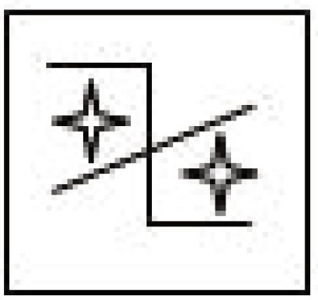
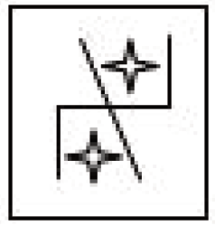
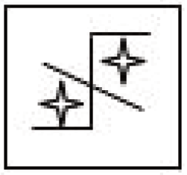
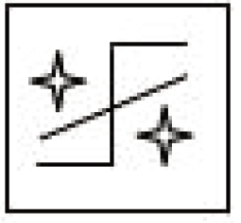
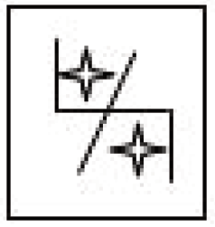
SSC JE 2023 | Reasoning Classes | By Abhishek Sir
Q8. Select the correct mirror image of the given figure when the mirror is placed to the right side of the figure. (SSC JE 2022)
(a) (b) (c) (d)

Slide 12
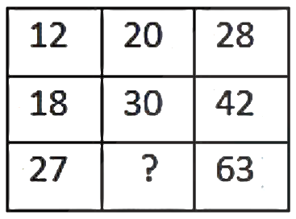
SSC JE 2023 | Reasoning Classes | By Abhishek Sir
Q9. Fill in the blank with correct option. (SSC JE 2022)
(a) 46
(b) 45
(c) 43
(d) 44

Slide 13
SSC JE 2023 | Reasoning Classes | By Abhishek Sir
Q10. Select the word-pair from the given options in which the two words are related in the same way as the two words in the following pair. (SSC JE 2022)
Motor : Car
(a) Tele : Vision
(b) Type : Writer
(c) Money : Order
(d) Bull : Cart

Slide 14
SSC JE 2023 | Reasoning Classes | By Abhishek Sir
Q11. ‘Hat’ is related to ‘Head’ in the same way as ‘Belt’ is related to ‘_________’.
'क्या' 'सिर' से उसी तरह संबंधित है जैसे 'बेल्ट' '________' से संबंधित है। (SSC JE 2022)
(a) Pant
(b) Trouser
(c) Waist
(d) Bag

Slide 15
SSC JE 2023 | Reasoning Classes | By Abhishek Sir
Q12. Select the option in which the number pair shares the same relationship as that shared by the following number pair. (SSC JE 2022)
54 : 99
(a) 65 : 111
(b) 42 : 88
(c) 32 : 66
(d) 43 : 77

Slide 16
SSC JE 2023 | Reasoning Classes | By Abhishek Sir
Q13. In a row of Class 7 students, Kanika was 9th from left and 11th from right. How many students were there in the row?
कक्षा 7 के विद्यार्थियों की एक पंक्ति में, कनिका बायें से 9वें और दायें से 11वें स्थान पर है। पंक्ति में कितने छात्र थे?(SSC JE 2022)
(a) 18
(b) 21
(c) 20
(d) 19

Slide 17
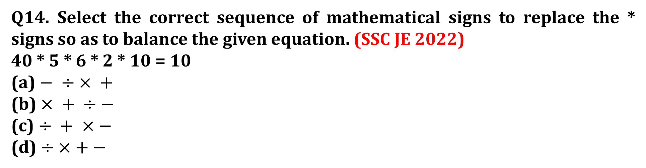
SSC JE 2023 | Reasoning Classes | By Abhishek Sir
Q14. Select the correct sequence of mathematical signs to replace the * signs so as to balance the given equation. (SSC JE 2022)
40 * 5 * 6 * 2 * 10 = 10
(a) $− ÷ × +$
(b) $× + ÷−$
(c) $÷ + ×−$
(d) $÷ × +−$

Slide 18
SSC JE 2023 | Reasoning Classes | By Abhishek Sir
Q15. ‘Owl’ is related to ‘Hoot’ in the same was as ‘Frog’ is related to
उल्लू' का संबंध 'हूट' से उसी प्रकार है जैसे 'मेंढक' का संबंध है ‘___________. (SSC JE 2022)
(a) Croak
(b) Caw
(c) Quack
(d) Cackle

Slide 19
SSC JE 2023 | Reasoning Classes | By Abhishek Sir
Q16. Two statements are given followed by two conclusions numbered I and II. Assuming the statements to be true. even if they seem to be at variance with commonly known facts, decide which of the conclusions logically follow(s) from the statements. (SSC JE 2022)
Statements:
1. All horses are bears.
2. All bears are donkeys.
Conclusions:
I. All donkeys are horses.
II. All horses are donkeys.
(a) Both conclusions I and II follow
(b) Only conclusion I follows
(c) Only conclusion II follows
(d) Neither conclusion I nor II follows

Slide 20
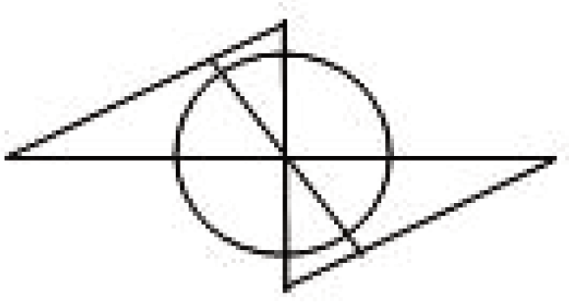
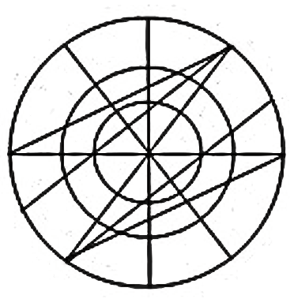
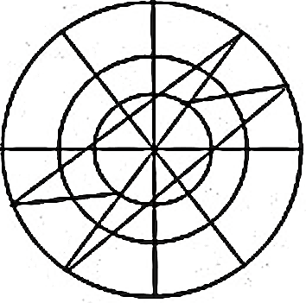
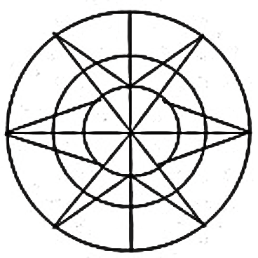
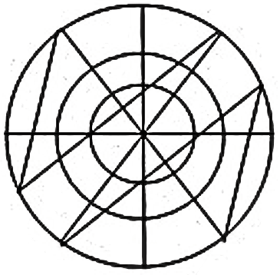
SSC JE 2023 | Reasoning Classes | By Abhishek Sir
Q17. Select the option in which the given figure is embedded (Rotation is not allowed). (SSC JE 2022)
(a) (b) (c) (d)

Slide 21
SSC JE 2023 | Reasoning Classes | By Abhishek Sir
Q18. Which letter from the options will replace the question mark (?) in the following series? (SSC JE 2022)
V, T, R, P, N, ?
(a) K
(b) M
(c) J
(d) L

Slide 22
SSC JE 2023 | Reasoning Classes | By Abhishek Sir
Q19. Select the option that is related to the third term in the same way as the second term is related to the ﬁrst term. (SSC JE 2022)
PENCIL : EPCNLI : : ERASER : ___________ .
(a) ARERES
(b) RESARE
(c) RESERA
(d) REASRE

Slide 23
SSC JE 2023 | Reasoning Classes | By Abhishek Sir
Q20. Which letter cluster will replace the question mark (?) in the following letter series? (SSC JE 2022)
USW, SQU, QOS, ?
(a) SQS
(b) OMQ
(c) OMI
(d) QSW

Slide 24
SSC JE 2023 | Reasoning Classes | By Abhishek Sir
Q21. Identify the option that arranges the following stages in a logical and meaningful sequence. (SSC JE 2022)
1. Puberty
2. Infancy
3. Adolescence
4. Neonatal
5. Childhood
(a) 4, 2, 1, 5, 3
(b) 2, 4, 5, 1, 3
(c) 4, 2, 5, 3, 1
(d) 4, 2, 5, 1, 3
1. यौवन
2. शैशवावस्था
3. किशोरावस्था
4. नवजात
5. बचपन

Slide 25
SSC JE 2023 | Reasoning Classes | By Abhishek Sir
Q22. Select the letter-cluster that can replace the question mark (?) in the following series. (SSC JE 2022)
aceg, aeim, agms, ?
(a) ajrz
(b) aiqy
(c) akmz
(d) ahkn

Slide 26
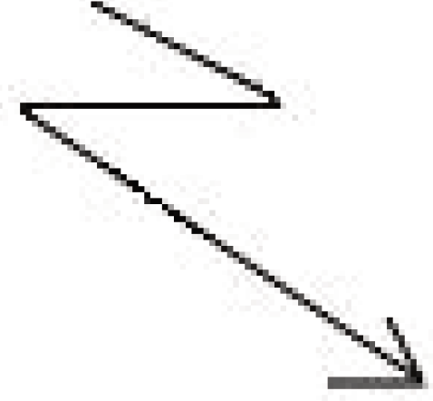
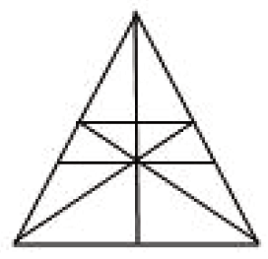
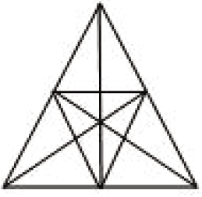
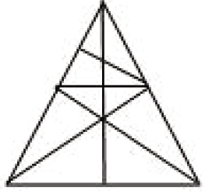
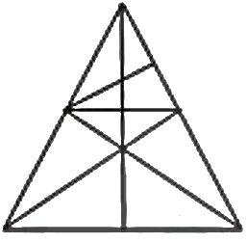
SSC JE 2023 | Reasoning Classes | By Abhishek Sir
Q23. Select the option in which the given figure is embedded (Rotation is not allowed). (SSC JE 2022)
(a) (b) (c) (d)

Slide 27
SSC JE 2023 | Reasoning Classes | By Abhishek Sir
Q24. Select the option that is related to the third term in the same way as the second term is related to the ﬁrst term. (SSC JE 2022)
CARPENTER : RETNDPRAC : : SUGARCANE : ___________.
(a) GUSCRAENA
(b) AGUSSENAC
(c) AGUSRENAC
(d) ENACQAGUS

Slide 28
SSC JE 2023 | Reasoning Classes | By Abhishek Sir
Q25. Select the option is which the number pair shares the same relationship as that shared by the following number pair. (SSC JE 2022)
344 : 513
(a) 126 : 217
(b) 1331 : 2744
(c) 999 : 1330
(d) 1332 : 1001

Slide 29
SSC JE 2023 | Reasoning Classes | By Abhishek Sir
Q26. ‘Advocate’ is related to ‘Advice’ in the same way as ‘Physician’ is related to ‘ __________’ .
अधिवक्ता' का संबंध 'सलाह' से उसी प्रकार है जैसे 'चिकित्सक' का संबंध '__________' से है।(SSC JE 2022)
(a) Prescription
(b) Patient
(c) Disease
(d) Operation

Slide 30
SSC JE 2023 | Reasoning Classes | By Abhishek Sir
Q27. Which number from the options will replace the question mark (?) in the following series? (SSC JE 2022)
0, 8, 24, 48, ?
(a) 81
(b) 74
(c) 82
(d) 80

Slide 31

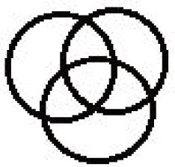


SSC JE 2023 | Reasoning Classes | By Abhishek Sir
Q28. Select the Venn diagram that best illustrates the relationship between the following classes: (SSC JE 2022)
Potato, Vegetables, Bottle ground
(a) (b) (c) (d)

Slide 32
SSC JE 2023 | Reasoning Classes | By Abhishek Sir
Q29. Which letter from the options will replace the question mark (?) in the following series? (SSC JE 2022)
D, H, M, Q, V, ?
(a) Z
(b) A
(c) B
(d) Y

Slide 33
SSC JE 2023 | Reasoning Classes | By Abhishek Sir
Q30. Two statements are given followed by two conclusions numbered I and II. Assuming the statements to be true, even if they seem to be at variance with commonly known facts, decide which of the conclusions logically follow(s) from the statements. (SSC JE 2022)
Statements:
1. Some Carts are Rats.
2. All Rats are Bats.
Conclusions:
I. Some Cats are Bats.
II. Some Bats are Cats.
(a) Only conclusion II follows
(b) Only conclusion I follows
(c) Both conclusions I and II follow
(d) Neither conclusion I nor II follows

Slide 34

SSC JE 2023 | Reasoning Classes | By Abhishek Sir
Q31. Four different positions of a dice are shown below. Identify the letter which lies exactly opposite to the letter ‘E‘ on this dice. (SSC JE 2022)
(a) D
(b) C
(c) A
(d) B

Slide 35
SSC JE 2023 | Reasoning Classes | By Abhishek Sir
Q32. If LONDON is coded as 37, then NEWYORK is coded as:
यदि LONDON को 37 के रूप में कूटबद्ध किया जाता है, तो NEWYORK को कूटबद्ध किया जाता है:(SSC JE 2022)
(a) 54.5
(b) 55
(c) 53.5
(d) 55.5

Slide 36
SSC JE 2023 | Reasoning Classes | By Abhishek Sir
Q33. Train A runs at the speed of 80 km/h and it leaves from station X at 6:00 o'clock. Train B departs from the same station at 6:15 o'clock. At what speed should train B run so as to reach together with Train A on the next station located at a distance of 100 km? (SSC JE 2022)
(a) 100 km/h
(b) 90 km/h
(c) 95 km/h
(d) 110 km/h
ट्रेन A 80 किमी/घंटा की गति से चलती है और यह स्टेशन X से 6:00 बजे निकलती है। ट्रेन B उसी स्टेशन से 6:15 बजे निकलती है। 100 किमी की दूरी पर स्थित अगले स्टेशन पर ट्रेन A के साथ पहुँचने के लिए ट्रेन B को किस गति से चलना चाहिए?

Slide 37
SSC JE 2023 | Reasoning Classes | By Abhishek Sir
Q33. Train A runs at the speed of 80 km/h and it leaves from station X at 6:00 o'clock. Train B departs from the same station at 6:15 o'clock. At what speed should train B run so as to reach together with Train A on the next station located at a distance of 100 km? (SSC JE 2022)
(a) 100 km/h
(b) 90 km/h
(c) 95 km/h
(d) 110 km/h

Slide 38
SSC JE 2023 | Reasoning Classes | By Abhishek Sir
Q34. Select the option in which the two words are related in the same way as are the two words in the given word-pair. (SSC JE 2022)
Bengali : Bangladesh
(a) Arabic : Iraq
(b) Aymara : Burma
(c) Spanish : Brazil
(d) Greek : Nigeria

Slide 39
SSC JE 2023 | Reasoning Classes | By Abhishek Sir
Q35. Arrange the following words in an order they appear in dictionary. (SSC JE 2022)
1. Depending
2. Dependence
3. Dependency
4. Dependant
(a) 2, 4, 3, 1
(b) 2, 4, 1, 3
(c) 4, 2, 3, 1
(d) 1, 4, 2, 3

Slide 40
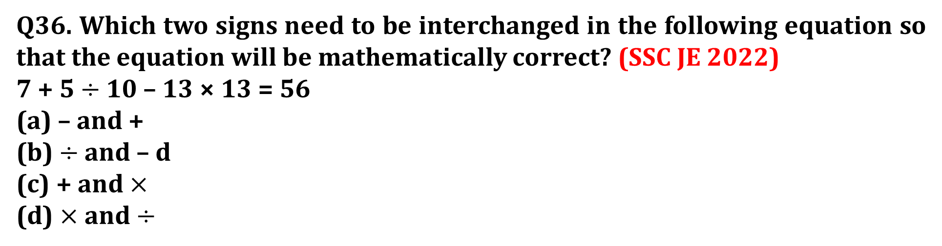
SSC JE 2023 | Reasoning Classes | By Abhishek Sir
Q36. Which two signs need to be interchanged in the following equation so that the equation will be mathematically correct? (SSC JE 2022)
7 + 5 $÷$ 10 – 13 × 13 = 56
(a) – and +
(b) $÷$ and – d
(c) + and $×$
(d) $×$ and $÷$

Slide 41

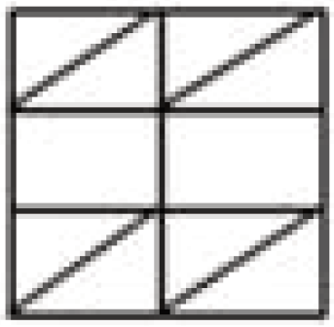
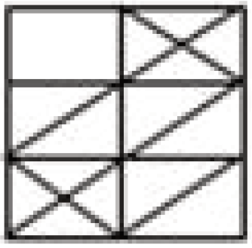
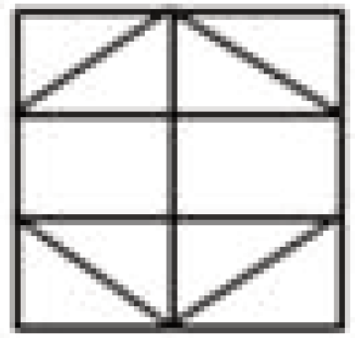
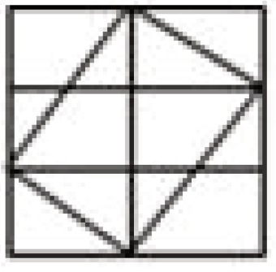
SSC JE 2023 | Reasoning Classes | By Abhishek Sir
Q37. Select the option in which the following figure is embedded (Rotation is not allowed). (SSC JE 2022)
(a) (b) (c) (d)

Slide 42
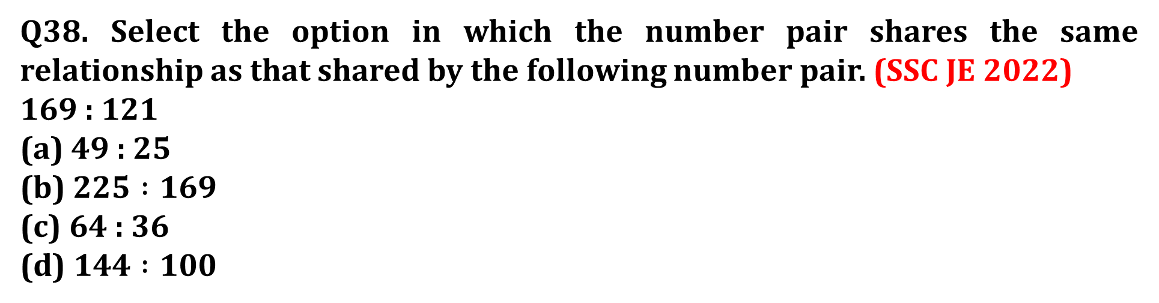
SSC JE 2023 | Reasoning Classes | By Abhishek Sir
Q38. Select the option in which the number pair shares the same relationship as that shared by the following number pair. (SSC JE 2022)
169 : 121
(a) 49 : 25
(b) $225 :169$
(c) 64 : 36
(d) $144 :100$

Slide 43
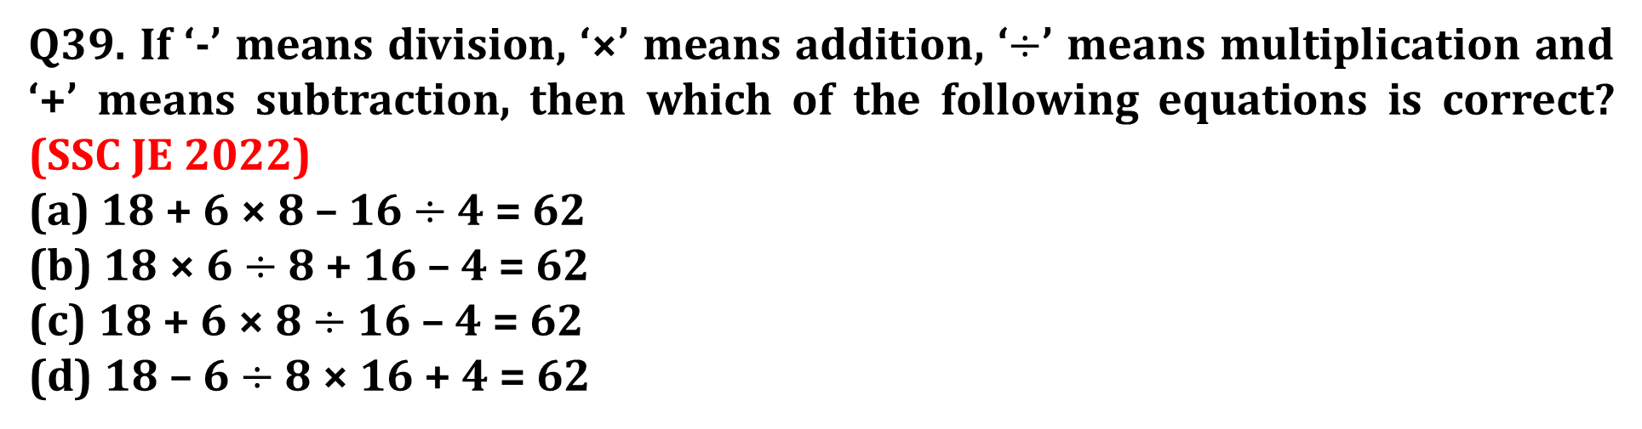
SSC JE 2023 | Reasoning Classes | By Abhishek Sir
Q39. If ‘-’ means division, ‘×’ means addition, ‘$÷$’ means multiplication and ‘+’ means subtraction, then which of the following equations is correct? (SSC JE 2022)
(a) 18 + 6 × 8 – 16 $÷$ 4 = 62
(b) $18$ × 6 $÷$ 8 + 16 – 4 = 62
(c) 18 + 6 × 8 $÷$ 16 – 4 = 62
(d) $18$ – 6 $÷$ 8 × 16 + 4 = 62

Slide 44
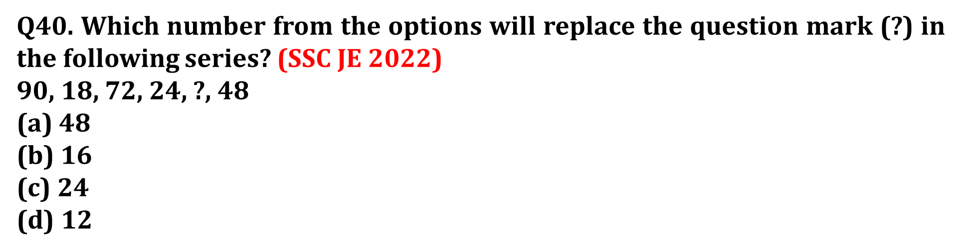
SSC JE 2023 | Reasoning Classes | By Abhishek Sir
Q40. Which number from the options will replace the question mark (?) in the following series? (SSC JE 2022)
90, 18, 72, 24, ?, 48
(a) 48
(b) $16$
(c) 24
(d) $12$

Slide 45

SSC JE 2023 | Reasoning Classes | By Abhishek Sir
Q41. A vendor packed 96 eggs into three boxes : X, Y and Z. There are twice as many eggs in the Z box as there are in the X box, and twice as many in the X and Y boxes combined as there are in the Z box. How many eggs did he pack in the Y box? (SSC JE 2022)
(a) 40
(b) 48
(c) 56
(d) $32$
एक विक्रेता ने 96 अंडों को तीन बक्सों: X, Y और Z में पैक किया। Z बॉक्स में X बॉक्स में जितने अंडे हैं, उससे दोगुने अंडे हैं, और X और Y बॉक्स में संयुक्त रूप से Z के मुकाबले दोगुने अंडे हैं। डिब्बा। उसने Y बॉक्स में कितने अंडे पैक किए?

Slide 46
SSC JE 2023 | Reasoning Classes | By Abhishek Sir
Q41. A vendor packed 96 eggs into three boxes : X, Y and Z. There are twice as many eggs in the Z box as there are in the X box, and twice as many in the X and Y boxes combined as there are in the Z box. How many eggs did he pack in the Y box? (SSC JE 2022)
(a) 40
(b) 48
(c) 56
(d) $32$

Slide 47
SSC JE 2023 | Reasoning Classes | By Abhishek Sir
Q42. Five friends were sitting on a bench facing the east. Ritik was seated just right to Abhi, but on the third left of Ranjan. Ajit and Jayant were sitting together Jayant being to the right of Ajit. Who was sitting to the extreme right on the bench? (SSC JE 2022)
(a) Jayant
(b) Abhi
(c) Cannot be determined
(d) Ranjan
एक बेंच पर पूर्व दिशा की ओर मुख करके पाँच मित्र बैठे थे। ऋतिक अभी के ठीक दायें बैठा था, लेकिन रंजन के बायें तीसरे स्थान पर। अजीत और जयंत एक साथ बैठे थे। जयंत अजीत के दाहिनी ओर था। बेंच पर सबसे दाहिनी ओर कौन बैठा था?

Slide 48
SSC JE 2023 | Reasoning Classes | By Abhishek Sir
Q42. Five friends were sitting on a bench facing the east. Ritik was seated just right to Abhi, but on the third left of Ranjan. Ajit and Jayant were sitting together Jayant being to the right of Ajit. Who was sitting to the extreme right on the bench? (SSC JE 2022)
(a) Jayant
(b) Abhi
(c) Cannot be determined
(d) Ranjan

Slide 49
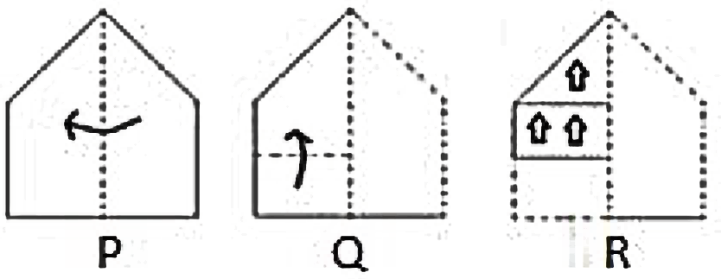
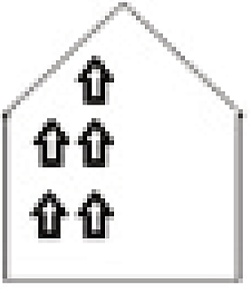
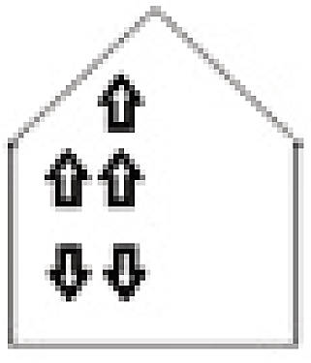

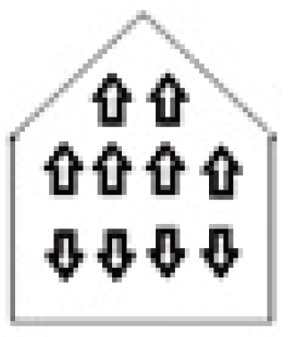
SSC JE 2023 | Reasoning Classes | By Abhishek Sir
Q43. A paper is folded and cut as shown below. How will it appear when figure R is unfolded? (SSC JE 2022)
(a) (b) (c) (d)

Slide 50
SSC JE 2023 | Reasoning Classes | By Abhishek Sir
Q44. Which letter cluster will replace the question mark (?) in the following letter series? (SSC JE 2022)
ORVY, MPTW, KNRUN, ?
(a) LORU
(b) ILOR
(c) ILPS
(d) LOSV

Slide 51
SSC JE 2023 | Reasoning Classes | By Abhishek Sir
Q45. While going to market from her office Kritika initially went straight, then she turned right and walked a while. From there she turned left and again turned left after traveling some distance. If she is now going northward, in which direction did she initially start from her office? (SSC JE 2022)
(a) South east
(b) East
(c) South
(d) West
अपने ऑफिस से बाजार जाते समय कृतिका पहले सीधी चली, फिर वह दायें मुड़ी और कुछ देर चली। वहाँ से वह बाएँ मुड़ी और कुछ दूर चलने के बाद फिर से बाएँ मुड़ी। यदि वह अब उत्तर की ओर जा रही है, तो उसने शुरुआत में अपने कार्यालय से किस दिशा में शुरुआत की थी?

Slide 52



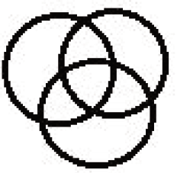
SSC JE 2023 | Reasoning Classes | By Abhishek Sir
Q46. Select the Venn diagram that best illustrates the relationship between the following classes: (SSC JE 2022)
Students, Football players, Basketball players
(a) (b) (c) (d)

Slide 53
SSC JE 2023 | Reasoning Classes | By Abhishek Sir
Q47. Select the option that is related to the third term in the same way as the second term is related to the first term. (SSC JE 2022)
GOLDSMITH : GPNGWROAP : : NEWSPAPER : __________.
(a) NFXTQBQFS
(b) NFYURCRGT
(c) NREEWPSAP
(d) NFYVTFVLZ

Slide 54
SSC JE 2023 | Reasoning Classes | By Abhishek Sir
Q48. Select the word – pair from the given options in which the two words are related in the same way as the two words in the following pair. (SSC JE 2022)
Hostile : Friendly
(a) Confident : Brave
(b) Discourteous : Humorous
(c) Rude : Polite
(d) Pessimistic : Helping

Slide 55
SSC JE 2023 | Reasoning Classes | By Abhishek Sir
Q49. Shreya traveled 6 km from point A to reach point B. She took a left turn from there and traveled 5 km up to point C. She then took a right turn to reach point D at a distance of 6 km. After reaching point D, she turned left and traveled 3 km to reach point E. Finally, she turned left from there and traveled 12 km and stopped at point F. Find the aerial distance between point B and F. (SSC JE 2022)
(a) 11 km
(b) 8 km
(c) 10 km
(d) 9 km
श्रेया बिंदु A से बिंदु B तक पहुँचने के लिए 6 किमी की यात्रा करती है। वह वहाँ से एक बायीं ओर मुड़ती है और बिंदु C तक 5 किमी की यात्रा करती है। फिर वह 6 किमी की दूरी पर बिंदु D पर पहुँचने के लिए दाएँ मुड़ती है। बिंदु D पर पहुँचने के बाद, वह बाईं ओर मुड़ी और बिंदु E पर पहुँचने के लिए 3 किमी की यात्रा की। अंत में, वह वहाँ से बाईं ओर मुड़ी और 12 किमी की यात्रा की और बिंदु F पर रुक गई। बिंदु B और F के बीच हवाई दूरी ज्ञात कीजिए।

Slide 56
SSC JE 2023 | Reasoning Classes | By Abhishek Sir
Q50. If LEATHER is coded as 67 and JAGGERY is coded as 71, then how will MECHANIC be coded?
यदि LEATHER को 67 के रूप में कोडित किया जाता है और JAGGERY को 71 के रूप में कोडित किया जाता है, तो MECHANIC को कैसे कोडित किया जाएगा? (SSC JE 2022)
(a) 52
(b) 54
(c) 50
(d) 56

Slide 57


