Slide 1
10

Slide 3
JSSC JE 2023 | Mechanical Engineers | Most Expected QuestionsSet-9
Mechanical Engineering
The purpose of gate is to .
A. feed the casting at a rate consistent with the rate of solidification
B. act as reservoir for molten metal
C. help feed the casting until all solidification takes place
D. feed molten metal from the pouring basin to gate
For 78% Discount
Use Code : “Y166”
For Complete theory and concepts join our Mahapack Batch, Use Code Y166 For 78% of Discount

Slide 4
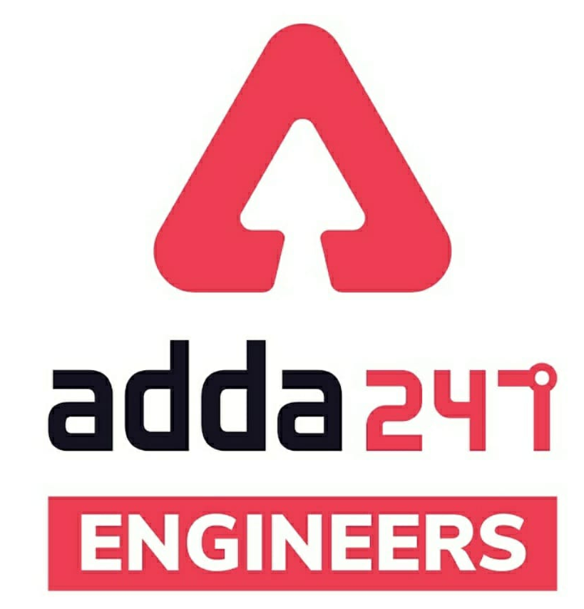
JSSC JE Exam 2023 | Mechanical Engineering | Most Expected Questions
Mechanical Soormas
Naresh Kr
Ritick Konwar
Ruby Prajapati
Pragya Srivastava
Dilip Gupta
Lokesh Varwan
Priyanshu Kushwaha
RaviRaj
Alok Kumar
Warif
Ajit Singh
Ankit Mongre
Subir
Mayur
Prashant Bhadauria
Ayush Suthar
Raj Yadav
Amarjyoti
Shivani Singh
Aashik Hussain
Chandrakant Raut
Sandeep Kumar Jha
Shahzad Ali
Anuj Kanoujiya
Mohit Kumar
Vikas Dev Pandey
Jitendra
Shubhi Tiwari
for
Code : “Y166”

Slide 5
JSSC JE Exam 2023 | Mechanical Engineering | Most Expected Questions
Mechanical Soormas
Pankaj Mahato
Pawan Singh Rana
Anil Gola
Rajat Bobde
Rupam Kumar
Narendra Sura
Konwledge Facts
Pintu Mahato
Shubham Gaur
Jignesh Shah
Ravindra Kumar Nirala
Rati Srivastava
Ajit Potbhare
for
Code : “Y166”

Slide 6
JSSC JE 2023 | Mechanical Engineers | Most Expected QuestionsSet-9
Mechanical Engineering
For 78% Discount
Use Code : “Y166”
For Complete theory and concepts join our Mahapack Batch, Use Code Y166 For 78% of Discount

Slide 7
2023 AE/JE Aspirants | List of all upcoming Vacancies | By Shivam Sir
For Complete theory and concepts join our Mahapack Batch, Use Code Y166 For 78% of Discount

Slide 8
JSSC JE 2023 | Mechanical Engineers | Most Expected QuestionsSet-10
Mechanical Engineering
Q. System in which No heat can transfer the boundary is known as!
Open system
Closed system
Can be both open and closed system
None of the above
For 78% Discount
Use Code : “Y166”
For Complete theory and concepts join our Mahapack Batch, Use Code Y166 For 78% of Discount

Slide 9
JSSC JE 2023 | Mechanical Engineers | Most Expected QuestionsSet-10
Mechanical Engineering
Q. Ratio of Weight density to mass density can be termed as-
Dimensionless Quantity
Acceleration due to gravity
Mass
Volume
For 78% Discount
Use Code : “Y166”
For Complete theory and concepts join our Mahapack Batch, Use Code Y166 For 78% of Discount

Slide 10
JSSC JE 2023 | Mechanical Engineers | Most Expected QuestionsSet-10
Mechanical Engineering
Q. PERT is Termed as-
Process Evolution and research Technique
Product Evaluation and review Technique
Product Evolution and review Technique
Process Evaluation and research Technique
For 78% Discount
Use Code : “Y166”
For Complete theory and concepts join our Mahapack Batch, Use Code Y166 For 78% of Discount

Slide 11
JSSC JE 2023 | Mechanical Engineers | Most Expected QuestionsSet-10
Mechanical Engineering
Q. The Slowest practically possible process is-
Quasistatic Process
Isothermal Process
Adiabatic Process
Isochoric Process
For 78% Discount
Use Code : “Y166”
For Complete theory and concepts join our Mahapack Batch, Use Code Y166 For 78% of Discount

Slide 12
JSSC JE 2023 | Mechanical Engineers | Most Expected QuestionsSet-10
Mechanical Engineering
Q. The Fastest practically possible process is_
Quasistatic Process
Isothermal Process
Adiabatic Process
Isochoric Process
For 78% Discount
Use Code : “Y166”
For Complete theory and concepts join our Mahapack Batch, Use Code Y166 For 78% of Discount

Slide 13
JSSC JE 2023 | Mechanical Engineers | Most Expected QuestionsSet-10
Mechanical Engineering
Q. The dimensions of Acceleration due to gravity are!
A. M¹L¹T⁻²
B. M⁻¹L¹T⁻²
C. M⁻¹L¹T²
D. None
For 78% Discount
Use Code : “Y166”
For Complete theory and concepts join our Mahapack Batch, Use Code Y166 For 78% of Discount

Slide 14
JSSC JE 2023 | Mechanical Engineers | Most Expected QuestionsSet-10
Mechanical Engineering
Q. The maximum magnitude of the unbalanced force acting along the perpendicular to the line of stroke is_
attractive force
(b) Centrifugal force
(c) hammer blow
(d) None of the given answer
For 78% Discount
Use Code : “Y166”
For Complete theory and concepts join our Mahapack Batch, Use Code Y166 For 78% of Discount

Slide 15
JSSC JE 2023 | Mechanical Engineers | Most Expected QuestionsSet-10
Mechanical Engineering
Q. The work output of theoretical Otto cycle!
(a) Increases with increase in compression ratio
(b) Increases with increase in pressure ratio
(c) Increases with increase in adiabatic index
(d) Follows all the above
For 78% Discount
Use Code : “Y166”
For Complete theory and concepts join our Mahapack Batch, Use Code Y166 For 78% of Discount

Slide 16
JSSC JE 2023 | Mechanical Engineers | Most Expected QuestionsSet-10
Mechanical Engineering
Q. For a four stroke diesel engine exhaust gas temperature.
(a) Increases with load
(b) Decreases with load
(c)Is constant throughout the variation of load
(d) No prediction is possible
For 78% Discount
Use Code : “Y166”
For Complete theory and concepts join our Mahapack Batch, Use Code Y166 For 78% of Discount

Slide 17
JSSC JE 2023 | Mechanical Engineers | Most Expected QuestionsSet-10
Mechanical Engineering
Q. For the same maximum pressure and temperature of Otto, diesel and duel combustion air standard cycles!
(a) the compression ratios will be the same
(b)the heat supplied to the cycles will be the same
(c)the air standard efficiency will have the same value
(d)the heat rejected by the engine will be the same
For 78% Discount
Use Code : “Y166”
For Complete theory and concepts join our Mahapack Batch, Use Code Y166 For 78% of Discount

Slide 18
JSSC JE 2023 | Mechanical Engineers | Most Expected QuestionsSet-10
Mechanical Engineering
Q. For same output, same speed and same compression ratio, the thermal efficiency of a two stroke cycle petrol engine as compared to that for four stroke cycle petrol engine is-
(a) more
(b) less
(c) same as long as compression ratio is same (d) same as long as output is same
For 78% Discount
Use Code : “Y166”
For Complete theory and concepts join our Mahapack Batch, Use Code Y166 For 78% of Discount

Slide 19
JSSC JE 2023 | Mechanical Engineers | Most Expected QuestionsSet-10
Mechanical Engineering
Q. For same power and same speed, the flywheel of a four-stroke engine as compared to two-stroke I.C. engine will be :-
(a) smaller
(b) bigger
(c) same size
(d) dependent on other engine parameters
For 78% Discount
Use Code : “Y166”
For Complete theory and concepts join our Mahapack Batch, Use Code Y166 For 78% of Discount

Slide 20
JSSC JE 2023 | Mechanical Engineers | Most Expected QuestionsSet-10
Mechanical Engineering
Q: Scavenging air in diesel engine means:!
(a) Air used for combustion sent under pressure
(b) Forced air for cooling cylinder
(c) Burnt air containing product of combustion
(d) Air used for forcing burnt gases out of engine
cylinder during the exhaust period.
For 78% Discount
Use Code : “Y166”
For Complete theory and concepts join our Mahapack Batch, Use Code Y166 For 78% of Discount

Slide 21
JSSC JE 2023 | Mechanical Engineers | Most Expected QuestionsSet-10
Mechanical Engineering
Q: A Gasoline engine running in a closed room is dangerous because the exhaust gas contains mainly _
(a) Blue Smoke
(b) Water Vapour
(c) Carbon mono oxide
(d) Carbon di Oxide
For 78% Discount
Use Code : “Y166”
For Complete theory and concepts join our Mahapack Batch, Use Code Y166 For 78% of Discount

Slide 22
JSSC JE 2023 | Mechanical Engineers | Most Expected QuestionsSet-9
Mechanical Engineering
For 78% Discount
Use Code : “Y166”
For Complete theory and concepts join our Mahapack Batch, Use Code Y166 For 78% of Discount

Slide 23
JSSC JE 2023 | Mechanical Engineers | Most Expected QuestionsSet-10
Mechanical Engineering
Q: Among the following the best insulator is-
(a) Ash
(b) Air
(c) Water
(d) Aluminium
For 78% Discount
Use Code : “Y166”
For Complete theory and concepts join our Mahapack Batch, Use Code Y166 For 78% of Discount

Slide 24
JSSC JE 2023 | Mechanical Engineers | Most Expected QuestionsSet-10
Mechanical Engineering
Q. Hydraulic jump is used for!
(a) Increasing the flow rate
(b) Reducing the flow rate
(c) Reducing the velocity of flow
(d) Reducing the energy of flow
For 78% Discount
Use Code : “Y166”
For Complete theory and concepts join our Mahapack Batch, Use Code Y166 For 78% of Discount

Slide 25
JSSC JE 2023 | Mechanical Engineers | Most Expected QuestionsSet-10
Mechanical Engineering
Q. Function of 'Spillways' is to:!
(a) It Provide structural stability to dam during reservoir flooding
(b) Provide safety during earthquakes
(c) Provide extra water during droughts
(d) All of these
For 78% Discount
Use Code : “Y166”
For Complete theory and concepts join our Mahapack Batch, Use Code Y166 For 78% of Discount

Slide 26
JSSC JE 2023 | Mechanical Engineers | Most Expected QuestionsSet-10
Mechanical Engineering
Q. A submerged weir is one in which the water level on the downstream of the weir is_
(a) Just at the crest level
(b) Below the crest level
(c) Is above the crest level
(d) At the same elevation as the upstream water
surface
For 78% Discount
Use Code : “Y166”
For Complete theory and concepts join our Mahapack Batch, Use Code Y166 For 78% of Discount

Slide 27
JSSC JE 2023 | Mechanical Engineers | Most Expected QuestionsSet-10
Mechanical Engineering
Q Which of the following head loss is significant in a pipe flow- ?
Loss of head due to gradual contraction
(b) Loss of head due to friction
(c) Loss of head due to sudden enlargement
(d) Loss of head due to sudden contraction
For 78% Discount
Use Code : “Y166”
For Complete theory and concepts join our Mahapack Batch, Use Code Y166 For 78% of Discount

Slide 28
JSSC JE 2023 | Mechanical Engineers | Most Expected QuestionsSet-10
Mechanical Engineering
Q. Energy grade line (EGL) represents the_
(a) Elevation head
(b) Pressure head + Elevation head
(c) Pressure head+Velocity head+Elevation head
(d) Pressure head + Velocity head
For 78% Discount
Use Code : “Y166”
For Complete theory and concepts join our Mahapack Batch, Use Code Y166 For 78% of Discount

Slide 29
JSSC JE 2023 | Mechanical Engineers | Most Expected QuestionsSet-10
Mechanical Engineering
Q. The velocity distribution at any section of pipe for steady laminar flow is-
(a) Laminar
(b) Parabolic
(c) Exponential
(d) Hyperbolic
For 78% Discount
Use Code : “Y166”
For Complete theory and concepts join our Mahapack Batch, Use Code Y166 For 78% of Discount

Slide 30
JSSC JE 2023 | Mechanical Engineers | Most Expected QuestionsSet-10
Mechanical Engineering
Q The laminar flow is characterized by_
(a) Existence of eddies
(b) Irregular motion of fluid particles
(c) Fluid particles moving in layers parallel to the
boundary surface
(d) Its space coordinates
For 78% Discount
Use Code : “Y166”
For Complete theory and concepts join our Mahapack Batch, Use Code Y166 For 78% of Discount

Slide 31
JSSC JE 2023 | Mechanical Engineers | Most Expected QuestionsSet-10
Mechanical Engineering
Q The laminar flow is characterized by_
(a) Existence of eddies
(b) Irregular motion of fluid particles
(c) Fluid particles moving in layers parallel to the
boundary surface
(d) Its space coordinates
For 78% Discount
Use Code : “Y166”
For Complete theory and concepts join our Mahapack Batch, Use Code Y166 For 78% of Discount

Slide 32
2023 AE/JE Aspirants | List of all upcoming Vacancies | By Shivam Sir
For Complete theory and concepts join our Mahapack Batch, Use Code Y166 For 78% of Discount

Slide 33
JSSC JE 2023 | Mechanical Engineers | Most Expected QuestionsSet-10
Mechanical Engineering
Q. Viscosity of liquid____.!
A. increases with decrease in temperature
B. decreases with increase in temperature
C. independent of temperature
D. Both A & B
For 78% Discount
Use Code : “Y166”
For Complete theory and concepts join our Mahapack Batch, Use Code Y166 For 78% of Discount

