Slide 1
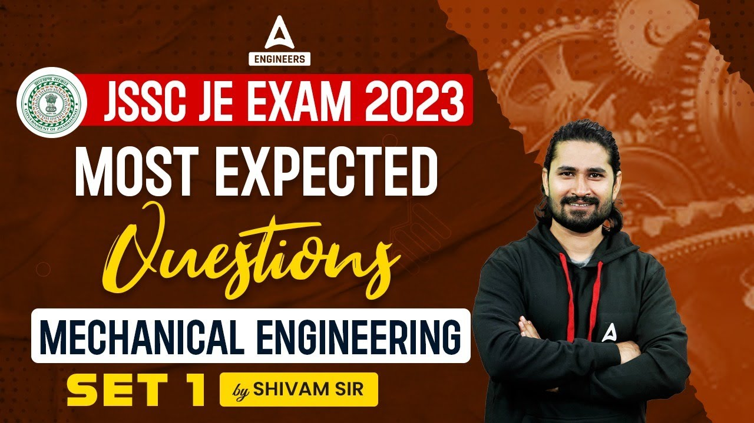
3

Slide 2


Slide 3


JSSC JE Exam 2023 | Mechanical Engineering | Most Expected Questions
Mechanical Engineering
Q. Automobile Steering gear is an example of!
Higher Pair
Sliding Pair
Turning pair
Lower pair
For 78% Discount
Use Code : “Y166”
For Complete theory and concepts join our Mahapack Batch, Use Code Y166 For 78% of Discount

Slide 4

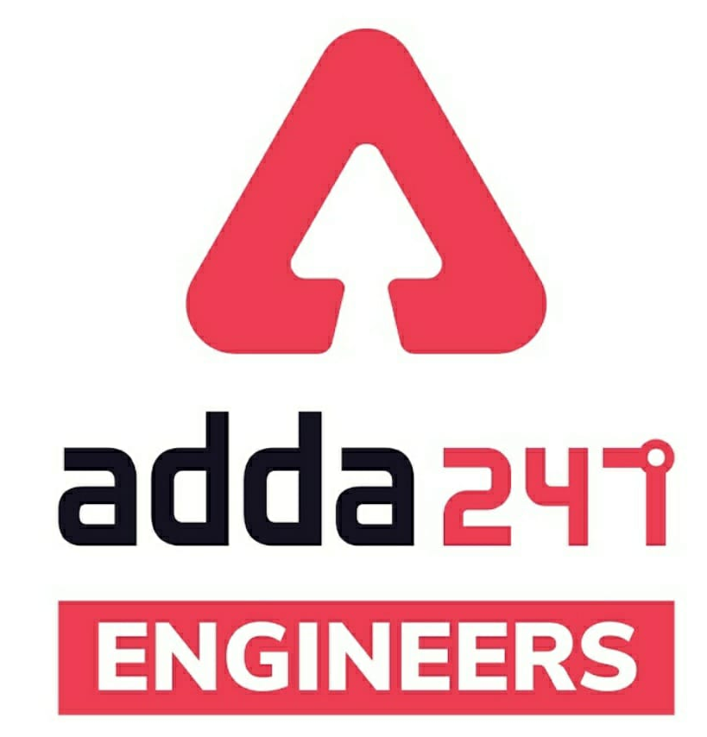

SSC JE Mechanical Previous Year Questions + Answers | Mechanical Engineering
Mechanical Soormas
Anuj Kanoujiya
Ajit Singh
Piyush Mechanical
Sahil Kumar
Saikurushna papulwar
Aman Kumar
Mechanical queen
Raj Yadav
Pankaj Mahato
Krutik Rana
Pragya Srivastava
Sandeep Kumar jha
Shivani Singh
Mechanical Queen
Dilip Gupta
Priyanshu Kushwaha
Anand Kumar
Ajaya Suna
Nitish Kumar
Nidha Zaman
Subir
Warif
Pannelal Kushwaha
Er. Firdous
Manadeep
Vikas Dev Pandey
Abhinav Arya
for
Code : “Y166”

Slide 5
SSC JE Mechanical Previous Year Questions + Answers | Mechanical Engineering
Mechanical Soormas
Mahesh Khodifad
Krishna
Shri Krishna
Ritika Saxena
Ajay Kumar
Shubhi Tiwari
Somnath Das
Kumari Manisha
Rajesh Rohila
Nandan Mehta
Kuntal Maji
Krishna India
Abhra Samanta
Om Prakash Chaurasiya
Ayush Suthar
Amar Jyoti
Narender Sura
Hardik Pal
Rahul R Pal
Kunal Kisku
for
Code : “Y166”

Slide 6

JSSC JE Exam 2023 | Mechanical Engineering | Most Expected Questions
Mechanical Engineering
For 78% Discount
Use Code : “Y166”
For Complete theory and concepts join our Mahapack Batch, Use Code Y166 For 78% of Discount

Slide 7
JSSC JE Exam 2023 | Mechanical Engineering | Most Expected Questions
Mechanical Engineering
Q. In Hydrostatic Bearing, Pressure to lubricant is supplied by.
External Sources
Partially external and partially from Rotation of Journal
Not Supplied by External Sorces
Shaft Driven Pump
For 78% Discount
Use Code : “Y166”
For Complete theory and concepts join our Mahapack Batch, Use Code Y166 For 78% of Discount

Slide 8
JSSC JE Exam 2023 | Mechanical Engineering | Most Expected Questions
Mechanical Engineering
Q. Moment of inertia of an area always least with respect to!
Bottom Most Axis
Radius of gyration
Vertical axis
Centroidal axis
For 78% Discount
Use Code : “Y166”
For Complete theory and concepts join our Mahapack Batch, Use Code Y166 For 78% of Discount

Slide 9
JSSC JE Exam 2023 | Mechanical Engineering | Most Expected Questions
Mechanical Engineering
Q. Shear Force at any point of the beam is the algebraic sum of_
All Vertical Forces
All Horizontal Forces
Forces on Either side of the point
Moment of forces on either side of the point
For 78% Discount
Use Code : “Y166”
For Complete theory and concepts join our Mahapack Batch, Use Code Y166 For 78% of Discount

Slide 10
JSSC JE Exam 2023 | Mechanical Engineering | Most Expected Questions
Mechanical Engineering
Q. The gas in the cooling chamber of a closed cycle gas turbine is cooled at_
Constant Volume
Constant Temperature
Constant Pressure
None of the above
For 78% Discount
Use Code : “Y166”
For Complete theory and concepts join our Mahapack Batch, Use Code Y166 For 78% of Discount

Slide 11
JSSC JE Exam 2023 | Mechanical Engineering | Most Expected Questions
Mechanical Engineering
Q. In an Electrolux Refrigerator!
Ammonia is absorbed in water
Ammonia is absorbed in hydrogen
Hydrogen is evaporated in ammonia
Ammonia is evaporated in hydrogen
For 78% Discount
Use Code : “Y166”
For Complete theory and concepts join our Mahapack Batch, Use Code Y166 For 78% of Discount

Slide 12
JSSC JE Exam 2023 | Mechanical Engineering | Most Expected Questions
Mechanical Engineering
Q. In Which of the following refrigeration system, waste heat can be effectively used-
Vapour Compression cycle
Vapour absorption cycle
Air Refrigeration cycle
None of the above
For 78% Discount
Use Code : “Y166”
For Complete theory and concepts join our Mahapack Batch, Use Code Y166 For 78% of Discount

Slide 13
JSSC JE Exam 2023 | Mechanical Engineering | Most Expected Questions
Mechanical Engineering
Q. The capillary tube, as an expansion device is used in!
Domestic refrigeration
Water cooler
Room air conditioners
All of these
For 78% Discount
Use Code : “Y166”
For Complete theory and concepts join our Mahapack Batch, Use Code Y166 For 78% of Discount

Slide 14
JSSC JE Exam 2023 | Mechanical Engineering | Most Expected Questions
Mechanical Engineering
Q. During dehumidification process,……………….remains constant_
Wet bulb temperature
Relative humidity
Dry bulb temperature
Specific humidity
For 78% Discount
Use Code : “Y166”
For Complete theory and concepts join our Mahapack Batch, Use Code Y166 For 78% of Discount

Slide 15
JSSC JE Exam 2023 | Mechanical Engineering | Most Expected Questions
Mechanical Engineering
Q. The shear stress-shear strain rate graph for a Newtonian fluid is a .
Straight line
Parabolic curve
Hyperbolic curve
elliptical
For 78% Discount
Use Code : “Y166”
For Complete theory and concepts join our Mahapack Batch, Use Code Y166 For 78% of Discount

Slide 16
JSSC JE Exam 2023 | Mechanical Engineering | Most Expected Questions
Mechanical Engineering
Q. The flow in a pipe is turbulent when Reynold number is!
Less than 2000
Between 2000 and 2800
Less than 4000
None of the above
For 78% Discount
Use Code : “Y166”
For Complete theory and concepts join our Mahapack Batch, Use Code Y166 For 78% of Discount

Slide 17
JSSC JE Exam 2023 | Mechanical Engineering | Most Expected Questions
Mechanical Engineering
Q. In a steady flow process,!
The rate of heat transfer is constant
The rate of work transfer is constant
The ratio of mass flow at inlet and outlet is same
All of these
For 78% Discount
Use Code : “Y166”
For Complete theory and concepts join our Mahapack Batch, Use Code Y166 For 78% of Discount

Slide 18
JSSC JE Exam 2023 | Mechanical Engineering | Most Expected Questions
Mechanical Engineering
Q. When a shaft is subjected to a twisting moment, every cross section of the shaft will be under_
Tensile stress
Compressive stress
Shear stress
Bending stress
For 78% Discount
Use Code : “Y166”
For Complete theory and concepts join our Mahapack Batch, Use Code Y166 For 78% of Discount

Slide 19
JSSC JE Exam 2023 | Mechanical Engineering | Most Expected Questions
Mechanical Engineering
Q. The columns whose slenderness ratio is less than 80, are known as.
Short Columns
Long columns
Weak columns
Medium columns
For 78% Discount
Use Code : “Y166”
For Complete theory and concepts join our Mahapack Batch, Use Code Y166 For 78% of Discount

Slide 20
JSSC JE Exam 2023 | Mechanical Engineering | Most Expected Questions
Mechanical Engineering
Q. Coefficient of friction depends upon-
Area of Contact only
Nature of surface only
Both a and b
None of the above
For 78% Discount
Use Code : “Y166”
For Complete theory and concepts join our Mahapack Batch, Use Code Y166 For 78% of Discount

Slide 21
JSSC JE Exam 2023 | Mechanical Engineering | Most Expected Questions
Mechanical Engineering
Q. Coefficient of friction depends upon-
Area of Contact only
Nature of surface only
Both a and b
None of the above
For 78% Discount
Use Code : “Y166”
For Complete theory and concepts join our Mahapack Batch, Use Code Y166 For 78% of Discount

Slide 22
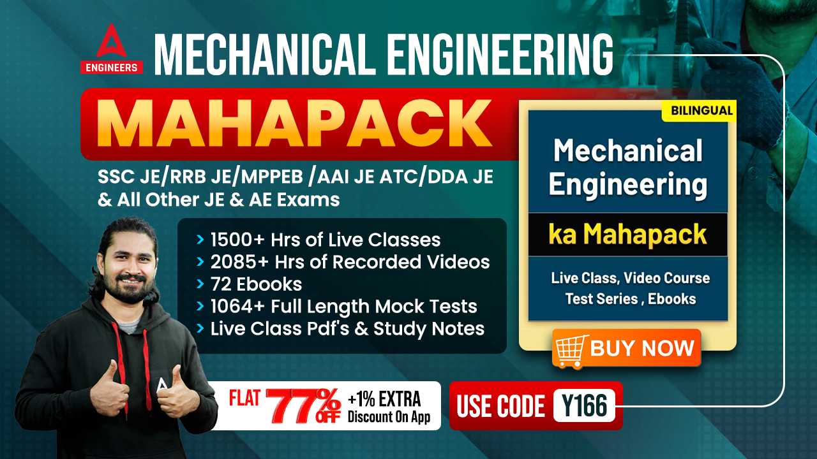

Slide 23
JSSC JE Exam 2023 | Mechanical Engineering | Most Expected Questions
Mechanical Engineering
HW. Heaviest fluid is _________--
A. Air
B. Castor oil
C. alcohol
D. Carbon tetrachloride
For 78% Discount
Use Code : “Y166”
For Complete theory and concepts join our Mahapack Batch, Use Code Y166 For 78% of Discount

