Slide 1


Slide 2


Slide 3


Slide 4





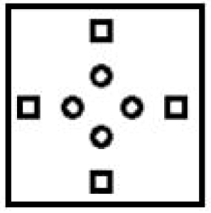
SSC JE 2023 | Reasoning Classes | By Abhishek Sir
Q1. The sequence of folding a piece of paper and the manner in which the folded paper has been cut is shown in the given figures. How would this paper look when unfolded? (SSC JE 2022)
(a) (b) (c) (d)

Slide 5
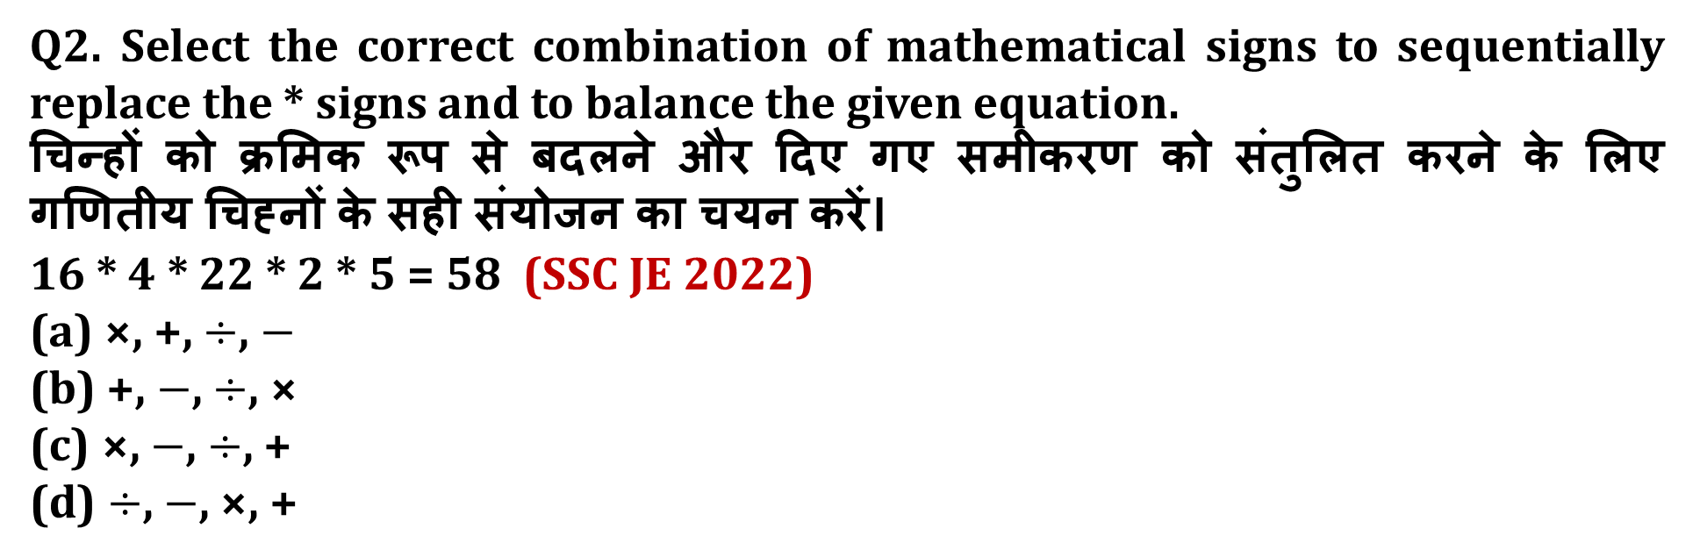
SSC JE 2023 | Reasoning Classes | By Abhishek Sir
Q2. Select the correct combination of mathematical signs to sequentially replace the * signs and to balance the given equation.
चिन्हों को क्रमिक रूप से बदलने और दिए गए समीकरण को संतुलित करने के लिए गणितीय चिह्नों के सही संयोजन का चयन करें।
16 * 4 * 22 * 2 * 5 = 58 (SSC JE 2022)
(a) ×, +, $÷$, $−$
(b) +, $−$, $÷$, ×
(c) ×, $−$, $÷$, +
(d) $÷$, $−$, ×, +

Slide 6




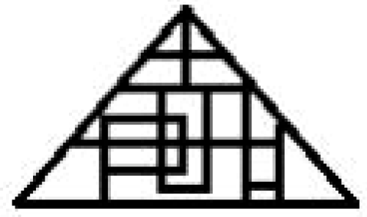
SSC JE 2023 | Reasoning Classes | By Abhishek Sir
Q3. Select the option in which the given figure is embedded (rotation is NOT allowed). (SSC JE 2022)
(a) (b) (c) (d)

Slide 7
SSC JE 2023 | Reasoning Classes | By Abhishek Sir
Q4. A little boy is performing on stage. Pointing to her, her father in the audience said to the woman sitting next to him, "That boy's grandmother's husband is also the husband of your husband's wife's daughter's grandmother." How is it related to the mother-in-law who is the father of the boy performing on the stage?एक छोटा लड़का मंच पर प्रदर्शन कर रहा है। उसकी ओर संकेत करते हुए, दर्शकों में बैठे उसके पिता ने बगल में बैठी महिला से कहा, ‘‘उस लड़के की नानी के पति, आपके पति की पत्नी की पुत्री की दादी के पति भी हैं।’’ दर्शकों में बेठी महिला का उस पुरुष की सास से क्या रिश्ता है जो मंच पर प्रदर्शन करने वाले लड़के का पिता है? (SSC JE 2022)
(a) पुत्री
(b) बहू
(c) भाभी/साली
(d) पोती/नाती

Slide 8
SSC JE 2023 | Reasoning Classes | By Abhishek Sir
Q5. Mangesh bought a bicycle from a shop. He sold it to Ragini and earned a profit of 12%. Ragini further sold it to Kartik for Rs. 5362.56 and earned a profit of 14%. At what price did Mangesh buy the bicycle from the shop? मंगेश ने एक दुकान से साइकिल खरीदी। उसने इसे रागिनी को बेच दिया और 12% का लाभ अर्जित किया। रागिनी ने इसे आगे कार्तिक को रुपये में बेच दिया। 5362.56 और 14% का लाभ कमाया। मंगेश ने दुकान से साइकिल किस कीमत पर खरीदी?(SSC JE 2022)
(a) Rs. 4200
(b) Rs. 4956
(c) Rs. 4000
(d) Rs. 4800

Slide 9
SSC JE 2023 | Reasoning Classes | By Abhishek Sir
Q6. Select the option that is related to the third number in the same way as the second number related to the first number.
18 : 306 : : 23 : ? (SSC JE 2022)
(a) 506
(b) 509
(c) 508
(d) 507

Slide 10
SSC JE 2023 | Reasoning Classes | By Abhishek Sir
Q7. Choose the pair that best represents a similar relationship to the one expressed in the original of words.
Seismograph : Earthquakes (SSC JE 2022)
(a) Hygrometer : Torque
(b) Viscometer : Elasticity
(c) Fathometer : Gravity
(d) Udometer : Rain

Slide 11
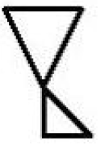
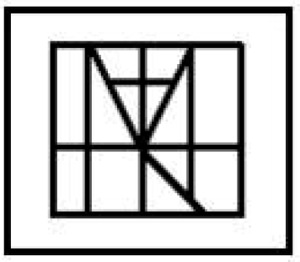

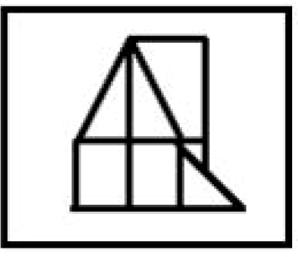

SSC JE 2023 | Reasoning Classes | By Abhishek Sir
Q8. Select the option in which the given figure is embedded (rotation is NOT allowed). (SSC JE 2022)
(a) (b) (c) (d)

Slide 12
SSC JE 2023 | Reasoning Classes | By Abhishek Sir
Q9. Select the option that is related to the third term in the same way as the second term is related to the first term.
INCOME : MHNBDL : : FORMAT : ? (SSC JE 2022)
(a) BQEDJY
(b) NZXEWQ
(c) NELQSZ
(d) JHMDBK

Slide 13
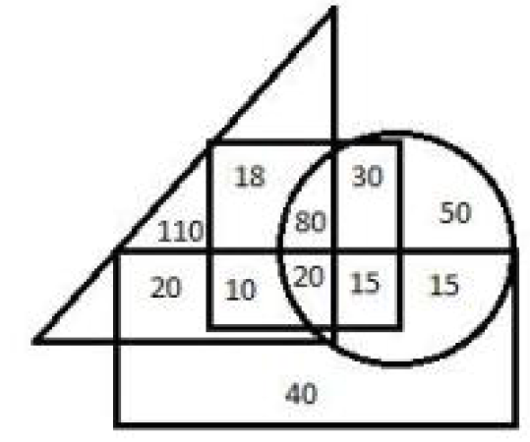
SSC JE 2023 | Reasoning Classes | By Abhishek Sir
Q10. The following diagram shows the information collected from a survey in Teachers Colony regarding the social status. The triangle represents families having an AC, the circle represents families having a laptop, the rectangle represents families having car, and the square represents families having a scooter. (SSC JE 2022)
Find the number of families that have a laptop and scooter both, but neither an AC nor a car.
(a) 15 (b) 8
(c) 50 (d) 30

Slide 14
SSC JE 2023 | Reasoning Classes | By Abhishek Sir
Q11. Which number will replace the question mark (?) in the following series.
3, 8, 13, 21, 61, 108, ? (SSC JE 2022)
(a) 513
(b) 351
(c) 315
(d) 531

Slide 15





SSC JE 2023 | Reasoning Classes | By Abhishek Sir
Q12. Select the option in which the given figure is embedded (rotation is NOT allowed).
(SSC JE 2022)
(a) (b) (c) (d)

Slide 16
SSC JE 2023 | Reasoning Classes | By Abhishek Sir
Q13. Study the given pattern carefully and select the number that can replace the question mark (?) in it.
12 24 26
30 31 42
48 38 ? (SSC JE 2022)
(a) 46
(b) 58
(c) 56
(d) 48

Slide 17
SSC JE 2023 | Reasoning Classes | By Abhishek Sir
Q14. Select the option in which the words share the same relationship as that shared by the given pair of words.
Reptiles : Crocodiles (SSC JE 2022)
(a) Amphibians : Crows
(b) Fishes : Water
(c) Mammals : Tigers
(d) Kangaroos : Mollusks

Slide 18
SSC JE 2023 | Reasoning Classes | By Abhishek Sir
Q15. Select the correct option that indicates the arrangement of the given words in a logical and meaningful order.
1. Attending webinar
2. e-Certificate
3. Notification
4. Feedback
5. Registration (SSC JE 2022)
(a) 3, 1, 4, 5, 2
(b) 3, 5, 2, 1, 4
(c) 3, 1, 5, 4, 2
(d) 3, 5, 1, 4, 2

Slide 19
SSC JE 2023 | Reasoning Classes | By Abhishek Sir
Q16. Select the option that is related to the third number in the same way as the second number is related to the first number.
12 : 138 : : 14 : ? (SSC JE 2022)
(a) 163
(b) 187
(c) 189
(d) 191

Slide 20
SSC JE 2023 | Reasoning Classes | By Abhishek Sir
Q17. Select the letter – cluster from among the given options that can replace the question mark (?) in the following series.
HOX, INZ, JMB, KLD, ? (SSC JE 2022)
(a) LME
(b) LGG
(c) PKF
(d) LKF

Slide 21
SSC JE 2023 | Reasoning Classes | By Abhishek Sir
Q18. Two statements are given, followed by four conclusions numbered I, II, III, IV.
Assuming that the information given in the statements is true, even if it appears to be at variance with commonly known facts, decide which of the given conclusions logically follow(s) from the statements. (SSC JE 2022)
Statements:
1. No lotion is a syrup.
2. All syrups are liquids.
Conclusions:
I. No lotion is a liquid.
II. No liquid is a lotion.
III. Some liquids are syrups.
IV. All liquids are syrups.
(a) Only conclusion I follows
(b) Both conclusions I and IV follow
(c) Both conclusions I and II follow
(d) Only conclusion III follows

Slide 22
SSC JE 2023 | Reasoning Classes | By Abhishek Sir
Q19. Select the option that is related to the third letter – cluster in the same way as the second letter – cluster is related to the first letter – cluster.
PRIMER : IRPREM : CANDLE : ? (SSC JE 2022)
(a) CDEALN
(b) ELDNAC
(c) ACNDEL
(d) NACELD

Slide 23
SSC JE 2023 | Reasoning Classes | By Abhishek Sir
Q20. Seven years from now, Arun will be as old as Bidan was 4 years ago. Charan was born 2 years ago. After 10 years the average age of Arun, Bidan and Charan will be 33 years. What is the present age of Arun?
अब से सात वर्ष बाद, अरुण की उम्र उतनी होगी जितनी उम्र बिडान की 4 वर्ष पहले थी। चरण का जन्म 2 वर्ष पहले हुआ था। 10 वर्ष बाद अरुण, बिडान और चरण की औसत आयु 33 वर्ष होगी। अरुण की वर्तमान आयु कितनी है? (SSC JE 2022)
(a) 28 वर्ष
(b) 30 वर्ष
(c) 29 वर्ष
(d) 31 वर्ष

Slide 24
SSC JE 2023 | Reasoning Classes | By Abhishek Sir
Q21. Select the option that is correct for the bracketed letters with respect to their inclusion in the given series.
D, 4, F, 8, F, J, 12, (K), P, 16, P, X, 20, U, H, 24, (Y) (SSC JE 2022)
(a) Both the bracketed letters are incorrect.
(b) The first bracketed letter is incorrect and the second bracketed letter is correct.
(c) The first bracketed letter is correct and the second bracketed letter is incorrect.
(d) Both the bracketed letters are correct.

Slide 25
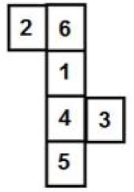
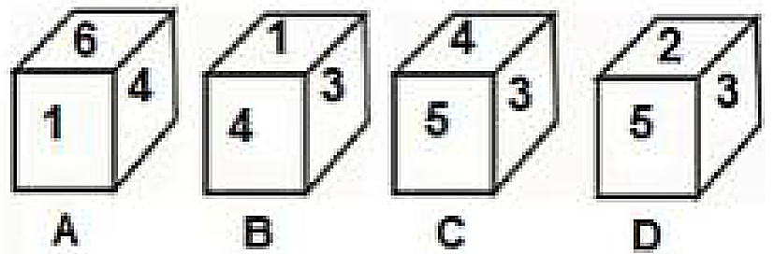
SSC JE 2023 | Reasoning Classes | By Abhishek Sir
Q22. Select the dice (from among the figures A, B, C and D) that can be formed by folding the given sheet along the lines.
(SSC JE 2022)
(a) Only A, B and C
(b) Only B, C and D
(c) Only B and C
(d) Only A and B

Slide 26
SSC JE 2023 | Reasoning Classes | By Abhishek Sir
Q23. ‘Osteoporosis’ is related to ‘Bones’ in the same way as ‘Vitiligo’ is related to ‘__________’.
ऑस्टियोपोरोसिस' 'हड्डियों' से उसी तरह संबंधित है जैसे 'विटिलिगो' '__________' से संबंधित है। (SSC JE 2022)
(a) Kidney
(b) Heart
(c) Brain
(d) Skin

Slide 27
SSC JE 2023 | Reasoning Classes | By Abhishek Sir
Q24. Read the given statements and conclusions carefully. Assuming that the information given in the statements is true, even if it appears to be at variance with commonly known facts, decide which of the given conclusions logically follow(s) from the statement s.
Statement s:
1. All balls are plastics items.
2. All utensils are balls.
Conclusions:
I. All utensils are plastic items.
II. Some balls are not plastic items.
(SSC JE 2022)
(a) Both conclusions I and II follow
(b) Only conclusion II follows
(c) Only conclusion I follows
(d) Neither conclusion I nor II follows

Slide 28
SSC JE 2023 | Reasoning Classes | By Abhishek Sir
Q25. Select the option that is related to the third term in the same way as the second term is related to the first term.
SMART : MSTTR : : CROWN : ? (SSC JE 2022)
(a) NWHRC
(b) RCHNW
(c) WNHCR
(d) CRHNW

Slide 29
SSC JE 2023 | Reasoning Classes | By Abhishek Sir
Q26. Spade' is related to 'digging' and 'scissors' is related to 'shearing' in the same way as 'scythe' is related to '-----’.
‘कुदाल’, ‘खुदाई’ से और ‘कैंची’, ‘कर्तन (कटाई)’ से उसी प्रकार संबंधित हैं, जिस प्रकार ‘दराँती’, ‘------’ से संबंधित है। (SSC JE 2022)
(a) फसल कटाई
(b) सिलाई
(c) सिंचाई
(d) मापन

Slide 30
SSC JE 2023 | Reasoning Classes | By Abhishek Sir
Q27. Select the correct option that indicates the arrangement of the given words in the order in which they appear in an English dictionary.
1. Never
2. Nervous
3. Nicotine
4. Navigation
5. Neptune (SSC JE 2022)
(a) 4, 2. 5, 1, 3
(b) 4, 2, 1, 5, 3
(c) 4, 5, 1, 2, 3
(d) 4, 5, 2, 1, 3

Slide 31
SSC JE 2023 | Reasoning Classes | By Abhishek Sir
Q28. In a certain code language, AVENUE is written as ZQVIFZ and VOYAGE is written as EJBVT Z. How will EDIT OR be writ ten in that language?
एक निश्चित कूट भाषा में AVENUE को ZQVIFZ और VOYAGE को EJBVT Z लिखा जाता है। उस भाषा में EDIT OR को राइट टेन कैसे लिखा जाएगा? (SSC JE 2022)
(a) VYSOLN
(b) VYROLM
(c) UYOSNL
(d) UYROPM

Slide 32
SSC JE 2023 | Reasoning Classes | By Abhishek Sir
Q29. Select the correct option, which indicates the logical and meaningful sequence of the given word arrangement.
1. rectangle
2. Octagon
3. dodecahedron
4. Triangle
5. decagon (SSC JE 2022)
(a) 4, 2, 1, 5, 3
(b) 4, 3, 1, 2, 5
(c) 4, 1, 2, 5, 3
(d) 4, 1, 2, 3, 5

Slide 33
SSC JE 2023 | Reasoning Classes | By Abhishek Sir
Q30. Which letter will replace the question mark (?) in the following series?
M, H, E, Z, W, R, O, ? (SSC JE 2022)
(a) N
(b) J
(c) M
(d) K

Slide 34
SSC JE 2023 | Reasoning Classes | By Abhishek Sir
Q31. Which two signs should be interchanged to make the given equation correct ?
266 ÷ 7 + 2 − 80 × 13 = 9 (SSC JE 2022)
(a) − and ÷
(b) + and ×
(c) + and −
(d) × and ÷

Slide 35
SSC JE 2023 | Reasoning Classes | By Abhishek Sir
Q32. In a family of six persons, A, B, C, D, E and F, C is the father of B. A is the mother of F. D is the son of B. E is the mother-in-law of B’s wife. F is the sister of D. How is C related to E?
A, B, C, D, E और F छह व्यक्तियों के एक परिवार में, C, B का पिता है। A, F की माँ है। D, B का पुत्र है। E, B की सास है। पत्नी। F, D की बहन है। C, E से किस प्रकार संबंधित है?
(SSC JE 2022)
(a) Father
(b) Mother
(c) Husband
(d) Wife

Slide 36
SSC JE 2023 | Reasoning Classes | By Abhishek Sir
Q33. If MALICE is coded as 116 and NORMAL is coded as 87, then how will OMINOUS be coded?
यदि MALICE को 116 के रूप में कोडित किया जाता है और NORMAL को 87 के रूप में कोडित किया जाता है, तो OMINOUS को कैसे कोडित किया जाएगा?(SSC JE 2022)
(a) 81
(b) 80
(c) 79
(d) 82

Slide 37
SSC JE 2023 | Reasoning Classes | By Abhishek Sir
Q34. Which letter cluster will replace the question mark (?) in the following series?
FKKP, IOOU, LSSZ, OWWE, ? (SSC JE 2022)
(a) RAZA
(b) ZARA
(c) RAAJ
(d) ZAAR

Slide 38
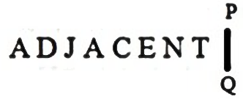
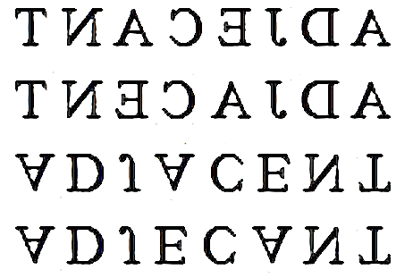
SSC JE 2023 | Reasoning Classes | By Abhishek Sir
Q35. Select the correct mirror image of the given combination when the mirror is placed at ‘PQ’ as shown.
(SSC JE 2022)
(a)
(b)
(c)
(d)

Slide 39
SSC JE 2023 | Reasoning Classes | By Abhishek Sir
Q36. Select the option that is related to the third number in the same way as the second number is related to the first number.
13 : 26 : : 14 : ? (SSC JE 2022)
(a) 36
(b) 33
(c) 31
(d) 30

Slide 40
SSC JE 2023 | Reasoning Classes | By Abhishek Sir
Q37. In a certain code language, MOTHER is written as TGJVQO. How will SHOULD be written in that language?
एक निश्चित कोड भाषा में, MOTHER को TGJVQO लिखा जाता है। उस भाषा में कैसे लिखा जाएगा?(SSC JE 2022)
(a) FOVQKU
(b) UIQXMG
(c) FNWQJU
(d) UJQWNF

Slide 41
SSC JE 2023 | Reasoning Classes | By Abhishek Sir
Q38. A student walked 110 m to the East to look for his class teacher, and then he turned right and walked 40 m. Then he turned right again, and after walking 50 m he reached his class teacher’s staff room. His class teacher was not there. From there he walked 120 m to his north and met his class teacher. How far from the starting point did he meet his class teacher? (SSC JE 2022)
(a) 80 m
(b) 100 m
(c) 260 m
(d) 120 m
एक छात्र अपने कक्षा शिक्षक को देखने के लिए 110 मीटर पूर्व की ओर चलता है, और फिर वह दायें मुड़ता है और 40 मीटर चलता है। फिर वह फिर दाएँ मुड़ा और 50 मीटर चलने के बाद अपने क्लास टीचर के स्टाफ़ रूम में पहुँचा। उनके क्लास टीचर वहां नहीं थे। वहां से वह अपने उत्तर की ओर 120 मीटर चला और अपने क्लास टीचर से मिला। वह प्रारंभिक स्थान से अपने कक्षा शिक्षक से कितनी दूर पर मिला?

Slide 42
SSC JE 2023 | Reasoning Classes | By Abhishek Sir
Q38. A student walked 110 m to the East to look for his class teacher, and then he turned right and walked 40 m. Then he turned right again, and after walking 50 m he reached his class teacher’s staff room. His class teacher was not there. From there he walked 120 m to his north and met his class teacher. How far from the starting point did he meet his class teacher? (SSC JE 2022)
(a) 80 m
(b) 100 m
(c) 260 m
(d) 120 m

Slide 43
SSC JE 2023 | Reasoning Classes | By Abhishek Sir
Q39. Kamal is 82 m north-west of Sarika. If Murali is 82 m north-east of Sarika, then Murali is in which direction with respect to Kamal?
कमल, सारिका से 82 मीटर उत्तर-पश्चिम में है। यदि मुरली सारिका से 82 मीटर उत्तर-पूर्व में है, तो कमल के सन्दर्भ में मुरली किस दिशा में है?(SSC JE 2022)
(a) East
(b) West
(c) North
(d) South-East

Slide 44
SSC JE 2023 | Reasoning Classes | By Abhishek Sir
Q40. Which letter cluster will replace the question mark (?) in the following series?
MASTERMIND, NSTJMMIA, ITOHMS, ? (SSC JE 2022)
(a) MTTC
(b) MTCT
(c) MCTC
(d) MCTT

Slide 45
SSC JE 2023 | Reasoning Classes | By Abhishek Sir
Q41. If SINK is coded as 49 and CRAFT is coded as 43, then how will PRINT be coded?
यदि SINK को 49 के रूप में कोडित किया जाता है और CRAFT को 43 के रूप में कोडित किया जाता है, तो PRINT को कैसे कोडित किया जाएगा?(SSC JE 2022)
(a) 73
(b) 72
(c) 77
(d) 75

Slide 46
SSC JE 2023 | Reasoning Classes | By Abhishek Sir
Q42. Select the number from among the given options that can replace the question mark (?) in the following series.
43, 57, 72, ?, 105, 123 (SSC JE 2022)
(a) 83
(b) 102
(c) 78
(d) 88

Slide 47


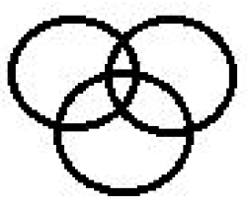

SSC JE 2023 | Reasoning Classes | By Abhishek Sir
Q43. Select the Venn diagram that best illustrates the relationship between the given classes.
Rabbit, Animals, Lion (SSC JE 2022)
(a) (b) (c) (d)

Slide 48
SSC JE 2023 | Reasoning Classes | By Abhishek Sir
Q44. Select the option that has the same relationship between the words as the relationship between the words in the given pair.
believer : atheist
आस्तिक : नास्तिक (SSC JE 2022)
(a) पुलिस : थल सेना
(b) खतरनाक : सुरक्षित
(c) स्वादिष्ट : स्वादपूर्ण
(d) आनंददायक : प्रीतिकर

Slide 49
SSC JE 2023 | Reasoning Classes | By Abhishek Sir
Q45. विभिन्न देशें के छः प्रतिनिधित एक गोल मेज के परितः एक - दूसरे के विकर्णीय रुप से सम्मुख बैठे थे। भारतीय प्रतिनिधित, रुसी प्रतिनिधि के दाईं ओर था, लेकिन वह अमेरिकी प्रतिनिधि के बाई ओर था। ऑस्ट्रेलियाई प्रतिनिधित ठीक भारतीय प्रतिनिधि के सम्मुख था, लेकिन वह दक्षिण अफ्रीकी प्रतिनिधि के दाई ओर और कनाडा के प्रतिनिधि के बाईं ओर था। दक्षिण अफ्रीकी प्रतिनिधित के ठीक सम्मुख कौन सा प्रतिनिधि बैठा था? (SSC JE 2022)
(a) कनाडा का प्रतिनिधि
(b) ऑस्ट्रेलियाई प्रतिनिधि
(c) भारतीय प्रतिनिधि
(d) रुसी प्रतिनिधि
Six representatives of different countries were sitting around a round table facing each other diagonally. The Indian delegate was to the right of the Russian delegate, but he was to the left of the American delegate. The Australian representative was directly opposite the Indian representative, but to the right of the South African representative and to the left of the Canadian representative. Which representative was sitting exactly opposite to the South African representative?

Slide 50
SSC JE 2023 | Reasoning Classes | By Abhishek Sir
Six representatives of different countries were sitting around a round table facing each other diagonally. The Indian delegate was to the right of the Russian delegate, but he was to the left of the American delegate. The Australian representative was directly opposite the Indian representative, but to the right of the South African representative and to the left of the Canadian representative. Which representative was sitting exactly opposite to the South African representative?
(a) कनाडा का प्रतिनिधि
(b) ऑस्ट्रेलियाई प्रतिनिधि
(c) भारतीय प्रतिनिधि
(d) रुसी प्रतिनिधि

Slide 51
SSC JE 2023 | Reasoning Classes | By Abhishek Sir
Q46. Arpita, Gagan, Nitin, Varsha, Shreay and Shahid are sitting in a straight line facing the north. Nitin is to the immediate left of Gagan. Shreya is between Arpit a and Shahid. Shahid is at the second place from the right end. Four persons are sitting between Nitin and Varsha. Who is sitting between Varsha and Shreya?
अर्पिता, गगन, नितिन, वर्षा, श्रेय और शाहिद एक सीधी रेखा में उत्तर की ओर मुख करके बैठे हैं। नितिन, गगन के ठीक बायें है। श्रेया, अर्पित और शाहिद के बीच में है। शाहिद दायें छोर से दूसरे स्थान पर है। नितिन और वर्षा के बीच चार व्यक्ति बैठे हैं। वर्षा और श्रेया के मध्य कौन बैठा है?(SSC JE 2022)
(a) Arpita
(b) Nitin
(c) Gagan
(d) Shahid

Slide 52
SSC JE 2023 | Reasoning Classes | By Abhishek Sir
Q47. ‘Cardiology’ is related to ‘Heart’ in the same way as ‘Phonetics’ is related to ‘_________’.
कार्डियोलॉजी' 'हृदय' से उसी तरह संबंधित है जैसे 'फोनेटिक्स' '________' से संबंधित है।(SSC JE 2022)
(a) Insects
(b) Heredity
(c) Phones
(d) Sound

Slide 53
SSC JE 2023 | Reasoning Classes | By Abhishek Sir
Q48. Which number will replace the question mark (?) in the following series.
32, 33, 29, 38, 22, 47, 11, ? (SSC JE 2022)
(a) 40
(b) 45
(c) 60
(d) 55

Slide 54
SSC JE 2023 | Reasoning Classes | By Abhishek Sir
Q49. Select the correct option, which indicates the arrangement of the given words in a logical and meaningful order.(SSC JE 2022)
1. Admission
2. Attendance in class
3. Entrance Exam
4. Reporting in the Department
5. Merit List
(a) 3, 5, 1, 4, 2
(b) 3, 1, 2, 5, 4
(c) 3, 5, 2, 1, 4
(d) 3, 1, 5, 2, 4

Slide 55
SSC JE 2023 | Reasoning Classes | By Abhishek Sir
Q50. Select the option in which the numbers are related in the same way as are the numbers in the given set.
(8, 3, 21)(SSC JE 2022)
(a) (5, 7, 33)
(b) (9, 4, 27)
(c) (6, 3, 18)
(d) (5, 7, 23)

Slide 56


