Slide 1
2

Slide 3
JSSC JE Exam 2023 | Mechanical Engineering | Most Expected Questions
Mechanical Engineering
Q. Following equipment are used in arc welding of material by the use of carbon electrode!
(a) AC Welding set
(b) Rectifier
(c) Motor Generator
(d) DC Welding set with straight polarity
For 78% Discount
Use Code : “Y166”
For Complete theory and concepts join our Mahapack Batch, Use Code Y166 For 78% of Discount

Slide 4
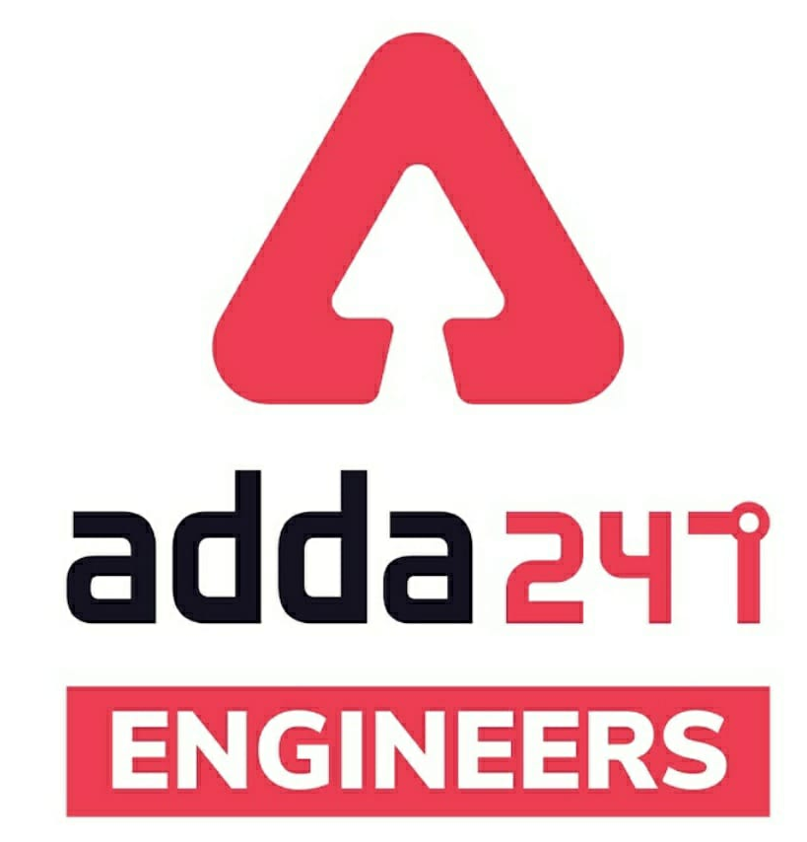
SSC JE Mechanical Previous Year Questions + Answers | Mechanical Engineering
Mechanical Soormas
Sahil Kumar
Lokesh Varwan
Priyanshu Kushwaha
Amit Kumar
Anuj Kanoujiya
Aman Kumar
Shri Krishna
Pragya Srivastava
Ramen Ghosh
Nitish Kumar
Dilip Gupta
Aashik Hussain
Shivani Singh
Mechanical Queen
Mechanical Warrior
Sanajit Jana
Pannelal Kushwaha
Nidha Zamen
Ruby Prajapati
Warif
Raj Yadav
Manadeep
Shubhi Tiwari
Mahesh Khodifad
Ritika Saxena
Kuntal Maji
Rajesh Rohila
Subir
for
Code : “Y166”

Slide 5
SSC JE Mechanical Previous Year Questions + Answers | Mechanical Engineering
Mechanical Soormas
Amar Jyoti
Kunal Kisku
Karishna India
Ajay Kumar
Pankaj Mahato
Pintu Mahato
for
Code : “Y166”

Slide 6
JSSC JE Exam 2023 | Mechanical Engineering | Most Expected Questions
Mechanical Engineering
For 78% Discount
Use Code : “Y166”
For Complete theory and concepts join our Mahapack Batch, Use Code Y166 For 78% of Discount

Slide 7
JSSC JE Exam 2023 | Mechanical Engineering | Most Expected Questions
Mechanical Engineering
Q. Welding of stainless steel is generally difficult because of_
(a) Rust Formation takes place
(b) High Melting Temperature of stainless steel
(c) Formation of oxide film
(d) fear of cracking
For 78% Discount
Use Code : “Y166”
For Complete theory and concepts join our Mahapack Batch, Use Code Y166 For 78% of Discount

Slide 8
JSSC JE Exam 2023 | Mechanical Engineering | Most Expected Questions
Mechanical Engineering
Q. For welding metals less than 5 mm thick, following method of gas welding would give best results.
(a) forehand
(b) backhand
(c) Straight hand
(d) inclined hand
For 78% Discount
Use Code : “Y166”
For Complete theory and concepts join our Mahapack Batch, Use Code Y166 For 78% of Discount

Slide 9
JSSC JE Exam 2023 | Mechanical Engineering | Most Expected Questions
Mechanical Engineering
Q. Hobbing process is not suitable for cutting following type of gear!
(a) spur
(b) helical
(c) worm
(d) bevel
For 78% Discount
Use Code : “Y166”
For Complete theory and concepts join our Mahapack Batch, Use Code Y166 For 78% of Discount

Slide 10
JSSC JE Exam 2023 | Mechanical Engineering | Most Expected Questions
Mechanical Engineering
Q. Hobbing process is faster than milling because!
(a) Indexing time is less
(b) hob rotates faster
(c) work rotates faster
(d) several teeth cut at a time
For 78% Discount
Use Code : “Y166”
For Complete theory and concepts join our Mahapack Batch, Use Code Y166 For 78% of Discount

Slide 11
JSSC JE Exam 2023 | Mechanical Engineering | Most Expected Questions
Mechanical Engineering
Q. When venturimeter is inclined, !\then for a given flow it will show_
(a) Less reading
(b) more reading
(c) same reading
(d) inaccurate reading
For 78% Discount
Use Code : “Y166”
For Complete theory and concepts join our Mahapack Batch, Use Code Y166 For 78% of Discount

Slide 12
JSSC JE Exam 2023 | Mechanical Engineering | Most Expected Questions
Mechanical Engineering
Q. Grey Cast Iron is usually welded by.
(a) Gas Welding
(b) Resistance Welding
(c) Arc Welding
(d) Tig Welding
For 78% Discount
Use Code : “Y166”
For Complete theory and concepts join our Mahapack Batch, Use Code Y166 For 78% of Discount

Slide 13
JSSC JE Exam 2023 | Mechanical Engineering | Most Expected Questions
Mechanical Engineering
Q. Grey Cast Iron is usually welded by.
(a) Gas Welding
(b) Resistance Welding
(c) Arc Welding
(d) Tig Welding
For 78% Discount
Use Code : “Y166”
For Complete theory and concepts join our Mahapack Batch, Use Code Y166 For 78% of Discount

Slide 14
JSSC JE Exam 2023 | Mechanical Engineering | Most Expected Questions
Mechanical Engineering
Q : Which of the following are true for high carbon steels -?
(a) Carbon content =0.2%
(b) Respond readily to heat treatments
(c) Have much ductility as compared to low and medium carbon steels
(d) Easy to weld
For 78% Discount
Use Code : “Y166”
For Complete theory and concepts join our Mahapack Batch, Use Code Y166 For 78% of Discount

Slide 15
JSSC JE Exam 2023 | Mechanical Engineering | Most Expected Questions
Mechanical Engineering
Q. A piezometer can’t be used for pressure measurement in pipes when____ _
A. Pressure is very low
B. Velocity is high
C. Fluid in the pipe is a gas
D. Fluid is highly viscous
For 78% Discount
Use Code : “Y166”
For Complete theory and concepts join our Mahapack Batch, Use Code Y166 For 78% of Discount

Slide 16
JSSC JE Exam 2023 | Mechanical Engineering | Most Expected Questions
Mechanical Engineering
Q. If no resistance is encountered by displacement, such a substance is known as_______--
A. fluid
B. water
C. gas
D. ideal fluid
For 78% Discount
Use Code : “Y166”
For Complete theory and concepts join our Mahapack Batch, Use Code Y166 For 78% of Discount

Slide 17
JSSC JE Exam 2023 | Mechanical Engineering | Most Expected Questions
Mechanical Engineering
Q. Specific gravity is defined as the ratio of density of fluid and density of water at which temperature (in °K)--?
A. 0
B. 273.16
C. 277.16
D. 277.15
For 78% Discount
Use Code : “Y166”
For Complete theory and concepts join our Mahapack Batch, Use Code Y166 For 78% of Discount

Slide 18
JSSC JE Exam 2023 | Mechanical Engineering | Most Expected Questions
Mechanical Engineering
Q. On increasing the temperature The viscosity of a Fluid ________!
A. decreases
B. increases
C. is independent of temperature
D. Cant say anything
For 78% Discount
Use Code : “Y166”
For Complete theory and concepts join our Mahapack Batch, Use Code Y166 For 78% of Discount

Slide 19
JSSC JE Exam 2023 | Mechanical Engineering | Most Expected Questions
Mechanical Engineering
Q. For a governor running at a constant speed, what is the value of the force acting on the sleeve.?
A. Zero
B. Variable depending upon the load
C. Maximum
D. Minimum
For 78% Discount
Use Code : “Y166”
For Complete theory and concepts join our Mahapack Batch, Use Code Y166 For 78% of Discount

Slide 20
JSSC JE Exam 2023 | Mechanical Engineering | Most Expected Questions
Mechanical Engineering
Q. The Function of a washer is!
A. Providing smooth surface in place of rough surface
B. To provide cushioning effect
C. To absorb shocks and vibrations
D. To provide bearing area
For 78% Discount
Use Code : “Y166”
For Complete theory and concepts join our Mahapack Batch, Use Code Y166 For 78% of Discount

Slide 21
JSSC JE Exam 2023 | Mechanical Engineering | Most Expected Questions
Mechanical Engineering
Q. The Valve rod in a steam engine is connected to an eccentric rod by_
A. Cotter Joint
B. Bolted Joint
C. Knuckle Joint
D. Universal Coupling
For 78% Discount
Use Code : “Y166”
For Complete theory and concepts join our Mahapack Batch, Use Code Y166 For 78% of Discount

Slide 22
JSSC JE Exam 2023 | Mechanical Engineering | Most Expected Questions
Mechanical Engineering
Q. Taper on the cotter and slot is provided-
A. On both the sides
B. On one side only
C. On none of the sides
D. None of the above
For 78% Discount
Use Code : “Y166”
For Complete theory and concepts join our Mahapack Batch, Use Code Y166 For 78% of Discount

Slide 23
JSSC JE Exam 2023 | Mechanical Engineering | Most Expected Questions
Mechanical Engineering
Q. Gear Box is used_
A. To produce torque
B. For Speed Reduction
C. To obtain variable speed
D. To increase efficiency of system
For 78% Discount
Use Code : “Y166”
For Complete theory and concepts join our Mahapack Batch, Use Code Y166 For 78% of Discount

Slide 24
JSSC JE Exam 2023 | Mechanical Engineering | Most Expected Questions
Mechanical Engineering
Q. Automobile Steering gear is an example of!
Higher Pair
Sliding Pair
Turning pair
Lower pair
For 78% Discount
Use Code : “Y166”
For Complete theory and concepts join our Mahapack Batch, Use Code Y166 For 78% of Discount

Slide 25
JSSC JE Exam 2023 | Mechanical Engineering | Most Expected Questions
Mechanical Engineering
Q. In Hydrostatic Bearing, Pressure to lubricant is supplied by.
External Sources
Partially external and partially from Rotation of Journal
Not Supplied by External Sorces
Shaft Driven Pump
For 78% Discount
Use Code : “Y166”
For Complete theory and concepts join our Mahapack Batch, Use Code Y166 For 78% of Discount

Slide 26
JSSC JE Exam 2023 | Mechanical Engineering | Most Expected Questions
Mechanical Engineering
Q. Moment of inertia of an area always least with respect to!
Bottom Most Axis
Radius of gyration
Vertical axis
Centroidal axis
For 78% Discount
Use Code : “Y166”
For Complete theory and concepts join our Mahapack Batch, Use Code Y166 For 78% of Discount

Slide 28
JSSC JE Exam 2023 | Mechanical Engineering | Most Expected Questions
Mechanical Engineering
HW. Heaviest fluid is _________--
A. Air
B. Castor oil
C. alcohol
D. Carbon tetrachloride
For 78% Discount
Use Code : “Y166”
For Complete theory and concepts join our Mahapack Batch, Use Code Y166 For 78% of Discount

