Slide 1


Slide 2


Slide 3


Slide 4

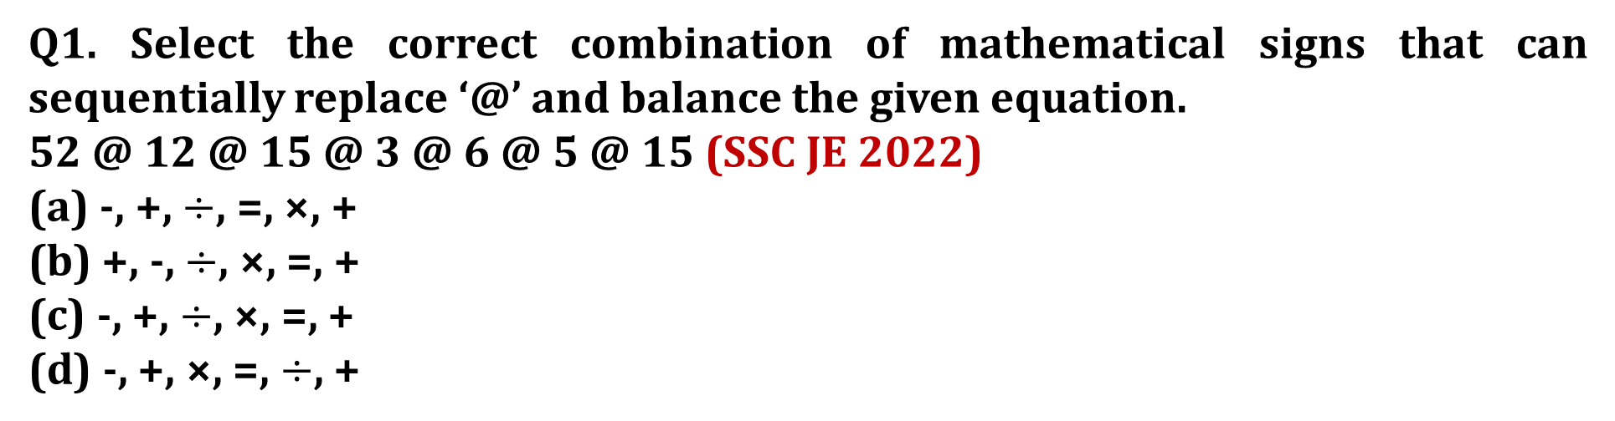
SSC JE 2023 | Reasoning Classes | By Abhishek Sir
Q1. Select the correct combination of mathematical signs that can sequentially replace ‘@’ and balance the given equation.
52 @ 12 @ 15 @ 3 @ 6 @ 5 @ 15 (SSC JE 2022)
(a) -, +, $÷$, =, ×, +
(b) +, -, $÷$, ×, =, +
(c) -, +, $÷$, ×, =, +
(d) -, +, ×, =, $÷$, +

Slide 5
SSC JE 2023 | Reasoning Classes | By Abhishek Sir
Q2. In a code language, ‘CANDLE’ is written as ‘3-1-14-4-12-5’ and ‘DARK’ is written as ‘4-1-18-11’. How will ‘LIGHT’ be written in that language
एक कूट भाषा में, 'CANDLE' को '3-1-14-4-12-5' और 'DARK' को '4-1-18-11' लिखा जाता है। उस भाषा में 'LIGHT' कैसे लिखा जाएगा(SSC JE 2022)
(a) 12 – 9 – 8 – 7 – 20
(b) 11 – 6 – 7 – 8 – 20
(c) 12 – 7 – 8 – 9 – 20
(d) 12 – 9 – 7 – 8 – 20

Slide 6
SSC JE 2023 | Reasoning Classes | By Abhishek Sir
Q3. Select the set in which the numbers are related in the same way as are the numbers of the following set.
(NOTE : Operations should be performed on the whole numbers, without breaking down the numbers into its constituent digits. E.g. 13 — Operations on 13 such as adding /subtracting /multiplying etc. to 13 can be performed. Breaking down 13 into 1 and 3 and then performing mathematical operations on 1 and 3 is NOT allowed)
(15, 56, 13)
(8, 15, 7) (SSC JE 2022)
(a) (11, 57, 8)
(b) (17, 69, 15)
(c) (12, 100, 7)
(d) (13, 99, 9)

Slide 7
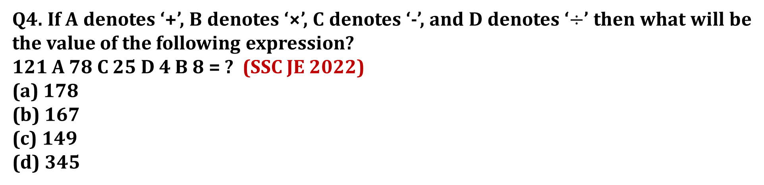
SSC JE 2023 | Reasoning Classes | By Abhishek Sir
Q4. If A denotes ‘+’, B denotes ‘×’, C denotes ‘-’, and D denotes ‘$÷$’ then what will be the value of the following expression?
121 A 78 C 25 D 4 B 8 = ? (SSC JE 2022)
(a) 178
(b) 167
(c) 149
(d) 345

Slide 8
SSC JE 2023 | Reasoning Classes | By Abhishek Sir
Q5. Select the correct option that indicates the arrangement of the following words in a logical and meaningful order.
1.Knead
2.Bread
3.Bake
4.Flour
5.Grain (SSC JE 2022)
(a) 5, 4, 1, 3, 2
(b) 5, 1, 4, 2, 3
(c) 5, 4, 1, 2, 3
(d) 5, 1, 4, 3, 2

Slide 9
SSC JE 2023 | Reasoning Classes | By Abhishek Sir
Q6. Which of the following numbers will replace the question mark (?) in the given series?
3, 9, 15, 33, 63, ? (SSC JE 2022)
(a) 124
(b) 192
(c) 129
(d) 142

Slide 10
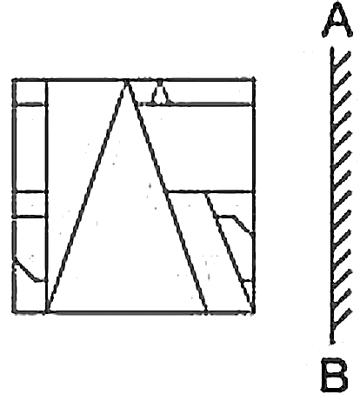
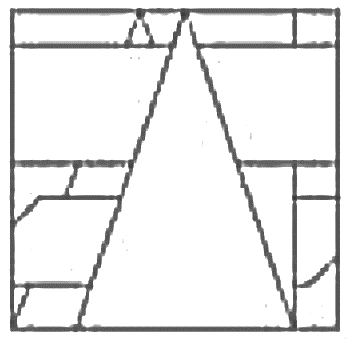
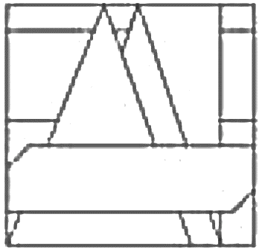
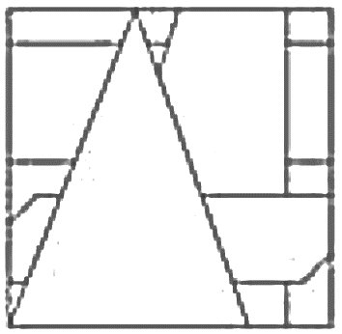
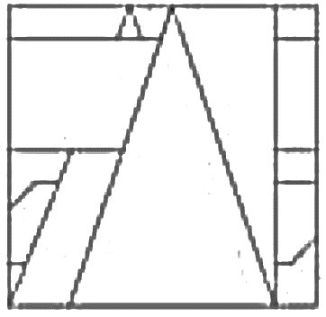
SSC JE 2023 | Reasoning Classes | By Abhishek Sir
Q7. Select the correct mirror image of the given figure when the mirror is placed at ‘AB’ as shown. (SSC JE 2022)
(a) (b) (c) (d)

Slide 11
SSC JE 2023 | Reasoning Classes | By Abhishek Sir
Q9. Seven children, P, Q, R, S, T, U, and V are seated around a square dining table, all facing towards the centre. Some of them are sitting at the corners while some are sitting at the exact centre of the sides of the table. One seat is left vacant. U and T are immediate neighbours. Q is seated at a corner, third to the right of T. Only three kids are seated between U and Q. R is an immediate neighbour of both P and Q. P is not an immediate neighbour of T. S is seated second to the left of T. If V is seated fourth to the right of P, where is the vacant seat? (SSC JE 2022)
(a) Third to the right of T
(b) Fourth to the left of Q
(c) Second to the left of R
(d) To the immediate left of V
सात बच्चे, P, Q, R, S, T, U, और V एक चौकोर खाने की मेज के चारों ओर केंद्र की ओर उन्मुख होकर बैठे हैं। उनमें से कुछ कोने पर बैठे हैं जबकि कुछ मेज की भुजाओं के ठीक मध्य में बैठे हैं। एक सीट खाली रह गई है। U और T तत्काल पड़ोसी हैं। Q कोने पर बैठा है, T के दायें से तीसरा। U और Q के बीच केवल तीन बच्चे बैठे हैं। R, P और Q दोनों का निकटतम पड़ोसी है। P, T का निकटतम पड़ोसी नहीं है। T के बायें। यदि V, P के दायें से चौथे स्थान पर बैठा है, तो खाली सीट कहाँ है?

Slide 12
SSC JE 2023 | Reasoning Classes | By Abhishek Sir
Q9. Seven children, P, Q, R, S, T, U, and V are seated around a square dining table, all facing towards the centre. Some of them are sitting at the corners while some are sitting at the exact centre of the sides of the table. One seat is left vacant. U and T are immediate neighbours. Q is seated at a corner, third to the right of T. Only three kids are seated between U and Q. R is an immediate neighbour of both P and Q. P is not an immediate neighbour of T. S is seated second to the left of T. If V is seated fourth to the right of P, where is the vacant seat? (SSC JE 2022)
(a) Third to the right of T
(b) Fourth to the left of Q
(c) Second to the left of R
(d) To the immediate left of V

Slide 13





SSC JE 2023 | Reasoning Classes | By Abhishek Sir
Q10. Select the option that will replace the question mark (?) in the given figure to complete the pattern. (SSC JE 2022)
(a) (b) (c) (d)

Slide 14
SSC JE 2023 | Reasoning Classes | By Abhishek Sir
Q11. Select the option that is related to the fifth term in the same way as the second term is related to the first term and the fourth term is related to the third term.
SEVERE : EREVES :: CRIMINAL: LANIMIRC :: LOCATION : ? (SSC JE 2022)
(a) NIOATCOL
(b) NOITACOL
(c) NIOTACOL
(d) NOIATCOL

Slide 15
SSC JE 2023 | Reasoning Classes | By Abhishek Sir
Q12. Seven people A, B, C, D, E, F and G are sitting in a straight row, facing north. Only five people are sitting in between G and E. F is an immediate neighbour of both G and A. Only four people are sitting to the right of A. Who is sitting on the extreme left?
सात व्यक्ति A, B, C, D, E, F और G एक सीधी पंक्ति में उत्तर की ओर उन्मुख होकर बैठे हैं। G और E के मध्य केवल पांच व्यक्ति बैठे हैं। F, G और A दोनों का निकटतम पडोसी है। केवल चार व्यक्ति A के दायें बैठे हैं। अंतिम बायें कौन बैठा है?(SSC JE 2022)
(a) G
(b) B
(c) D
(d) E

Slide 16
SSC JE 2023 | Reasoning Classes | By Abhishek Sir
Q13. Which of the given letter-clusters will replace the question mark (?) in the following series?
FVYA, ITWD, LRUG, ?, RNQM (SSC JE 2022)
(a) OPSI
(b) OPSJ
(c) OTSI
(d) OPTJ

Slide 17
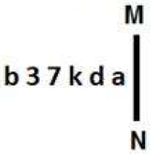
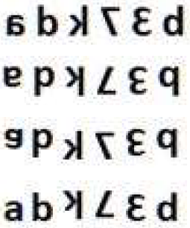
SSC JE 2023 | Reasoning Classes | By Abhishek Sir
Q14. Select the correct mirror image of the given figure when the mirror is placed at MN as shown. (SSC JE 2022)
(a)
(b)
(c)
(d)

Slide 18
SSC JE 2023 | Reasoning Classes | By Abhishek Sir
Q15. Select the set in which the numbers are related in the same way as are the numbers of the given sets.
(NOTE : Operations should be performed on the whole numbers, without breaking down the numbers into its constituent digits. E.g. 13 — Operations on 13 such as adding /subtracting /multiplying etc. to 13 can be performed. Breaking down 13 into 1 and 3 and then performing mathematical operations on 1 and 3 is not allowed.)
(6, 5, 35)
(8, 4, 36) (SSC JE 2022)
(a) (10, 6, 60)
(b) (7, 9, 72)
(c) (4, 8, 36)
(d) (9, 5, 45)

Slide 19
SSC JE 2023 | Reasoning Classes | By Abhishek Sir
Q16. Select the option that represents the correct order of the given words as they would appear in an English dictionary.
1. Stalker
2. Station
3. Stammer
4. Stabbed
5. Strange
6. Strings
7. Stacked (SSC JE 2022)
(a) 4, 7, 1, 3, 2, 5, 6
(b) 7, 4, 1, 3, 2, 5, 6
(c) 4, 7, 1, 3, 5, 2, 6
(d) 4, 7, 1, 3, 2, 6, 5

Slide 20
SSC JE 2023 | Reasoning Classes | By Abhishek Sir
Q17. In this question, three statements are given, followed by two conclusions numbered I and II. Assuming the statements to be true, even if they seem to be at variance with commonly known facts, decide which of the conclusion(s) logically follow(s) from the statements.
Statements:
All scooters are cars.
No car is a cycle.
All cars are vehicles.
Conclusions:
I. All cars are scooters.
ll. Some cycles are vehicles. (SSC JE 2022)
(a) Only conclusion II follows. (b) Both conclusions I and II follow
(c) Only conclusion I follows. (d) Neither conclusion I nor II follows.

Slide 21
SSC JE 2023 | Reasoning Classes | By Abhishek Sir
Q18. Which letter-cluster will replace the question mark (?) to complete the given series?
FJVT, ?, JPBX, LSEZ, NVHB (SSC JE 2022)
(a) GKWR
(b) JMXU
(c) JKYR
(d) HMYV

Slide 22
SSC JE 2023 | Reasoning Classes | By Abhishek Sir
Q19. Select the option that represents the correct order of the given words as they would appear in an English dictionary.
1. Pentium
2. Pentagon
3. Penalise
4. Permeate
5. Personified
6. Penetrate
7. Pesticide (SSC JE 2022)
(a) 3, 2, 6, 1, 4, 5, 7
(b) 3, 6, 1, 2, 5, 4, 7
(c) 3, 6, 1, 2, 4, 5, 7
(d) 3, 6, 2, 1, 4, 5, 7

Slide 23
SSC JE 2023 | Reasoning Classes | By Abhishek Sir
Q20. Select the option that represents the letters that, when sequentially placed from left to right in the blanks below, will complete the letter series.
C _ HE _ CKCC _ ECC __ CH _ C _ K (SSC JE 2022)
(a) H E C C C E K
(b) C C H K C E C
(c) C H E C C E K
(d) C K E C C H E

Slide 24
SSC JE 2023 | Reasoning Classes | By Abhishek Sir
Q21. In a certain code language, 'TAXPAYER' is written as 'UCYRBAFT' and 'TAXATION’ is written as 'UCYCUKPP'. How will 'TENDENCY' be written in that language?
एक निश्चित कोड भाषा में, 'TAXPAYER' को 'UCYRBAFT' लिखा जाता है और 'TAXATION' को 'UCYCUKPP' लिखा जाता है। उस भाषा में 'टेंडेंसी' कैसे लिखा जाएगा? (SSC JE 2022)
(a) UGOEFPCA
(b) UGOFFPDA
(c) UGOFFPCB
(d) UHOFFPDA

Slide 25
SSC JE 2023 | Reasoning Classes | By Abhishek Sir
Q22. In a code language, ‘GATHER’ is written as '20-26-7-19-22-9' and ‘DISPERSE’ is written as '23-18-8-11-22-9-8-22'. How will ‘CONSTRAINT’ be written in that language?
एक कूट भाषा में, 'GATHER' को '20-26-7-19-22-9' और 'DISPERSE' को '23-18-8-11-22-9-8-22' लिखा जाता है। उस भाषा में 'CONSTRAINT' कैसे लिखा जाएगा?(SSC JE 2022)
(a) 24-12-13-9-8-7-26-18-13-7
(b) 24-13-12-8-7-9-26-13-18-7
(c) 24-12-13-8-7-9-26-18-13-7
(d) 24-11-13-7-8-9-26-18-13-7

Slide 26
SSC JE 2023 | Reasoning Classes | By Abhishek Sir
Q23. Hari's brother is Shiv. Shiv has two sons Ram and Shyam. Shyam’s daughter is Priya. How is Shiv related to Priya?
हरि के भाई शिव हैं। शिव के दो बेटे राम और श्याम हैं। श्याम की पुत्री प्रिया है। शिव, प्रिया से किस प्रकार संबंधित है? (SSC JE 2022)
(a) Father’s brother
(b) Father
(c) Father’s father
(d) Brother

Slide 27
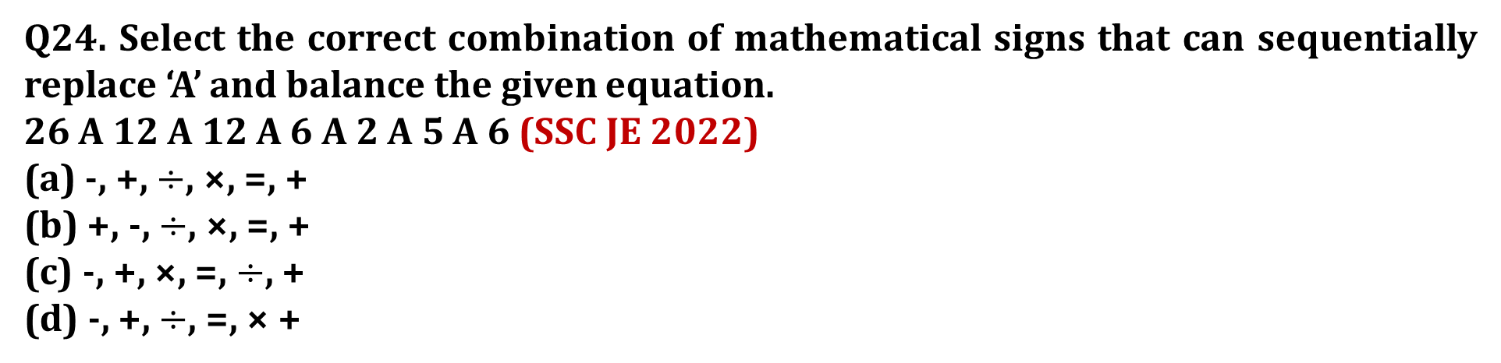
SSC JE 2023 | Reasoning Classes | By Abhishek Sir
Q24. Select the correct combination of mathematical signs that can sequentially replace ‘A’ and balance the given equation.
26 A 12 A 12 A 6 A 2 A 5 A 6 (SSC JE 2022)
(a) -, +, $÷$, ×, =, +
(b) +, -, $÷$, ×, =, +
(c) -, +, ×, =, $÷$, +
(d) -, +, $÷$, =, × +

Slide 28
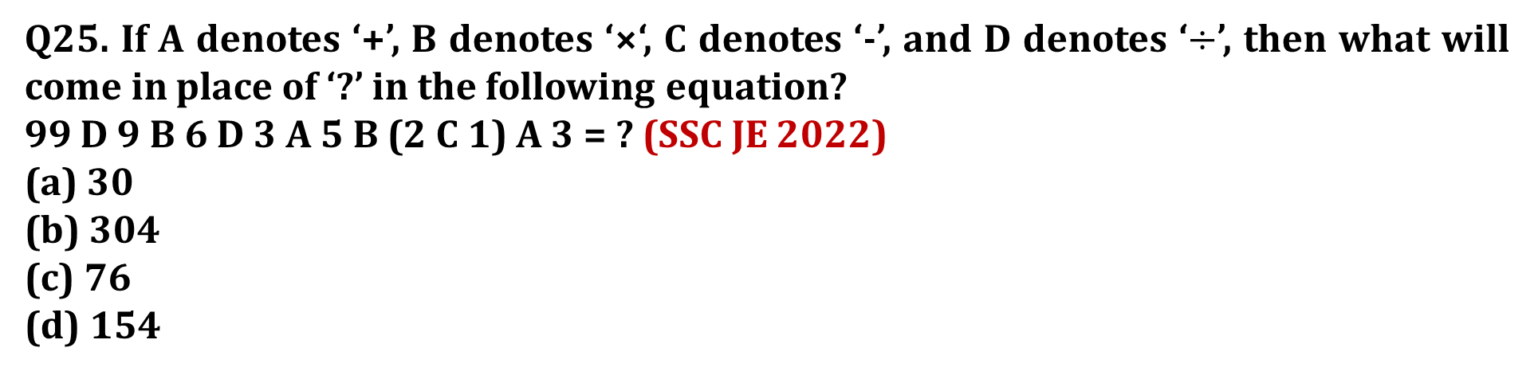
SSC JE 2023 | Reasoning Classes | By Abhishek Sir
Q25. If A denotes ‘+’, B denotes ‘×‘, C denotes ‘-’, and D denotes ‘$÷$’, then what will come in place of ‘?’ in the following equation?
99 D 9 B 6 D 3 A 5 B (2 C 1) A 3 = ? (SSC JE 2022)
(a) 30
(b) 304
(c) 76
(d) 154

Slide 29
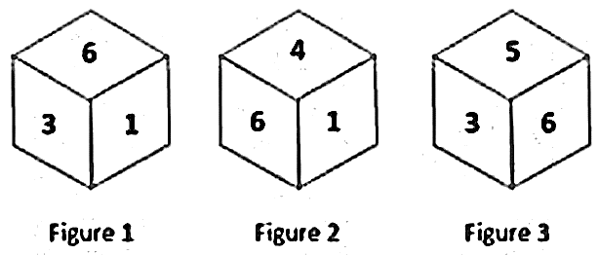
SSC JE 2023 | Reasoning Classes | By Abhishek Sir
Q26. Three different positions of the same dice are shown (Figure 1 – 3). Find the number on the face opposite to the face having ‘2’ (SSC JE 2022)
(a) 6
(b) 4
(c) 1
(d) 5

Slide 30
SSC JE 2023 | Reasoning Classes | By Abhishek Sir
Q27. In a certain code language, 'EASY' is written as '64' and 'CAMP' is written as '47'. How will 'ABET' be written in that language?
एक निश्चित कोड भाषा में, 'EASY' को '64' और 'CAMP' को '47' लिखा जाता है। उस भाषा में 'ABET' कैसे लिखा जाएगा?(SSC JE 2022)
(a) 32
(b) 44
(c) 42
(d) 46

Slide 31
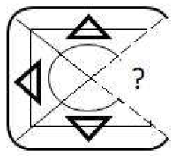




SSC JE 2023 | Reasoning Classes | By Abhishek Sir
Q28. Select the option that will replace the question mark (?) in the given figure to complete the pattern. (SSC JE 2022)
(a) (b) (c) (d)

Slide 32
SSC JE 2023 | Reasoning Classes | By Abhishek Sir
Q29. Select the option that is related to the third term in the same way as the second term is related to the first term and the sixth term is related to the fifth term.
145 : 170 :: 290 : ? :: 442 : 485 (SSC JE 2022)
(a) 335
(b) 320
(c) 330
(d) 325

Slide 33
SSC JE 2023 | Reasoning Classes | By Abhishek Sir
Q30. Which of the following numbers will replace the question mark(?) in the given series?
27, ?, 40, 45, 49, 52 (SSC JE 2022)
(a) 32
(b) 35
(c) 34
(d) 36

Slide 34
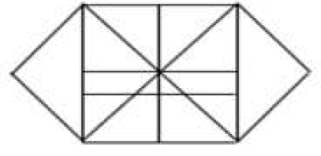

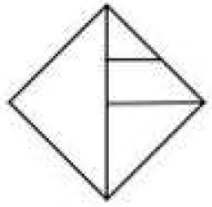
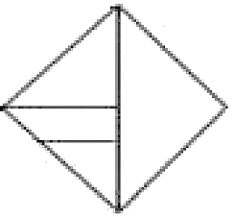
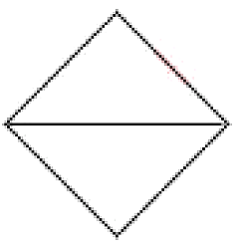
SSC JE 2023 | Reasoning Classes | By Abhishek Sir
Q31. Select the option that is embedded in the given figure (rotation is NOT allowed)
(SSC JE 2022)
(a) (b) (c) (d)

Slide 35
SSC JE 2023 | Reasoning Classes | By Abhishek Sir
Q32. Q lies to the east of P. R lies to the north of P. 8 lies to the north-east of Q. T lies to the south-east of P and south-west of Q. What is the position of T with respect to S?
Q, P के पूर्व में स्थित है। R, P के उत्तर में स्थित है। 8, Q के उत्तर-पूर्व में स्थित है। T, P के दक्षिण-पूर्व में और Q के दक्षिण-पश्चिम में स्थित है। संदर्भ में T की स्थिति क्या है? एस के लिए?
(SSC JE 2022)
(a) South –west
(b) North – east
(c) North – west
(d) South – east

Slide 36
SSC JE 2023 | Reasoning Classes | By Abhishek Sir
Q33. Which letter-cluster will replace the question mark (?) to complete the given series?
KIES, OLHW, ?, WRNE, AUQI (SSC JE 2022)
(a) MMJB
(b) NPJC
(c) TPLB
(d) SOKA

Slide 37
SSC JE 2023 | Reasoning Classes | By Abhishek Sir
Q34. Select the word-pair in which the two words are related in the same way as are the two words in the given pair.
(The words must be considered as meaningful English words and must not be related to each other based on the number of letters/number of consonants/vowels in the word)
Colossal : Enormous (SSC JE 2022)
(a) Diligent : Inactive
(b) Deceit : Fraud
(c) Exigent : Ordinary
(d) Jumble : Order

Slide 38
SSC JE 2023 | Reasoning Classes | By Abhishek Sir
Q35. Select the option that is related to the third word in the same way as the second word is related to the first word. (The words must be considered as meaningful English words and must not be related to each other based on the number of letters/number of consonants/vowels in the word.)
Needle : Sew :: Spanner : ?
सुई : सिलना :: स्पैनर : ? (SSC JE 2022)
(a) Scoop
(b) Hold
(c) Carve
(d) Grip

Slide 39
SSC JE 2023 | Reasoning Classes | By Abhishek Sir
Q36. Which of the following numbers will replace the question mark (?) and complete the given number series?
38, 57, 74, 93, 110, ? (SSC JE 2022)
(a) 127
(b) 118
(c) 129
(d) 139

Slide 40
SSC JE 2023 | Reasoning Classes | By Abhishek Sir
Q37. Which of the given letter-clusters will replace the question mark in the following series ?
CHAI, EKBM, GNCQ, ?, KTEY (SSC JE 2022)
(a) IQDU
(b) IRDU
(c) JRDV
(d) IRDV

Slide 41
SSC JE 2023 | Reasoning Classes | By Abhishek Sir
Q38. Two statements are given, followed by two conclusions numbered I and II. Assuming the statements to be true, even if they seem to be at variance with commonly known facts, decide which of the conclusions logically follow(s) from the statements.
Statements:
All ships are boats.
Some ships are cargo.
Conclusions:
I. Some boats are cargo.
II. All boats are ships. (SSC JE 2022)
(a) Only conclusion I follows
(b) Neither conclusion I nor II follows
(c) Both conclusions I and II follow
(d) Only conclusion II follows

Slide 42
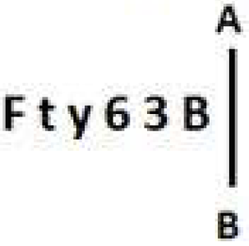
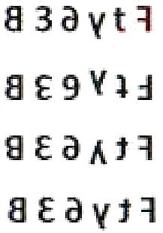
SSC JE 2023 | Reasoning Classes | By Abhishek Sir
Q39. Select the correct mirror image of the given combination when the mirror is placed at line AB as shown. (SSC JE 2022)
(a)
(b)
(c)
(d)

Slide 43



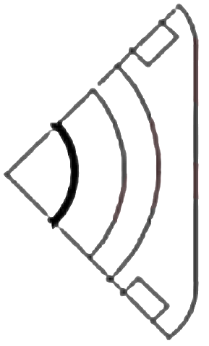

SSC JE 2023 | Reasoning Classes | By Abhishek Sir
Q40. Select the figure from the options that can replace the question mark (?) and complete the pattern.
(SSC JE 2022)
(a) (b) (c) (d)

Slide 44
SSC JE 2023 | Reasoning Classes | By Abhishek Sir
Q41. Pointing at a lady, Sheela said, “She is my only brother’s daughter’s father’s mother.” How is that lady related to Sheela?
एक महिला की ओर इशारा करते हुए शीला ने कहा, "वह मेरे इकलौते भाई की बेटी के पिता की माँ है।" वह महिला शीला से किस प्रकार संबंधित है? (SSC JE 2022)
(a) Mother
(b) Daughter
(c) Mother’s sister
(d) Sister

Slide 45
SSC JE 2023 | Reasoning Classes | By Abhishek Sir
Q42. Select the set in which the numbers are related in the same way as are the numbers of the given sets.
(NOTE : Operations should be performed on the whole numbers, without breaking down the numbers into its constituent digits. E.g. 13 — Operations on 13 such as adding /subtracting /multiplying etc. to 13 can be performed. Breaking down 13 into 1 and 3 and then performing mathematical operations on 1 and 3 is not allowed.)
(17, 136, 7)
(12, 120, 9) (SSC JE 2022)
(a) (16, 85, 5)
(b) (14, 126, 8)
(c) (11, 99, 9)
(d) (15, 125, 7)

Slide 46
SSC JE 2023 | Reasoning Classes | By Abhishek Sir
Q43. Select the option that is related to the third word in the same way as the second word is related to the first word. (The words must be considered as meaningful English words and must not be related to each other based on the number of letters/number of consonants/vowels in the word.)
Odisha : Bhubaneshwar :: Nagaland : ?
ओडिशा : भुवनेश्वर : : नागालैंड : ? (SSC JE 2022)
(a) Dispur
(b) Kohima
(c) Jaipur
(d) Gangtok

Slide 47
SSC JE 2023 | Reasoning Classes | By Abhishek Sir
Q44. Select the option that is related to the fourth term in the same way as the first term is related to the second term and fifth term is related to sixth term.
52 : 5 :: ? : 6 :: 100 : 7 (SSC JE 2022)
(a) 72
(b) 61
(c) 96
(d) 74

Slide 48
SSC JE 2023 | Reasoning Classes | By Abhishek Sir
Q45. A, B, C, D, E, F and G are seven cousins of different ages. A is younger than only E. G is younger than C but older than D. B is the youngest amongst them. F is younger than D. How many people is D younger than?
A, B, C, D, E, F और G अलग-अलग उम्र के सात चचेरे भाई हैं। A केवल E से छोटा है। G, C से छोटा है लेकिन D से बड़ा है। B उनमें से सबसे छोटा है। F, D से छोटा है। D कितने लोगों से छोटा है?
(SSC JE 2022)
(a) 4
(b) 3
(c) 2
(d) 1

Slide 49
SSC JE 2023 | Reasoning Classes | By Abhishek Sir
Q46. Select the correct option that indicates the arrangement of the following words in a logical and meaningful order. (From Small to Big)
1. River
2. 0cean
3. Pond
4. Sea
5. Lake (SSC JE 2022)
(a) 5, 1, 3, 4, 2
(b) 3, 4, 5, 1, 2
(c) 3, 1, 5, 4, 2
(d) 3, 5, 1, 4, 2

Slide 50
SSC JE 2023 | Reasoning Classes | By Abhishek Sir
Q47. Jia starts from Point A and drives 6.3 km towards the north. She then takes a right turn, drives 2.65 km, turns right and drives 10.25 km. She then takes a right turn and drives 8.72 km. She takes a final right turn, drives 3.95 km and stops at Point P. How far and towards which direction should she now drive in order to reach Point A again? (All turns are 90 degree turns only) (SSC JE 2022)
(a) 6.07 km, east
(b) 6.07 km, north
(c) 6.05 km, north
(d) 6.05 km, west
जिया बिंदु A से शुरू करती है और उत्तर की ओर 6.3 किमी चलती है। फिर वह दाएं मुड़ती है, 2.65 किमी ड्राइव करती है, दाएं मुड़ती है और 10.25 किमी ड्राइव करती है। फिर वह दाएं मुड़ती है और 8.72 किमी चलती है। वह अंतिम दायें मुड़ती है, 3.95 किमी ड्राइव करती है और बिंदु P पर रुकती है। अब उसे बिंदु A तक पहुँचने के लिए कितनी दूर और किस दिशा में गाड़ी चलानी चाहिए? (सभी मोड़ केवल 90 डिग्री के मोड़ हैं)

Slide 51
SSC JE 2023 | Reasoning Classes | By Abhishek Sir
Q47. Jia starts from Point A and drives 6.3 km towards the north. She then takes a right turn, drives 2.65 km, turns right and drives 10.25 km. She then takes a right turn and drives 8.72 km. She takes a final right turn, drives 3.95 km and stops at Point P. How far and towards which direction should she now drive in order to reach Point A again? (All turns are 90 degree turns only) (SSC JE 2022)
(a) 6.07 km, east
(b) 6.07 km, north
(c) 6.05 km, north
(d) 6.05 km, west

Slide 52

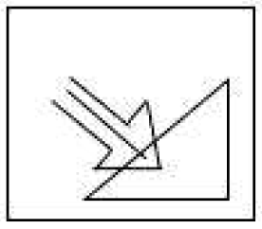
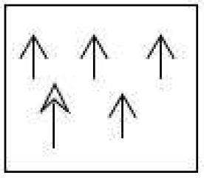
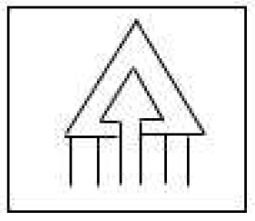
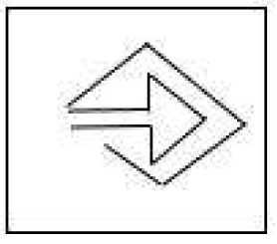
SSC JE 2023 | Reasoning Classes | By Abhishek Sir
Q48. Select the option in which the given figure is embedded. (Rotation is NOT allowed) (SSC JE 2022)
(a) (b) (c) (d)

Slide 53
SSC JE 2023 | Reasoning Classes | By Abhishek Sir
Q49. Select the option that indicates the correct arrangement of the given words in a logical and meaningful order.
1. Carpet
2. Ceiling
3. Bed
4. Floor
5. Fan (SSC JE 2022)
(a) 4, 1, 3, 5, 2
(b) 4, 2, 1, 5, 3
(c) 1, 2, 4, 5, 3
(d) 2, 1, 4, 3, 5

Slide 54
SSC JE 2023 | Reasoning Classes | By Abhishek Sir
Q50. Select the word-pair in which the two words are related in the same way as are the two words in the given pair.
(The words must be considered as meaningful English words and must not be related to each other based on the number of letters/number of consonants/vowels in the word)
Lucid : Rational
स्पष्ट अर्थ: तर्कसंगत (SSC JE 2022)
(a) Morbid : Healthy
(b) Numerous : Profuse
(c) Molest : Console
(d) Malice : Kindness

Slide 55


