Slide 1


JSSC JE 2023 | Sunday Special | Concept of Thermodynamics | General Eng

Slide 2
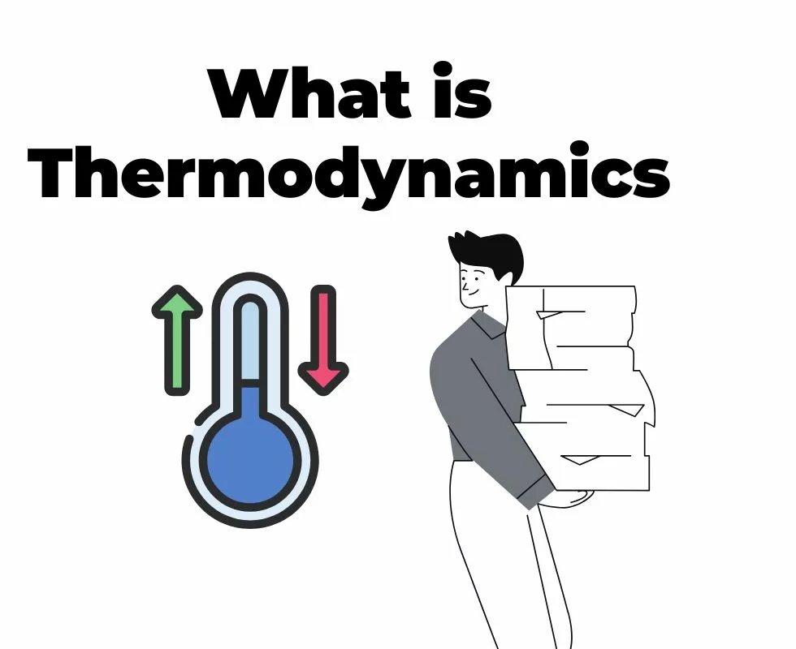

JSSC JE 2023 | Sunday Special | Concept of Thermodynamics | General Eng

Slide 3
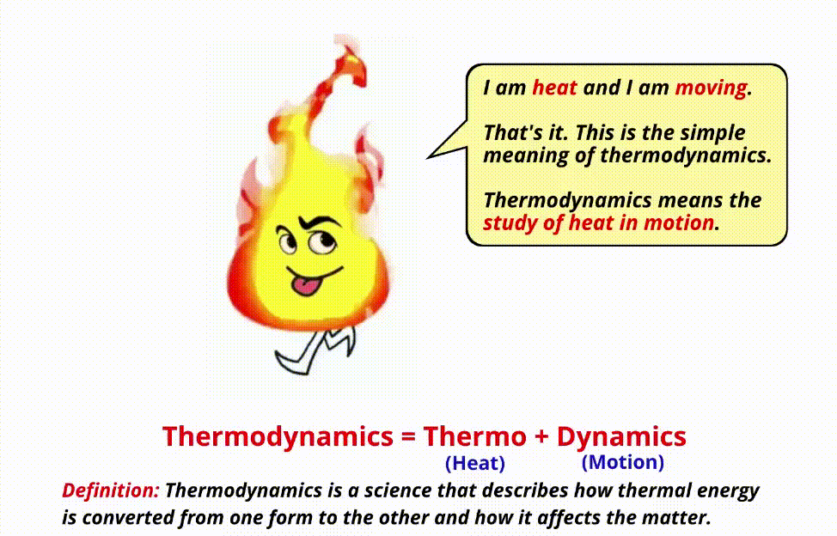
JSSC JE 2023 | Sunday Special | Concept of Thermodynamics | General Eng

Slide 4
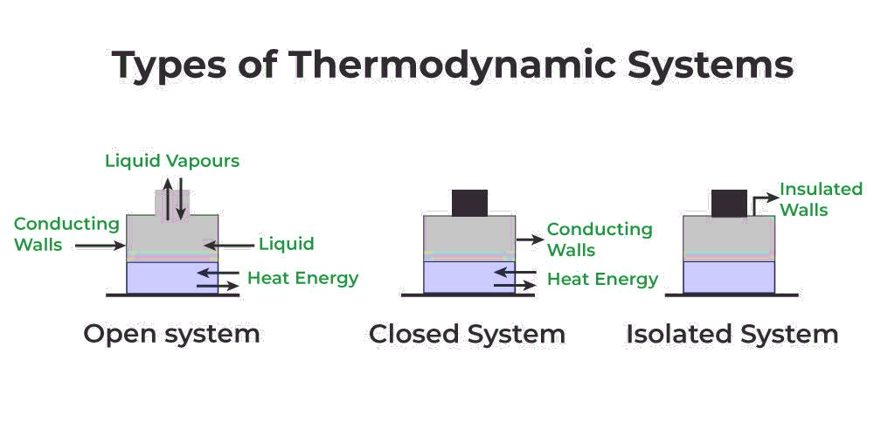
JSSC JE 2023 | Sunday Special | Concept of Thermodynamics | General Eng

Slide 5
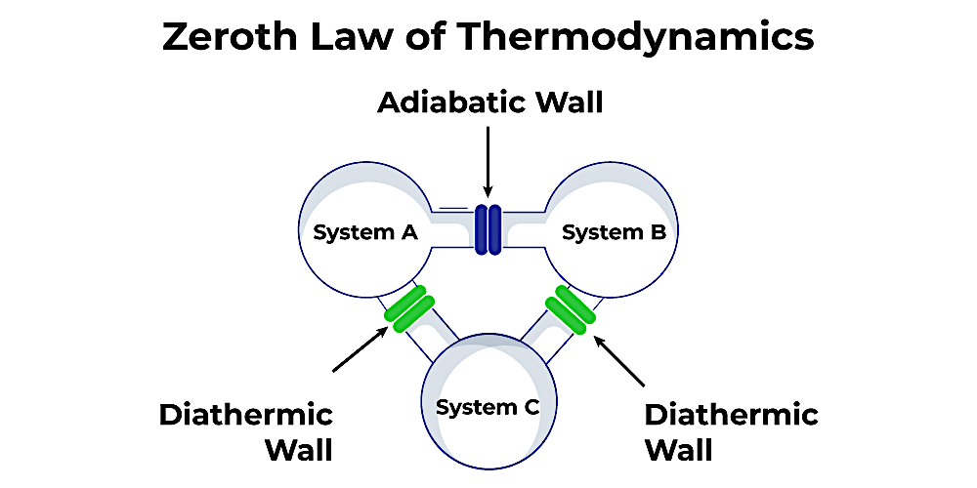
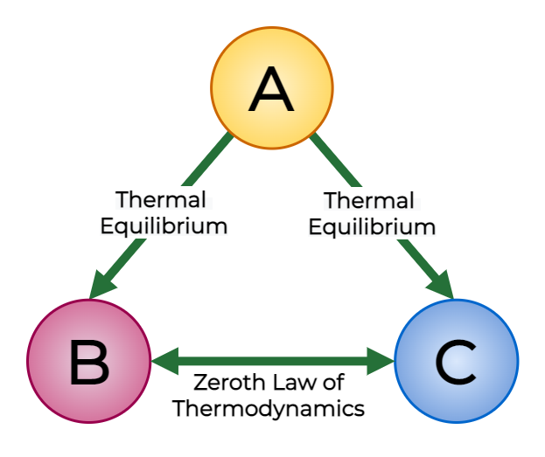
JSSC JE 2023 | Sunday Special | Concept of Thermodynamics | General Eng

Slide 6
JSSC JE 2023 | Sunday Special | Concept of Thermodynamics | General Eng

Slide 7
JSSC JE 2023 | Sunday Special | Concept of Thermodynamics | General Eng

Slide 8
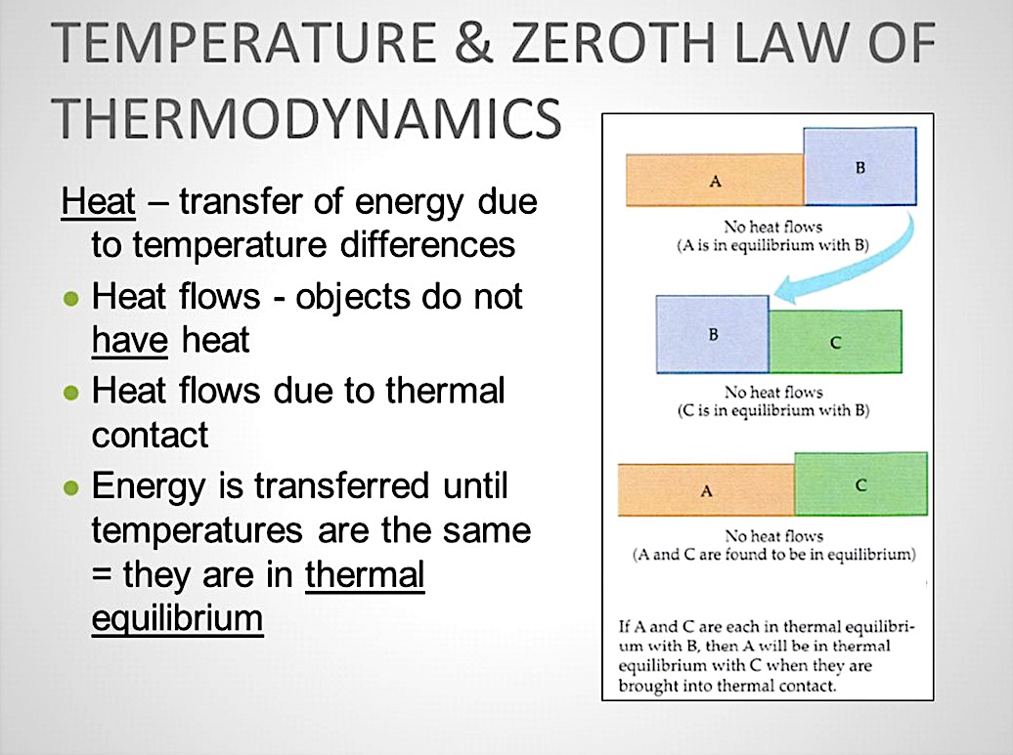
JSSC JE 2023 | Sunday Special | Concept of Thermodynamics | General Eng

Slide 9
JSSC JE 2023 | Sunday Special | Concept of Thermodynamics | General Eng

Slide 10
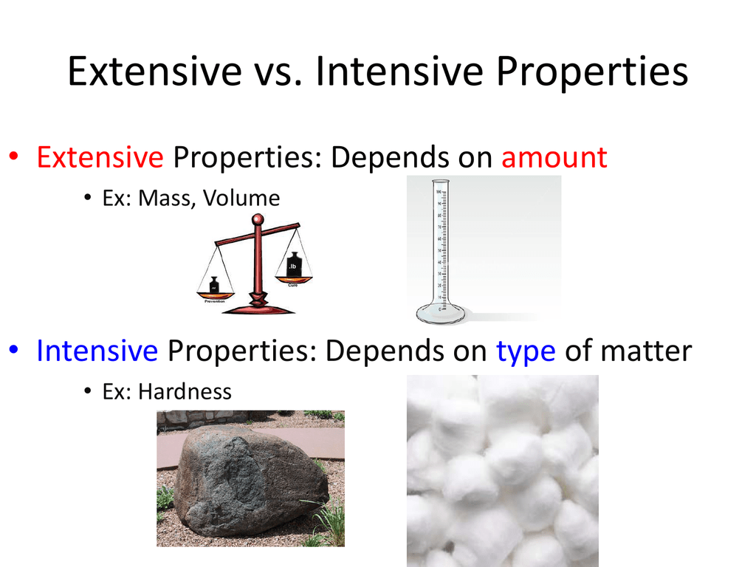
JSSC JE 2023 | Sunday Special | Concept of Thermodynamics | General Eng

Slide 11
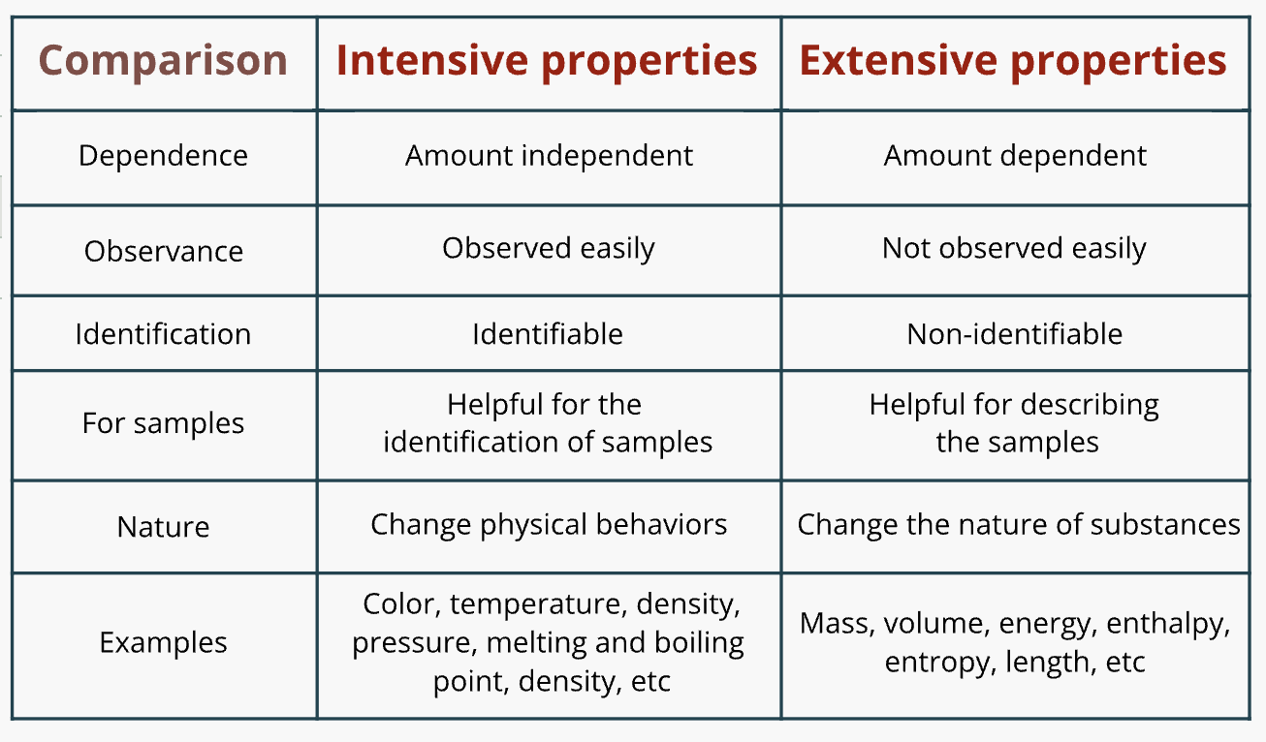
JSSC JE 2023 | Sunday Special | Concept of Thermodynamics | General Eng

Slide 12
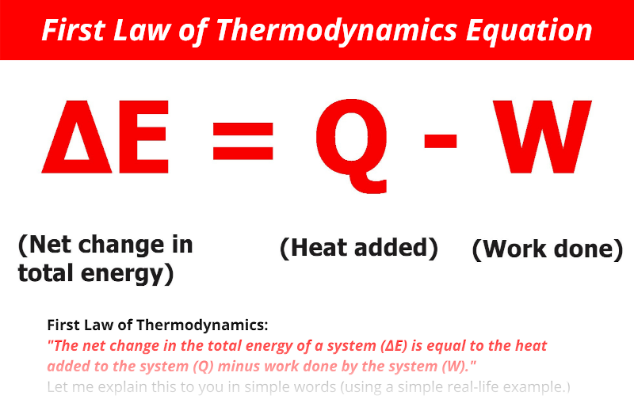
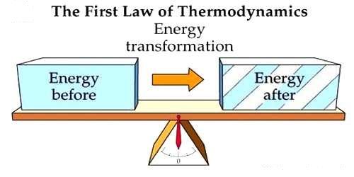
JSSC JE 2023 | Sunday Special | Concept of Thermodynamics | General Eng

Slide 13
JSSC JE 2023 | Sunday Special | Concept of Thermodynamics | General Eng

Slide 14
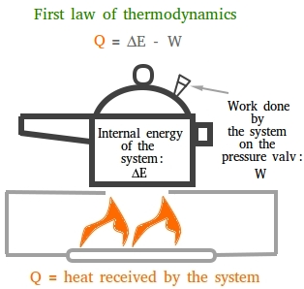
JSSC JE 2023 | Sunday Special | Concept of Thermodynamics | General Eng

Slide 15
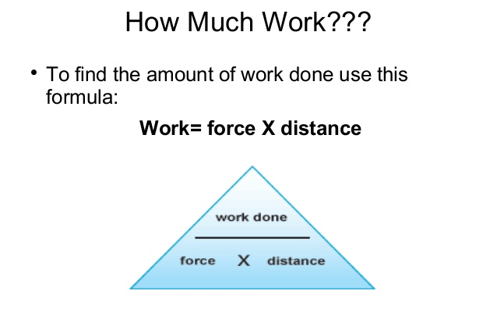
JSSC JE 2023 | Sunday Special | Concept of Thermodynamics | General Eng

Slide 16
JSSC JE 2023 | Sunday Special | Concept of Thermodynamics | General Eng

Slide 17
JSSC JE 2023 | Sunday Special | Concept of Thermodynamics | General Eng

Slide 18
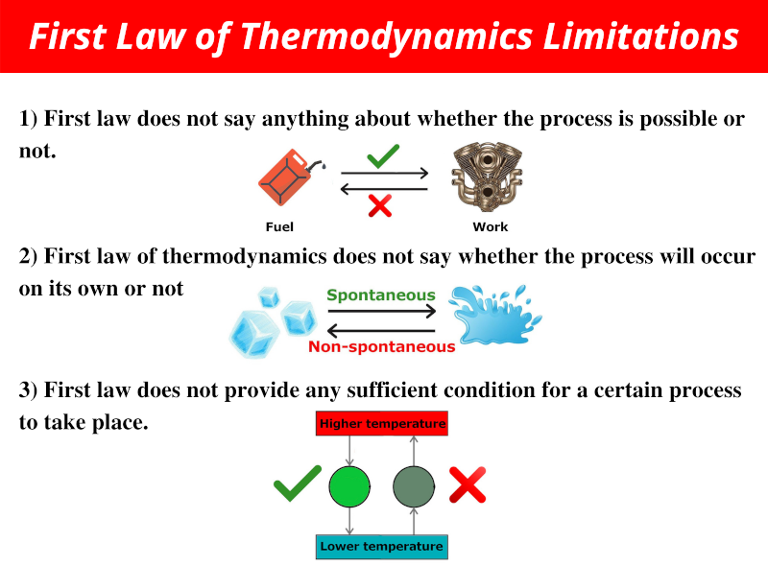
JSSC JE 2023 | Sunday Special | Concept of Thermodynamics | General Eng

Slide 19
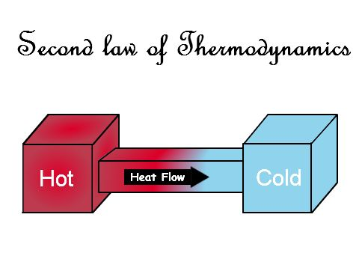
JSSC JE 2023 | Sunday Special | Concept of Thermodynamics | General Eng

Slide 20
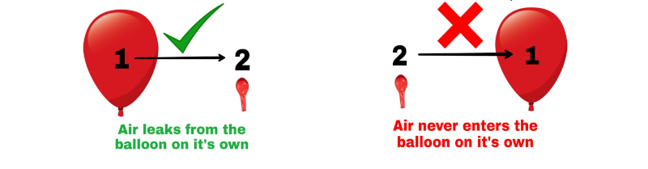
JSSC JE 2023 | Sunday Special | Concept of Thermodynamics | General Eng

Slide 21
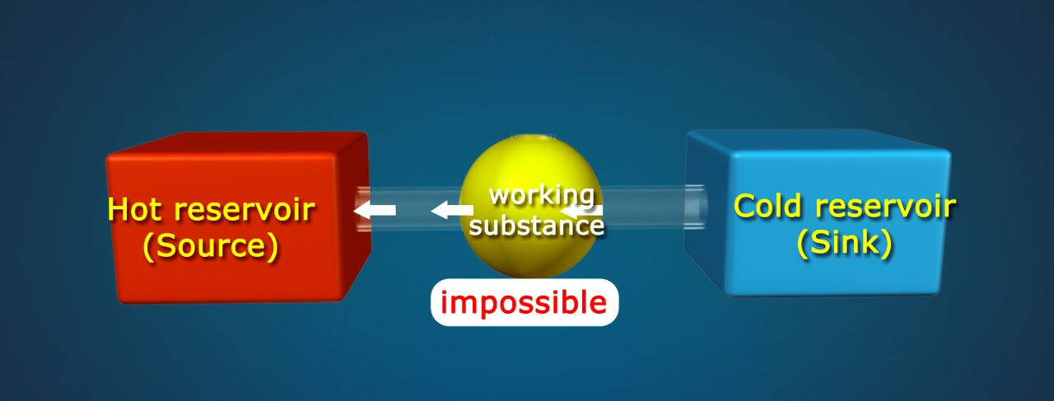
JSSC JE 2023 | Sunday Special | Concept of Thermodynamics | General Eng

Slide 22
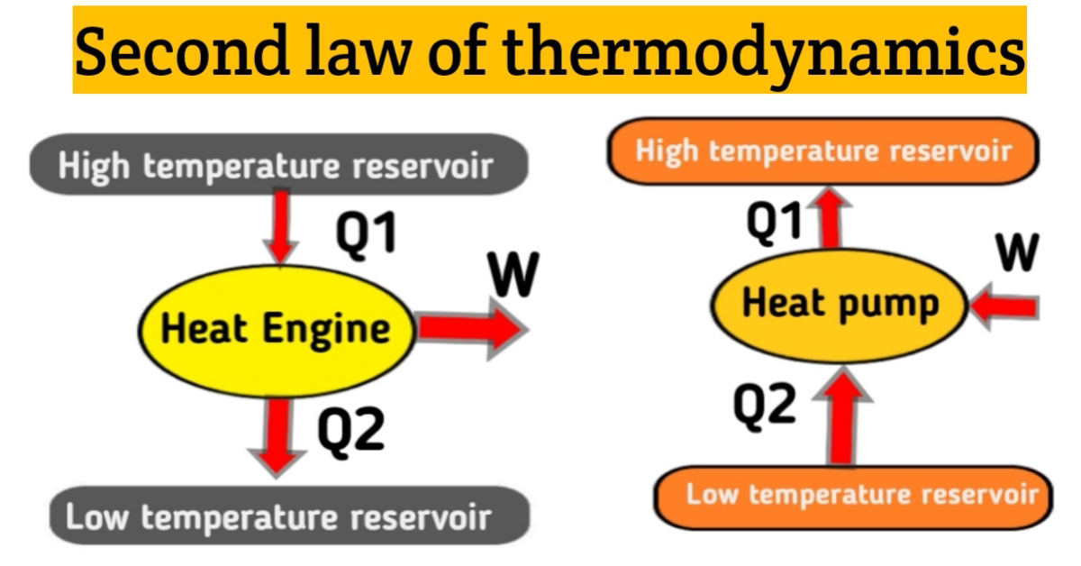
JSSC JE 2023 | Sunday Special | Concept of Thermodynamics | General Eng

Slide 23
JSSC JE 2023 | Sunday Special | Concept of Thermodynamics | General Eng

Slide 24
JSSC JE 2023 | Sunday Special | Concept of Thermodynamics | General Eng

Slide 25
JSSC JE 2023 | Sunday Special | Concept of Thermodynamics | General Eng
Q. A control volume is !
A. an isolated system
B. a closed system but heat and work can cross the boundary
C. a specific amount of mass in space
D. a fixed region in space where mass, heat and work can cross the boundary of that region
[29th January 2018, Shift-2]

Slide 26
JSSC JE 2023 | Sunday Special | Concept of Thermodynamics | General Eng
Q. First law of thermodynamics furnishes the relationship between -
A. heat and work
B. heat, work and properties of the system
C. various properties of the system
D. various thermodynamic processes
[2009]

Slide 27
JSSC JE 2023 | Sunday Special | Concept of Thermodynamics | General Eng
Q. The first law of thermodynamics is the law of -
A. conservation of mass
B. conservation of energy
C. conservation of momentum
D. conservation of heat
[2010]

Slide 28
JSSC JE 2023 | Sunday Special | Concept of Thermodynamics | General Eng
Q. Extensive property of a system is one whose value.
A. depends on the mass of the system, like volume
B. does not depend on the mass of the system, like temperature, pressure, etc.
C. is not dependent path followed but on the state
D. is dependent on the path followed and not on the state
[1st March2017, Shift-2]

Slide 29
JSSC JE 2023 | Sunday Special | Concept of Thermodynamics | General Eng
Q. A system will be thermodynamic equilibrium only if it is in___!
A. thermal equilibrium
B. mechanical Equilibrium
C. Chemical equilibrium
A. Only A
B. Only B
C. Only C
D. A, B and C
[1st March2017, Shift-2]

Slide 30
JSSC JE 2023 | Sunday Special | Concept of Thermodynamics | General Eng
Q. Zeroth law of thermodynamics defines_
A. internal energy
B. enthalpy
C. temperature
D. pressure
[2008]

Slide 31
JSSC JE 2023 | Sunday Special | Concept of Thermodynamics | General Eng
Q. Which of the following entities is not a thermodynamics property!?
A. Specific volume
B. Heat
C. Work
D. Both B & C

Slide 32
JSSC JE 2023 | Sunday Special | Concept of Thermodynamics | General Eng
Q. Which property is an intrinsic property of!
A. Specific enthalpy
B. Specific Volume
C. Thermal conductivity
D. All of the above

Slide 33
JSSC JE 2023 | Sunday Special | Concept of Thermodynamics | General Eng
Q. One of the extensive properties of a thermodynamic system amongst the following is -
A. pressure
B. volume
C. temperature
D. density
[2013]

Slide 34
JSSC JE 2023 | Sunday Special | Concept of Thermodynamics | General Eng
Q. Which of the following is an extensive property!?
A. temperature
B. pressure
C. density
D. enthalpy
[2014, Set-2]

Slide 35
JSSC JE 2023 | Sunday Special | Concept of Thermodynamics | General Eng

Slide 36
JSSC JE 2023 | Sunday Special | Concept of Thermodynamics | General Eng

