Slide 1

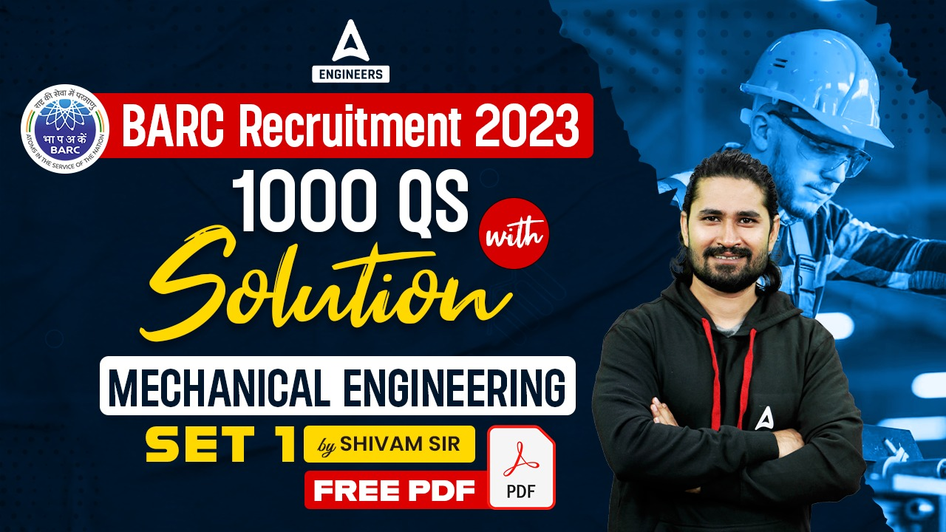

SSC JE Mechanical Previous Year Questions + Answers | Mechanical Engineering
Mechanical Engineering
Q.Which of the following is reason of irreversibility!?
A. Lack of equilibrium during the process
B. involvement of dissipative effects
C. None of the above
D. both a & b
For 78% Discount
Use Code : “Y166”
78% Discount
Y166
11
Join Our Paid Batch : SSC JE Batch | Mahapack Batch | Use Code Y166 For 78% of Discount

Slide 2


Slide 3
1000Qs For All AE/JE Exams | Mechanical Engg | Questions + Answer
Mechanical Engineering
Q. Which of following is an output device for CAD!?
A. Pen plotters
B. Hard copy units
C. Computer output to microfilm units
D. All of above
For 78% Discount
Use Code : “Y166”
78% Discount
Y166
Mentor : Shivam Gupta
For Complete theory and concepts join our Mahapack Batch, Use Code Y166 For 78% of Discount

Slide 4

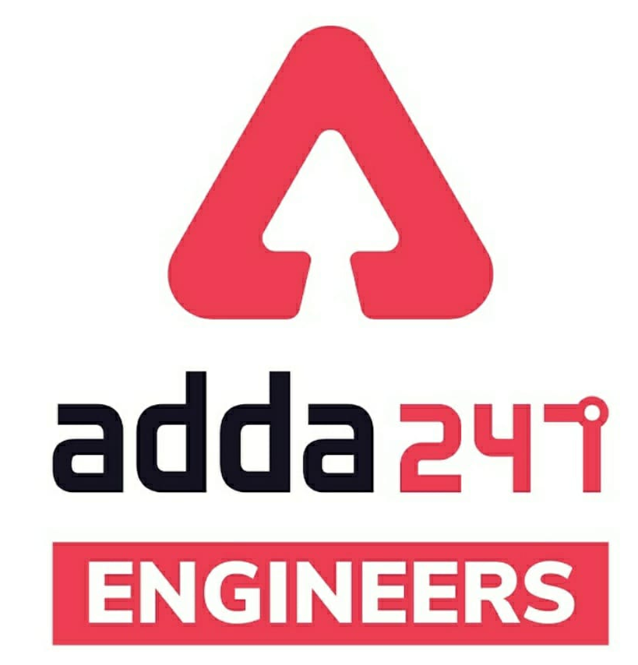

SSC JE Mechanical Previous Year Questions + Answers | Mechanical Engineering
Mechanical Soormas
Anuj Kanoujiya
Sahil Kumar
Pragya Srivastava
Ashu Lone
Lokesh Varwan
Aman Kumar
Subir
Shivani Singh
Priyanshu Kushwaha
Kritika Mall
Raushan Kumar
Mechanical Queen
Dilip Gupta
Aashik Hussain
Ayush Suthar
Warif
Pannelal Kushwaha
Aashik Hussain
Vikas Dev Pandey
Raj Yadav
Shubhi Tiwari
Alfiya Fatima
Pankaj Mahato
Kuntal Maji
Rajesh Rohila
Ajaya Suna
Rajat Bobde
Nandan Mehta
Pintu Mahato
for
Code : “Y166”

Slide 5
SSC JE Mechanical Previous Year Questions + Answers | Mechanical Engineering
Mechanical Soormas
Deepak Kumar
Shri Krishna
for
Code : “Y166”

Slide 6

SSC JE Mechanical Previous Year Questions + Answers | Mechanical Engineering
Mechanical Engineering
For 78% Discount
Use Code : “Y166”
Join Our Paid Batch : SSC JE Batch | Mahapack Batch | Use Code Y166 For 78% of Discount

Slide 7
1000Qs For All AE/JE Exams | Mechanical Engg | Questions + Answer
Mechanical Engineering
Q. To enlarge or reduce the apparent size of objects, the command used in Auto CAD is -
A. SNAP
B. ZOOM
C. UNDO
D. ORTHO
For 78% Discount
Use Code : “Y166”
78% Discount
Y166
Mentor : Shivam Gupta
For Complete theory and concepts join our Mahapack Batch, Use Code Y166 For 78% of Discount

Slide 8
1000Qs For All AE/JE Exams | Mechanical Engg | Questions + Answer
Mechanical Engineering
Q. Steady flow occurs when.
A. Conditions do not change with time at any unit
B. Conditions are same at adjacent points at any instant
C. Conditions change steadily with time
d. dv/dt is Constant
For 78% Discount
Use Code : “Y166”
78% Discount
Y166
Mentor : Shivam Gupta
For Complete theory and concepts join our Mahapack Batch, Use Code Y166 For 78% of Discount

Slide 9
1000Qs For All AE/JE Exams | Mechanical Engg | Questions + Answer
Mechanical Engineering
Q. During throttling process .
A. Enthalpy does not change
B. Pressure does not change
C. Entropy does not change
D. Internal energy does not change
For 78% Discount
Use Code : “Y166”
78% Discount
Y166
Mentor : Shivam Gupta
For Complete theory and concepts join our Mahapack Batch, Use Code Y166 For 78% of Discount

Slide 10
1000Qs For All AE/JE Exams | Mechanical Engg | Questions + Answer
Mechanical Engineering
For 78% Discount
Use Code : “Y166”
78% Discount
Y166
Mentor : Shivam Gupta
For Complete theory and concepts join our Mahapack Batch, Use Code Y166 For 78% of Discount

Slide 11
1000Qs For All AE/JE Exams | Mechanical Engg | Questions + Answer
Mechanical Engineering
Q. For same compression ratio .
A. Thermal efficiency of otto cycle is greater than that of diesel cycle
B. Thermal efficiency of otto cycle is less than that of diesel cycle
C. Thermal efficiency of otto cycle is same as that for diesel cycle
D. Thermal efficiency of otto cycle can not be predicted
For 78% Discount
Use Code : “Y166”
78% Discount
Y166
Mentor : Shivam Gupta
For Complete theory and concepts join our Mahapack Batch, Use Code Y166 For 78% of Discount

Slide 12
1000Qs For All AE/JE Exams | Mechanical Engg | Questions + Answer
Mechanical Engineering
Q Kelvin-Plank’s law deals with_
A. Conservation of heat
B. Conservation of energy
C. Conservation of heat into work
D. Conservation of mass
For 78% Discount
Use Code : “Y166”
78% Discount
Y166
Mentor : Shivam Gupta
For Complete theory and concepts join our Mahapack Batch, Use Code Y166 For 78% of Discount

Slide 13
1000Qs For All AE/JE Exams | Mechanical Engg | Questions + Answer
Mechanical Engineering
Q. If the temperature of the source is increased, the efficiency of the carnot engine -
A. Decreases
B. Increases
C. Does not change
D. Depends on other factors
For 78% Discount
Use Code : “Y166”
78% Discount
Y166
Mentor : Shivam Gupta
For Complete theory and concepts join our Mahapack Batch, Use Code Y166 For 78% of Discount

Slide 14
1000Qs For All AE/JE Exams | Mechanical Engg | Questions + Answer
Mechanical Engineering
Q. For free convection, Nusselt number is a function of.
A. Prandtl and Grashof number
B. Reynolds and Grashof number
C. Grashof number only
D. Reynolds and Prandtl number
For 78% Discount
Use Code : “Y166”
78% Discount
Y166
Mentor : Shivam Gupta
For Complete theory and concepts join our Mahapack Batch, Use Code Y166 For 78% of Discount

Slide 15
1000Qs For All AE/JE Exams | Mechanical Engg | Questions + Answer
Mechanical Engineering
Q. The unit of overall heat transfer coefficient is -
A. w/m³k
B. w/m²k
C. w/m²
D. w/mk
For 78% Discount
Use Code : “Y166”
78% Discount
Y166
Mentor : Shivam Gupta
For Complete theory and concepts join our Mahapack Batch, Use Code Y166 For 78% of Discount

Slide 16
1000Qs For All AE/JE Exams | Mechanical Engg | Questions + Answer
Mechanical Engineering
Q. The so called radiator of an automobile is a heat exchanged of !
A. Open type
B. Parallel flow type
C. Counter flow type
D. Cross flow type
For 78% Discount
Use Code : “Y166”
78% Discount
Y166
Mentor : Shivam Gupta
For Complete theory and concepts join our Mahapack Batch, Use Code Y166 For 78% of Discount

Slide 17
1000Qs For All AE/JE Exams | Mechanical Engg | Questions + Answer
Mechanical Engineering
Q. The shape of Bending moment diagram for uniform cantilever beam carrying a uniformly distributed load over its length is !
A. A straight line
B. A hyperbola
C. An ellipse
D. A parabola
For 78% Discount
Use Code : “Y166”
78% Discount
Y166
Mentor : Shivam Gupta
For Complete theory and concepts join our Mahapack Batch, Use Code Y166 For 78% of Discount

Slide 18
1000Qs For All AE/JE Exams | Mechanical Engg | Questions + Answer
Mechanical Engineering
Q. Which theory of failure will you use for aluminium components under steady loading -
A. Strain Energy theory
B. maximum shear stress theory
C. Principal stress theory
D. Principal strain theory
For 78% Discount
Use Code : “Y166”
78% Discount
Y166
Mentor : Shivam Gupta
For Complete theory and concepts join our Mahapack Batch, Use Code Y166 For 78% of Discount

Slide 19
1000Qs For All AE/JE Exams | Mechanical Engg | Questions + Answer
Mechanical Engineering
Q. Which material is used for bearing lining- ?
A. Brass
B. Bronze
C. Gun metal
D. White metal
For 78% Discount
Use Code : “Y166”
78% Discount
Y166
Mentor : Shivam Gupta
For Complete theory and concepts join our Mahapack Batch, Use Code Y166 For 78% of Discount

Slide 20
1000Qs For All AE/JE Exams | Mechanical Engg | Questions + Answer
Mechanical Engineering
Q. Monel Metal is an alloy of-
A. Molybdanum and nickel
B. nickel and copper
C. Molybdamum and aluminium
D. Molybdanum and zinc
For 78% Discount
Use Code : “Y166”
78% Discount
Y166
Mentor : Shivam Gupta
For Complete theory and concepts join our Mahapack Batch, Use Code Y166 For 78% of Discount

Slide 21
1000Qs For All AE/JE Exams | Mechanical Engg | Questions + Answer
Mechanical Engineering
For 78% Discount
Use Code : “Y166”
78% Discount
Y166
Mentor : Shivam Gupta
For Complete theory and concepts join our Mahapack Batch, Use Code Y166 For 78% of Discount

Slide 22
1000Qs For All AE/JE Exams | Mechanical Engg | Questions + Answer
Mechanical Engineering
Q. In an irreversible process there is a.
A. Loss of heat
B. No loss of work
C. Gain of heat
D. No gain of heat
For 78% Discount
Use Code : “Y166”
78% Discount
Y166
Mentor : Shivam Gupta
For Complete theory and concepts join our Mahapack Batch, Use Code Y166 For 78% of Discount

Slide 23
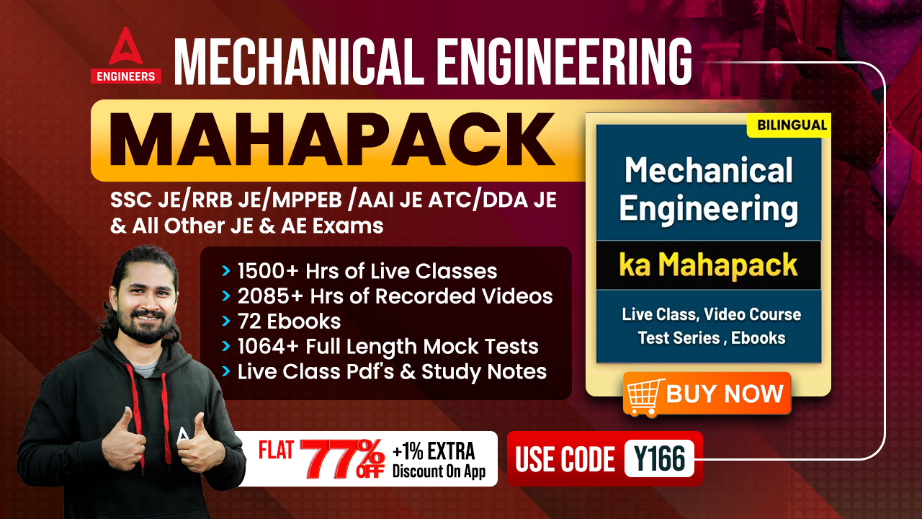

Slide 24
1000Qs For All AE/JE Exams | Mechanical Engg | Questions + Answer
Mechanical Engineering
Q. Availability function is expressed as_
A. a = (u + p_{o}u+T_{o}s)
B. a = (du + p_{o}dv +T_{o}ds)
C. a = (du + p_{o}dv - T_{o}ds)
D. a = (u + p_{o}u + T_{o}s)
For 78% Discount
Use Code : “Y166”
78% Discount
Y166
Mentor : Shivam Gupta
For Complete theory and concepts join our Mahapack Batch, Use Code Y166 For 78% of Discount

Slide 25
1000Qs For All AE/JE Exams | Mechanical Engg | Questions + Answer
Mechanical Engineering
Q. In steam and other vapour cycles, the process of removing non-condensable is called-
A. Scavenging process
B. Deaeration process
C. Exhaust process
D. Condensation process
For 78% Discount
Use Code : “Y166”
78% Discount
Y166
Mentor : Shivam Gupta
For Complete theory and concepts join our Mahapack Batch, Use Code Y166 For 78% of Discount

Slide 26
1000Qs For All AE/JE Exams | Mechanical Engg | Questions + Answer
Mechanical Engineering
Q. The steam is boiler drum is always.
A. Wet
B. Dry
C. Super heat
D. Wet or Dry
For 78% Discount
Use Code : “Y166”
78% Discount
Y166
Mentor : Shivam Gupta
For Complete theory and concepts join our Mahapack Batch, Use Code Y166 For 78% of Discount

Slide 27
1000Qs For All AE/JE Exams | Mechanical Engg | Questions + Answer
Mechanical Engineering
Q. An Economizer is installed in a boiler primarily to-
A. Super heat the steam
B. Reduce fuel consumption
C. Increase steam pressure
D. all of above
For 78% Discount
Use Code : “Y166”
78% Discount
Y166
Mentor : Shivam Gupta
For Complete theory and concepts join our Mahapack Batch, Use Code Y166 For 78% of Discount

Slide 28
1000Qs For All AE/JE Exams | Mechanical Engg | Questions + Answer
Mechanical Engineering
Q. Ratio of heat absorbs by feed water to the heat supplied by fuel in a given time, is known as_
A. Factor of Evaporation
B. Equivalent Evaporation
C. Boiler Efficiency
D. Power of a boiler
For 78% Discount
Use Code : “Y166”
78% Discount
Y166
Mentor : Shivam Gupta
For Complete theory and concepts join our Mahapack Batch, Use Code Y166 For 78% of Discount

Slide 29
1000Qs For All AE/JE Exams | Mechanical Engg | Questions + Answer
Mechanical Engineering
Q. Diesel cycle consists of _
A. Two adiabatic and two constant volume process
B. Two adiabatic and two constant pressure process
C. Two adiabatics, one constant pressure and one constant volume process
D. Two isothermal, one constant pressure and one constant volume process
For 78% Discount
Use Code : “Y166”
78% Discount
Y166
Mentor : Shivam Gupta
For Complete theory and concepts join our Mahapack Batch, Use Code Y166 For 78% of Discount

Slide 30
1000Qs For All AE/JE Exams | Mechanical Engg | Questions + Answer
Mechanical Engineering
Q. Brayton cycle consists of sets of process-
A. Isentropic and constant volume
B. Isentropic and constant pressure
C. Isothermal and constant pressure
D. Isothermal and constant volume
For 78% Discount
Use Code : “Y166”
78% Discount
Y166
Mentor : Shivam Gupta
For Complete theory and concepts join our Mahapack Batch, Use Code Y166 For 78% of Discount

Slide 31
1000Qs For All AE/JE Exams | Mechanical Engg | Questions + Answer
Mechanical Engineering
Q. White metal is an alloy of!
A. Copper and Zinc
B. Copper and Tin
C. Copper, Tin and Zinc
D. Copper, Tin and Antimony
For 78% Discount
Use Code : “Y166”
78% Discount
Y166
Mentor : Shivam Gupta
For Complete theory and concepts join our Mahapack Batch, Use Code Y166 For 78% of Discount

Slide 32
1000Qs For All AE/JE Exams | Mechanical Engg | Questions + Answer
Mechanical Engineering
Q. Pressure of cobalt in steel improves its_
A. Cutting ability
B. Corrosion resistance
C. Strength & Hardness
D. None
For 78% Discount
Use Code : “Y166”
78% Discount
Y166
Mentor : Shivam Gupta
For Complete theory and concepts join our Mahapack Batch, Use Code Y166 For 78% of Discount

Slide 33
1000Qs For All AE/JE Exams | Mechanical Engg | Questions + Answer
Mechanical Engineering
Q. Carbon percentage is same in cast iron and-
A. Wrought Iron
B. Pig Iron
C. Mild Steel
D. High Silicon
For 78% Discount
Use Code : “Y166”
78% Discount
Y166
Mentor : Shivam Gupta
For Complete theory and concepts join our Mahapack Batch, Use Code Y166 For 78% of Discount

Slide 34
1000Qs For All AE/JE Exams | Mechanical Engg | Questions + Answer
Mechanical Engineering
Q. Which key permits axial movement as well as transmits a turning moment.?
A. Feather key
B. Dowel Key
C. Saddle key
D. Woodruff key
For 78% Discount
Use Code : “Y166”
78% Discount
Y166
Mentor : Shivam Gupta
For Complete theory and concepts join our Mahapack Batch, Use Code Y166 For 78% of Discount

Slide 35
1000Qs For All AE/JE Exams | Mechanical Engg | Questions + Answer
Mechanical Engineering
Q. The longitudinal joint in a boiler shell is usually_
A. Butt joint
B. Lap joint
C. Butt joint with two cover plates
D. Butt joint with single cover plate
For 78% Discount
Use Code : “Y166”
78% Discount
Y166
Mentor : Shivam Gupta
For Complete theory and concepts join our Mahapack Batch, Use Code Y166 For 78% of Discount

Slide 36
1000Qs For All AE/JE Exams | Mechanical Engg | Questions + Answer
Mechanical Engineering
Q. The firing order for a six cylinder engine is-
A. 1-6-2-5-3-4
B. 1-5-3-6-2-4
C. 1-2-5-4-3-6
D. 1-3-2-6-5-4
For 78% Discount
Use Code : “Y166”
78% Discount
Y166
Mentor : Shivam Gupta
For Complete theory and concepts join our Mahapack Batch, Use Code Y166 For 78% of Discount

Slide 37
1000Qs For All AE/JE Exams | Mechanical Engg | Questions + Answer
Mechanical Engineering
Q. Cavitation is caused by !
A. High velocity
B. Low barometric pressure
C. High pressure
D. Low pressure
For 78% Discount
Use Code : “Y166”
78% Discount
Y166
Mentor : Shivam Gupta
For Complete theory and concepts join our Mahapack Batch, Use Code Y166 For 78% of Discount

Slide 38
1000Qs For All AE/JE Exams | Mechanical Engg | Questions + Answer
Mechanical Engineering
Q. What is the value of taper angle provided in draft allowances-?
A. 11°-12°
B. 0°-3°
C. 5°-7°
D. 8°-10°
For 78% Discount
Use Code : “Y166”
78% Discount
Y166
Mentor : Shivam Gupta
For Complete theory and concepts join our Mahapack Batch, Use Code Y166 For 78% of Discount

Slide 39
1000Qs For All AE/JE Exams | Mechanical Engg | Questions + Answer
Mechanical Engineering
Q. A nozzle meter is used to measure:-
A. Viscosity
B. Flow rate
C. Volume
D. Velocity
For 78% Discount
Use Code : “Y166”
78% Discount
Y166
Mentor : Shivam Gupta
For Complete theory and concepts join our Mahapack Batch, Use Code Y166 For 78% of Discount

Slide 40
1000Qs For All AE/JE Exams | Mechanical Engg | Questions + Answer
Mechanical Engineering
Q. A circular shaft is subjected to torque. The torsional rigidity is defined as:.
A. product of polar moment of inertia and modulus of rigidity
B. ratio of torque and polar moment of inertia
C. product of torque and length
D. sum of polar moment of inertia and modulus of rigidity
For 78% Discount
Use Code : “Y166”
78% Discount
Y166
Mentor : Shivam Gupta
For Complete theory and concepts join our Mahapack Batch, Use Code Y166 For 78% of Discount

Slide 41
1000Qs For All AE/JE Exams | Mechanical Engg | Questions + Answer
Mechanical Engineering
Q. What is the purpose of crowning of pulleys.?
A. To prevent belt running off the pulley
B. To increase the tightness of the belt on the pulley
C. To increase the torque transmitted
D. To improve the shape and strength of pulley
For 78% Discount
Use Code : “Y166”
78% Discount
Y166
Mentor : Shivam Gupta
For Complete theory and concepts join our Mahapack Batch, Use Code Y166 For 78% of Discount

Slide 42
1000Qs For All AE/JE Exams | Mechanical Engg | Questions + Answer
Mechanical Engineering
Q. Which of the following is a Natural Circulation' boiler.?
A. Cochran
B. Velox
C. Benson
D. Lamont
For 78% Discount
Use Code : “Y166”
78% Discount
Y166
Mentor : Shivam Gupta
For Complete theory and concepts join our Mahapack Batch, Use Code Y166 For 78% of Discount

Slide 43
1000Qs For All AE/JE Exams | Mechanical Engg | Questions + Answer
Mechanical Engineering
Q. In an isothermal process, the internal energy of ideal gas:_
A. increases
B. may increase or decrease, depends on properties of gas
C. remain constant
D. decreases
For 78% Discount
Use Code : “Y166”
78% Discount
Y166
Mentor : Shivam Gupta
For Complete theory and concepts join our Mahapack Batch, Use Code Y166 For 78% of Discount

Slide 44
1000Qs For All AE/JE Exams | Mechanical Engg | Questions + Answer
Mechanical Engineering
Q. A tank containing air is stirred by a paddle wheel. The work input to the wheel is 14000 kJ and heat transferred to the surrounding from the tank is 5000 kJ. The change in internal energy of the system (air) is:-
A. -9000 kJ
B. +9000 KJ
C. +19000 kJ
D. -19000 KJ
For 78% Discount
Use Code : “Y166”
78% Discount
Y166
Mentor : Shivam Gupta
For Complete theory and concepts join our Mahapack Batch, Use Code Y166 For 78% of Discount

Slide 45
1000Qs For All AE/JE Exams | Mechanical Engg | Questions + Answer
Mechanical Engineering
Q. Which of the following is true regarding a basic shaft-?
A. Lower deviation is zero
B. Upper deviation is zero
C. Both lower deviation and upper deviation are zero
D. Lower deviation is one and upper deviation is zero
For 78% Discount
Use Code : “Y166”
78% Discount
Y166
Mentor : Shivam Gupta
For Complete theory and concepts join our Mahapack Batch, Use Code Y166 For 78% of Discount

Slide 46
1000Qs For All AE/JE Exams | Mechanical Engg | Questions + Answer
Mechanical Engineering
HW. For viscous flow the co-efficient of frictions is given by..
f = 8/Re
f = 16/Re
f = 64/Re
f = 32/Re
For 78% Discount
Use Code : “Y166”
78% Discount
Y166
Mentor : Shivam Gupta
For Complete theory and concepts join our Mahapack Batch, Use Code Y166 For 78% of Discount

