Slide 1
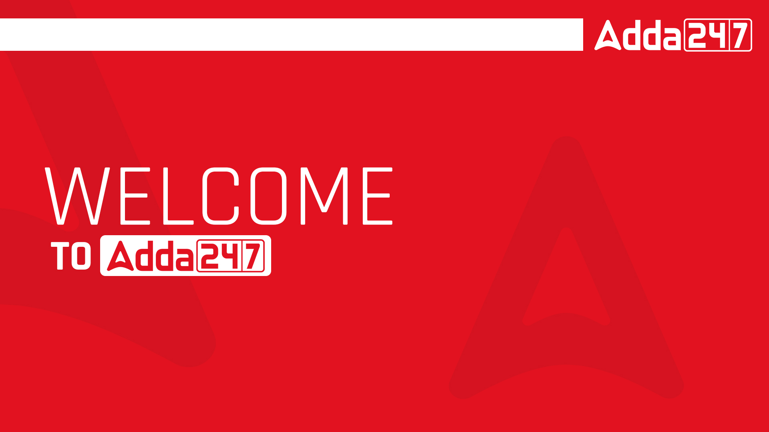

Slide 2


Slide 3


Slide 4

SSC JE 2023 | Reasoning Classes | By Abhishek Sir
Q1. In a code language, ‘REACTION’ is written as ‘9-22-26-24-7-18-12-13’ and ‘SCIENCE’ is written as ‘8-24-18-22-13-24-22’. How will ‘CHEMICAL’ be written in that language?(SSC JE 2022)
(a) 24-18-22-14-19-24-26-15
(b) 23-19-22-14-18—23-26-15
(c) 24-16-21-14-17-24-26-15
(d) 24-19-22-14-18-24-26-15

Slide 5
SSC JE 2023 | Reasoning Classes | By Abhishek Sir
Q2. Select the option that indicates the correct arrangement of the given words in the order they appear in an English dictionary.
(SSC JE 2022)
1. Compassion 2. Complexion
3. Complacency 4. Competence
5. Compatible 6. Compendious
(a) 5, 1, 4, 6, 3, 2
(b) 1, 5, 6, 4, 3, 2
(c) 5, 1, 4, 6, 2, 3
(d) 1, 5, 4, 6, 3, 2

Slide 6
SSC JE 2023 | Reasoning Classes | By Abhishek Sir
Q3. Select the option that is related to the fifth term in the same way as the second term is related to the first term and the fourth term is related to the third term.
HONEST: TSENOH :: JUNGLE : ELGNUJ :: CHEWING: ?
(SSC JE 2022)
(a) GNIEWHC
(b) GNWIEHC
(c) GNIWHEC
(d) GNIWEHC

Slide 7
SSC JE 2023 | Reasoning Classes | By Abhishek Sir
Q4. City C is north of the mid-point of the horizontal line joining city A and city B. City A is to the north-east of city E and south-west of city C. If city D is to the east of city C and north of city B, then what is the position of city D with respect to city E?
शहर C, शहर A और शहर B को मिलाने वाली क्षैतिज रेखा के मध्य-बिंदु के उत्तर में है। शहर A, शहर E के उत्तर-पूर्व में और शहर C के दक्षिण-पश्चिम में है। यदि शहर D, शहर C के पूर्व में है और शहर B के उत्तर में है, तो शहर E के सन्दर्भ में शहर D का स्थान क्या है?
(SSC JE 2022)
(a) East
(b) South – west
(c) North
(d) North – east

Slide 8
SSC JE 2023 | Reasoning Classes | By Abhishek Sir
Q5. Select the option that is related to the fifth term in the same way as the second term is related to the first term and the fourth term is related to the third term.
TIN3 : VGP15 :: MAN4 : OYP20 :: NUT8 : ?(SSC JE 2022)
(a) PVV40
(b) PSV32
(c) PWV40
(d) PSV40

Slide 9
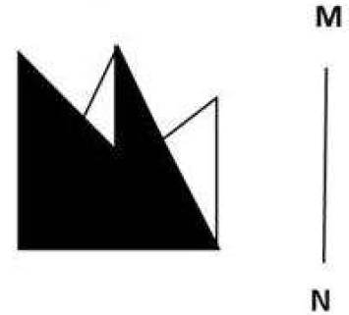




SSC JE 2023 | Reasoning Classes | By Abhishek Sir
Q6. Select the correct mirror image of the given figure when the mirror is placed at MN as shown below. (SSC JE 2022)
(a) (b) (c) (d)

Slide 10
SSC JE 2023 | Reasoning Classes | By Abhishek Sir
Q7. Select the combination of letters that when sequentially placed in the blanks of the given series, will complete the series.
_ KJ _ KJJK _ J _ _ (SSC JE 2022)
(a) JJKJK
(b) JJJKJ
(c) KJKKJ
(d) KKJKK

Slide 11
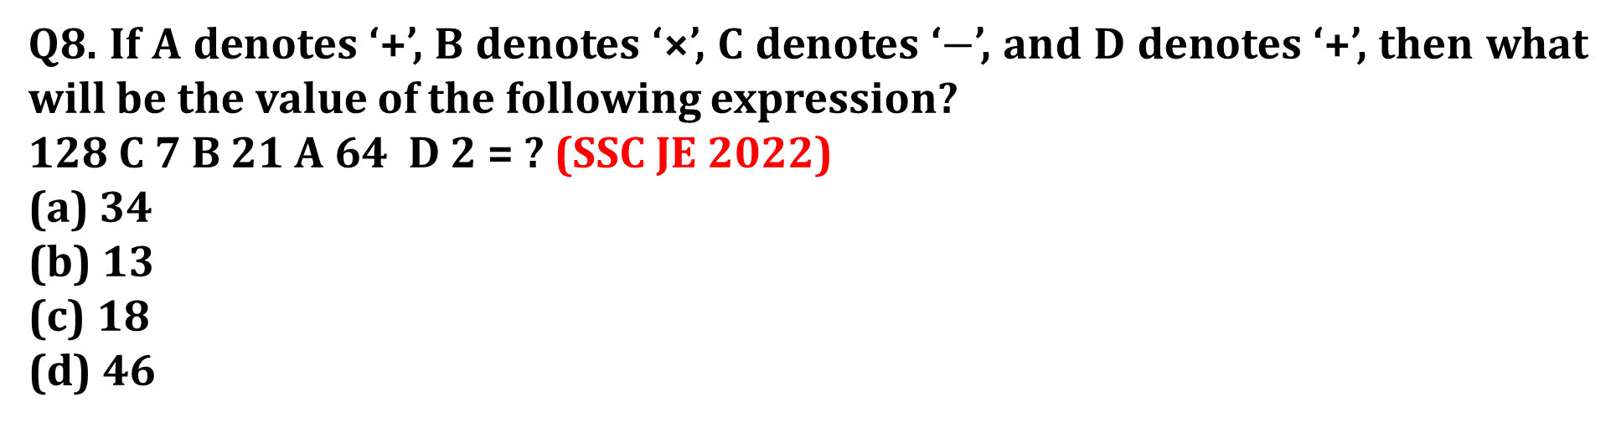
SSC JE 2023 | Reasoning Classes | By Abhishek Sir
Q8. If A denotes ‘+’, B denotes ‘×’, C denotes ‘$−$’, and D denotes ‘+’, then what will be the value of the following expression?
128 C 7 B 21 A 64 D 2 = ? (SSC JE 2022)
(a) 34
(b) 13
(c) 18
(d) 46

Slide 12
SSC JE 2023 | Reasoning Classes | By Abhishek Sir
Q9. In this question three statements are given followed by three conclusions I, II and I".
You have to consider the three statements to be true even if they seem to be at variance from commonly known facts. Read all the conclusions and then decide which of the given conclusion(s) logically follow(s) from the given statements. .(SSC JE 2022)
Statements:
All birds are kites.
Some kites are imported.
No imported thing is red.
Conclusions:
(I) No kite is red.
(ll) Some birds are red.
(Ill) Some kites are red
(a) Only conclusion III follows.
(b) Only conclusion II follows.
(c) All conclusions I, II and III follow
(d) None of the conclusions follow.

Slide 13
SSC JE 2023 | Reasoning Classes | By Abhishek Sir
Q11. Which of the following numbers will replace the question mark (?) in the given series?
83, 69, 57, ?, 39, 33, 29(SSC JE 2022)
(a) 37
(b) 53
(c) 49
(d) 47

Slide 14
SSC JE 2023 | Reasoning Classes | By Abhishek Sir
Q12. Sia starts from Point A and drives 10.7 km towards the north. She then takes a right turn, drives 8.2 km, turns right and drives 14.3 km. She then takes a right turn and drives 5.4 km. Further she takes a right turn, drives 3.2 km and takes a final left turn, drives 2.8km and stops at Point P. How far and towards which direction should she now drive in order to reach Point A again? (All turns are 90 degree turns only) (SSC JE 2022)
(a) 0.4 km, west
(b) 0.6 km, north
(c) 0.8 km, north
(d) 0.4 km, north
सिया बिंदु A से शुरू होती है और उत्तर की ओर 10.7 किमी चलती है। फिर वह दाएं मुड़ती है, 8.2 किमी ड्राइव करती है, दाएं मुड़ती है और 14.3 किमी ड्राइव करती है। फिर वह दाएं मुड़ती है और 5.4 किमी चलती है। इसके बाद वह दाएं मुड़ती है, 3.2 किमी ड्राइव करती है और अंतिम बाएं मुड़ती है, 2.8 किमी ड्राइव करती है और बिंदु P पर रुकती है। बिंदु A पर फिर से पहुंचने के लिए उसे अब कितनी दूर और किस दिशा में गाड़ी चलानी चाहिए?

Slide 15
SSC JE 2023 | Reasoning Classes | By Abhishek Sir
Q12. Sia starts from Point A and drives 10.7 km towards the north. She then takes a right turn, drives 8.2 km, turns right and drives 14.3 km. She then takes a right turn and drives 5.4 km. Further she takes a right turn, drives 3.2 km and takes a final left turn, drives 2.8km and stops at Point P. How far and towards which direction should she now drive in order to reach Point A again? (All turns are 90 degree turns only) (SSC JE 2022)
(a) 0.4 km, west
(b) 0.6 km, north
(c) 0.8 km, north
(d) 0.4 km, north

Slide 16
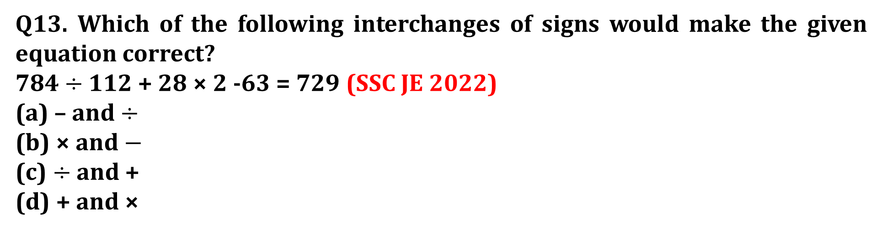
SSC JE 2023 | Reasoning Classes | By Abhishek Sir
Q13. Which of the following interchanges of signs would make the given equation correct?
784 $÷$ 112 + 28 × 2 -63 = 729 (SSC JE 2022)
(a) – and $÷$
(b) × and $−$
(c) $÷$ and +
(d) + and ×

Slide 17

SSC JE 2023 | Reasoning Classes | By Abhishek Sir
Q14. If A denotes ‘+’, B denotes ‘×’, B denotes ‘×’, C denotes ‘-’, and D denotes ‘$÷$’, then what will be the value of the following expression?
121 D 11 A 15 C 6 B 3 = ? (SSC JE 2022)
(a) 6
(b) 4
(c) $12$
(d) 8

Slide 18
SSC JE 2023 | Reasoning Classes | By Abhishek Sir
Q15. Select the set in which the numbers are related in the same way as are the numbers of the following set.
(NOTE: Operations should be performed on the whole numbers, without breaking down the numbers into its constituent digits. E.g. 13 — Operations on 13 such as adding /subtracting /multiplying etc. to 13 can be performed. Breaking down 13 into 1 and 3 and then performing mathematical operations on 1 and 3 is NOT allowed)
(317, 518, 719)
(427, 628, 829) (SSC JE 2022)
(a) (405, 506, 707)
(b) (292, 493, 694)
(c) (397, 598, 709)
(d) (352, 556, 708)

Slide 19
SSC JE 2023 | Reasoning Classes | By Abhishek Sir
Q16. Select the set in which the numbers are NOT related in the same way as are the numbers of the given set.
(NOTE: Operations should be performed on the whole numbers, without breaking down the numbers into its constituent digits. E.g. 13 — Operations on 13 such as adding /subtracting /multiplying etc. to 13 can be performed. Breaking down 13 into 1 and 3 and then performing mathematical operations on 1 and 3 is not allowed)
(12, 18, 108) (SSC JE 2022)
(a) (16, 12, 156)
(b) (22, 18, 198)
(c) (18, 16, 144)
(d) (28, 14, 196)

Slide 20
SSC JE 2023 | Reasoning Classes | By Abhishek Sir
Q17. Select the set in which the numbers are related in the same way as are the numbers of the given sets.
(NOTE : Operations should be performed on the whole numbers, without breaking down the numbers into its constituent digits. E.g. 13 — Operations on 13 such as adding /subtracting /multiplying etc. to 13 can be performed. Breaking down 13 into 1 and 3 and then performing mathematical operations on 1 and 3 is not allowed.)
(37, 42, 126)
(21, 26, 78)
(SSC JE 2022)
(a) (33, 38, 114)
(b) (30, 36, 118)
(c) (28, 35, 110)
(d) (24, 30, 90)

Slide 21
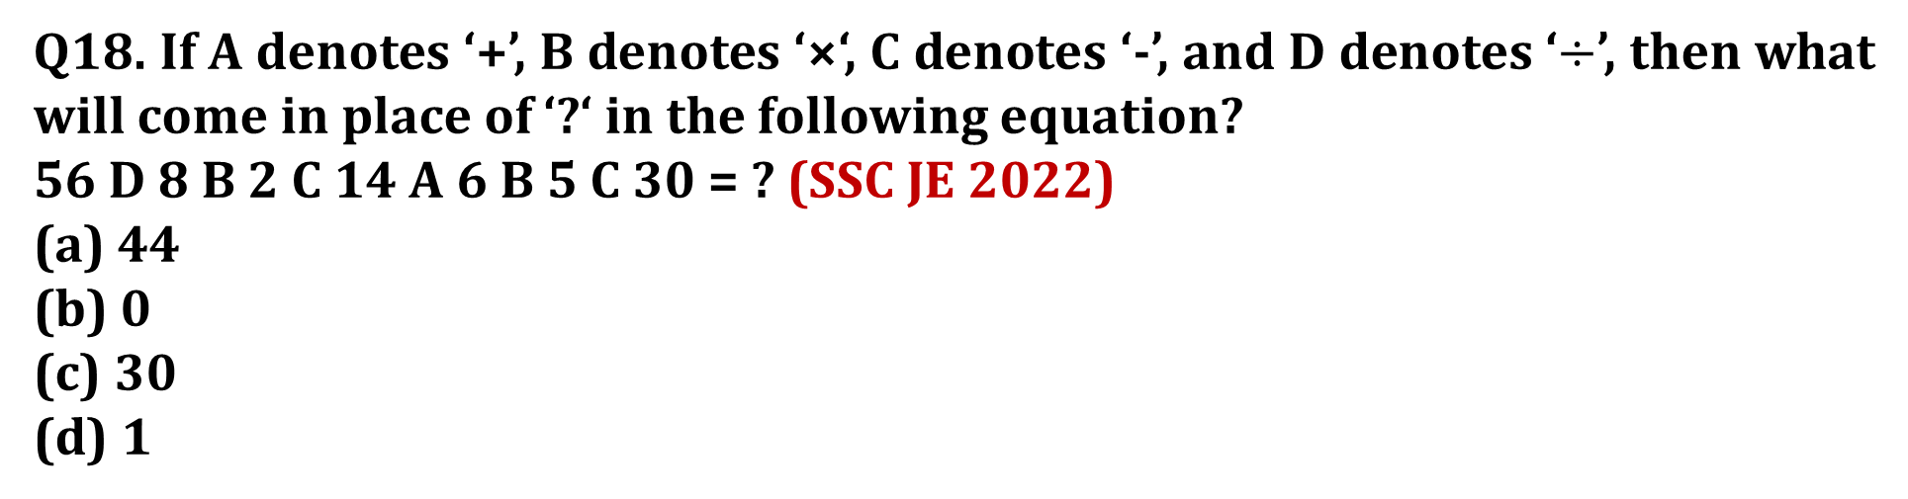
SSC JE 2023 | Reasoning Classes | By Abhishek Sir
Q18. If A denotes ‘+’, B denotes ‘×‘, C denotes ‘-’, and D denotes ‘$÷$’, then what will come in place of ‘?‘ in the following equation?
56 D 8 B 2 C 14 A 6 B 5 C 30 = ? (SSC JE 2022)
(a) 44
(b) 0
(c) 30
(d) 1

Slide 22
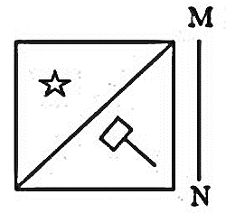
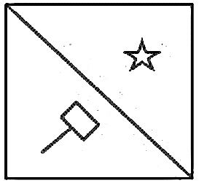
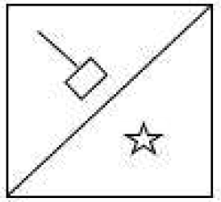
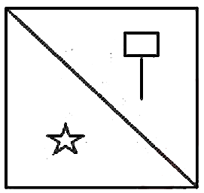
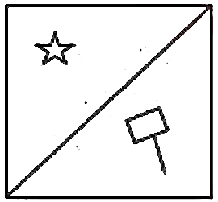
SSC JE 2023 | Reasoning Classes | By Abhishek Sir
Q19. Select the correct mirror image of the given figure when the mirror is placed at line MN as shown.
(SSC JE 2022)
(a) (b) (c) (d)

Slide 23
SSC JE 2023 | Reasoning Classes | By Abhishek Sir
Q20. Select the correct option that indicates the arrangement of the following words in a logical and meaningful order.
1. Baby 2. Embryo 3. Kid 4. Foetus 5. Teenager
(SSC JE 2022)
(a) 1, 4, 2, 3, 5
(b) 2, 4, 1, 3, 5
(c) 4, 2, 1, 3, 5
(d) 3, 2, 1, 4, 5

Slide 24
SSC JE 2023 | Reasoning Classes | By Abhishek Sir
Q21. Two statements are given, followed by two conclusions numbered l and II. Assuming the statements to be true, even if they seem to be at variance with commonly known facts, decide which of the conclusions logically follow(s) from the statements.
Statements:
Some scribbles are drawings.
Some drawings are paintings.
Conclusions:
I. All drawings are scribbles.
ll. Some scribbles are definitely not paintings.
(SSC JE 2022)
(a) Only conclusion I follows
(b) Both conclusions I and II follow
(c) Neither conclusion I nor II follows
(d) Only conclusion II follows

Slide 25
SSC JE 2023 | Reasoning Classes | By Abhishek Sir
Q22. Eight people are sitting in two parallel rows with four people each in such a way that there is equal distance between adjacent persons. B, L, O and T are seated in the same row facing South. A, C, K and P are seated in the same row facing North. C sits at the extreme left end of their row and is the immediate neighbour of A. K sits between A and P and is exactly opposite L. T sits exactly opposite P. O does not sit at the extreme corner of their row.
Who sits exactly opposite A?(SSC JE 2022)
(a) T
(b) O
(c) B
(d) L
आठ व्यक्ति दो समानांतर पंक्तियों में चार-चार व्यक्तियों के साथ इस प्रकार बैठे हैं कि अगल-बगल के व्यक्तियों के बीच समान दूरी है। B, L, O और T समान पंक्ति में दक्षिण की ओर मुख करके बैठे हैं। A, C, K और P समान पंक्ति में उत्तर की ओर उन्मुख होकर बैठे हैं। C उनकी पंक्ति के अंतिम छोर पर बैठा है और A का निकटतम पड़ोसी है। K, A और P के बीच में बैठा है और L के ठीक विपरीत बैठा है। T, P के ठीक विपरीत बैठा है। O उनकी पंक्ति के अंतिम कोने पर नहीं बैठा है।

Slide 26
SSC JE 2023 | Reasoning Classes | By Abhishek Sir
Q22. Eight people are sitting in two parallel rows with four people each in such a way that there is equal distance between adjacent persons. B, L, O and T are seated in the same row facing South. A, C, K and P are seated in the same row facing North. C sits at the extreme left end of their row and is the immediate neighbour of A. K sits between A and P and is exactly opposite L. T sits exactly opposite P. O does not sit at the extreme corner of their row.
Who sits exactly opposite A?(SSC JE 2022)
(a) T
(b) O
(c) B
(d) L

Slide 27
SSC JE 2023 | Reasoning Classes | By Abhishek Sir
Q23. Select the option that is related to the third word in the same way as the second word is related to the first word. (The words must be considered as meaningful English words and must not be related to each other based on the number of letters/number of consonants/vowels in the word.)
Rectangle : Line :: Circle: ? (SSC JE 2022)
(a) Round
(b) Radius
(c) Radius
(d) Arc

Slide 28
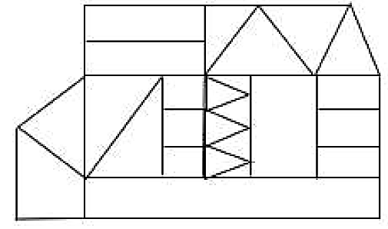
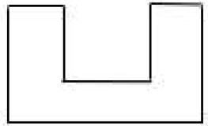
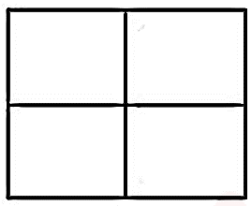
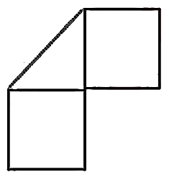
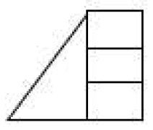
SSC JE 2023 | Reasoning Classes | By Abhishek Sir
Q24. Select the option figure which is embedded in the given figure as its part (rotation is NOT allowed).
(SSC JE 2022)
(a) (b) (c) (d)

Slide 29
SSC JE 2023 | Reasoning Classes | By Abhishek Sir
Q25. In a certain code language, 'WHATEVER' is written as '204' and 'TOGETHER' is written as '196’. How will 'TRAINING' be written in that language?(SSC JE 2022)
(a) 190
(b) 184
(c) 182
(d) 188

Slide 30
SSC JE 2023 | Reasoning Classes | By Abhishek Sir
Q26. Which of the following letter-clusters will replace the question mark (?) in the given series?
EM, JP, 0V, TE, ? (SSC JE 2022)
(a) XQ
(b) YR
(c) ZQ
(d) YQ

Slide 31
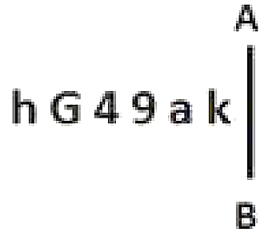
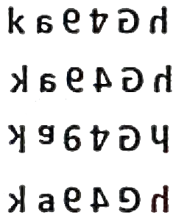
SSC JE 2023 | Reasoning Classes | By Abhishek Sir
Q27. Select the correct mirror image of the given combination when the mirror is placed at line ‘AB’ as shown. (SSC JE 2022)
(a)
(b)
(c)
(d)

Slide 32
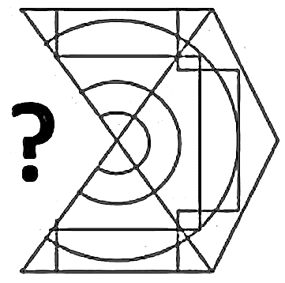
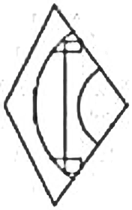
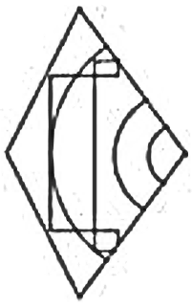
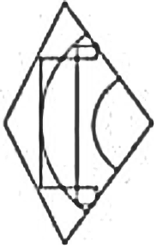
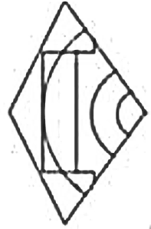
SSC JE 2023 | Reasoning Classes | By Abhishek Sir
Q28. Select the figure from the options that can replace the question mark (?) and complete the pattern.
(SSC JE 2022)
(a) (b) (c) (d)

Slide 33
SSC JE 2023 | Reasoning Classes | By Abhishek Sir
Q29. Which letter-cluster will replace the question mark (1’) to complete the given series?
GJLD, ?, KZPT, MURO, OPTJ
(SSC JE 2022)
(a) JFNN
(b) HFNZ
(c) HGMX
(d) IENY

Slide 34
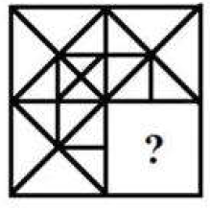




SSC JE 2023 | Reasoning Classes | By Abhishek Sir
Q30. Select the figure from the options that can replace the question mark (?) and complete the pattern (rotation is NOT allowed).
(SSC JE 2022)
(a) (b) (c) (d)

Slide 35
SSC JE 2023 | Reasoning Classes | By Abhishek Sir
Q31. Select the correct option that indicates the arrangement of the following words in a logical and meaningful order.
1. Adult Butterfly
2. Eggs
3. Pupa
4. Caterpillar
5. Emerging Butterfly
(SSC JE 2022)
(a) 2, 4, 3, 5, 1
(b) 3, 2, 4, 5, 1
(c) 4, 3, 2, 1, 5
(d) 5, 3, 2, 1, 4

Slide 36
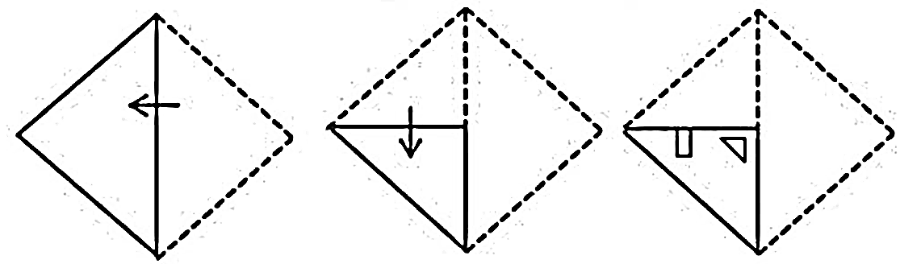

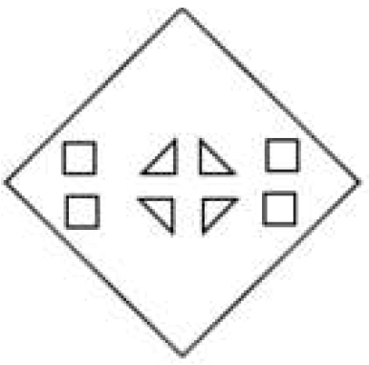
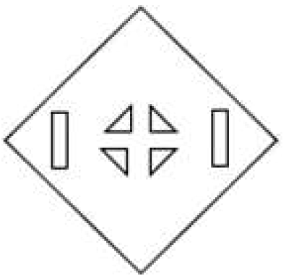
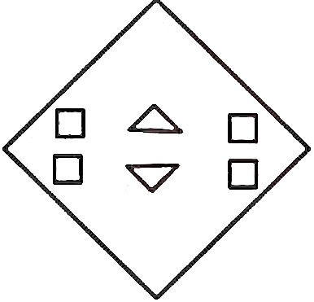
SSC JE 2023 | Reasoning Classes | By Abhishek Sir
Q32. A paper is folded and cut as shown below. How will it appear when unfolded?
(SSC JE 2022)
(a) (b) (c) (d)

Slide 37
SSC JE 2023 | Reasoning Classes | By Abhishek Sir
Q33. Select the option that represents the correct order of the given words as they would appear in an English dictionary.
1. Adaptation
2. Adjunct
3. Addendum
4. Adjacent
5. Advocate
6. Adjudicate
7. Adjourn
(SSC JE 2022)
(a) 1, 3, 4, 6, 7, 2, 5 (b) 1, 3, 4, 6, 2, 7. 5
(c) 1, 3, 4, 7, 2, 6, 5 (d) 1, 3, 4, 7, 6, 2, 5

Slide 38
SSC JE 2023 | Reasoning Classes | By Abhishek Sir
Q34. Select the word-pair that best represents a similar relationship to the one expressed in the pair of words given below. (The words must be considered as meaningful English words and must NOT be related to each other based on the number of letters/ number of consonants / vowels in the word)
Bold : Timid
(SSC JE 2022)
(a) Tranquil : Excitable
(b) Facile : Easy
(c) Ambitious : Crucial
(d) Burdensome : Laborious

Slide 39
SSC JE 2023 | Reasoning Classes | By Abhishek Sir
Q35. Pointing towards a man, Pushpa, who is a girl, said, “He is the father-in-law of my father’s wife”. How is Pushpa related to the man?
एक पुरुष की ओर संकेत करते हुए पुष्पा, जो एक लड़की है, ने कहा, “वह मेरे पिता की पत्नी का ससुर है”। पुष्पा उस आदमी से किस प्रकार संबंधित है?
(SSC JE 2022)
(a) Sister
(b) Mother
(c) Paternal granddaughter
(d) Daughter

Slide 40
SSC JE 2023 | Reasoning Classes | By Abhishek Sir
Q36. Select the set in which the numbers are related in the same way as are the numbers of the given sets.
(NOTE : Operations should be performed on the whole numbers, without breaking down the numbers into its constituent digits. E.g. 13 — Operations on 13 such as adding /subtracting /multiplying etc. to 13 can be performed. Breaking down 13 into 1 and 3 and then performing mathematical operations on 1 and 3 is not allowed.)
(26, 74, 41)
(33, 81, 48)
(SSC JE 2022)
(a) (42, 80, 57) (b) (36, 74, 31)
(c) (44, 92, 59) (d) (39, 79, 45)

Slide 41
SSC JE 2023 | Reasoning Classes | By Abhishek Sir
Q37. Select the number from among the given options that can replace the question mark (?) in the following series.
12, 101, 45, 134, 78, 167, ?
(SSC JE 2022)
(a) 124
(b) 118
(c) 111
(d) 120

Slide 42
SSC JE 2023 | Reasoning Classes | By Abhishek Sir
Q38. Select the option that represents the letters that when placed from left to right in the blanks below will complete the letter series.
K _ J _ ON _ MJ _ ON _ M _ L _ NK _ JL _ _
(SSC JE 2022)
(a) LMKLJKOMNO
(b) MLLKKJONOM
(c) LMKLKJOMON
(d) MLKLKJOMON

Slide 43
SSC JE 2023 | Reasoning Classes | By Abhishek Sir
Q39. In a certain code language, ‘DUST’ is written as ‘64’ and ‘FARM’ is written as ‘38’. How will ‘GOLF’ be written in that language?
एक निश्चित कोड भाषा में, 'DUST' को '64' और 'FARM' को '38' लिखा जाता है। उस भाषा में 'GOLF' कैसे लिखा जाएगा?
(SSC JE 2022)
(a) 52
(b) 36
(c) 54
(d) 40

Slide 44
SSC JE 2023 | Reasoning Classes | By Abhishek Sir
Q40. In a certain code language, 'LAMP' is written as '121512613141611' and 'LANE’ is written as '12151261413522'. How will 'JOYS' be written in that language?
(SSC JE 2022)
(a) 10171512252198
(d) 10171512552598
(c) 10171512252289
(d) 10171422351198

Slide 45
SSC JE 2023 | Reasoning Classes | By Abhishek Sir
Q41. Pointing at a boy, Shikha said, “He is my brother’s mother‘s husband’s son.” How is that boy related to Shikha?
एक लड़के की ओर इशारा करते हुए शिखा ने कहा, "वह मेरे भाई की माँ के पति का बेटा है।" वह लड़का शिखा से किस प्रकार संबंधित है?
(SSC JE 2022)
(a) Brother
(d) Son
(c) Father
(d) Father’s brother

Slide 46
SSC JE 2023 | Reasoning Classes | By Abhishek Sir
Q42. Select the option that is related to the third term in the same way as the second term is related to the first term and the sixth term is related to the fifth term.
143 : 170 :: 255 : ? :: 483 : 530
(SSC JE 2022)
(a) 299
(d) 290
(c) 285
(d) 300

Slide 47
SSC JE 2023 | Reasoning Classes | By Abhishek Sir
Q43. Select the option that represents the correct order of the given words as they would appear in an English dictionary.
1. Legerity
2. Legitimate
3. Legislation
4. Legendary
5. Legalist
6. Legging
(SSC JE 2022)
(a) 5, 4, 6, 2, 1, 3
(d) 5, 4, 1, 2, 6, 3
(c) 5, 4, 6, 3, 1, 2
(d) 5, 4, 1, 6, 3, 2

Slide 48
SSC JE 2023 | Reasoning Classes | By Abhishek Sir
Q44. L, M, N, O, P, Q, R and S are eight people sitting around a square table facing the centre of the table. Some of them sit at the corners while others sit at the exact centre of the sides. R sits at one of the corners of the table with M and O sitting on either of his sides. Q sits to the immediate left of M. P does not sit at any of the corners and is not the immediate neighbour of Q. N sits third to the left of S. Who sits second to the left of P? (SSC JE 2022)
(a) N
(d) L
(c) O
(d) S
L, M, N, O, P, Q, R और S आठ व्यक्ति हैं जो एक वर्गाकार मेज के चारों ओर केंद्र की ओर मुख करके बैठे हैं। उनमें से कुछ कोनों पर बैठते हैं जबकि अन्य भुजाओं के ठीक केंद्र पर बैठते हैं। R मेज के एक कोने पर बैठा है और M और O उसके दोनों ओर बैठे हैं। Q, M के ठीक बायें बैठा है। P किसी भी कोने पर नहीं बैठा है और Q का निकटतम पडोसी नहीं है। N, S के बायें से तीसरे स्थान पर बैठा है। P के बायें से दूसरे स्थान पर कौन बैठा है? (एसएससी जेई 2022)

Slide 49
SSC JE 2023 | Reasoning Classes | By Abhishek Sir
Q44. L, M, N, O, P, Q, R and S are eight people sitting around a square table facing the centre of the table. Some of them sit at the corners while others sit at the exact centre of the sides. R sits at one of the corners of the table with M and O sitting on either of his sides. Q sits to the immediate left of M. P does not sit at any of the corners and is not the immediate neighbour of Q. N sits third to the left of S. Who sits second to the left of P? (SSC JE 2022)
(a) N
(d) L
(c) O
(d) S

Slide 50
SSC JE 2023 | Reasoning Classes | By Abhishek Sir
Q45. J, K, L, M, N, O and P are seven friends of different heights each. O is taller than N but not taller than L. M is the tallest. J is shorter than three of his friends. P is shorter than only M. N is not the shortest. Who amongst the seven friends is the shortest?
J, K, L, M, N, O और P सात मित्र हैं जिनकी लंबाई अलग-अलग है। O, N से लम्बा है लेकिन L से लम्बा नहीं है। M सबसे लम्बा है। J अपने तीन दोस्तों से छोटा है। P केवल M से छोटा है। N सबसे छोटा नहीं है। सात दोस्तों में से कौन सबसे छोटा है? (SSC JE 2022)
(a) M
(d) O
(c) L
(d) K

Slide 51
SSC JE 2023 | Reasoning Classes | By Abhishek Sir
Q46. Which of the given letter-clusters will replace the question mark (?) in the following series ?
FBID, ICMF, LDQH, ?, RFYL (SSC JE 2022)
(a) OETJ
(d) OEWJ
(c) OEUJ
(d) OEVI

Slide 52
SSC JE 2023 | Reasoning Classes | By Abhishek Sir
Q47. Which of the following numbers will replace the question mark (?) and complete the given number series?
108, 133, 162, 195, 232, ? (SSC JE 2022)
(a) 278
(d) 275
(c) 273
(d) 271

Slide 53





SSC JE 2023 | Reasoning Classes | By Abhishek Sir
Q48. Select the figure from the options that can replace the question mark (?) and complete the pattern.
(SSC JE 2022)
(a) (d) (c) (d)

Slide 54
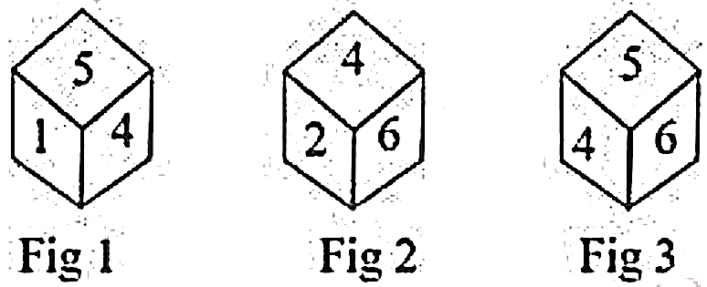
SSC JE 2023 | Reasoning Classes | By Abhishek Sir
Q49. Three different positions of the same dice are shown. Find the number on the face opposite to the face showing 6.
(SSC JE 2022)
(a) 3
(d) 1
(c) 5
(d) 2

Slide 55
SSC JE 2023 | Reasoning Classes | By Abhishek Sir
Q50. Select the word-pair in which the two words are related in the same way as are the two words in the given pair.
(The words must be considered as meaningful English words and must not be related to each other based on the number of letters/number of consonants/vowels in the word)
Cobbler : Awl
(SSC JE 2022)
(a) Farmer : Plier
(d) Gardener : Needle
(c) Blacksmith : Chopper
(d) Surgeon : Scalpel

Slide 56


