Slide 1

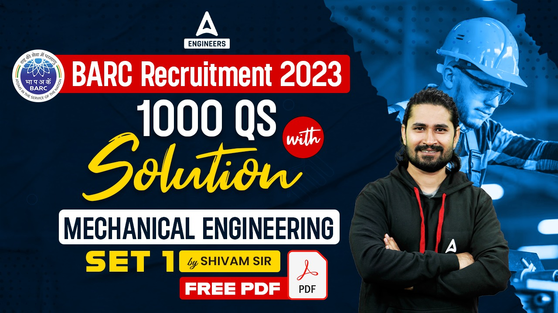

SSC JE Mechanical Previous Year Questions + Answers | Mechanical Engineering
Mechanical Engineering
Q.Which of the following is reason of irreversibility!?
A. Lack of equilibrium during the process
B. involvement of dissipative effects
C. None of the above
D. both a & b
For 78% Discount
Use Code : “Y166”
78% Discount
Y166
9
Join Our Paid Batch : SSC JE Batch | Mahapack Batch | Use Code Y166 For 78% of Discount

Slide 2


Slide 3
1000Qs For All AE/JE Exams | Mechanical Engg | Questions + Answer
Mechanical Engineering
Q. The pulley, which is used to increase the angle of contact, is called a/an _____ pulley_
A. loose
B. fast
C. idler
D. cross belt
For 78% Discount
Use Code : “Y166”
78% Discount
Y166
Mentor : Shivam Gupta
For Complete theory and concepts join our Mahapack Batch, Use Code Y166 For 78% of Discount

Slide 4

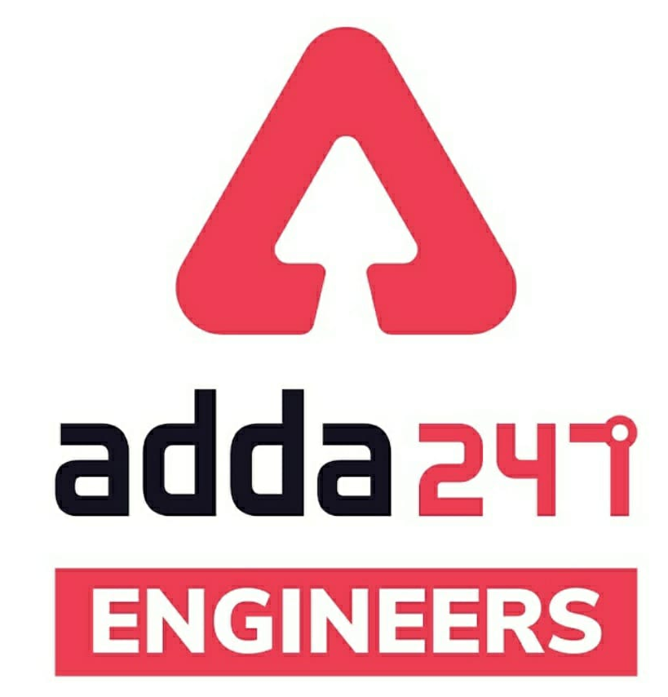

SSC JE Mechanical Previous Year Questions + Answers | Mechanical Engineering
Mechanical Soormas
Sahil Kumar
Subir
Ravi Raj
Shivani Singh
Priyanshu Kushwaha
Amit Kumar
Anuj Kanoujiya
Pankaj Mahato
Lunavath Rajesh
Alok Kumar
Mechanical Queen
Cycle Raja
Ajay Kumar
Dilip Gupta
Atit Ramteke
Warif
Alok Kumar
Ayush Suthar
Raj Yadav
Er. Munish Kumar
Lokesh Varwan
Vikas Dev Pandey
Shiksha Aur Vikas
Sadhan Paul
Deepak Yadav
Aashik Hussain
I’m Groot
Ela Sahoo
for
Code : “Y166”

Slide 5
SSC JE Mechanical Previous Year Questions + Answers | Mechanical Engineering
Mechanical Soormas
Jitendra Kumar
Pawan Singh Rana
Pannelal Kushwaha
Kuntal Maji
Nandan Mehta
Ruby Prajapati
Rajat Bobde
Ajay Kumar
Sudeep Kumar
Krishna India
Narendra Sura
Kuldeet Das
Kunal Kisku
Ram Kushwaha
Akhilesh Gupta
for
Code : “Y166”

Slide 6

SSC JE Mechanical Previous Year Questions + Answers | Mechanical Engineering
Mechanical Engineering
For 78% Discount
Use Code : “Y166”
Join Our Paid Batch : SSC JE Batch | Mahapack Batch | Use Code Y166 For 78% of Discount

Slide 7
1000Qs For All AE/JE Exams | Mechanical Engg | Questions + Answer
Mechanical Engineering
Q. Crowning of a pulley is done to :_
A. prevent the wear and tear of the belt
B. increase strength of the pulley
C. avoid slipping of the belt
D. enable pulley rigidly fixed to the shaft
For 78% Discount
Use Code : “Y166”
78% Discount
Y166
Mentor : Shivam Gupta
For Complete theory and concepts join our Mahapack Batch, Use Code Y166 For 78% of Discount

Slide 8
1000Qs For All AE/JE Exams | Mechanical Engg | Questions + Answer
Mechanical Engineering
Q. The uniform pressure theory as compared to the uniform wear theory gives __.
A. Higher frictional torque
B. Lower frictional torque
C. Either lower or higher frictional torque
D. None of these
For 78% Discount
Use Code : “Y166”
78% Discount
Y166
Mentor : Shivam Gupta
For Complete theory and concepts join our Mahapack Batch, Use Code Y166 For 78% of Discount

Slide 9
1000Qs For All AE/JE Exams | Mechanical Engg | Questions + Answer
Mechanical Engineering
Q. Which of the following statement is INCORRECT about the dry clutch and wet clutch_?
A. Heat dissipation is more difficult in dry clutch.
B. Rate of wear is very less in wet clutches as compared to dry clutches.
C. Torque transmitting capacity of dry clutch is less than wet clutch.
D. Engagement in wet clutch is smoother than dry clutch.
For 78% Discount
Use Code : “Y166”
78% Discount
Y166
Mentor : Shivam Gupta
For Complete theory and concepts join our Mahapack Batch, Use Code Y166 For 78% of Discount

Slide 10
1000Qs For All AE/JE Exams | Mechanical Engg | Questions + Answer
Mechanical Engineering
Q. The equation for the calculation of torque transmitting capacity in the conical clutch as per uniform wear theory is ________.
A.
B.
C.
D.
For 78% Discount
Use Code : “Y166”
78% Discount
Y166
Mentor : Shivam Gupta
For Complete theory and concepts join our Mahapack Batch, Use Code Y166 For 78% of Discount

Slide 11
1000Qs For All AE/JE Exams | Mechanical Engg | Questions + Answer
Mechanical Engineering
Q. In the disc-clutch the clutch acts as a ________-
A. driving member
B. driven member
C. neutral member
D. None of these
For 78% Discount
Use Code : “Y166”
78% Discount
Y166
Mentor : Shivam Gupta
For Complete theory and concepts join our Mahapack Batch, Use Code Y166 For 78% of Discount

Slide 12
1000Qs For All AE/JE Exams | Mechanical Engg | Questions + Answer
Mechanical Engineering
Q. Which of the following clutch is also considered as the wet clutch-?
A. Single plate clutch
B. Multi-plate clutch
C. Both Single plate clutch and M ulti-plate clutch
D. None of these
For 78% Discount
Use Code : “Y166”
78% Discount
Y166
Mentor : Shivam Gupta
For Complete theory and concepts join our Mahapack Batch, Use Code Y166 For 78% of Discount

Slide 13
1000Qs For All AE/JE Exams | Mechanical Engg | Questions + Answer
Mechanical Engineering
Q. Which of the following statement is CORRECT about the dry clutch!?
A. Heat dissipation is more difficult in dry clutch.
B. Rate of wear is more in dry clutches.
C. Dry clutch has the highest coefficient of friction
D. All options correct
For 78% Discount
Use Code : “Y166”
78% Discount
Y166
Mentor : Shivam Gupta
For Complete theory and concepts join our Mahapack Batch, Use Code Y166 For 78% of Discount

Slide 14
1000Qs For All AE/JE Exams | Mechanical Engg | Questions + Answer
Mechanical Engineering
Q. The outer cone of the conical clutch is keyed to the ________ shaft and the inner cone is ________ to slide axially_
A. driven, fixed
B. driving, fixed
C. driving, free
D. driven, free
For 78% Discount
Use Code : “Y166”
78% Discount
Y166
Mentor : Shivam Gupta
For Complete theory and concepts join our Mahapack Batch, Use Code Y166 For 78% of Discount

Slide 15
1000Qs For All AE/JE Exams | Mechanical Engg | Questions + Answer
Mechanical Engineering
Q. Which of the following statement is CORRECT about the wet clutch-?
A. Torque transmitting capacity of wet clutch is higher than the dry clutch.
B. Heat dissipation is easier on the wet clutch as compared to the dry clutch.
C. The engagement of the dry clutch is smoother in the wet clutch.
D. All option are correct
For 78% Discount
Use Code : “Y166”
78% Discount
Y166
Mentor : Shivam Gupta
For Complete theory and concepts join our Mahapack Batch, Use Code Y166 For 78% of Discount

Slide 16
1000Qs For All AE/JE Exams | Mechanical Engg | Questions + Answer
Mechanical Engineering
Q. The torque transmitting capacity of the single plate clutch is calculated by__________.
A.
B.
C.
D.
For 78% Discount
Use Code : “Y166”
78% Discount
Y166
Mentor : Shivam Gupta
For Complete theory and concepts join our Mahapack Batch, Use Code Y166 For 78% of Discount

Slide 17
1000Qs For All AE/JE Exams | Mechanical Engg | Questions + Answer
Mechanical Engineering
Q. Which of the following method is CORRECT for increasing the torque transmitting capacity of the clutch!?
A. Using the frictional material with a higher coefficient of friction.
B. Increase the plate pressure.
C. Increase the mean radius of the friction disk.
D. All options are correct
For 78% Discount
Use Code : “Y166”
78% Discount
Y166
Mentor : Shivam Gupta
For Complete theory and concepts join our Mahapack Batch, Use Code Y166 For 78% of Discount

Slide 18
1000Qs For All AE/JE Exams | Mechanical Engg | Questions + Answer
Mechanical Engineering
Q. Why are gear teeth made harder.?
A. To avoid wear
B. To avoid pitting
C. to avoid abrasion
D. To avoid tensile strength
For 78% Discount
Use Code : “Y166”
78% Discount
Y166
Mentor : Shivam Gupta
For Complete theory and concepts join our Mahapack Batch, Use Code Y166 For 78% of Discount

Slide 19
1000Qs For All AE/JE Exams | Mechanical Engg | Questions + Answer
Mechanical Engineering
Q. Gear teeth are made harder to avoid!
A. greater compressive stress in bending
B. tensile strength
C. abrasion
D. wear
For 78% Discount
Use Code : “Y166”
78% Discount
Y166
Mentor : Shivam Gupta
For Complete theory and concepts join our Mahapack Batch, Use Code Y166 For 78% of Discount

Slide 20
1000Qs For All AE/JE Exams | Mechanical Engg | Questions + Answer
Mechanical Engineering
Q. If the radius of the pitch circle of the gear profile is 50 mm and the value of addendum is 5 mm. What will be the radius of the addendum circle-?
A. 27.5
B. 55
C. 50
D. 52.5
For 78% Discount
Use Code : “Y166”
78% Discount
Y166
Mentor : Shivam Gupta
For Complete theory and concepts join our Mahapack Batch, Use Code Y166 For 78% of Discount

Slide 21
1000Qs For All AE/JE Exams | Mechanical Engg | Questions + Answer
Mechanical Engineering
Q. If pitch diameter is 200 mm and number of teeth are 20 then circular pitch of the gear will be:_
A. 0.314 mm
B. 3.14 mm
C. 31.4 mm
D. 314 mm
For 78% Discount
Use Code : “Y166”
78% Discount
Y166
Mentor : Shivam Gupta
For Complete theory and concepts join our Mahapack Batch, Use Code Y166 For 78% of Discount

Slide 22
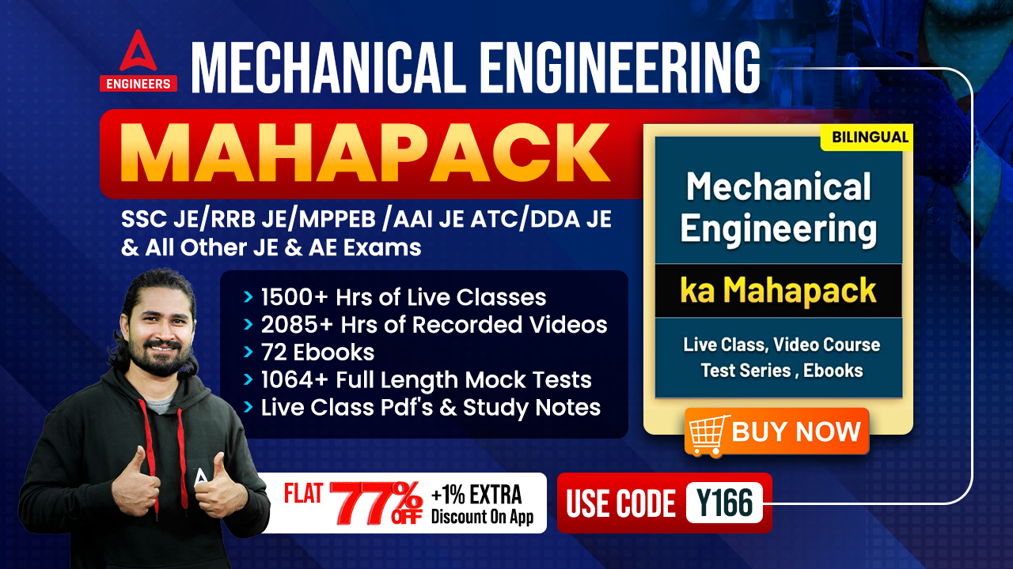
1000Qs For All AE/JE Exams | Mechanical Engg | Questions + Answer
Mechanical Engineering
Q. If the head on the turbine is more than 300m, the type of turbine used should be _
(a) Kaplan
(b) Francis
(c) Pelton wheel
(d) Propeller
For 78% Discount
Use Code : “Y166”
78% Discount
Y166
Mentor : Shivam Gupta
For Complete theory and concepts join our Mahapack Batch, Use Code Y166 For 78% of Discount

Slide 23
1000Qs For All AE/JE Exams | Mechanical Engg | Questions + Answer
Mechanical Engineering
Q. The friction torque, transmitted in case of flat pivot bearing for uniform ratio of wear is equal to--
A. μWR
B.
C.
D.
[2008]
For 78% Discount
Use Code : “Y166”
78% Discount
Y166
Mentor : Shivam Gupta
For Complete theory and concepts join our Mahapack Batch, Use Code Y166 For 78% of Discount

Slide 24
1000Qs For All AE/JE Exams | Mechanical Engg | Questions + Answer
Mechanical Engineering
Q. Which of the following is the best suitable range of working head of Kaplan turbine.?
(a) 5 - 70 m
(b) 500 - 2000 m
(c) 300 - 1500 m
(d) 100 - 300 m
For 78% Discount
Use Code : “Y166”
78% Discount
Y166
Mentor : Shivam Gupta
For Complete theory and concepts join our Mahapack Batch, Use Code Y166 For 78% of Discount

Slide 25
1000Qs For All AE/JE Exams | Mechanical Engg | Questions + Answer
Mechanical Engineering
Q. The critical speed of a turbine is _
(a) same as the runaway speed
(b) the speed that will lead to mechanical failure of the shaft
(c) the speed which equals the natural frequency of the rotor
(d) the speed equal to the synchronous speed of the generator
For 78% Discount
Use Code : “Y166”
78% Discount
Y166
Mentor : Shivam Gupta
For Complete theory and concepts join our Mahapack Batch, Use Code Y166 For 78% of Discount

Slide 26
1000Qs For All AE/JE Exams | Mechanical Engg | Questions + Answer
Mechanical Engineering
Q. In reaction turbine, draft tube is used: -
(a) To transport water downstream without eddies
(b) To convert the kinetic energy to flow energy by a gradual expansion of the flow crosssection
(c) For safety to turbine
(d) To increase the flow rate
For 77% Discount
Use Code : “Y166”
78% Discount
Y166
Mentor : Shivam Gupta
For Complete theory and concepts join our Mahapack Batch, Use Code Y166 For 78% of Discount

Slide 27
1000Qs For All AE/JE Exams | Mechanical Engg | Questions + Answer
Mechanical Engineering
Q. Turbine is a machine which converts:-
(a) mechanical energy to hydraulic energy
(b) Hydraulic energy to mechanical energy
(c) Electrical energy to mechanical energy
(d) Mechanical energy to electrical energy
For 78% Discount
Use Code : “Y166”
78% Discount
Y166
Mentor : Shivam Gupta
For Complete theory and concepts join our Mahapack Batch, Use Code Y166 For 78% of Discount

Slide 28
1000Qs For All AE/JE Exams | Mechanical Engg | Questions + Answer
Mechanical Engineering
Q. Francis turbine is usually used for -
(a) law head installation up to 30 m
(b) medium head installation from 30 m to 180 m
(c) high head installation above 180
(d) for all heads
For 78% Discount
Use Code : “Y166”
78% Discount
Y166
Mentor : Shivam Gupta
For Complete theory and concepts join our Mahapack Batch, Use Code Y166 For 78% of Discount

Slide 29
1000Qs For All AE/JE Exams | Mechanical Engg | Questions + Answer
Mechanical Engineering
Q. A Pelton wheel is ideally suited for : .
(a) High head and low discharge
(b) High head and high discharge
(c) Low head and low discharge
(d) Medium head and medium discharge
For 78% Discount
Use Code : “Y166”
78% Discount
Y166
Mentor : Shivam Gupta
For Complete theory and concepts join our Mahapack Batch, Use Code Y166 For 78% of Discount

Slide 30
1000Qs For All AE/JE Exams | Mechanical Engg | Questions + Answer
Mechanical Engineering
Q. The discharge through a single acting reciprocating pump is [N → rpm]-
A. Q = ALN
B. Q = ALN/60
C. Q = 2 ALN/60
D. Q = ALN
For 78% Discount
Use Code : “Y166”
78% Discount
Y166
Mentor : Shivam Gupta
For Complete theory and concepts join our Mahapack Batch, Use Code Y166 For 78% of Discount

Slide 31
1000Qs For All AE/JE Exams | Mechanical Engg | Questions + Answer
Mechanical Engineering
Q. Multistage centrifugal pumps are used to obtain high”_
A. Pumping of viscous fluids
B. Discharge
C. Head
D. Efficiency
For 77% Discount
Use Code : “Y166”
78% Discount
Y166
Mentor : Shivam Gupta
For Complete theory and concepts join our Mahapack Batch, Use Code Y166 For 78% of Discount

Slide 32
1000Qs For All AE/JE Exams | Mechanical Engg | Questions + Answer
Mechanical Engineering
Q. The ratio of actual measured head to head imparted to fluid by impeller for a centrifugal pump is known as _
A. mechanical
B. volumetric
C. manometric
D. impeller
For 78% Discount
Use Code : “Y166”
78% Discount
Y166
Mentor : Shivam Gupta
For Complete theory and concepts join our Mahapack Batch, Use Code Y166 For 78% of Discount

Slide 33
1000Qs For All AE/JE Exams | Mechanical Engg | Questions + Answer
Mechanical Engineering
Q. If the head on the turbine is more than 300m, the type of turbine used should be _
(a) Kaplan
(b) Francis
(c) Pelton wheel
(d) Propeller
For 78% Discount
Use Code : “Y166”
78% Discount
Y166
Mentor : Shivam Gupta
For Complete theory and concepts join our Mahapack Batch, Use Code Y166 For 78% of Discount

Slide 34
1000Qs For All AE/JE Exams | Mechanical Engg | Questions + Answer
Mechanical Engineering
Q. Medium specific speed of a pump implies that it is __________-
A. centrifugal pump
B. mixed flow pump
C. axial flow pump
D. axial flow pump or centrifugal pump
For 78% Discount
Use Code : “Y166”
78% Discount
Y166
Mentor : Shivam Gupta
For Complete theory and concepts join our Mahapack Batch, Use Code Y166 For 78% of Discount

Slide 35
1000Qs For All AE/JE Exams | Mechanical Engg | Questions + Answer
Mechanical Engineering
Q. For discharge at high pressure head following pump isn’t preferred_
A. Axial flow
B. Reciprocating
C. Centrifugal
D. None of the above
For 78% Discount
Use Code : “Y166”
78% Discount
Y166
Mentor : Shivam Gupta
For Complete theory and concepts join our Mahapack Batch, Use Code Y166 For 78% of Discount

Slide 36
1000Qs For All AE/JE Exams | Mechanical Engg | Questions + Answer
Mechanical Engineering
Q. In a centrifugal pump casing, the flow of water leaving the impeller casing is !
A. Rectilinear flow
B. Radial flow
C. Free vortex motion
D. Forced vortex motion
For 78% Discount
Use Code : “Y166”
78% Discount
Y166
Mentor : Shivam Gupta
For Complete theory and concepts join our Mahapack Batch, Use Code Y166 For 78% of Discount

Slide 37
1000Qs For All AE/JE Exams | Mechanical Engg | Questions + Answer
Mechanical Engineering
Q. To avoid boiling of water in centrifugal pumps _
A. Suction pressure should be low
B. Delivery pressure should be low
C. Suction pressure should be high
D. Delivery pressure should be high
For 78% Discount
Use Code : “Y166”
78% Discount
Y166
Mentor : Shivam Gupta
For Complete theory and concepts join our Mahapack Batch, Use Code Y166 For 78% of Discount

Slide 38
1000Qs For All AE/JE Exams | Mechanical Engg | Questions + Answer
Mechanical Engineering
Q. To reduce the Acceleration of the fluid in reciprocating pump ______ is used-
One way valve
Air Vessel
Transfer port
All of the above
For 78% Discount
Use Code : “Y166”
78% Discount
Y166
Mentor : Shivam Gupta
For Complete theory and concepts join our Mahapack Batch, Use Code Y166 For 78% of Discount

Slide 39
1000Qs For All AE/JE Exams | Mechanical Engg | Questions + Answer
Mechanical Engineering
Q. Which of the following pump is used for pumping bingham plastic fluid-?
A. Centrifugal pump
B. Screw pump
C. reciprocating pump
D. jet pump
For 78% Discount
Use Code : “Y166”
78% Discount
Y166
Mentor : Shivam Gupta
For Complete theory and concepts join our Mahapack Batch, Use Code Y166 For 78% of Discount

Slide 40
1000Qs For All AE/JE Exams | Mechanical Engg | Questions + Answer
Mechanical Engineering
Q. A single speed centrifugal pump, feeding a less water supply distribution system of a block of houses, works at ________._
A. Maximum efficiency
B. Minimum efficiency
C. Reduced efficiency
D. None of these
For 78% Discount
Use Code : “Y166”
78% Discount
Y166
Mentor : Shivam Gupta
For Complete theory and concepts join our Mahapack Batch, Use Code Y166 For 78% of Discount

Slide 41
1000Qs For All AE/JE Exams | Mechanical Engg | Questions + Answer
Mechanical Engineering
Q. Which of the following is not a rotary pump!?
A. gear
B. vane
C. screw
D. None of the above
For 78% Discount
Use Code : “Y166”
78% Discount
Y166
Mentor : Shivam Gupta
For Complete theory and concepts join our Mahapack Batch, Use Code Y166 For 78% of Discount

Slide 42
1000Qs For All AE/JE Exams | Mechanical Engg | Questions + Answer
Mechanical Engineering
Q. Low specific speed of a pump implies that it is .
A. High Discharge pump
B. Low Discharge pump
C. Both High and Low discharge pump
D. None of the above
For 78% Discount
Use Code : “Y166”
78% Discount
Y166
Mentor : Shivam Gupta
For Complete theory and concepts join our Mahapack Batch, Use Code Y166 For 78% of Discount

Slide 43
1000Qs For All AE/JE Exams | Mechanical Engg | Questions + Answer
Mechanical Engineering
Q. If the head on the turbine is more than 300m, the type of turbine used should be _
(a) Kaplan
(b) Francis
(c) Pelton wheel
(d) Propeller
For 78% Discount
Use Code : “Y166”
78% Discount
Y166
Mentor : Shivam Gupta
For Complete theory and concepts join our Mahapack Batch, Use Code Y166 For 78% of Discount

Slide 44
1000Qs For All AE/JE Exams | Mechanical Engg | Questions + Answer
Mechanical Engineering
Q. Two pumps can operate independently at heads H₁, H₂ and discharges Q₁, Q₂, respectively. If the pumps are connected in parallel, then what are the resulting discharge (Q) and head (H)?!
A. Q = Q₁ + Q₂
H = H₁ + H₂
B. Q = Q₁ – Q₂
H = H₁ – H₂
C. Q = Q₁ = Q₂
H = H₁ = H₂
D. None
For 78% Discount
Use Code : “Y166”
78% Discount
Y166
Mentor : Shivam Gupta
For Complete theory and concepts join our Mahapack Batch, Use Code Y166 For 78% of Discount

Slide 45
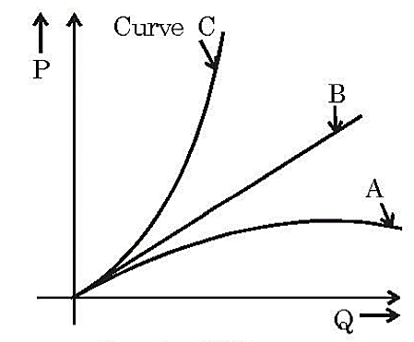
1000Qs For All AE/JE Exams | Mechanical Engg | Questions + Answer
Mechanical Engineering
Q. The figure given below shows the relationship between power (P) and discharge (Q) for different vane exit angles of centrifugal pump. In the figure given below, curve c holds good for:_
A. vane exit angle of 90°
B. vane exit angle of less than 90°
C. vane exit angle of more than 90°
D. any vane exit angle
For 78% Discount
Use Code : “Y166”
78% Discount
Y166
Mentor : Shivam Gupta
For Complete theory and concepts join our Mahapack Batch, Use Code Y166 For 78% of Discount

Slide 46
1000Qs For All AE/JE Exams | Mechanical Engg | Questions + Answer
Mechanical Engineering
Q. Head developed by a centrifugal pump depends on _______.!
A. impeller diameter
B. speed
C. fluid density
D. all of the above.
For 78% Discount
Use Code : “Y166”
78% Discount
Y166
Mentor : Shivam Gupta
For Complete theory and concepts join our Mahapack Batch, Use Code Y166 For 78% of Discount

Slide 47
1000Qs For All AE/JE Exams | Mechanical Engg | Questions + Answer
Mechanical Engineering
Q. After starting the centrifugal pump.
A. delivery valve is kept wide open
B. delivery valve is kept closed
C. inlet valve is kept closed
D. delivery valve is opened slightly
For 78% Discount
Use Code : “Y166”
78% Discount
Y166
Mentor : Shivam Gupta
For Complete theory and concepts join our Mahapack Batch, Use Code Y166 For 78% of Discount

Slide 48
1000Qs For All AE/JE Exams | Mechanical Engg | Questions + Answer
Mechanical Engineering
Q. In the centrifugal pump, minimum efficiency is obtained when the blades are -
A. bent backward
B. bent forward
C. straight
D. bent to have aerofoil section
For 78% Discount
Use Code : “Y166”
78% Discount
Y166
Mentor : Shivam Gupta
For Complete theory and concepts join our Mahapack Batch, Use Code Y166 For 78% of Discount

Slide 49
1000Qs For All AE/JE Exams | Mechanical Engg | Questions + Answer
Mechanical Engineering
Q. At The suction pressure in a reciprocating pump, the flow separation occurs at !
A. 2.6 m of water
B. 7.74 m of water
C. 760 mm of water
D. All of the above
For 78% Discount
Use Code : “Y166”
78% Discount
Y166
Mentor : Shivam Gupta
For Complete theory and concepts join our Mahapack Batch, Use Code Y166 For 78% of Discount

Slide 50
1000Qs For All AE/JE Exams | Mechanical Engg | Questions + Answer
Mechanical Engineering
HW. For viscous flow the co-efficient of frictions is given by..
f = 8/Re
f = 16/Re
f = 64/Re
f = 32/Re
For 78% Discount
Use Code : “Y166”
78% Discount
Y166
Mentor : Shivam Gupta
For Complete theory and concepts join our Mahapack Batch, Use Code Y166 For 78% of Discount

