Slide 1
SSC JE Mechanical Previous Year Questions + Answers | Mechanical Engineering
Mechanical Engineering
Q.Which of the following is reason of irreversibility!?
A. Lack of equilibrium during the process
B. involvement of dissipative effects
C. None of the above
D. both a & b
For 78% Discount
Use Code : “Y166”
78% Discount Y166
6
Join Our Paid Batch : SSC JE Batch | Mahapack Batch | Use Code Y166 For 78% of Discount

Slide 3
1000Qs For All AE/JE Exams | Mechanical Engg | Questions + Answer
Mechanical Engineering
Q. Which of the following is an inversion of single slider crank chain !
A. Watt's indicator mechanism
B. Beam Engine
C. Elliptical trammels
D. Whitworth quick return motion mechanism
For 78% Discount
Use Code : “Y166”
78% Discount Y166
Mentor : Shivam Gupta
For Complete theory and concepts join our Mahapack Batch, Use Code Y166 For 78% of Discount

Slide 4
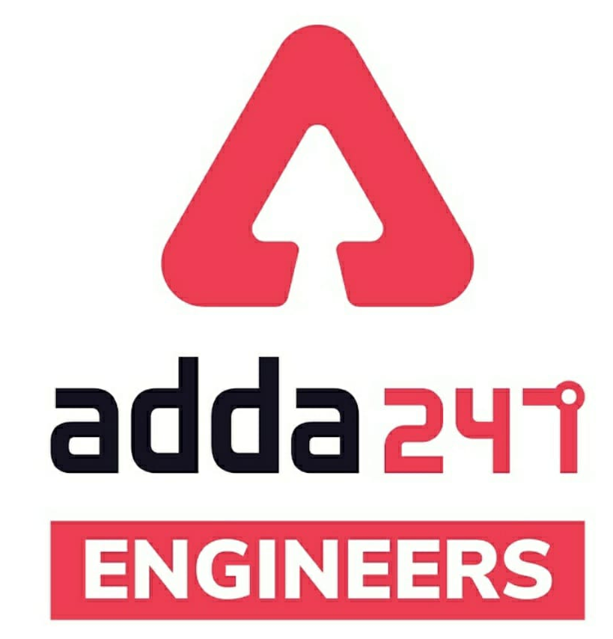
SSC JE Mechanical Previous Year Questions + Answers | Mechanical Engineering
Mechanical Soormas
Shubham Shukla
Lokesh Varwan
Subir
Aman Kumar
Shiksha Aur Vikas
Shivani Singh
Sandip Mahata
Priyanshu Kushwaha
Dilip Gupta
Amit Kumar
Cycle Raja
Atit Ramteke
Ajay Kumar
Krishna
Kunal Kisku
Aashik Hussain
Pankaj Mahato
Vikas DevPandey
Rajat Bobde
Pannelal Kushwaha
Sahil Kumar
Nidha Zaman
Ruby Prajapati
Sanajit Jana
Anuj Kanoujiya
Warif
Rahul Kumar
Raj Yadav
for
Code : “Y166”

Slide 5
SSC JE Mechanical Previous Year Questions + Answers | Mechanical Engineering
Mechanical Soormas
Hardik Pal
Neha
Mohit Kumar
Akhilesh Gupta
Gurdeep Singh
Rajesh Rohila
Ajaya Suna
Pawan Singh Rana
Rishabh Kanaujiya
Kuldeet Das
Ela Sahoo
Om Prakash Chaurasiya
Alfiya Fatima
Narendra Sura
Shishram Bayala
Mitu Kumar
Deepak Kumar
for
Code : “Y166”

Slide 6
SSC JE Mechanical Previous Year Questions + Answers | Mechanical Engineering
Mechanical Engineering
For 78% Discount
Use Code : “Y166”
78% Discount Y166
Join Our Paid Batch : SSC JE Batch | Mahapack Batch | Use Code Y166 For 78% of Discount

Slide 7
1000Qs For All AE/JE Exams | Mechanical Engg | Questions + Answer
Mechanical Engineering
Q. The power transmitted by a belt is maximum when the maximum tension in belt (T) is equal to T_{C} = Centrifugal Tension_
A. T_{C}
B. 2T_{C}
C. 3T_{C}
D. 4T_{C}
For 78% Discount
Use Code : “Y166”
78% Discount Y166
Mentor : Shivam Gupta
For Complete theory and concepts join our Mahapack Batch, Use Code Y166 For 78% of Discount

Slide 8
1000Qs For All AE/JE Exams | Mechanical Engg | Questions + Answer
Mechanical Engineering
Q. For the same compression ratio, the efficiency of diesel cycle as compared to the otto cycle is .
A. Less
B. More
C. Equal
D. None of the above
For 78% Discount
Use Code : “Y166”
78% Discount Y166
Mentor : Shivam Gupta
For Complete theory and concepts join our Mahapack Batch, Use Code Y166 For 78% of Discount

Slide 9
1000Qs For All AE/JE Exams | Mechanical Engg | Questions + Answer
Mechanical Engineering
Q. In case of sensible cooling of air, the coil efficiency is given by (BPF = by pass factor) : -
(a) BPF –1
(b) 1 – BPF
(c) 1/BPF
(d) 1 + BPF
For 78% Discount
Use Code : “Y166”
78% Discount Y166
Mentor : Shivam Gupta
For Complete theory and concepts join our Mahapack Batch, Use Code Y166 For 78% of Discount

Slide 10
1000Qs For All AE/JE Exams | Mechanical Engg | Questions + Answer
Mechanical Engineering
Q. Kinematic viscosity is equal to-
(a) Density/dynamic viscosity
(b) Dynamic viscosity/density
(c) Dynamic viscosity x density
(d) None of these
For 78% Discount
Use Code : “Y166”
78% Discount Y166
Mentor : Shivam Gupta
For Complete theory and concepts join our Mahapack Batch, Use Code Y166 For 78% of Discount

Slide 11
1000Qs For All AE/JE Exams | Mechanical Engg | Questions + Answer
Mechanical Engineering
Q. Compressibility of a liquid is expressed by its:!
(a) Density
(b) Pressure
(c) Volume
(d) Bulk modulus of elasticity
For 78% Discount
Use Code : “Y166”
78% Discount Y166
Mentor : Shivam Gupta
For Complete theory and concepts join our Mahapack Batch, Use Code Y166 For 78% of Discount

Slide 12
1000Qs For All AE/JE Exams | Mechanical Engg | Questions + Answer
Mechanical Engineering
Q. If D and d are the diameters of the runner and
jet of the Pelton wheel respectively, the number
of buckets on the runner is given by _
(a) 30 + D/d
(b) 30 + 2D/d
(c) 15 + D/2d
d) 15 + 2D/d
For 78% Discount
Use Code : “Y166”
78% Discount Y166
Mentor : Shivam Gupta
For Complete theory and concepts join our Mahapack Batch, Use Code Y166 For 78% of Discount

Slide 13
1000Qs For All AE/JE Exams | Mechanical Engg | Questions + Answer
Mechanical Engineering
Q. How to avoid the cavitation in centrifugal pump_
(a) By lowering the suction pressure
(b) By lowering the delivery pressure
(c) By increasing the suction pressure
(d) By increasing the delivery pressure
For 78% Discount
Use Code : “Y166”
78% Discount Y166
Mentor : Shivam Gupta
For Complete theory and concepts join our Mahapack Batch, Use Code Y166 For 78% of Discount

Slide 14
1000Qs For All AE/JE Exams | Mechanical Engg | Questions + Answer
Mechanical Engineering
Q. When trying to turn a key into a lock, the following is applied :!
(a) Coplanar force
(b) Lever
(c) Moment
(d) Couple
For 78% Discount
Use Code : “Y166”
78% Discount Y166
Mentor : Shivam Gupta
For Complete theory and concepts join our Mahapack Batch, Use Code Y166 For 78% of Discount

Slide 15
1000Qs For All AE/JE Exams | Mechanical Engg | Questions + Answer
Mechanical Engineering
Q. .......... represents the area under acceleration - time graph.!
(a) Acceleration
(b) Displacement
(c) Motion
(d) Change in velocity
For 78% Discount
Use Code : “Y166”
78% Discount Y166
Mentor : Shivam Gupta
For Complete theory and concepts join our Mahapack Batch, Use Code Y166 For 78% of Discount

Slide 16
1000Qs For All AE/JE Exams | Mechanical Engg | Questions + Answer
Mechanical Engineering
Q. The area of under the stress-strain diagram up to the rupture point is known as -
(a) Proof resilience
(b) Modulus of toughness
(c) Modulus of elasticity
(d) Modulus of resilience
For 78% Discount
Use Code : “Y166”
78% Discount Y166
Mentor : Shivam Gupta
For Complete theory and concepts join our Mahapack Batch, Use Code Y166 For 78% of Discount

Slide 17
1000Qs For All AE/JE Exams | Mechanical Engg | Questions + Answer
Mechanical Engineering
Q. For the same maximum pressure and heat input, the most efficient cycle is -
(a) Otto
(b) Diesel
(c) Dual
(d) none of the above
For 78% Discount
Use Code : “Y166”
78% Discount Y166
Mentor : Shivam Gupta
For Complete theory and concepts join our Mahapack Batch, Use Code Y166 For 78% of Discount

Slide 18
1000Qs For All AE/JE Exams | Mechanical Engg | Questions + Answer
Mechanical Engineering
Q. Which of the following is an inversion of single slider crank chain !
A. Watt's indicator mechanism
B. Beam Engine
C. Elliptical trammels
D. Whitworth quick return motion mechanism
For 78% Discount
Use Code : “Y166”
78% Discount Y166
Mentor : Shivam Gupta
For Complete theory and concepts join our Mahapack Batch, Use Code Y166 For 78% of Discount

Slide 19
1000Qs For All AE/JE Exams | Mechanical Engg | Questions + Answer
Mechanical Engineering
Q. The factor which effects the critical speed of a shaft is !
A. Diameter of the disc
B. Span of the shaft
C. Eccentricity
D. all of the above
For 78% Discount
Use Code : “Y166”
78% Discount Y166
Mentor : Shivam Gupta
For Complete theory and concepts join our Mahapack Batch, Use Code Y166 For 78% of Discount

Slide 20
1000Qs For All AE/JE Exams | Mechanical Engg | Questions + Answer
Mechanical Engineering
Q. The brakes commonly used in motor cars is!
A. Shoe brake
B. Band brake
C. Band and block brake
D. Internal expanding brake
For 78% Discount
Use Code : “Y166”
78% Discount Y166
Mentor : Shivam Gupta
For Complete theory and concepts join our Mahapack Batch, Use Code Y166 For 78% of Discount

Slide 21
1000Qs For All AE/JE Exams | Mechanical Engg | Questions + Answer
Mechanical Engineering
Q. A disc is spinning with angular velocity w red/s about the axis of spin. The couple applied to the disc causing precession will be !
I= Mass moment of Inertia of disc
wp = angular velocity of precession of axis of spin
A. 1/2 w²
B. Iw²
C. 1/2 Iww_{p}
D. Iww_{P}
For 78% Discount
Use Code : “Y166”
78% Discount Y166
Mentor : Shivam Gupta
For Complete theory and concepts join our Mahapack Batch, Use Code Y166 For 78% of Discount

Slide 22
1000Qs For All AE/JE Exams | Mechanical Engg | Questions + Answer
Mechanical Engineering
Q. When the speed of the engine fluctuates continuously above and below the mean speed, then the governor is said to be !
A. Unstable
B. Stable
C. Isochronous
D. hunt
For 78% Discount
Use Code : “Y166”
78% Discount Y166
Mentor : Shivam Gupta
For Complete theory and concepts join our Mahapack Batch, Use Code Y166 For 78% of Discount

Slide 23
1000Qs For All AE/JE Exams | Mechanical Engg | Questions + Answer
Mechanical Engineering
Q. A typical interactive graphics workstation consists of hardware components - !
A. A graphical terminal and operator input device
B. Output devices and terminal
C. CPU and terminal
D. all of the above
For 78% Discount
Use Code : “Y166”
78% Discount Y166
Mentor : Shivam Gupta
For Complete theory and concepts join our Mahapack Batch, Use Code Y166 For 78% of Discount

Slide 24
1000Qs For All AE/JE Exams | Mechanical Engg | Questions + Answer
Mechanical Engineering
Q. Which of the following is not a part of CAD hardware. _
A. Graphic display terminal
B. Keyboards
C. Computer programme
D. Peripheral equipment
For 78% Discount
Use Code : “Y166”
78% Discount Y166
Mentor : Shivam Gupta
For Complete theory and concepts join our Mahapack Batch, Use Code Y166 For 78% of Discount

Slide 25
1000Qs For All AE/JE Exams | Mechanical Engg | Questions + Answer
Mechanical Engineering
Q. A Carnot cycle refrigerator operates between 250k and 300k. Its coefficient of performance is-
A. 6
B. 5
C. 1.2
D. 0.8
For 78% Discount
Use Code : “Y166”
78% Discount Y166
Mentor : Shivam Gupta
For Complete theory and concepts join our Mahapack Batch, Use Code Y166 For 78% of Discount

Slide 26
1000Qs For All AE/JE Exams | Mechanical Engg | Questions + Answer
Mechanical Engineering
Q. When the wet steam flows through a throttle valve and remains wet at exit-
A. Its temperature and quality increases
B. Its temperature decreases but quality increases
C. Its temperature increases but quality decreases
D. Its temperature and quality decrease
For 78% Discount
Use Code : “Y166”
78% Discount Y166
Mentor : Shivam Gupta
For Complete theory and concepts join our Mahapack Batch, Use Code Y166 For 78% of Discount

Slide 27
1000Qs For All AE/JE Exams | Mechanical Engg | Questions + Answer
Mechanical Engineering
Q. A real fluid is any fluid which-
A. has zero shear stress B. has viscosity
C. has constant viscosity and density
D. has surface tension and is in compressible
For 78% Discount
Use Code : “Y166”
78% Discount Y166
Mentor : Shivam Gupta
For Complete theory and concepts join our Mahapack Batch, Use Code Y166 For 78% of Discount

Slide 28
1000Qs For All AE/JE Exams | Mechanical Engg | Questions + Answer
Mechanical Engineering
Q. The dimensions of the coefficient of dynamic viscosity in (M.L.T) notation system are !
A. M L T^{–1}
B. M^{–1} L T
C. M L^{–1} T
D. M L^{–1} T^{–1}
For 78% Discount
Use Code : “Y166”
78% Discount Y166
Mentor : Shivam Gupta
For Complete theory and concepts join our Mahapack Batch, Use Code Y166 For 78% of Discount

Slide 29
1000Qs For All AE/JE Exams | Mechanical Engg | Questions + Answer
Mechanical Engineering
Q. Inclined single column Manometer is useful for the measurement of _______ pressure-
A. Negative
B. Small
C. medium
D. High
For 78% Discount
Use Code : “Y166”
78% Discount Y166
Mentor : Shivam Gupta
For Complete theory and concepts join our Mahapack Batch, Use Code Y166 For 78% of Discount

Slide 30
1000Qs For All AE/JE Exams | Mechanical Engg | Questions + Answer
Mechanical Engineering
Q. High velocity in a conduct of large size is known as-
A. Laminar flow
B. Turbulent flow
C. Either of above
D. none of the above
For 78% Discount
Use Code : “Y166”
78% Discount Y166
Mentor : Shivam Gupta
For Complete theory and concepts join our Mahapack Batch, Use Code Y166 For 78% of Discount

Slide 31
1000Qs For All AE/JE Exams | Mechanical Engg | Questions + Answer
Mechanical Engineering
HW. The magnitude of linear velocity of a point B on link AB relative to point A is w = angular velocity of link AB.
A. w.AB
B. w.(AB)²
C. w².AB
D. (w.AB)²
For 78% Discount
Use Code : “Y166”
78% Discount Y166
Mentor : Shivam Gupta
For Complete theory and concepts join our Mahapack Batch, Use Code Y166 For 78% of Discount

