Slide 1

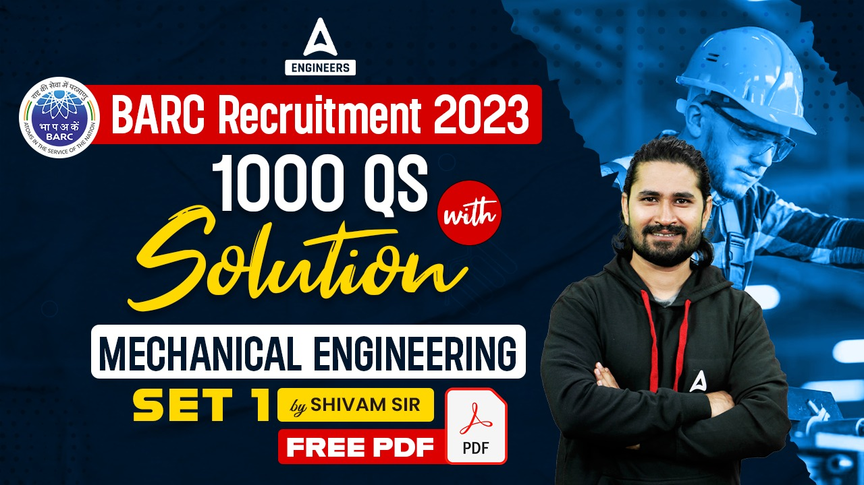

SSC JE Mechanical Previous Year Questions + Answers | Mechanical Engineering
Mechanical Engineering
Q.Which of the following is reason of irreversibility!?
A. Lack of equilibrium during the process
B. involvement of dissipative effects
C. None of the above
D. both a & b
For 78% Discount
Use Code : “Y166”
78% Discount
Y166
Join Our Paid Batch : SSC JE Batch | Mahapack Batch | Use Code Y166 For 78% of Discount

Slide 2


Slide 3
SSC JE Mechanical Previous Year Questions + Answers | Mechanical Engineering
Mechanical Engineering
Q. Reciprocating pump operating in series will result in -
A. Higher discharge
B. Higher Head
C. Low speed operation
D. Reduced power consumption
For 78% Discount
Use Code : “Y166”
78% Discount
Y166
Join Our Paid Batch : SSC JE Batch | Mahapack Batch | Use Code Y166 For 78% of Discount

Slide 4

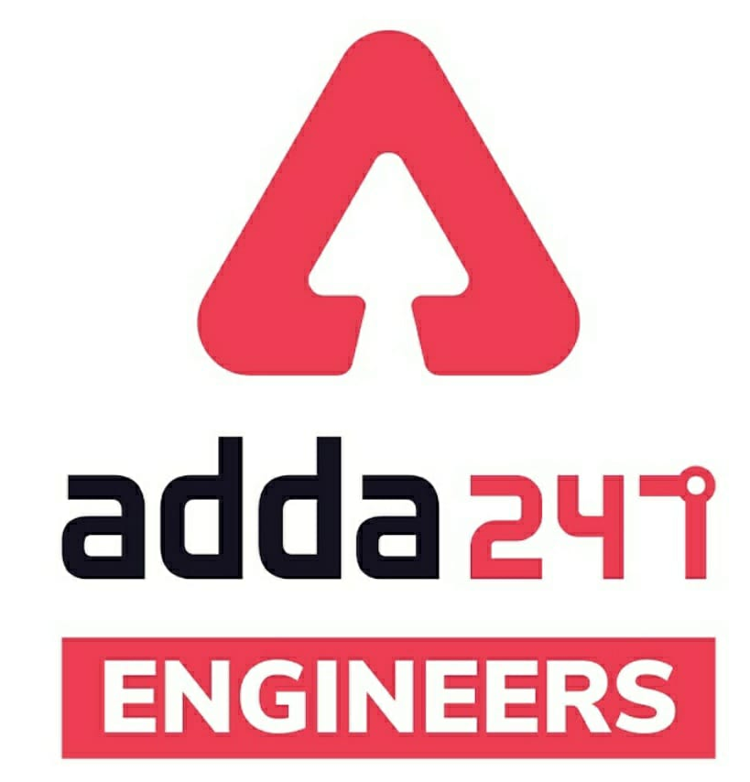

SSC JE Mechanical Previous Year Questions + Answers | Mechanical Engineering
Mechanical Soormas
Sahil Kumar
Lokesh Varwan
Ritick Konwar
Subir
Raj Yadav
Nagin Ke Papa
Sandip Mahata
Reyaz Samoon
Sahil Kumar
Yogi Tomar
Ashu Lone
Priyanshu Kushwaha
Lokesh Varwan
Shivani Singh
Dilip Gupta
Raj Yadav
Anchal Mishra
Pragya Srivastava
Aashik Hussain
Nidha Zaman
Amar Jyoti
Anuj Kanoujiya
Ajaya Suna
Subir
Ajay Kumar
Rajat Bobde
Sandhan Paul
Kashmir Premium
for
Code : “Y166”

Slide 5
SSC JE Mechanical Previous Year Questions + Answers | Mechanical Engineering
Mechanical Soormas
Sonakshi Pulast
Anjaneyulu G
Shishram Bayala
Nandan Mehta
Gaurav Patel
Pawan Singh Rana
Avadhesh Yadav
Ajit Potbhare
Deb
Kuldeet Das
Shubhi Tiwari
Tanvir Rather
for
Code : “Y166”

Slide 6

SSC JE Mechanical Previous Year Questions + Answers | Mechanical Engineering
Mechanical Engineering
For 78% Discount
Use Code : “Y166”
78% Discount
Y166
Join Our Paid Batch : SSC JE Batch | Mahapack Batch | Use Code Y166 For 78% of Discount

Slide 7

1000Qs For All AE/JE Exams | Mechanical Engg | Questions + Answer
Mechanical Engineering
Q. When two elastic bodies collide with each other,!
A. The two bodies will momentarily come to rest after collision.
B. The two bodies tend to compress and deform at the surface of the contact.
C. The two bodies begin to regain their original shape. ,
D. All of these
For 78% Discount
Use Code : “Y166”
78% Discount
Y166
Mentor : Shivam Gupta
For Complete theory and concepts join our Mahapack Batch, Use Code Y166 For 78% of Discount

Slide 8
1000Qs For All AE/JE Exams | Mechanical Engg | Questions + Answer
Mechanical Engineering
Q. An ideal machine is one whose efficiency is!
A. Between 60 and 70 %
B. Between 70 and 80 %
C. Between 80 and 90 %
D. 100 %
For 78% Discount
Use Code : “Y166”
78% Discount
Y166
Mentor : Shivam Gupta
For Complete theory and concepts join our Mahapack Batch, Use Code Y166 For 78% of Discount

Slide 9
1000Qs For All AE/JE Exams | Mechanical Engg | Questions + Answer
Mechanical Engineering
Q. The friction experienced by a body, when in motion, is known as-
A. Rolling friction.
B. Dynamic friction.
C. Limiting friction.
D. Static friction.
For 78% Discount
Use Code : “Y166”
78% Discount
Y166
Mentor : Shivam Gupta
For Complete theory and concepts join our Mahapack Batch, Use Code Y166 For 78% of Discount

Slide 10
1000Qs For All AE/JE Exams | Mechanical Engg | Questions + Answer
Mechanical Engineering
Q. The moment of inertia of a square of side A. about an axis through its centre of gravity is_
A. A⁴/4
B. A⁴/8
C. A⁴/12
D. A⁴/36
For 78% Discount
Use Code : “Y166”
78% Discount
Y166
Mentor : Shivam Gupta
For Complete theory and concepts join our Mahapack Batch, Use Code Y166 For 78% of Discount

Slide 11
1000Qs For All AE/JE Exams | Mechanical Engg | Questions + Answer
Mechanical Engineering
Q. The forces, whose lines of action are parallel to each other and act in the same directions, are known as _
A. Coplanar concurrent forces.
B. Coplanar non-concurrent forces.
C. Like parallel forces.
D. Unlike parallel forces.
For 78% Discount
Use Code : “Y166”
78% Discount
Y166
Mentor : Shivam Gupta
For Complete theory and concepts join our Mahapack Batch, Use Code Y166 For 78% of Discount

Slide 12
1000Qs For All AE/JE Exams | Mechanical Engg | Questions + Answer
Mechanical Engineering
Q. A ladder is resting on a rough ground and leaning against a smooth vertical wall. The force of friction will act _
A. Downward at its upper end.
B. Upward at its upper end.
C. Zero at its upper end.
D. Perpendicular to the wall at its upper end.
For 78% Discount
Use Code : “Y166”
78% Discount
Y166
Mentor : Shivam Gupta
For Complete theory and concepts join our Mahapack Batch, Use Code Y166 For 78% of Discount

Slide 13
1000Qs For All AE/JE Exams | Mechanical Engg | Questions + Answer
Mechanical Engineering
Q. Which of the following statement is correct!?
A. The stress is the pressure per unit area.
B. The strain is expressed in mm
C. Hook's law holds good upto the breaking point.
D. Stress is directly proportional to strain within the elastic limit.
For 78% Discount
Use Code : “Y166”
78% Discount
Y166
Mentor : Shivam Gupta
For Complete theory and concepts join our Mahapack Batch, Use Code Y166 For 78% of Discount

Slide 14
1000Qs For All AE/JE Exams | Mechanical Engg | Questions + Answer
Mechanical Engineering
Q. When a body is subjected to a direct stress tensile stress (σ) in one plane, then the normal stress on an oblique section of the body inclined at an angle θ to the normal of the section is-
A. σ cos θ
B. σ cos² θ
C. σ sin θ
D. σ sin² θ
For 78% Discount
Use Code : “Y166”
78% Discount
Y166
Mentor : Shivam Gupta
For Complete theory and concepts join our Mahapack Batch, Use Code Y166 For 78% of Discount

Slide 15
1000Qs For All AE/JE Exams | Mechanical Engg | Questions + Answer
Mechanical Engineering
Q. The bending moment on a section is maximum where shear force is!
A. Minimum.
B. Maximum.
C. Changing sign
D. Zero.
For 78% Discount
Use Code : “Y166”
78% Discount
Y166
Mentor : Shivam Gupta
For Complete theory and concepts join our Mahapack Batch, Use Code Y166 For 78% of Discount

Slide 16
1000Qs For All AE/JE Exams | Mechanical Engg | Questions + Answer
Mechanical Engineering
Q. Which of following statement is correct-?
A. A continuous beam has only two supports at the ends.
B. A uniformly distributed load spreads uniformly over the whole length of a beam.
C. The bending moment is maximum where shear force is maximum.
D. The maximum bending moment of a simply supported beam of length l with a central point load
For 78% Discount
Use Code : “Y166”
78% Discount
Y166
Mentor : Shivam Gupta
For Complete theory and concepts join our Mahapack Batch, Use Code Y166 For 78% of Discount

Slide 17
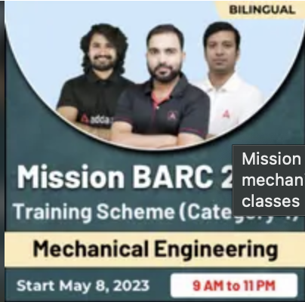
1000Qs For All AE/JE Exams | Mechanical Engg | Questions + Answer
Mechanical Engineering
For 78% Discount
Use Code : “Y166”
78% Discount
Y166
Join Our Paid Batch : SSC JE Batch | Mahapack Batch | Use Code Y166 For 78% of Discount

Slide 18
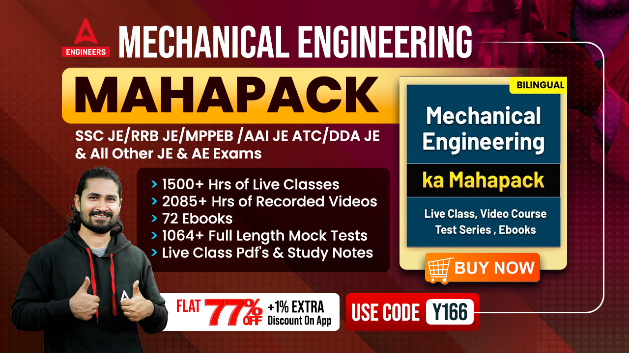

78% Discount
Y166
Join Our Paid Batch : SSC JE Batch | Mahapack Batch | Use Code Y166 For 78% of Discount

Slide 19
1000Qs For All AE/JE Exams | Mechanical Engg | Questions + Answer
Mechanical Engineering
Q. A leaf spring is supported at the-
A. Ends and loaded at centre.
B. Centre and loaded at the ends.
D. Centre and loaded anywhere.
C. Ends and loaded anywhere.
For 78% Discount
Use Code : “Y166”
78% Discount
Y166
Mentor : Shivam Gupta
For Complete theory and concepts join our Mahapack Batch, Use Code Y166 For 78% of Discount

Slide 20
1000Qs For All AE/JE Exams | Mechanical Engg | Questions + Answer
Mechanical Engineering
Q. The hoop stress in a thin cylindrical shell is!
A. Longitudinal stress
B. Compressive stress
C. Radial stress
D. Circumferential tensile stress
For 78% Discount
Use Code : “Y166”
78% Discount
Y166
Mentor : Shivam Gupta
For Complete theory and concepts join our Mahapack Batch, Use Code Y166 For 78% of Discount

Slide 21
1000Qs For All AE/JE Exams | Mechanical Engg | Questions + Answer
Mechanical Engineering
Q. The buckling load for a given column depends upon!
A. Dimensions of cross-section of the column
B. Length and least radius of gyration of the column.
C. Modulus of elasticity for the material of the column.
D. All of these
For 78% Discount
Use Code : “Y166”
78% Discount
Y166
Mentor : Shivam Gupta
For Complete theory and concepts join our Mahapack Batch, Use Code Y166 For 78% of Discount

Slide 22
1000Qs For All AE/JE Exams | Mechanical Engg | Questions + Answer
Mechanical Engineering
Q. Rivets are generally specified by.
A. Thickness of the plates to be joined.
B. Overall length.
C. Shank diameter.
D. Diameter of head.
For 78% Discount
Use Code : “Y166”
78% Discount
Y166
Mentor : Shivam Gupta
For Complete theory and concepts join our Mahapack Batch, Use Code Y166 For 78% of Discount

Slide 23
1000Qs For All AE/JE Exams | Mechanical Engg | Questions + Answer
Mechanical Engineering
Q. A With an increase in size of tube, the rise or depression of liquid in the tube due to surface tension will.
A. Decrease.
B. Increase.
C. Remain unchanged.
D. Depend upon the characteristics of liquid.
For 78% Discount
Use Code : “Y166”
78% Discount
Y166
Mentor : Shivam Gupta
For Complete theory and concepts join our Mahapack Batch, Use Code Y166 For 78% of Discount

Slide 24
1000Qs For All AE/JE Exams | Mechanical Engg | Questions + Answer
Mechanical Engineering
Q. A body floating in a liquid is said to be in neutral equilibrium, if its metacentre.
A. coincides with its centre of gravity.
B. lies above its centre of gravity.
C. lies below its centre of gravity.
D. lies between the centre of buoyancy and centre of gravity.
For 78% Discount
Use Code : “Y166”
78% Discount
Y166
Mentor : Shivam Gupta
For Complete theory and concepts join our Mahapack Batch, Use Code Y166 For 78% of Discount

Slide 25
1000Qs For All AE/JE Exams | Mechanical Engg | Questions + Answer
Mechanical Engineering
Q. When a liquid is flowing through a pipe, the velocity of the liquid is.
A. maximum at the centre and minimum near the walls.
B. minimum at the centre and maximum near the walls.
C. zero at the centre and maximum near the walls.
D. maximum at the centre and Maximum near the walls.
For 78% Discount
Use Code : “Y166”
78% Discount
Y166
Mentor : Shivam Gupta
For Complete theory and concepts join our Mahapack Batch, Use Code Y166 For 78% of Discount

Slide 26
1000Qs For All AE/JE Exams | Mechanical Engg | Questions + Answer
Mechanical Engineering
Q. The divergent portion of venturi meter is made of longer than convergent portion in order to. _
A. Avoid the tendency of breaking away the stream of liquid
B. To minimise frictional losses
C. Both A. and B.
D. None of these
For 78% Discount
Use Code : “Y166”
78% Discount
Y166
Mentor : Shivam Gupta
For Complete theory and concepts join our Mahapack Batch, Use Code Y166 For 78% of Discount

Slide 27
1000Qs For All AE/JE Exams | Mechanical Engg | Questions + Answer
Mechanical Engineering
Q. The effect of magnitude of the water hammer depends upon the !
A. Elastic properties of the pipe material
B. Elastic properties of the liquid flowing through the pipe
C. Speed at which the valve is closed
D. All of these
For 78% Discount
Use Code : “Y166”
78% Discount
Y166
Mentor : Shivam Gupta
For Complete theory and concepts join our Mahapack Batch, Use Code Y166 For 78% of Discount

Slide 28
1000Qs For All AE/JE Exams | Mechanical Engg | Questions + Answer
Mechanical Engineering
Q. One poise is equal to.
A. 0.1 N-s/m²
B. 1 N-s/m²
C. 10 N-s/m²
D. 100 N-s/m²
For 77% Discount
Use Code : “Y166”
78% Discount
Y166
Mentor : Shivam Gupta
For Complete theory and concepts join our Mahapack Batch, Use Code Y166 For 78% of Discount

Slide 29
1000Qs For All AE/JE Exams | Mechanical Engg | Questions + Answer
Mechanical Engineering
Q. In an inward reaction turbine_
A. The water flows parallel to the axis of the wheel.
B. The water enters at the centre axis of the wheel and then flows towards the outer periphery of the wheel.
C. The water enters the wheel at the outer periphery towards the centre of the wheel.
D. The flow of the water is partly radial and partly axial.
For 78% Discount
Use Code : “Y166”
78% Discount
Y166
Mentor : Shivam Gupta
For Complete theory and concepts join our Mahapack Batch, Use Code Y166 For 78% of Discount

Slide 30
1000Qs For All AE/JE Exams | Mechanical Engg | Questions + Answer
Mechanical Engineering
Q. The cavitation in a hydraulic machine!
A. causes noise and vibration of various parts.
B. reduce the discharge of a turbine.
C. causes sudden drop in power output and efficiency.
D. All of these
For 78% Discount
Use Code : “Y166”
78% Discount
Y166
Mentor : Shivam Gupta
For Complete theory and concepts join our Mahapack Batch, Use Code Y166 For 78% of Discount

Slide 31
1000Qs For All AE/JE Exams | Mechanical Engg | Questions + Answer
Mechanical Engineering
Q. Which of the following statement is wrong! ?
A. The reaction turbines are used for low head and high discharge.
B. The angle of taper of draft tube is less than 8°
C. An impulse turbine is generally fitted slightly above the tail race.
D. A Francis turbine is an impulse turbine.
For 77% Discount
Use Code : “Y166”
78% Discount
Y166
Mentor : Shivam Gupta
For Complete theory and concepts join our Mahapack Batch, Use Code Y166 For 78% of Discount

Slide 32
1000Qs For All AE/JE Exams | Mechanical Engg | Questions + Answer
Mechanical Engineering
Q. Multi-stage centrifugal pumps are used to-
A. give high discharge.
B. produce high heads
C. pump viscous fluids.
D. All of these
For 78% Discount
Use Code : “Y166”
78% Discount
Y166
Mentor : Shivam Gupta
For Complete theory and concepts join our Mahapack Batch, Use Code Y166 For 78% of Discount

Slide 33
1000Qs For All AE/JE Exams | Mechanical Engg | Questions + Answer
Mechanical Engineering
Q. An open system .
(a) is a specified region where transfers of energy and / or mass take place
(b) is a region of constant mass and only energy is allowed to cross the boundaries
(c) cannot transfer either energy or mass to or from the surroundings
(d) has an enthalpy transfer across its boundaries and the mass within the system is not necessarily constant
For 78% Discount
Use Code : “Y166”
78% Discount
Y166
Mentor : Shivam Gupta
For Complete theory and concepts join our Mahapack Batch, Use Code Y166 For 78% of Discount

Slide 34
1000Qs For All AE/JE Exams | Mechanical Engg | Questions + Answer
Mechanical Engineering
Q. During an isothermal expansion process of a gas :-
(a) pressure remains constant
(b) temperature remains constant
(c) both pressure and temperature remain constant
(d) none of the above
For 78% Discount
Use Code : “Y166”
78% Discount
Y166
Mentor : Shivam Gupta
For Complete theory and concepts join our Mahapack Batch, Use Code Y166 For 78% of Discount

Slide 35
1000Qs For All AE/JE Exams | Mechanical Engg | Questions + Answer
Mechanical Engineering
Q. Second law of thermodynamics is known as the law of-
(a) Energy
(b) Entropy
(c) Enthalpy
(d) Internal energy
For 78% Discount
Use Code : “Y166”
78% Discount
Y166
Mentor : Shivam Gupta
For Complete theory and concepts join our Mahapack Batch, Use Code Y166 For 78% of Discount

Slide 36
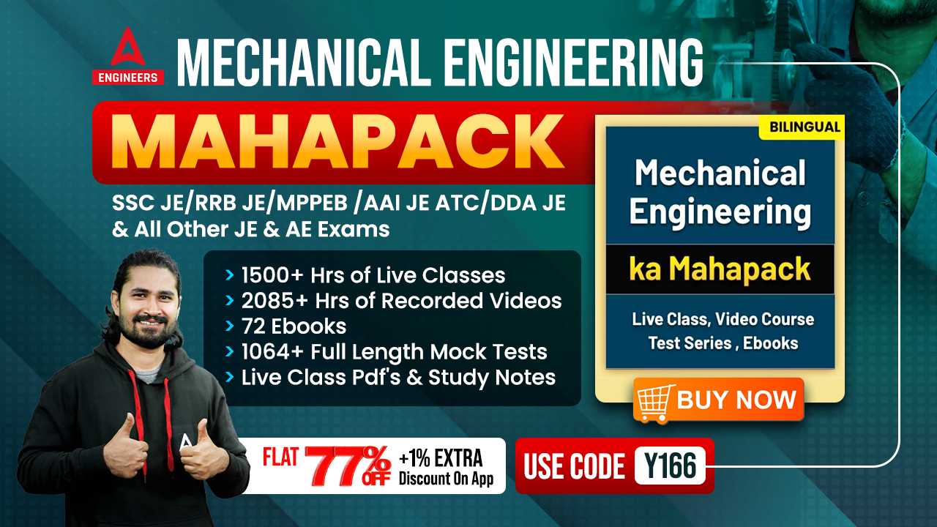

Slide 37
1000Qs For All AE/JE Exams | Mechanical Engg | Questions + Answer
Mechanical Engineering
Q. Efficiency of a Carnot engine is 75%. If the cycle direction is reversed, CoP of the reversed Carnot cycle ( reff) is . _
(a) 1.33
(b) 0.75
(c) 0.33
(d) 1.75
For 78% Discount
Use Code : “Y166”
78% Discount
Y166
Mentor : Shivam Gupta
For Complete theory and concepts join our Mahapack Batch, Use Code Y166 For 78% of Discount

Slide 38
1000Qs For All AE/JE Exams | Mechanical Engg | Questions + Answer
Mechanical Engineering
Q. If the value of ∫dQ/T is greater than zero, the nature of the thermodynamic cycle is !
(a) Reversible
(b) Irreversible
(c) Both reversible and irreversible
(d) Impossible
For 77% Discount
Use Code : “Y166”
78% Discount
Y166
Mentor : Shivam Gupta
For Complete theory and concepts join our Mahapack Batch, Use Code Y166 For 78% of Discount

Slide 39
1000Qs For All AE/JE Exams | Mechanical Engg | Questions + Answer
Mechanical Engineering
Q. The change in entropy is zero during ............ Process-
(a) Polytropic
(b) Adiabatic
(c) constant pressure
(d) Hyperbolic
For 78% Discount
Use Code : “Y166”
78% Discount
Y166
Mentor : Shivam Gupta
For Complete theory and concepts join our Mahapack Batch, Use Code Y166 For 78% of Discount

Slide 40
1000Qs For All AE/JE Exams | Mechanical Engg | Questions + Answer
Mechanical Engineering
Q. During fusion, the entropy :-
(a) decreases
(b) increases
(c) always remains constant
(d) none of these
For 78% Discount
Use Code : “Y166”
78% Discount
Y166
Mentor : Shivam Gupta
For Complete theory and concepts join our Mahapack Batch, Use Code Y166 For 78% of Discount

Slide 41
1000Qs For All AE/JE Exams | Mechanical Engg | Questions + Answer
Mechanical Engineering
Q. Superheating of the steam is done at_
(a) Constant temperature
(b) Constant volume
(c) Constant pressure
(d) Constant entropy
For 78% Discount
Use Code : “Y166”
78% Discount
Y166
Mentor : Shivam Gupta
For Complete theory and concepts join our Mahapack Batch, Use Code Y166 For 78% of Discount

Slide 42
1000Qs For All AE/JE Exams | Mechanical Engg | Questions + Answer
Mechanical Engineering
Q. Volume of 1 kg of dry steam is known as:_
(a) total volume
(b) saturated volume
(c) specific volume
(d) none of these
For 78% Discount
Use Code : “Y166”
78% Discount
Y166
Mentor : Shivam Gupta
For Complete theory and concepts join our Mahapack Batch, Use Code Y166 For 78% of Discount

Slide 43
1000Qs For All AE/JE Exams | Mechanical Engg | Questions + Answer
Mechanical Engineering
Q. Deaeration of feed water in a Rankine vapour cycle is carried out because it reduces : -
(a) Cavitation of boiler feed pumps
(b) Corrosion caused by oxygen
(c) Heat transfer coefficient
(d) pH value of water
For 78% Discount
Use Code : “Y166”
78% Discount
Y166
Mentor : Shivam Gupta
For Complete theory and concepts join our Mahapack Batch, Use Code Y166 For 78% of Discount

Slide 45
1000Qs For All AE/JE Exams | Mechanical Engg | Questions + Answer
Mechanical Engineering
Q. The process of maintaining the speed of a steam turbine constant for various load conditions is known as:_
(a) Reheating
(b) Bleeding
(c) Governing
(d) Cooling
For 78% Discount
Use Code : “Y166”
78% Discount
Y166
Mentor : Shivam Gupta
For Complete theory and concepts join our Mahapack Batch, Use Code Y166 For 78% of Discount

