Slide 1


Slide 2


Slide 3


Slide 4

SSC JE 2023 | Reasoning Classes | By Abhishek Sir
Q42. Seven people, A, B, C, D, E, F and G, are sitting in a straight row, facing the north. Only two people sit to the left of C. Only two people sit between A and B. B sits to the left of A. E is an immediate neighbour of A to the right. Only one person sits to the right of D. F is not an immediate neighbour of B. How many people sit between D and C? (SSC JE 2022)
(a) 1
(b) 0
(c) 2
(d) 3
सात व्यक्ति A, B, C, D, E, F और G एक सीधी पंक्ति में उत्तर की ओर उन्मुख होकर बैठे हैं। केवल दो व्यक्ति C के बायें बैठे हैं। केवल दो व्यक्ति A और B के मध्य बैठे हैं। B, A के बायें बैठा है। E, A के दायें निकटतम पडोसी है। केवल एक व्यक्ति D के दायें बैठा है। F, B का निकटतम पडोसी नहीं है। D और C के बीच कितने व्यक्ति बैठे हैं? (एसएससी जेई 2022)

Slide 5
SSC JE 2023 | Reasoning Classes | By Abhishek Sir
Q42. Seven people, A, B, C, D, E, F and G, are sitting in a straight row, facing the north. Only two people sit to the left of C. Only two people sit between A and B. B sits to the left of A. E is an immediate neighbour of A to the right. Only one person sits to the right of D. F is not an immediate neighbour of B. How many people sit between D and C? (SSC JE 2022)
(a) 1
(b) 0
(c) 2
(d) 3

Slide 6
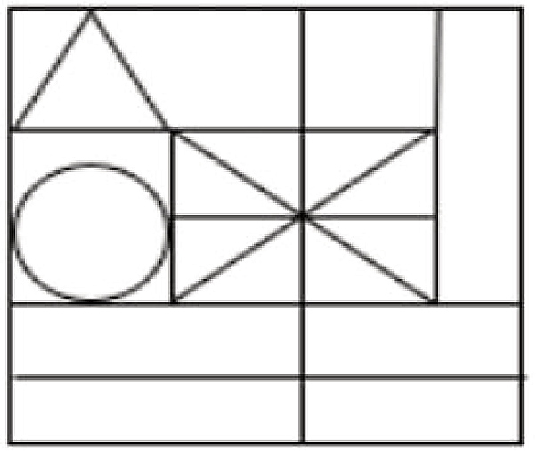

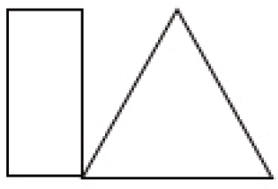
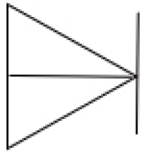
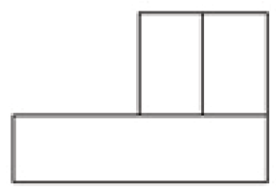
SSC JE 2023 | Reasoning Classes | By Abhishek Sir
Q43. Select the option figure which is embedded in the given figure as its part (rotation is NOT allowed).
(SSC JE 2022)
(a) (b) (c) (d)

Slide 7
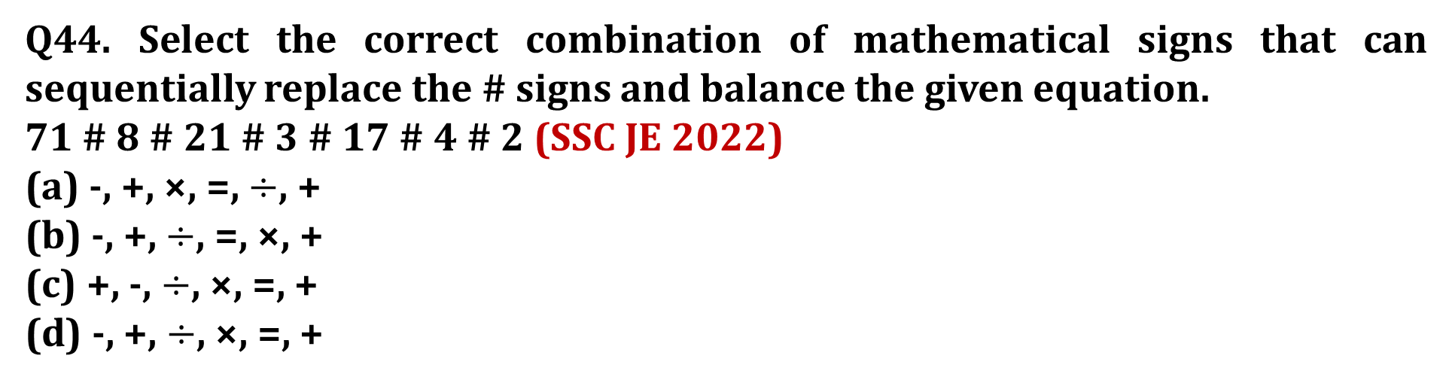
SSC JE 2023 | Reasoning Classes | By Abhishek Sir
Q44. Select the correct combination of mathematical signs that can sequentially replace the # signs and balance the given equation.
71 # 8 # 21 # 3 # 17 # 4 # 2 (SSC JE 2022)
(a) -, +, ×, =, $÷$, +
(b) -, +, $÷$, =, ×, +
(c) +, -, $÷$, ×, =, +
(d) -, +, $÷$, ×, =, +

Slide 8
SSC JE 2023 | Reasoning Classes | By Abhishek Sir
Q45. In a certain code language, ‘MOUNTAIN’ is written as ‘MUOTNIAN’ and ‘SQUIRREL’ is written as ‘SUQRIERL’. How will ‘VICTORIA’ be written in that language?
एक निश्चित कोड भाषा में, 'MOUNTAIN' को 'MUOTNIAN' लिखा जाता है और 'SQUIRREL' को 'SUQRIERL' लिखा जाता है। उस भाषा में 'विक्टोरिया' कैसे लिखा जाएगा? (SSC JE 2022)
(a) IVTCROAI
(b) VCIOTIRA
(c) IVCTROIA
(d) AIROTCIV

Slide 9
SSC JE 2023 | Reasoning Classes | By Abhishek Sir
Q46. In a code language, 'LIVER' is coded as 24-18-44-10-36 and 'BRAIN' is coded as 4-36-2-18-28. How will 'THIGH' be coded in the same language?
एक कूट भाषा में, 'LIVER' को 24-18-44-10-36 और 'BRAIN' को 4-36-2-18-28 के रूप में कूटबद्ध किया जाता है। उसी भाषा में 'THIGH' को किस प्रकार कोडित किया जाएगा? (SSC JE 2022)
(a) 36 – 16 – 18 – 14 – 16
(b) 36 – 16 – 18 – 16 – 14
(c) 40 – 16 – 18 – 14 – 16
(d) 40 – 18 – 16 – 14 – 16

Slide 10
SSC JE 2023 | Reasoning Classes | By Abhishek Sir
Q47. A person starts from point G and moves 10 km East. He turns left and moves 5 km, turns left again moves 5 km, then turns right and moves 3 km and takes a ﬁnal left turn and moves 5 km to reach a point F. How much and in which direction does he need to move now to reach point G? (SSC JE 2022)
(a) 8 km South
(b) 8 km North
(c) 10 km West
(d) 5 km West
एक व्यक्ति बिंदु G से शुरू करता है और 10 किमी पूर्व की ओर चलता है। वह बाएं मुड़ता है और 5 किमी चलता है, बाएं मुड़ता है फिर 5 किमी चलता है, फिर दाएं मुड़ता है और 3 किमी चलता है और अंतिम बाएं मुड़ता है और बिंदु F पर पहुंचने के लिए 5 किमी चलता है। अब उसे कितनी और किस दिशा में जाने की आवश्यकता है बिंदु G तक पहुँचने के लिए?

Slide 11
SSC JE 2023 | Reasoning Classes | By Abhishek Sir
Q48. Which of the given letter-clusters will replace the question mark (?) in the following series?
EGAU, GKCX, IOEA, ?, MWIG (SSC JE 2022)
(a) KSHD
(b) KTGD
(c) KSGD
(d) KTHD

Slide 12
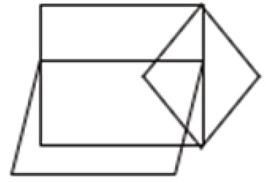
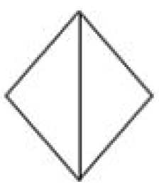
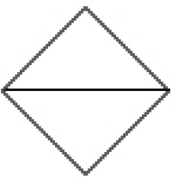
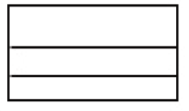
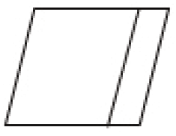
SSC JE 2023 | Reasoning Classes | By Abhishek Sir
Q49. Select the option that is embedded in the given figure (rotation is NOT allowed). (SSC JE 2022)
(a) (b) (c) (d)

Slide 13
SSC JE 2023 | Reasoning Classes | By Abhishek Sir
Q50. Six people, A, B, C, D, E, and F are seated in a row facing north. Only two people sit to the right of C. Only two people sit between B and C. F sits fourth to the right of B. E is an immediate neighbour of A and B. What is the position of D? (SSC JE 2022)
(a) Third to the left of A
(b) Third to the right of E
(c) Third to the left of E
(d) Third to the right of A
छह व्यक्ति, A, B, C, D, E, और F एक पंक्ति में उत्तर की ओर उन्मुख होकर बैठे हैं। केवल दो व्यक्ति C के दायें बैठे हैं। केवल दो व्यक्ति B और C के मध्य बैठे हैं। F, B के दायें से चौथे स्थान पर बैठा है। E, A और B का निकटतम पडोसी है। D का स्थान क्या है?

Slide 14
SSC JE 2023 | Reasoning Classes | By Abhishek Sir
Q1. Select the word-pair in which the two words are related in the same way as are the two words in the given pair.
(The words must be considered as meaningful English words and must not be related to each other based on the number of letters/number of consonants/vowels in the word) (SSC JE 2022)
Fragile : Tough
भंगुर : कठोर
(a) Immense : Huge
(b) Glory : Renown
(c) Gorgeous : Dazzling
(d) Hastily : Leisurely

Slide 15
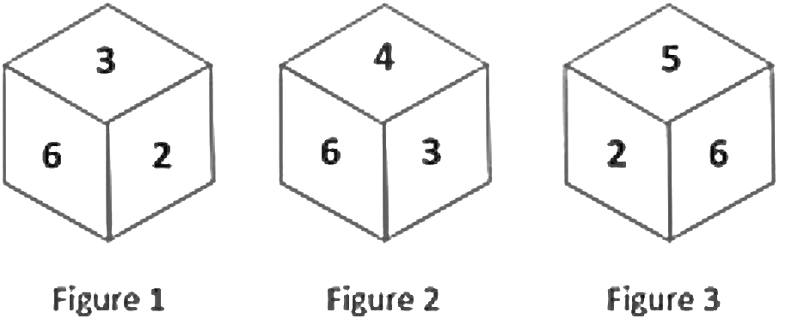
SSC JE 2023 | Reasoning Classes | By Abhishek Sir
Q2. Three different positions of the same dice are shown (Figures 1 – 3). Find the number on the face opposite to the face having ‘1’. (SSC JE 2022)
(a) 3
(b) 6
(c) 4
(d) 5

Slide 16
SSC JE 2023 | Reasoning Classes | By Abhishek Sir
Q3. Arrange the following in a logical and meaningful order. (SSC JE 2022)
1. Brown
2. Brief
3. Built
4. Beach
5. Blame
6. Birth
(a) 1, 5, 6, 4, 3, 2
(b) 4, 6, 5, 2, 1, 3
(c) 2, 6, 5, 4, 3, 1
(d) 1, 3, 2, 6, 4, 5

Slide 17
SSC JE 2023 | Reasoning Classes | By Abhishek Sir
Q4. Select the option that is related to the third number in the same way as the second number is related to the ﬁrst number and the sixth number is related to the ﬁfth number. (SSC JE 2022)
6 : 252 :: 4 : ? :: 9 : 810
(a) 80
(b) 82
(c) 78
(d) 75

Slide 18
SSC JE 2023 | Reasoning Classes | By Abhishek Sir
Q5. In a certain code language, ‘LIMITED’ is written as ‘MJNHUFE’ and ‘NEUTRAL’ is written as ‘OFVSSBM’. How will ‘ORGANIC’ be written in that language? (SSC JE 2022)
(a) NSIBCKE
(b) PSHZOJD
(c) PQIBOJD
(d) NQFZMHB

Slide 19
SSC JE 2023 | Reasoning Classes | By Abhishek Sir
Q6. Select the option that represents the letters that, when sequentially placed from left to right in the blanks below, will complete the letter series. (SSC JE 2022)
L R _ D L R M _ L _ M D _ _ _ D
(a) LRDMRD
(b) MDRLRM
(c) MDRMLR
(d) LDRMRD

Slide 20
SSC JE 2023 | Reasoning Classes | By Abhishek Sir
Q7. Seven people, A, B, C, D, E, F and G, are sitting in a straight row, facing the north. Only two people sit to the left of G. Only two people sit between A and F. A sits to the left of F. D is an immediate neighbour of F to the right. Only one person sits to the right of B. E is not an immediate neighbour of G. How many people sit between E and A? (SSC JE 2022)
(a) 2
(b) 3
(c) 5
(d) 4
सात व्यक्ति A, B, C, D, E, F और G एक सीधी पंक्ति में उत्तर की ओर उन्मुख होकर बैठे हैं। G के बायें ओर केवल दो व्यक्ति बैठे हैं। A और F के मध्य केवल दो व्यक्ति बैठे हैं। A, F के बायें बैठा है। D, F के दायें निकटतम पडोसी है। केवल एक व्यक्ति B के दायें बैठा है। E, G का निकटतम पडोसी नहीं है। E और A के मध्य कितने व्यक्ति बैठे हैं?

Slide 21
SSC JE 2023 | Reasoning Classes | By Abhishek Sir
Q7. Seven people, A, B, C, D, E, F and G, are sitting in a straight row, facing the north. Only two people sit to the left of G. Only two people sit between A and F. A sits to the left of F. D is an immediate neighbour of F to the right. Only one person sits to the right of B. E is not an immediate neighbour of G. How many people sit between E and A? (SSC JE 2022)
(a) 2
(b) 3
(c) 5
(d) 4

Slide 22
SSC JE 2023 | Reasoning Classes | By Abhishek Sir
Q8. Which of the following numbers will replace the question mark (?) in the given series? (SSC JE 2022)
4, 15, 48, ?, 444
(a) 147
(b) 246
(c) 96
(d) 128

Slide 23
SSC JE 2023 | Reasoning Classes | By Abhishek Sir
Q9. In a certain code language, ‘HIDE’ is written as ‘6723’ and ‘FORT’ is written as ‘4131618’. How will ‘DUTY’ be written in that language? (SSC JE 2022)
(a) 349186
(b) 42998
(c) 24986
(d) 2191823

Slide 24
SSC JE 2023 | Reasoning Classes | By Abhishek Sir
Q10. Two statements are given, followed by two conclusions numbered I and II. Assuming the statements to be true, even if they seem to be at variance with commonly known facts, decide which of the conclusions logically follow(s) from the statements. (SSC JE 2022)
Statements:
All dogs are pets.
Some dogs are stray.
Conclusions:
I. Some pets are dogs.
II. Some pets are stray.
(a) Neither conclusion I nor II follows
(b) Both conclusions I and II follow
(c) Only conclusion II follows
(d) Only conclusion I follows

Slide 25
SSC JE 2023 | Reasoning Classes | By Abhishek Sir
Q11. In this question, three statements are given, followed by two conclusions numbered I and II. Assuming the statements to be true, even if they seem to be at variance with commonly known facts, decide which of the conclusion(s) logically follow(s) from the statements. (SSC JE 2022)
Statements:
All girls are students.
All students are leaders.
Some leaders are brave.
Conclusions:
I. All girls are leaders.
II. Some girls are brave.
(a) Only conclusion I follows.
(b) Neither conclusion I nor II follows.
(c) Both conclusions I and II follow.
(d) Only conclusion II follows.

Slide 26
SSC JE 2023 | Reasoning Classes | By Abhishek Sir
Q12. Select the number from among the given options that can replace the question mark (?) in the following series. (SSC JE 2022)
115, 71, 90, 89, 65, 107, ?, 125
(a) 42
(b) 49
(c) 40
(d) 45

Slide 27
SSC JE 2023 | Reasoning Classes | By Abhishek Sir
Q13. Ten people are sitting in two parallel rows with ﬁve people each in such a way that there is equal distance between adjacent persons.
In row I – P, Q, R, S and T are seated and all of them are facing south.
In row II – A, B, C, D and E are seated and all of them are facing north.
R sits between S and P. D sits at the extreme right end of their row exactly opposite Q. B sits at the centre of their row exactly opposite P. E sits exactly opposite R. C is the immediate neighbour of D. Who sits at the extreme left end of the row of the people facing North? (SSC JE 2022)
(a) E
(b) A
(c) D
(d) B
दस व्यक्ति दो समानांतर पंक्तियों में पांच व्यक्तियों के साथ इस प्रकार बैठे हैं कि आसन्न व्यक्तियों के बीच समान दूरी है।
पंक्ति I में – P, Q, R, S और T बैठे हैं और उन सभी का मुख दक्षिण की ओर है।
पंक्ति II में – A, B, C, D और E बैठे हैं और उन सभी का मुख उत्तर की ओर है।
R, S और P के बीच में बैठता है। D उनकी पंक्ति के अंतिम छोर पर Q के ठीक विपरीत बैठता है। B उनकी पंक्ति के केंद्र में P के ठीक विपरीत बैठता है। E, R के ठीक विपरीत बैठता है। C, D का निकटतम पड़ोसी है। उत्तर की ओर उन्मुख लोगों की पंक्ति के अंतिम बाएं छोर पर?

Slide 28
SSC JE 2023 | Reasoning Classes | By Abhishek Sir
Q13. Ten people are sitting in two parallel rows with ﬁve people each in such a way that there is equal distance between adjacent persons.
In row I – P, Q, R, S and T are seated and all of them are facing south.
In row II – A, B, C, D and E are seated and all of them are facing north.
R sits between S and P. D sits at the extreme right end of their row exactly opposite Q. B sits at the centre of their row exactly opposite P. E sits exactly opposite R. C is the immediate neighbour of D. Who sits at the extreme left end of the row of the people facing North? (SSC JE 2022)
(a) E
(b) A
(c) D
(d) B

Slide 29
SSC JE 2023 | Reasoning Classes | By Abhishek Sir
Q14. Select the correct combination of mathematical signs to replace the * signs and to balance the given equation. (SSC JE 2022)
74 * 32 * 8 * 6 * 2 * 82
(a) ×, –, ÷, +, =
(b) –, ÷, +, ×, =
(c) ×, –, +, ÷, =
(d) –, +, ÷, ×, =

Slide 30
SSC JE 2023 | Reasoning Classes | By Abhishek Sir
Q15. In a code language, ‘FRIEND’ is written as ‘UIRVMW’, ‘STRANGER’ is written as ‘HGIZMTVI’. How will ‘CUSTOMER’ be written in that language? (SSC JE 2022)
(a) XFHGLNVI
(b) XHEGLMUI
(c) YEGHLNVI
(d) XHFGNLVI

