Slide 1










Rey waited for the train all night.
UPPCL – ENGLISH | MONDAY – SATURDAY | 9:00 AM

Slide 2

Rey waited for the train all night.
UPPCL – ENGLISH | MONDAY – SATURDAY | 9:00 AM
Select the most appropriate option to fill the blank.
You must _______ fail to watch my daughter’s first stage performance.
Unless
Without
Except
Devoid

Slide 3
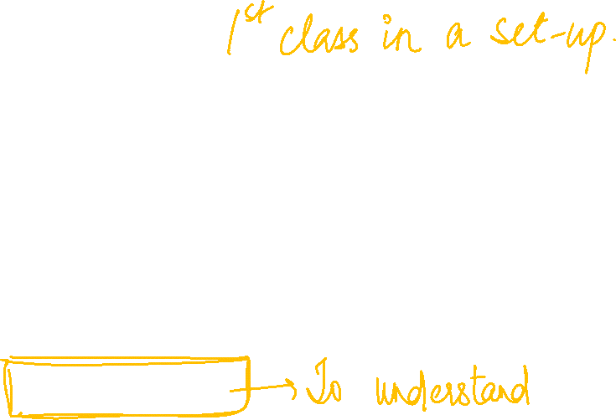
Rey waited for the train all night.
UPPCL – ENGLISH | MONDAY – SATURDAY | 9:00 AM
Select the most appropriate option to fill the blank.
2. A common man is not fully ___________ with the complexities of the laws.
Accused
Abused
Conversed
Reversed

Slide 4
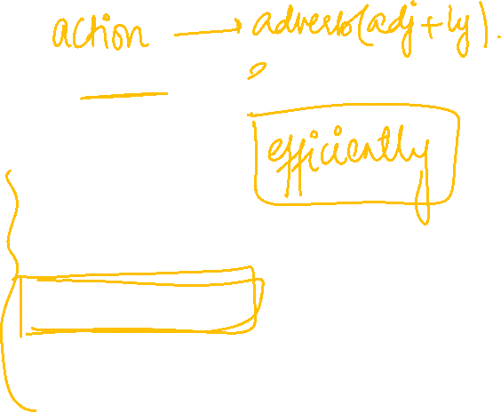
Rey waited for the train all night.
UPPCL – ENGLISH | MONDAY – SATURDAY | 9:00 AM
Select the most appropriate option to fill the blank.
3. I work very _________ and am decisive and accurate in my judgement.
Anxious
Elaborate
Efficiently
Precise

Slide 5
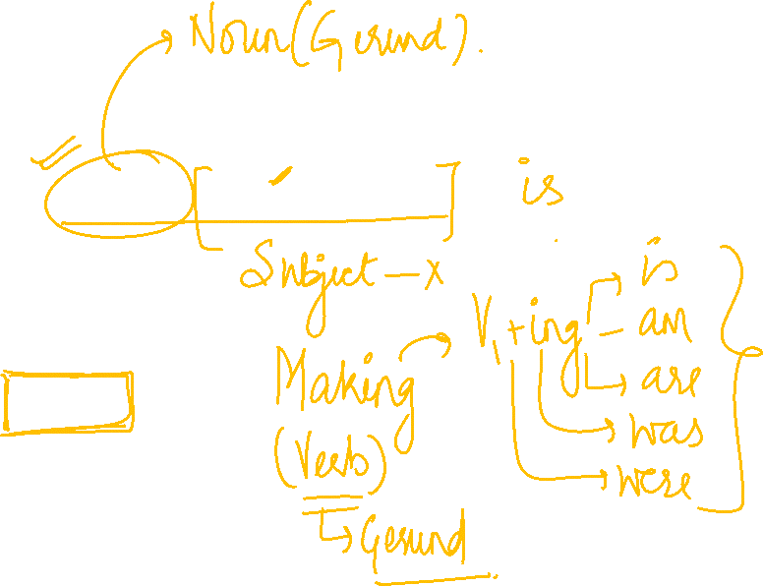
Rey waited for the train all night.
UPPCL – ENGLISH | MONDAY – SATURDAY | 9:00 AM
Select the most appropriate option to fill the blank.
4. Making pies and cakes ________ Mrs. Kumar’s speciality.
Have
Is
Has
Are being

Slide 6
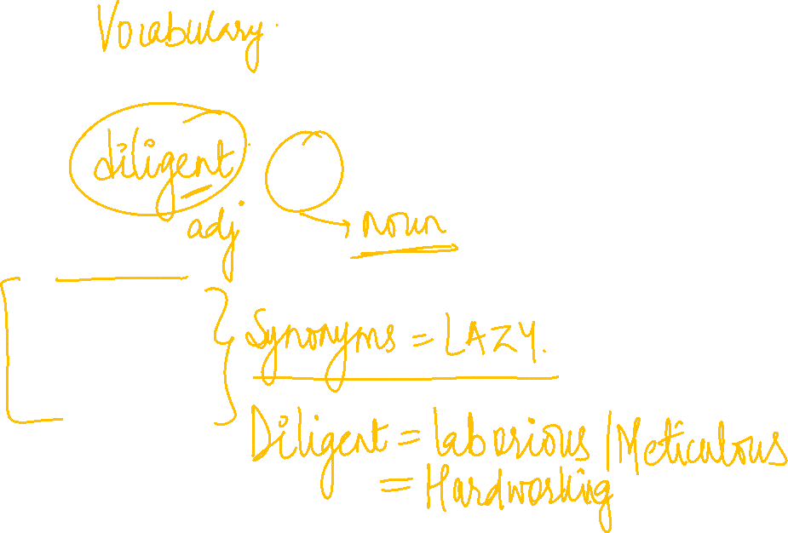
Rey waited for the train all night.
UPPCL – ENGLISH | MONDAY – SATURDAY | 9:00 AM
Select the most appropriate option to fill the blank.
5. A __________ man is certain to be prosperous.
Diligent
Inactive
Lethargic
Indolent

Slide 7
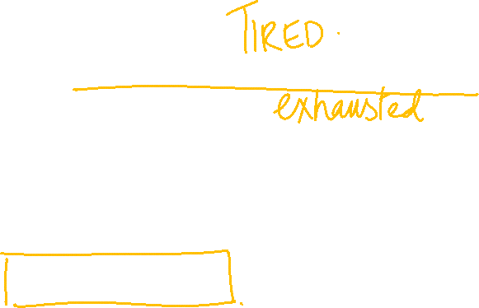
Rey waited for the train all night.
UPPCL – ENGLISH | MONDAY – SATURDAY | 9:00 AM
Select the most appropriate option to fill the blank.
6. I don’t have much energy these days. After a short stroll, I am quite ________.
Relieved
Eager
Exhausted
uplifted

Slide 8
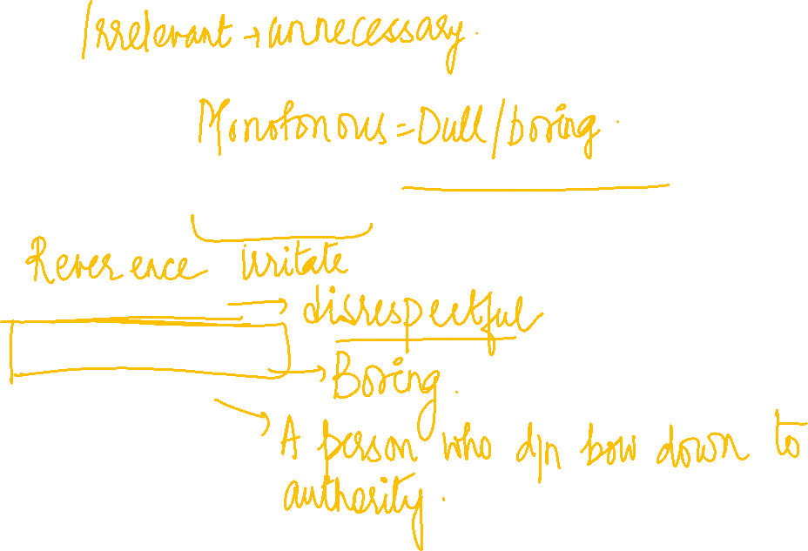
Rey waited for the train all night.
UPPCL – ENGLISH | MONDAY – SATURDAY | 9:00 AM
Select the most appropriate option to fill the blank.
7. Sanjay found the the unchanging rhythm of the musical piece to be annoyingly ___________.
Irreverent
Monotonous
Recusant
coherent

Slide 9

Rey waited for the train all night.
UPPCL – ENGLISH | MONDAY – SATURDAY | 9:00 AM
Select the most appropriate option to fill the blank.
8.Many national surveys _________ that malnutrition is common in developed countries.
Wheal
Reveal
Sheal
Vineal

Slide 10
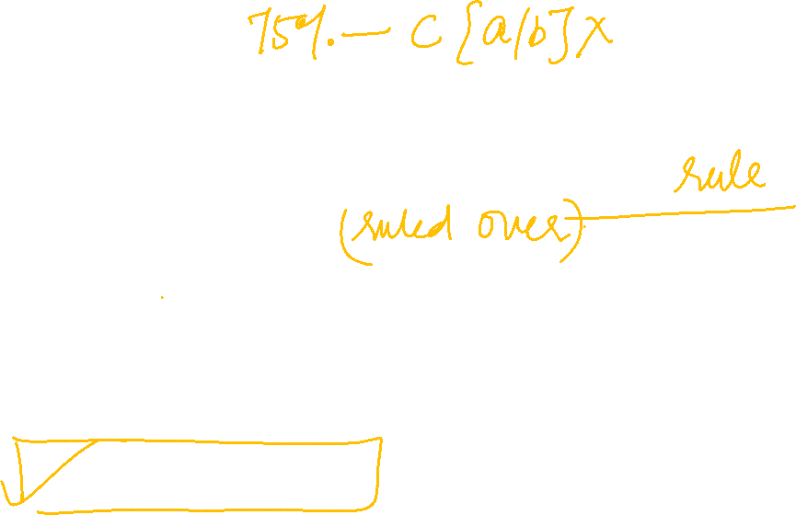
Rey waited for the train all night.
UPPCL – ENGLISH | MONDAY – SATURDAY | 9:00 AM
Select the most appropriate option to fill the blank.
9. Aristotle held that persons are fit to ______ while others are fit to be _______.
Ruled over, ruled
Ruling, rule
Rule, Ruled
Rule, Ruled over

Slide 11
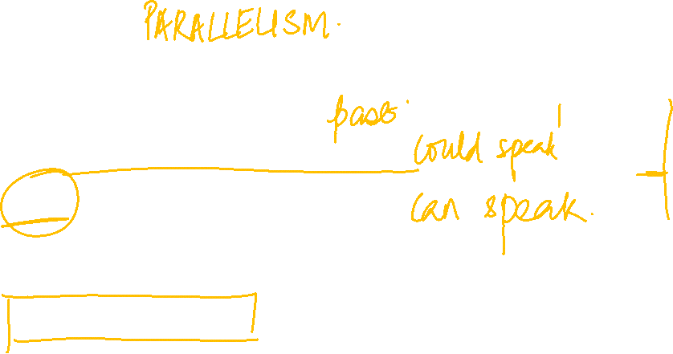
Rey waited for the train all night.
UPPCL – ENGLISH | MONDAY – SATURDAY | 9:00 AM
Select the most appropriate option to fill the blank.
10. Nitin told Rohan that he ________ English fluently and was very happy.
Can speak
Could Speak
Could have spoken
Could speaking

Slide 12
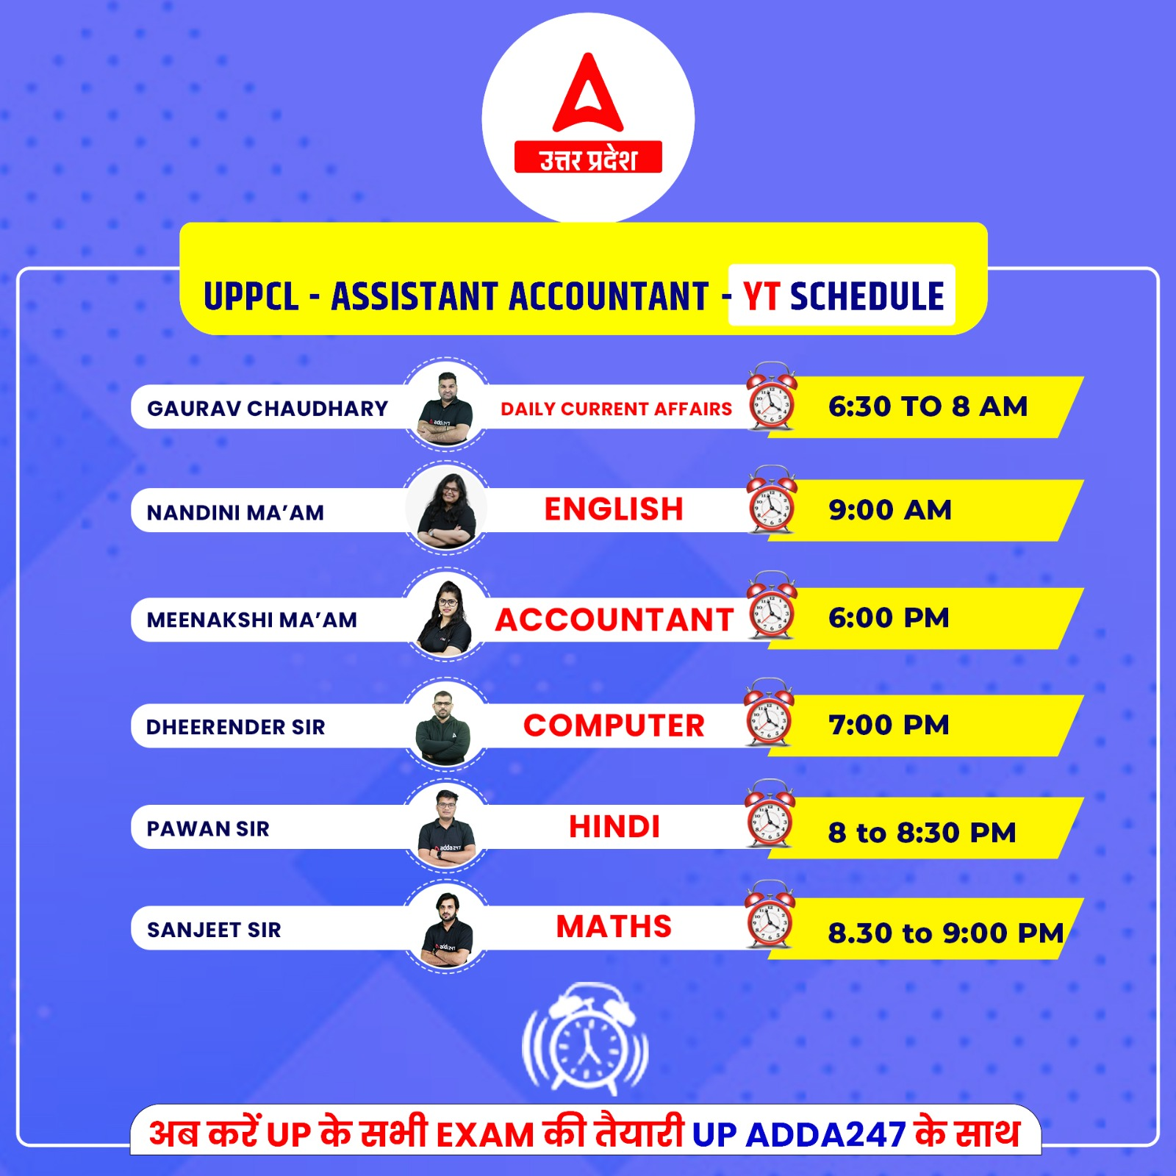

Rey waited for the train all night.
UPPCL – ENGLISH | MONDAY – SATURDAY | 9:00 AM

Slide 13
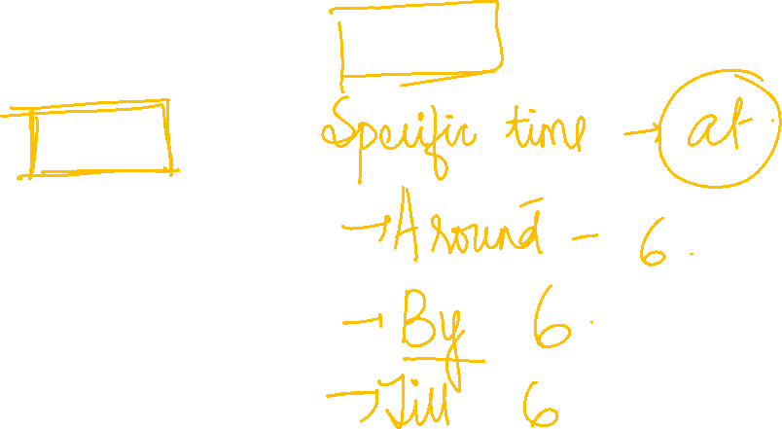
Rey waited for the train all night.
UPPCL – ENGLISH | MONDAY – SATURDAY | 9:00 AM
ONE WORD SUBSTITUTION:
11. We will leave towards 6:00 a.m.
At
ON
For
from

Slide 14
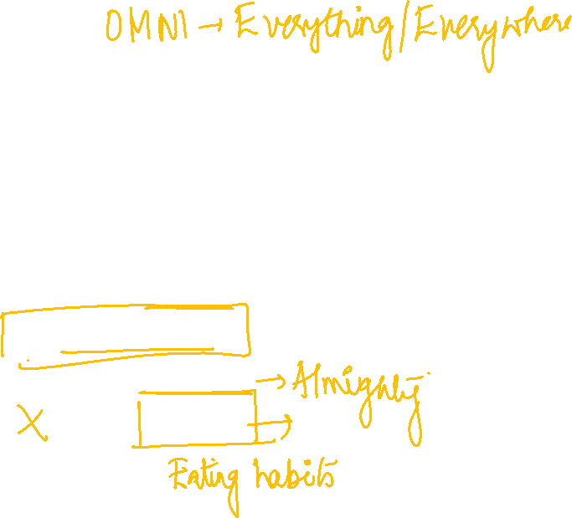
Rey waited for the train all night.
UPPCL – ENGLISH | MONDAY – SATURDAY | 9:00 AM
ONE WORD SUBSTITUTION:
12. The manager behaves as if he knows everything and has unlimited knowledge.
Omnipotent
Omniscient
Omnipresent
Omnivorous

Slide 15
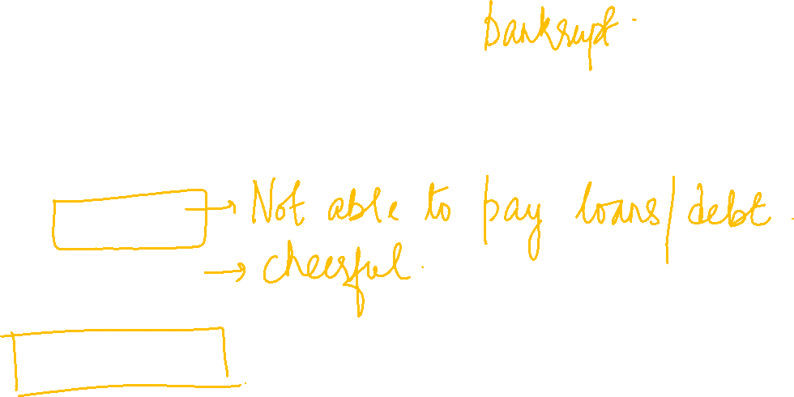
Rey waited for the train all night.
UPPCL – ENGLISH | MONDAY – SATURDAY | 9:00 AM
ONE WORD SUBSTITUTION:
13. Strong taste or liking for something.
Insolvent
Ebullient
Parole
Penchant

Slide 16

Rey waited for the train all night.
UPPCL – ENGLISH | MONDAY – SATURDAY | 9:00 AM
ONE WORD SUBSTITUTION:
14. Drawings or writings scribbled on the wall in public places.
Graffiti
Posters
Sketchers
Hoardings

Slide 17

Rey waited for the train all night.
UPPCL – ENGLISH | MONDAY – SATURDAY | 9:00 AM
ONE WORD SUBSTITUTION:
15. Easily hurt emotionally.
Senseless
Sensible
Incensed
Sensitive

Slide 18
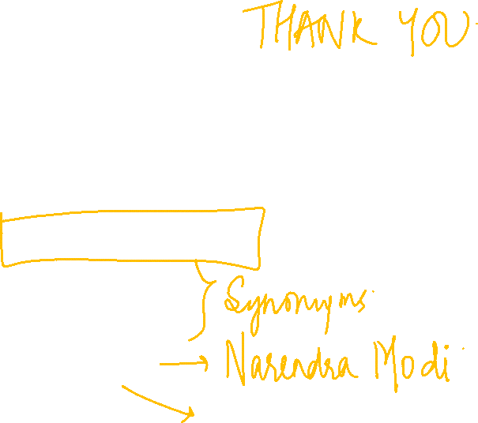
Rey waited for the train all night.
UPPCL – ENGLISH | MONDAY – SATURDAY | 9:00 AM
ONE WORD SUBSTITUTION:
16. One who speaks for others.
Spokesperson
Verbose
Talkative
Orator

Slide 19
Rey waited for the train all night.
UPPCL – ENGLISH | MONDAY – SATURDAY | 9:00 AM
ONE WORD SUBSTITUTION:
17. A set of rooms especially in a hotel for the use of one person or his family.
Suite
Flat
Apartment
Abode

Slide 20
Rey waited for the train all night.
UPPCL – ENGLISH | MONDAY – SATURDAY | 9:00 AM
ONE WORD SUBSTITUTION:
18. No longer in use.
Obscure
Oriental
Original
Obsolete

Slide 21
Rey waited for the train all night.
UPPCL – ENGLISH | MONDAY – SATURDAY | 9:00 AM
ONE WORD SUBSTITUTION:
19. A mass of ice, snow and rocks falling rapidly sown a mountain-side.
Blizzard
Glacier
Avalanche
Typhoon

Slide 22
Rey waited for the train all night.
UPPCL – ENGLISH | MONDAY – SATURDAY | 9:00 AM
ONE WORD SUBSTITUTION:
20. Made of artificial substance or material.
Synthetic
Offensive
Expensive
Authentic

Slide 23


