Slide 4
DICE

Slide 5
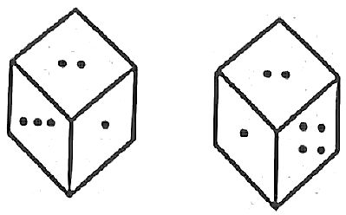
RRB JE & SSC JE 2023 | Reasoning Classes | By Abhishek Sir
TO GET MAXIMUM DISCOUNT || USE CODE- Y516
Q1. On the basis of two figures of dice. You have to tell what number will be there on the opposite side of number 2?
(a) 3
(b) 6 or 5
(c) 1
(d) Cannot be determined

Slide 6
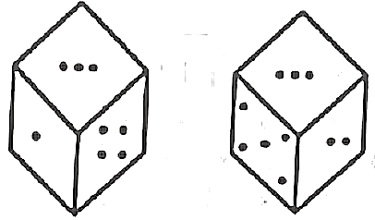
RRB JE & SSC JE 2023 | Reasoning Classes | By Abhishek Sir
TO GET MAXIMUM DISCOUNT || USE CODE- Y516
Q2. On the basis of two figures of dice you have to tell what number will be there on the opposite side of number 1?
(a) 3
(b) 4
(c) 6
(d) 5

Slide 7
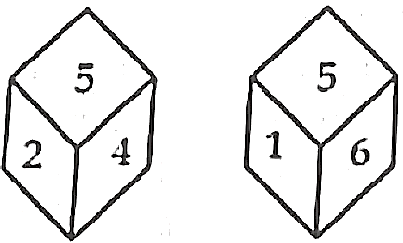
RRB JE & SSC JE 2023 | Reasoning Classes | By Abhishek Sir
TO GET MAXIMUM DISCOUNT || USE CODE- Y516
Direction (3 - 5): On the basis of two figures of dice. Answer the following questions.
Q3. Which number is at the opposite of number 2?
(a) 1
(b) 2
(c) 3
(d) 5

Slide 8
RRB JE & SSC JE 2023 | Reasoning Classes | By Abhishek Sir
TO GET MAXIMUM DISCOUNT || USE CODE- Y516
Q4. Which number is at the opposite of number 4?
(a) 1
(b) 6
(c) 3
(d) 4

Slide 9
RRB JE & SSC JE 2023 | Reasoning Classes | By Abhishek Sir
TO GET MAXIMUM DISCOUNT || USE CODE- Y516
Q5. Which number is at the opposite of number 5?
(a) 2
(b) 4
(c) 3
(d) 6

Slide 10
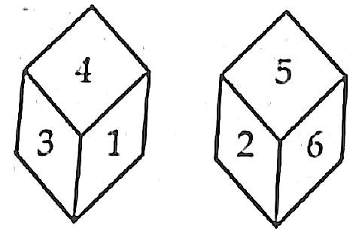
RRB JE & SSC JE 2023 | Reasoning Classes | By Abhishek Sir
TO GET MAXIMUM DISCOUNT || USE CODE- Y516
Directions (6 – 8): Questions given below are based on two figures of dice.
Q6. Which number is at the opposite of number 4?
(a) 5
(b) 2
(c) 6
(d) none of these

Slide 11
RRB JE & SSC JE 2023 | Reasoning Classes | By Abhishek Sir
TO GET MAXIMUM DISCOUNT || USE CODE- Y516
Q7. Which number is at the opposite of number 3?
(a) 2
(b) 5
(c) 6
(d) 4

Slide 12
RRB JE & SSC JE 2023 | Reasoning Classes | By Abhishek Sir
TO GET MAXIMUM DISCOUNT || USE CODE- Y516
Q8. Which number is at the opposite of number 1?
(a) 2
(b) 5
(c) 4
(d) 6

Slide 13
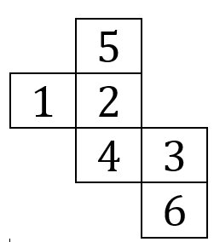
RRB JE & SSC JE 2023 | Reasoning Classes | By Abhishek Sir
TO GET MAXIMUM DISCOUNT || USE CODE- Y516
Q9. When the following figure is folded to form a cube, then which number is at the opposite of number 1?
(a) 3
(b) 6
(c) 4
(d) 5

Slide 14
RRB JE & SSC JE 2023 | Reasoning Classes | By Abhishek Sir
TO GET MAXIMUM DISCOUNT || USE CODE- Y516
Directions (10 – 16): In each of the following questions, four positions of the same dice has been shown. You have to see these figure and select the number/symbol opposite to number/symbol as asked in each of question.
Q10.
Which number is at opposite of number 6?
(a) 1
(b) 2
(c) 3
(d) 4

Slide 15
RRB JE & SSC JE 2023 | Reasoning Classes | By Abhishek Sir
TO GET MAXIMUM DISCOUNT || USE CODE- Y516
Q11.
Which number is at opposite of number 3?
(a) 5
(b) 1
(c) 2
(d) 6

Slide 16
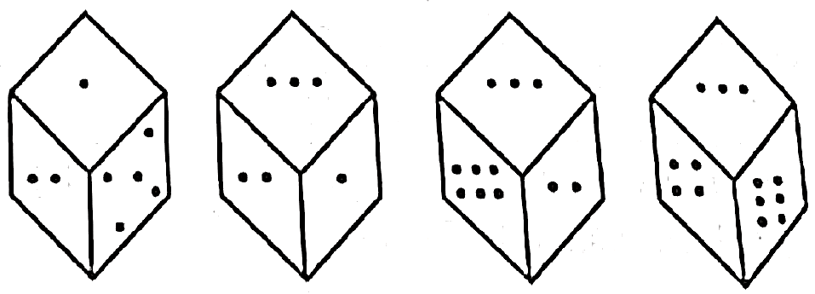
RRB JE & SSC JE 2023 | Reasoning Classes | By Abhishek Sir
TO GET MAXIMUM DISCOUNT || USE CODE- Y516
Q12.
Which number is at opposite of number 4?
(a) 1
(b) 2
(c) 5
(d) 3

Slide 17
RRB JE & SSC JE 2023 | Reasoning Classes | By Abhishek Sir
TO GET MAXIMUM DISCOUNT || USE CODE- Y516
Q13.
Which alphabet is at the opposite of alphabet E?
(a) C
(b) B
(c) D
(d) A

Slide 18
RRB JE & SSC JE 2023 | Reasoning Classes | By Abhishek Sir
TO GET MAXIMUM DISCOUNT || USE CODE- Y516
Q14.
Which symbol is at the opposite of symbol + ?
(a) ?
(b) $
(c) ×
(d) +

Slide 19
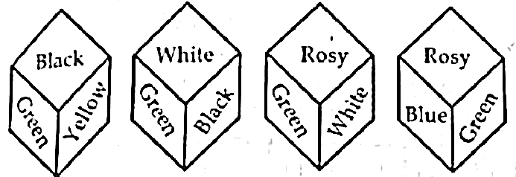
RRB JE & SSC JE 2023 | Reasoning Classes | By Abhishek Sir
TO GET MAXIMUM DISCOUNT || USE CODE- Y516
Q15.
Which colour is at the opposite of the black colour?
(a) Blue
(b) Rosy
(c) Green
(d) White

Slide 20
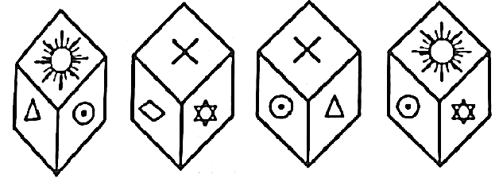
RRB JE & SSC JE 2023 | Reasoning Classes | By Abhishek Sir
TO GET MAXIMUM DISCOUNT || USE CODE- Y516
Q16.
Which symbol is at the opposite of the symbol ?
(a) (b)
(c) (d)

Slide 21
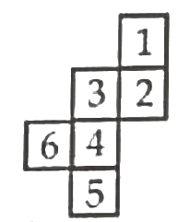
RRB JE & SSC JE 2023 | Reasoning Classes | By Abhishek Sir
TO GET MAXIMUM DISCOUNT || USE CODE- Y516
Q17. When the following figure is folded to form a cube, then which number is at the opposite of number?
(a) 6
(b) 4
(c) 5
(d) 1

Slide 22
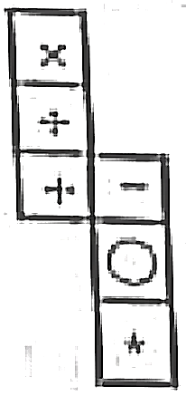
RRB JE & SSC JE 2023 | Reasoning Classes | By Abhishek Sir
TO GET MAXIMUM DISCOUNT || USE CODE- Y516
Q18. When the following figure is folded to from a cube, then which symbol is opposite to + ?
(a) (b)
(c) (d)

Slide 23
RRB JE & SSC JE 2023 | Reasoning Classes | By Abhishek Sir
TO GET MAXIMUM DISCOUNT || USE CODE- Y516
Q19. When the following figure is folded to from a cube, then which symbol is opposite of symbol $∆$ ?
(a) (b)
(c) (d)

Slide 24
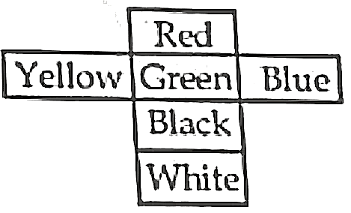
RRB JE & SSC JE 2023 | Reasoning Classes | By Abhishek Sir
TO GET MAXIMUM DISCOUNT || USE CODE- Y516
Q20. When the following figure is folded to from a cube, then which colour is at the opposite of colour white?
(a) Green
(b) Yellow
(c) Blue
(d) Red

Slide 25
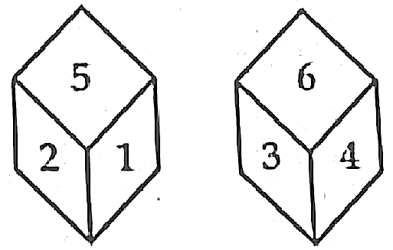
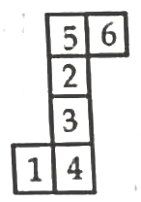
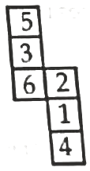
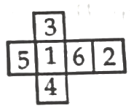
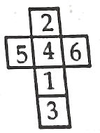
RRB JE & SSC JE 2023 | Reasoning Classes | By Abhishek Sir
TO GET MAXIMUM DISCOUNT || USE CODE- Y516
Direction (21 to 22): In each of the following questions two positions of the same dice have been shown. If from these dice a figure is made then which option will be suitable for answer.
Q21.
(a) (b) (c) (d)

Slide 26
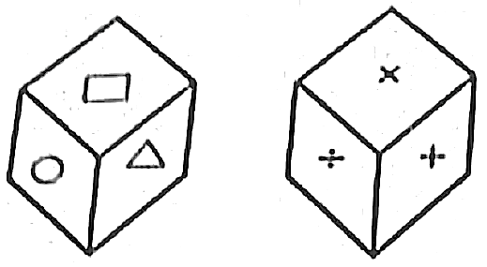
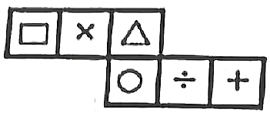
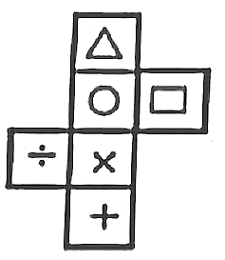
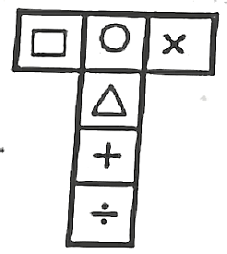
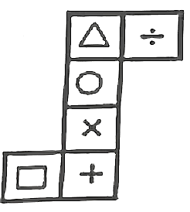
RRB JE & SSC JE 2023 | Reasoning Classes | By Abhishek Sir
TO GET MAXIMUM DISCOUNT || USE CODE- Y516
Q22.
(a) (b) (c) (d)

Slide 27
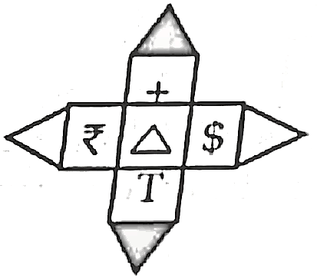
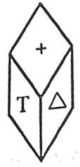
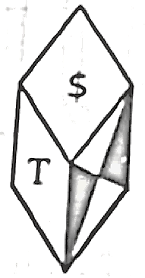
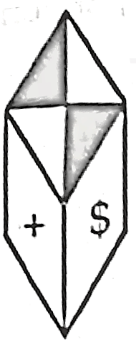
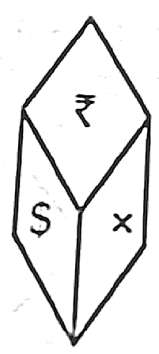
RRB JE & SSC JE 2023 | Reasoning Classes | By Abhishek Sir
TO GET MAXIMUM DISCOUNT || USE CODE- Y516
Q23. Given below a figure. If we fold the figure and give it shape of a dice then which option will be suitable for answer
(a) (b) (c) (d)

Slide 28
RRB JE & SSC JE 2023 | Reasoning Classes | By Abhishek Sir
TO GET MAXIMUM DISCOUNT || USE CODE- Y516
Q24. A cube is coloured red on all of its faces. It is then cut into 125 smaller cubes of equal size. Then how many smaller cubes have three surfaces painted with red colour?
(a) 4
(b) 8
(c) 12
(d) 10

Slide 29
Paste Your Course Details

