Slide 1
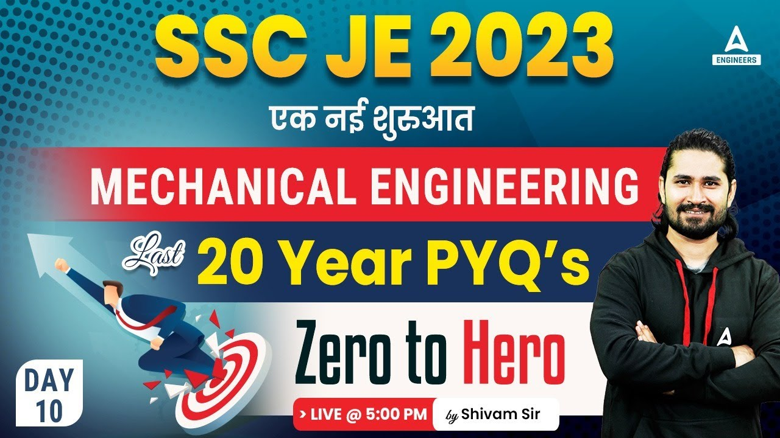
12

Slide 2


Slide 3


SSC JE Mechanical Previous Year Questions + Answers | Mechanical Engineering
Mechanical Engineering
Q. Ratio of Weight density to mass density can be termed as-
Dimensionless Quantity
Acceleration due to gravity
Mass
Volume
For 78% Discount
Use Code : “Y166”
78% Discount
Y166
Join Our Paid Batch : SSC JE Batch | Mahapack Batch | Use Code Y166 For 78% of Discount

Slide 4

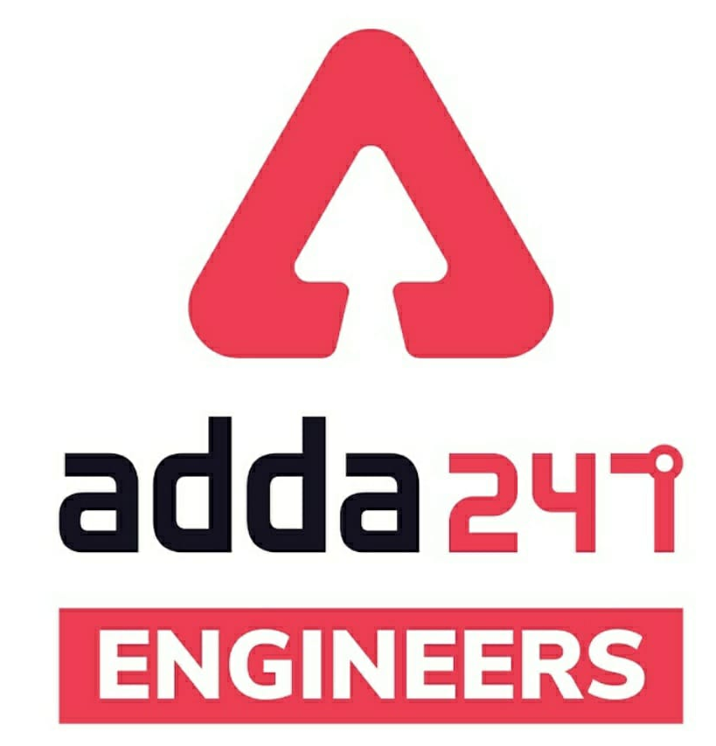

SSC JE Mechanical Previous Year Questions + Answers | Mechanical Engineering
Mechanical Soormas
Sourav Das
Subir
Last Bencher
Ravi Raj
Akhilesh Gupta
Lokesh Varwan
Sahil Kumar
Pankaj Mahato
Mr. Dilip Gupta
Nagin K Papa
Anuj Kanoujiya
Pragya Srivastava
Shin chain
Nandan Mehta
Reyaz Samoon
Anchal Mishra
Amar Jyoti
Yogi Tomar
Ritick Konwar
Shivani Singh
Raj Vimal
Rajesh Rohila
Piyush Mechanical
Amit Kumar
Aakheya Marke B
Entertainment Vlog
Raj Yadav
for
Code : “Y166”

Slide 5
SSC JE Mechanical Previous Year Questions + Answers | Mechanical Engineering
Mechanical Soormas
Pawan Singh Rana
Tanvir Rather
Shiksha Aur Vikas
Nikhil Venkhade
Santi Akhil
Ajay Kumar
Chandan Kumar
Garima Shukla
Avadhesh Yadav
Aman Kumar
Kuldeet Das
Shahzad Ali
Alok Kumar
Anshit Verma
Er Suhail
Rajat Bobde
Ela Sahoo
Kumari Manisha
Deepak Kumar
Om Prakash Chaurasiya
Kunal Kisku
Yash Menariya
Sonakshi Pulast
for
Code : “Y166”

Slide 6

SSC JE Mechanical Previous Year Questions + Answers | Mechanical Engineering
Mechanical Engineering
For 78% Discount
Use Code : “Y166”
78% Discount
Y166
Join Our Paid Batch : SSC JE Batch | Mahapack Batch | Use Code Y166 For 78% of Discount

Slide 7
SSC JE Mechanical Previous Year Questions + Answers | Mechanical Engineering
Mechanical Engineering
Q. Newton second per square meter is the unit of_
A. pressure
B. kinematic viscosity
C. dynamic viscosity
D. surface tension
For 78% Discount
Use Code : “Y166”
78% Discount
Y166
Join Our Paid Batch : SSC JE Batch | Mahapack Batch | Use Code Y166 For 78% of Discount

Slide 8
SSC JE Mechanical Previous Year Questions + Answers | Mechanical Engineering
Mechanical Engineering
The process of removing unwanted material from the casting is called.
A. Fettling
B. Cleaning
C. Finishing
D. Blowing
For 78% Discount
Use Code : “Y166”
78% Discount
Y166
Join Our Paid Batch : SSC JE Batch | Mahapack Batch | Use Code Y166 For 78% of Discount

Slide 9
SSC JE Mechanical Previous Year Questions + Answers | Mechanical Engineering
Mechanical Engineering
Q. The condition for the reversibility of a cycle is !
A. the pressure and temperature of the working substance must not differ, appreciably, from those of the surroundings at any stage in the process
B. all the processes, taking place in the cycle of operation, must be extremely slow
C. the working parts of the engine must be friction free
D. all of the above
For 78% Discount
Use Code : “Y166”
78% Discount
Y166
Join Our Paid Batch : SSC JE Batch | Mahapack Batch | Use Code Y166 For 78% of Discount

Slide 10
SSC JE Mechanical Previous Year Questions + Answers | Mechanical Engineering
Mechanical Engineering
Q. Which of the following is an example of irreversible process-?
A. Polytropic expansion of fluid
B. Isenthalpic expansion of gases
C. Isothermal expansion
D. Electrolysis
For 78% Discount
Use Code : “Y166”
78% Discount
Y166
Join Our Paid Batch : SSC JE Batch | Mahapack Batch | Use Code Y166 For 78% of Discount

Slide 11
SSC JE Mechanical Previous Year Questions + Answers | Mechanical Engineering
Mechanical Engineering
Q. Which of the following processes are thermodynamically reversible!?
A. Throttling
B. Free expansion
C. Constant volume and constant pressure
D. Isothermal and adiabatic
TNPSC 2019
For 78% Discount
Use Code : “Y166”
78% Discount
Y166
Join Our Paid Batch : SSC JE Batch | Mahapack Batch | Use Code Y166 For 78% of Discount

Slide 12
SSC JE Mechanical Previous Year Questions + Answers | Mechanical Engineering
Mechanical Engineering
Q. In the polytropic process equation PV^n = constant if n is infinitely large, the process is termed as.
A. Constant volume
B. Constant pressure
C. Constant temperature
D. Adiabatic
RPSC AE 2018
TNPSC AE 2018
UKPSC AE 2007 Paper -II
For 78% Discount
Use Code : “Y166”
78% Discount
Y166
Join Our Paid Batch : SSC JE Batch | Mahapack Batch | Use Code Y166 For 78% of Discount

Slide 13
SSC JE Mechanical Previous Year Questions + Answers | Mechanical Engineering
Mechanical Engineering
Q. complete evaporation of the refrigerant in VCRS will lead to_
High compression
Low compression
Dry compression
Wet compression
For 78% Discount
Use Code : “Y166”
78% Discount
Y166
Join Our Paid Batch : SSC JE Batch | Mahapack Batch | Use Code Y166 For 78% of Discount

Slide 14
SSC JE Mechanical Previous Year Questions + Answers | Mechanical Engineering
Mechanical Engineering
Q. If sensitive manometer is the function of sin then the Draft or Tapper given in draft allowancens in metal casting is the function of?
Angle of Sin
Angle of Cos
Angle of Tan
None of the above
For 78% Discount
Use Code : “Y166”
78% Discount
Y166
Join Our Paid Batch : SSC JE Batch | Mahapack Batch | Use Code Y166 For 78% of Discount

Slide 15
SSC JE Mechanical Previous Year Questions + Answers | Mechanical Engineering
Mechanical Engineering
Q. Fourneyorn Turbine is which type of turbine!?
Impulse turbine
Inward flow Reaction Turbine
Modern Reaction turbine
Outward flow Reaction Turbine
For 78% Discount
Use Code : “Y166”
78% Discount
Y166
Join Our Paid Batch : SSC JE Batch | Mahapack Batch | Use Code Y166 For 78% of Discount

Slide 16


78% Discount
Y166
Join Our Paid Batch : SSC JE Batch | Mahapack Batch | Use Code Y166 For 78% of Discount

Slide 17
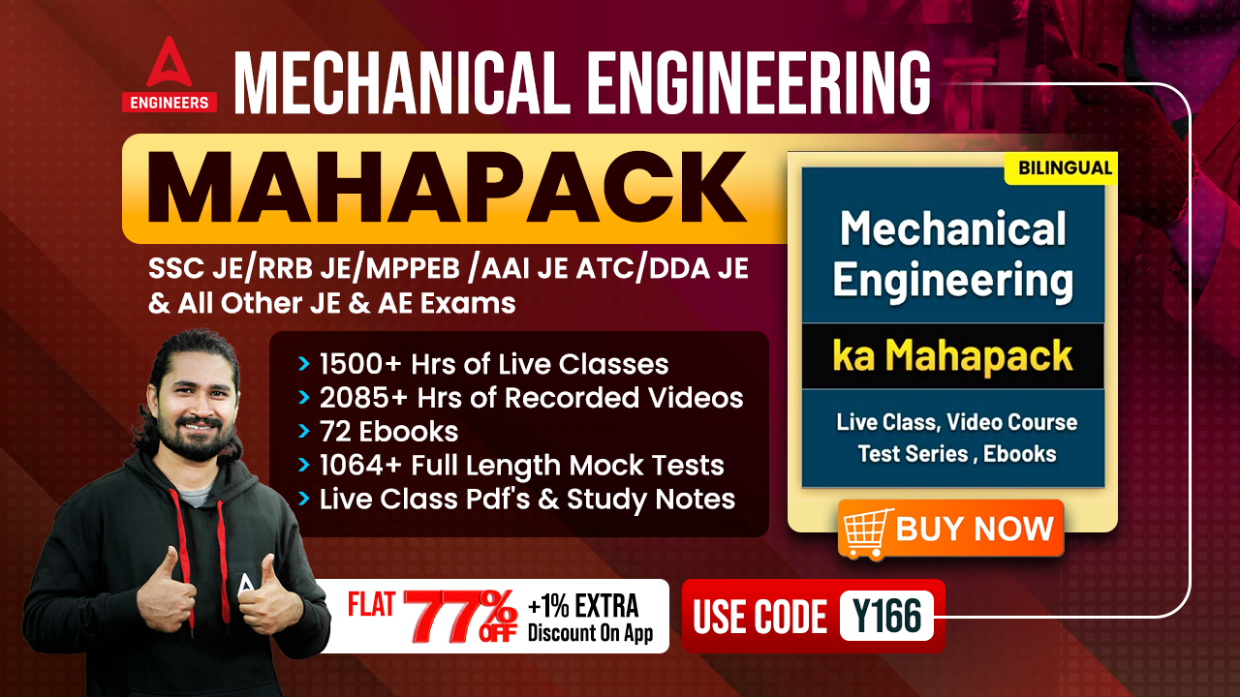

78% Discount
Y166
Join Our Paid Batch : SSC JE Batch | Mahapack Batch | Use Code Y166 For 78% of Discount

Slide 18
SSC JE Mechanical Previous Year Questions + Answers | Mechanical Engineering
Mechanical Engineering
Q. Certain quantities cannot be located on the graph by a point but are given by the area under the curve corresponding to the process. These quantities in concepts of thermodynamics are called as !
A. cyclic functions
B. point functions
C. Real functions
D. None of the above
For 78% Discount
Use Code : “Y166”
78% Discount
Y166
Join Our Paid Batch : SSC JE Batch | Mahapack Batch | Use Code Y166 For 78% of Discount

Slide 19
SSC JE Mechanical Previous Year Questions + Answers | Mechanical Engineering
Mechanical Engineering
Q. If the compression or expansion of a gas takes place in such a way that the gas neither gives heat nor takes heat from its surroundings, the process is said to be !
A. Isothermal
B. Adiabatic
C. Isobaric
D. Isolated
For 78% Discount
Use Code : “Y166”
78% Discount
Y166
Join Our Paid Batch : SSC JE Batch | Mahapack Batch | Use Code Y166 For 78% of Discount

Slide 20
SSC JE Mechanical Previous Year Questions + Answers | Mechanical Engineering
Mechanical Engineering
Q. A system is taken from state A to state B along two different paths 1 and 2. The heat absorbed and work done by the system along these paths are Q1 and Q2 and W1 and W2 respectively, then!
A. Q1 = Q2
B. W1 + Q1 = Q2 + W2
C. W1 = W2
D. Q1 – W1 = Q2 – W2
UKPSC AE 2012 Paper–II
For 78% Discount
Use Code : “Y166”
78% Discount
Y166
Join Our Paid Batch : SSC JE Batch | Mahapack Batch | Use Code Y166 For 78% of Discount

Slide 21
SSC JE Mechanical Previous Year Questions + Answers | Mechanical Engineering
Mechanical Engineering
Q. Which of the following devices complies with the Clausius statement of the second law of thermodynamics!?
A. Closed-cycle gas turbine
B. Internal combustion engine
C. Steam power plant
D. Milk chilling plant
For 78% Discount
Use Code : “Y166”
78% Discount
Y166
Join Our Paid Batch : SSC JE Batch | Mahapack Batch | Use Code Y166 For 78% of Discount

Slide 22
SSC JE Mechanical Previous Year Questions + Answers | Mechanical Engineering
Mechanical Engineering
Q. The area of a p-v diagram for a Carnot cycle represents_
A. Heat supplied
B. Heat rejected
C. Work done
D. Temperature drop
UPPSC AE 12.04.2016 Paper-II
TPSC AE 2015
For 78% Discount
Use Code : “Y166”
78% Discount
Y166
Join Our Paid Batch : SSC JE Batch | Mahapack Batch | Use Code Y166 For 78% of Discount

Slide 23
SSC JE Mechanical Previous Year Questions + Answers | Mechanical Engineering
Mechanical Engineering
Q. Carnot cycle consists of !
A. Two Isochoric & two isentropic processes
B. Two isothermal and two isenthalpic processes
C. Two constant pressure and two isentropic processes
D. none of the above
For 78% Discount
Use Code : “Y166”
78% Discount
Y166
Join Our Paid Batch : SSC JE Batch | Mahapack Batch | Use Code Y166 For 78% of Discount

Slide 24
SSC JE Mechanical Previous Year Questions + Answers | Mechanical Engineering
Mechanical Engineering
Q. Three centrifugal pumps having rate of 240 litre in one hour are connected in straight line having H1,H2,H3 as 5 mt, 5 mt, and 10mt. then its discharge will become (litre/min)!
230
240
120
none
For 78% Discount
Use Code : “Y166”
78% Discount
Y166
Join Our Paid Batch : SSC JE Batch | Mahapack Batch | Use Code Y166 For 78% of Discount

Slide 25
SSC JE Mechanical Previous Year Questions + Answers | Mechanical Engineering
Mechanical Engineering
Q. Vishal is working in Refrigeration plant where he found that the plant is consuming 630KJ of energy to produce 2TR of refrigeration effect. If the refrigeration plant is working on VCRS then what will be the compressor work in KJ-
90 KJ
630 KJ
750 KJ
250 KJ
For 78% Discount
Use Code : “Y166”
78% Discount
Y166
Join Our Paid Batch : SSC JE Batch | Mahapack Batch | Use Code Y166 For 78% of Discount

Slide 26
SSC JE Mechanical Previous Year Questions + Answers | Mechanical Engineering
Mechanical Engineering
Q. On the basis of thermodynamics in any Static process which of the parameter can be seen_
Workdone
Heat transfer
Enthalpy
None
For 78% Discount
Use Code : “Y166”
78% Discount
Y166
Join Our Paid Batch : SSC JE Batch | Mahapack Batch | Use Code Y166 For 78% of Discount

Slide 27
SSC JE Mechanical Previous Year Questions + Answers | Mechanical Engineering
Mechanical Engineering
Q. A system is having 250KJ of internal energy at 50 degree Kelvin. In the period of 6 hours its internal energy became 100KJ then the Least unavailable energy will be_!
250KJ
350KJ
100KJ
150KJ
For 78% Discount
Use Code : “Y166”
78% Discount
Y166
Join Our Paid Batch : SSC JE Batch | Mahapack Batch | Use Code Y166 For 78% of Discount

Slide 28
SSC JE Mechanical Previous Year Questions + Answers | Mechanical Engineering
Mechanical Engineering
Q. A 5 TR refrigeration capacity refrigerator is 50% efficient what will be amount of energy input-
3.5KW
35KW
50KW
5KW
For 78% Discount
Use Code : “Y166”
78% Discount
Y166
Join Our Paid Batch : SSC JE Batch | Mahapack Batch | Use Code Y166 For 78% of Discount

Slide 29

Use Code “Y166” for
maximum 78%* discount
400+ Hours Two-way Interactive Live Classes.
Syllabus is based on Recent Notification, Previous Years Exam and the same will be updated accordingly.
Enroll in this Batch, Limited Seats available.
Recorded Videos available 24/7 for quick Revision.
Solve Unlimited doubts with experts.
Get Preparation tips from the experts & Learn Time Management.
Join Our Paid Batch : SSC JE Batch | Mahapack Batch | Use Code Y166 For 78% of Discount

Slide 30
78% Discount
Y166
Join Our Paid Batch : SSC JE Batch | Mahapack Batch | Use Code Y166 For 78% of Discount

Slide 31
SSC JE Mechanical Previous Year Questions + Answers | Mechanical Engineering
Mechanical Engineering
HW. The rate of change of bending moment is equal to ______.
A. shear force at the section
B. deflection at the section
C. loading at that section
D. slope at that section
For 78% Discount
Use Code : “Y166”
78% Discount
Y166
Join Our Paid Batch : SSC JE Batch | Mahapack Batch | Use Code Y166 For 78% of Discount

