Slide 1
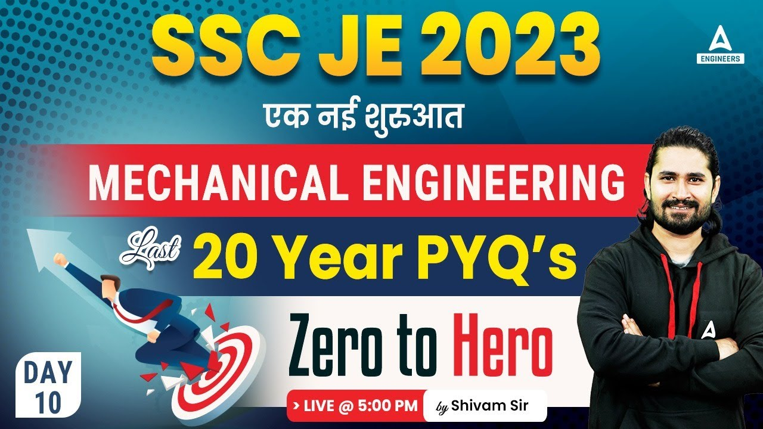

Slide 2


Slide 3


SSC JE Mechanical Previous Year Questions + Answers | Mechanical Engineering
Mechanical Engineering
Q. The tendency of rotation of body along the axis also known as the...!
A. Moment
B. acceleration
C. couple
D. torque
For 78% Discount
Use Code : “Y166”
78% Discount
Y166
Join Our Paid Batch : SSC JE Batch | Mahapack Batch | Use Code Y166 For 78% of Discount

Slide 4

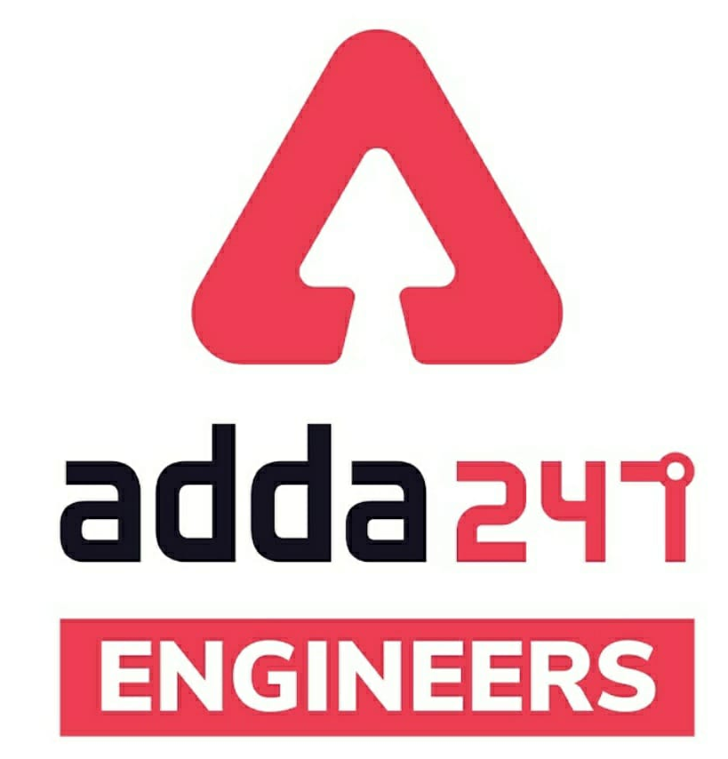

SSC JE Mechanical Previous Year Questions + Answers | Mechanical Engineering
Mechanical Soormas
Sourav Das
Yash Menariya
Lokesh Varwan
Subir
Anuj Kanoujiya
Piyush Mechanical
Pragya Srivastava
Mr Dilip Gupta
Ravi Raj
Pankaj Mahato
Shin Chain
Kaustav Maity
MS_D2E
Lunavath Rajesh
Anchal Mishra
Nandan Mehta
Aman Kumar
Shivani Singh
Eshika Rajak
Tathagat Science Academy
Pawan Singh Rana
Neeraj Rathor
Akhilesh Gupta
Ashutosh Kant
Ashish Tandan
Deepak Yadav
Rajat Bobde
for
Code : “Y166”

Slide 5
SSC JE Mechanical Previous Year Questions + Answers | Mechanical Engineering
Mechanical Soormas
Raj Yadav
Kuldeet Das
Sandeep Kumar Jha
Rajesh Rohila
Sonakshi Pulast
Ajit Aingh
Krishna India
Prajwal Kalindria
Pintu Mahato
Shubhi Tiwari
Sahil Kumar
Ajay Kumar
Shubhanker Pandey
Ritika Saxena
Kumari Manisha
Om Prakash Chaurasiya
Sahid Ahmed
Amar Jyoti
Chandan Kumar
for
Code : “Y166”

Slide 6

SSC JE Mechanical Previous Year Questions + Answers | Mechanical Engineering
Mechanical Engineering
For 78% Discount
Use Code : “Y166”
78% Discount
Y166
Join Our Paid Batch : SSC JE Batch | Mahapack Batch | Use Code Y166 For 78% of Discount

Slide 7
SSC JE Mechanical Previous Year Questions + Answers | Mechanical Engineering
Mechanical Engineering
Q. Concept of autofrettage is used in!
Solid shaft
Hollow Shaft
Thin Cylinder
None of the above
For 78% Discount
Use Code : “Y166”
78% Discount
Y166
Join Our Paid Batch : SSC JE Batch | Mahapack Batch | Use Code Y166 For 78% of Discount

Slide 8
SSC JE Mechanical Previous Year Questions + Answers | Mechanical Engineering
Mechanical Engineering
Q. Keeping All the parameters same, For Flat vanes of centrifugal pump the efficiency will be_____ than forward bent vanes efficiency.
More
Less
Remains The Same
None of the above
For 78% Discount
Use Code : “Y166”
78% Discount
Y166
Join Our Paid Batch : SSC JE Batch | Mahapack Batch | Use Code Y166 For 78% of Discount

Slide 9
SSC JE Mechanical Previous Year Questions + Answers | Mechanical Engineering
Mechanical Engineering
Q. Cutting Angle having more than 60 Degree the cutting will be_
Orthogonal cutting
Oblique cutting
Can be both orthogonal Or oblique cutting
Turning cutting
For 78% Discount
Use Code : “Y166”
78% Discount
Y166
Join Our Paid Batch : SSC JE Batch | Mahapack Batch | Use Code Y166 For 78% of Discount

Slide 10
SSC JE Mechanical Previous Year Questions + Answers | Mechanical Engineering
Mechanical Engineering
Q. Flow occurring in a pipeline when a valve is being opened is-
Steady
Unsteady
Laminar
Vortex
For 78% Discount
Use Code : “Y166”
78% Discount
Y166
Join Our Paid Batch : SSC JE Batch | Mahapack Batch | Use Code Y166 For 78% of Discount

Slide 11
SSC JE Mechanical Previous Year Questions + Answers | Mechanical Engineering
Mechanical Engineering
Q. If a particle is in static equilibrium, then the work done by the system of force acting on that particle is_
Negative
Positive
Zero
Infinity
For 78% Discount
Use Code : “Y166”
78% Discount
Y166
Join Our Paid Batch : SSC JE Batch | Mahapack Batch | Use Code Y166 For 78% of Discount

Slide 12


78% Discount
Y166
Join Our Paid Batch : SSC JE Batch | Mahapack Batch | Use Code Y166 For 78% of Discount

Slide 13
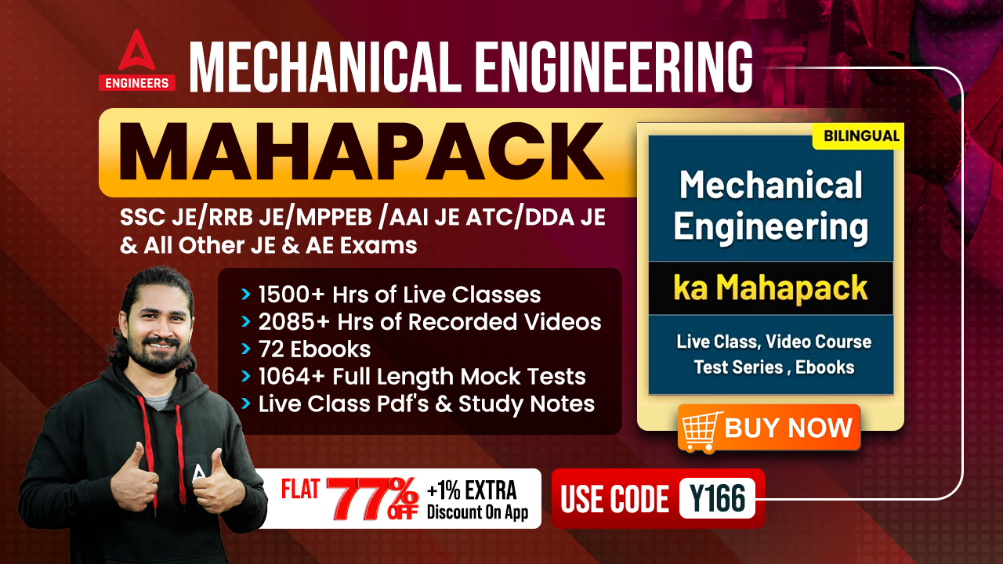

78% Discount
Y166
Join Our Paid Batch : SSC JE Batch | Mahapack Batch | Use Code Y166 For 78% of Discount

Slide 14
SSC JE Mechanical Previous Year Questions + Answers | Mechanical Engineering*
Mechanical Engineering
Q. When the gas is heated at constant volume, the heat supplied!
A. increase the internal energy of the gas.
B. increase the temperature of the gas.
C. does some external
D. Both A. and B.
For 78% Discount
Use Code : “Y166”
78% Discount
Y166
(43)Join Our Paid Batch : SSC JE Batch | Mahapack Batch | Use Code Y166 For 78% of Discount

Slide 15
SSC JE Mechanical Previous Year Questions + Answers | Mechanical Engineering
Mechanical Engineering
Q. Moment of inertia of an area alwys least with respect to_
Bottom most axis
Radius of gyration
Vertical Axis
Centroidal Axis
For 78% Discount
Use Code : “Y166”
78% Discount
Y166
Join Our Paid Batch : SSC JE Batch | Mahapack Batch | Use Code Y166 For 78% of Discount

Slide 16
SSC JE Mechanical Previous Year Questions + Answers | Mechanical Engineering
Mechanical Engineering
Q. Physical Quantity Considered as Scaler Quantity_
Acceleration
Strain
Pressure
Stress
For 78% Discount
Use Code : “Y166”
78% Discount
Y166
Join Our Paid Batch : SSC JE Batch | Mahapack Batch | Use Code Y166 For 78% of Discount

Slide 17
SSC JE Mechanical Previous Year Questions + Answers | Mechanical Engineering*
Mechanical Engineering
Q. The main part of the rivet does not involve which of the following part_?
A. Head
B. Shank
C. Thread
D. Point
For 78% Discount
Use Code : “Y166”
78% Discount
Y166
(75)Join Our Paid Batch : SSC JE Batch | Mahapack Batch | Use Code Y166 For 78% of Discount

Slide 18
SSC JE Mechanical Previous Year Questions + Answers | Mechanical Engineering
Mechanical Engineering
Q. In case of free expansion process which quantity does not remains the same_
pressure
temperature
Both A & B
None of the above
For 78% Discount
Use Code : “Y166”
78% Discount
Y166
Join Our Paid Batch : SSC JE Batch | Mahapack Batch | Use Code Y166 For 78% of Discount

Slide 19
SSC JE Mechanical Previous Year Questions + Answers | Mechanical Engineering
Mechanical Engineering
Q. A heat engine is having 40% efficiency if this engine is used as heat engine then what will be the efficiency of heat pump-?
1.25
2.5
1.2
1.5
For 78% Discount
Use Code : “Y166”
78% Discount
Y166
Join Our Paid Batch : SSC JE Batch | Mahapack Batch | Use Code Y166 For 78% of Discount

Slide 20
SSC JE Mechanical Previous Year Questions + Answers | Mechanical Engineering
Mechanical Engineering
Q. Same Independent elastic property at all the points at a direction is known as.
Homogeneous material
Isotropic material
Anisotropic material
Orthotropic material
For 78% Discount
Use Code : “Y166”
78% Discount
Y166
Join Our Paid Batch : SSC JE Batch | Mahapack Batch | Use Code Y166 For 78% of Discount

Slide 21
SSC JE Mechanical Previous Year Questions + Answers | Mechanical Engineering
Mechanical Engineering
Q. ___________is a heat-treating process for medium-to-high carbon ferrous metals which produces a metallurgical structure called bainite
Carborizing
Austempering
Quenching
Normalizing
For 78% Discount
Use Code : “Y166”
78% Discount
Y166
Join Our Paid Batch : SSC JE Batch | Mahapack Batch | Use Code Y166 For 78% of Discount

Slide 22
SSC JE Mechanical Previous Year Questions + Answers | Mechanical Engineering
Mechanical Engineering
Q. For making the threads _______ cutting angle is preferred.
Positive rake angle
Negative rake angle
Zero rake angle
Side cutting edge angle
For 78% Discount
Use Code : “Y166”
78% Discount
Y166
Join Our Paid Batch : SSC JE Batch | Mahapack Batch | Use Code Y166 For 78% of Discount

Slide 23
SSC JE Mechanical Previous Year Questions + Answers | Mechanical Engineering
Mechanical Engineering
Q. System in which No heat can transfer the boundary is known as!
Open system
Closed system
Can be both open and closed system
None of the above
For 78% Discount
Use Code : “Y166”
78% Discount
Y166
Join Our Paid Batch : SSC JE Batch | Mahapack Batch | Use Code Y166 For 78% of Discount

Slide 24
SSC JE Mechanical Previous Year Questions + Answers | Mechanical Engineering
Mechanical Engineering
Q. Ratio of Weight density to mass density can be termed as-
Dimensionless Quantity
Acceleration due to gravity
Mass
Volume
For 78% Discount
Use Code : “Y166”
78% Discount
Y166
Join Our Paid Batch : SSC JE Batch | Mahapack Batch | Use Code Y166 For 78% of Discount

Slide 25
SSC JE Mechanical Previous Year Questions + Answers | Mechanical Engineering
Mechanical Engineering
Q. The Slowest practically possible process is-
Quasistatic Process
Isothermal Process
Adiabatic Process
Isochoric Process
For 78% Discount
Use Code : “Y166”
78% Discount
Y166
Join Our Paid Batch : SSC JE Batch | Mahapack Batch | Use Code Y166 For 78% of Discount

Slide 26
SSC JE Mechanical Previous Year Questions + Answers | Mechanical Engineering
Mechanical Engineering
Q. Newton second per square meter is the unit of_
A. pressure
B. kinematic viscosity
C. dynamic viscosity
D. surface tension
For 78% Discount
Use Code : “Y166”
78% Discount
Y166
Join Our Paid Batch : SSC JE Batch | Mahapack Batch | Use Code Y166 For 78% of Discount

Slide 27

Use Code “Y166” for
maximum 78%* discount
400+ Hours Two-way Interactive Live Classes.
Syllabus is based on Recent Notification, Previous Years Exam and the same will be updated accordingly.
Enroll in this Batch, Limited Seats available.
Recorded Videos available 24/7 for quick Revision.
Solve Unlimited doubts with experts.
Get Preparation tips from the experts & Learn Time Management.
Join Our Paid Batch : SSC JE Batch | Mahapack Batch | Use Code Y166 For 78% of Discount

Slide 28
78% Discount
Y166
Join Our Paid Batch : SSC JE Batch | Mahapack Batch | Use Code Y166 For 78% of Discount

Slide 29
SSC JE Mechanical Previous Year Questions + Answers | Mechanical Engineering
Mechanical Engineering
The process of removing unwanted material from the casting is called.
A. Fettling
B. Cleaning
C. Finishing
D. Blowing
For 78% Discount
Use Code : “Y166”
78% Discount
Y166
Join Our Paid Batch : SSC JE Batch | Mahapack Batch | Use Code Y166 For 78% of Discount

