Slide 3
Saturday Special | Heat Treatment Process | Mechanical Engineering | By Shivam Sir
Mechanical Engineering
For 78% Discount
Use Code : “Y166”
78% Discount Y166
Join Our Paid Batch : SSC JE Batch | Mahapack Batch | Use Code Y166 For 78% of Discount

Slide 4
Saturday Special | Heat Treatment Process | Mechanical Engineering | By Shivam Sir
Join Our Paid Batch : SSC JE Batch | Mahapack Batch | Use Code Y166 For 78% of Discount

Slide 5
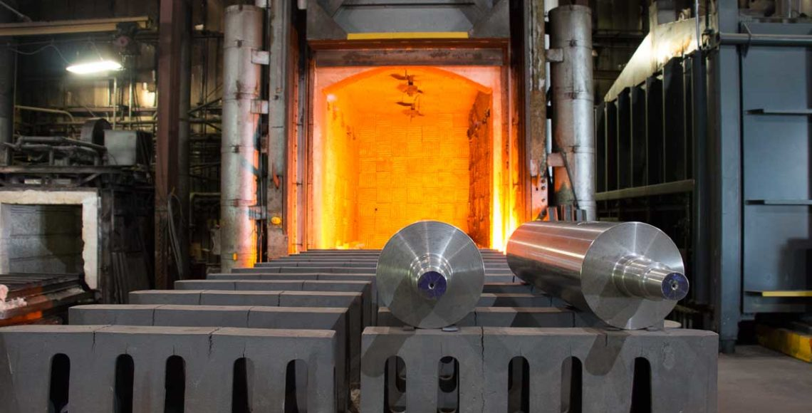
Saturday Special | Heat Treatment Process | Mechanical Engineering | By Shivam Sir
What Is Heat Treatment? Methods & Benefits
Heat treatment is the process of heating and cooling metals, using specific predetermined methods to obtain desired properties
Both ferrous as well as non-ferrous metals undergo heat treatment before putting them to use.
Ferrous Metals
non-ferrous metals
Join Our Paid Batch : SSC JE Batch | Mahapack Batch | Use Code Y166 For 78% of Discount

Slide 6
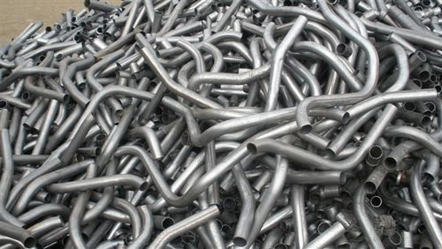
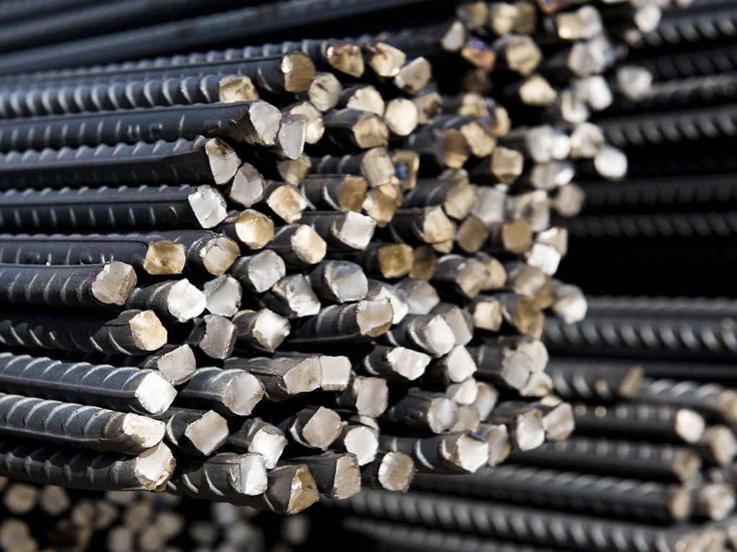
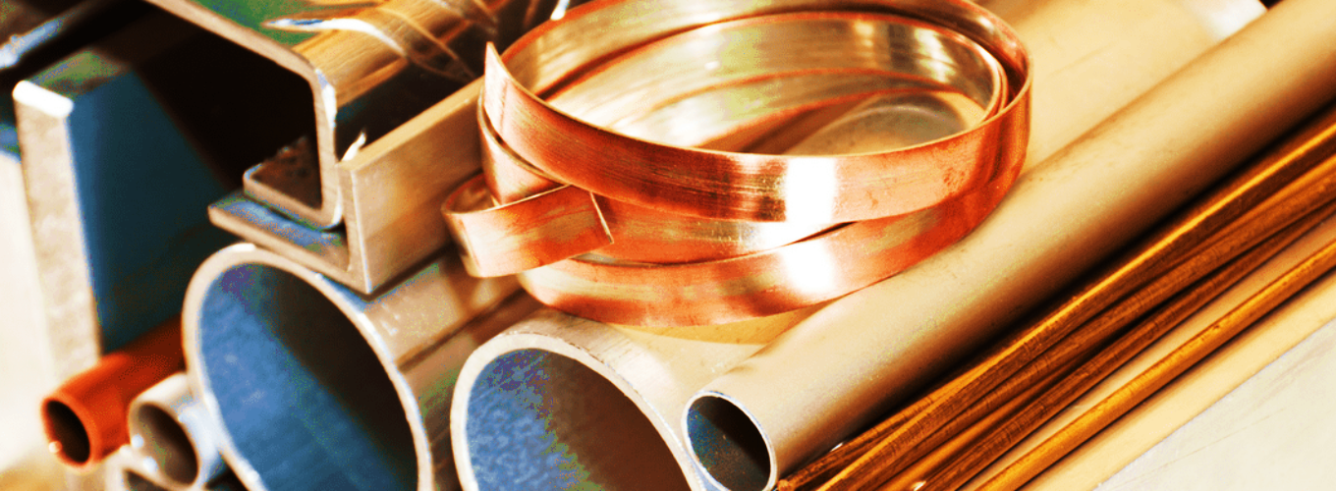
Saturday Special | Heat Treatment Process | Mechanical Engineering | By Shivam Sir
Ferrous Metals
In case of ferrous (ferrum=iron) metals, the base metal is iron. They compose a large part of the overall metals in use today.
Non- Ferrous Metals
a non-ferrous metal is a metal, including alloys, that does not contain iron in appreciable amounts. Generally more costly than ferrous metals, non-ferrous metals are used because of desirable properties such as low weight, higher conductivity, non-magnetic property or resistance to corrosion.
Join Our Paid Batch : SSC JE Batch | Mahapack Batch | Use Code Y166 For 78% of Discount

Slide 7
Saturday Special | Heat Treatment Process | Mechanical Engineering | By Shivam Sir
The Benefits
More durable product.
Steel becomes tougher, stronger.
Easier to weld.
Becomes more flexible.
Increases its wear-resistance.
Increase in overall lifetime of the part
Improves Hardness
Affects heat and electrical Conductivity
Develops Desirable Chemical Properties
Join Our Paid Batch : SSC JE Batch | Mahapack Batch | Use Code Y166 For 78% of Discount

Slide 8
Saturday Special | Heat Treatment Process | Mechanical Engineering | By Shivam Sir
Heat Treatment Process Steps
In simple terms, heat treatment is the process of heating the metal, holding it at that temperature, and then cooling it back. During the process, the metal part will undergo changes in its mechanical properties.
This is because the high temperature alters the microstructure of the metal. And microstructure plays an important role in the mechanical properties of a material.
Join Our Paid Batch : SSC JE Batch | Mahapack Batch | Use Code Y166 For 78% of Discount

Slide 9
Saturday Special | Heat Treatment Process | Mechanical Engineering | By Shivam Sir
Heat Treatment Process Steps
Over the course of this process, the metal’s properties will change. Among those properties are…
electrical resistance,
magnetism,
hardness,
toughness,
ductility,
brittleness and
corrosion resistance.
Join Our Paid Batch : SSC JE Batch | Mahapack Batch | Use Code Y166 For 78% of Discount

Slide 10
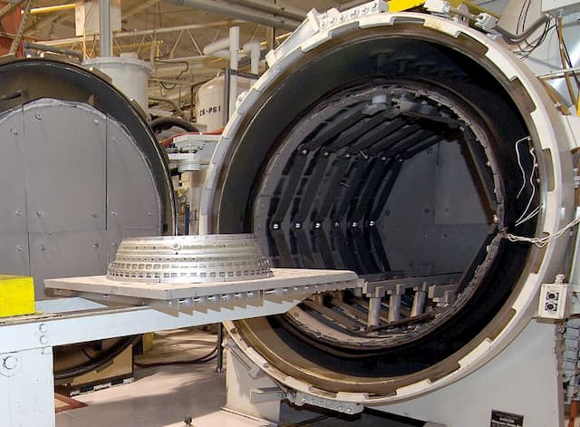
Saturday Special | Heat Treatment Process | Mechanical Engineering | By Shivam Sir
Heat Treatment Process Steps
Heating : Heating upto desired temperature
Holding : During the holding, or soaking stage, the metal is kept at the achieved temperature. The duration of that depends on the requirements.
Cooling : After the soaking stage is complete, the metal must be cooled in a prescribed manner.
Jet engine parts going into a furnace
Join Our Paid Batch : SSC JE Batch | Mahapack Batch | Use Code Y166 For 78% of Discount

Slide 11
Saturday Special | Heat Treatment Process | Mechanical Engineering | By Shivam Sir
Common Heat Treatment Methods
The most common heat treatment methods include:
Annealing
Normalising
Hardening
Ageing
Stress relieving
Tempering
Carburisation
Join Our Paid Batch : SSC JE Batch | Mahapack Batch | Use Code Y166 For 78% of Discount

Slide 12
78% Discount Y166
Join Our Paid Batch : SSC JE Batch | Mahapack Batch | Use Code Y166 For 78% of Discount

Slide 13
78% Discount Y166
Join Our Paid Batch : SSC JE Batch | Mahapack Batch | Use Code Y166 For 78% of Discount

Slide 14
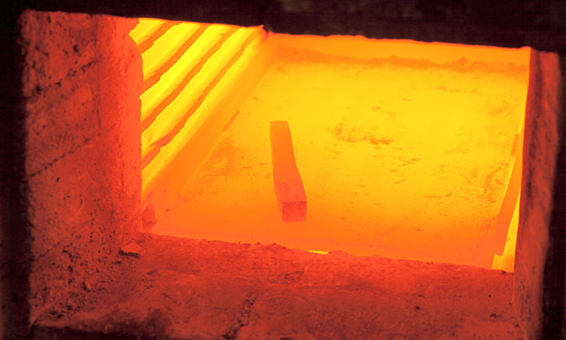
Saturday Special | Heat Treatment Process | Mechanical Engineering | By Shivam Sir
Annealing
In annealing, the metal is heated beyond the upper critical temperature and then cooled at a slow rate.
Annealing is carried out to soften the metal. It makes the metal more suitable for cold working and forming. It also enhances the metal’s machinability, ductility and toughness.
Annealing is also useful in relieving stresses in the part caused due to prior cold working processes.
Metals may undergo recrystallisation annealing, full annealing, partial annealing and final annealing.
Join Our Paid Batch : SSC JE Batch | Mahapack Batch | Use Code Y166 For 78% of Discount

Slide 15
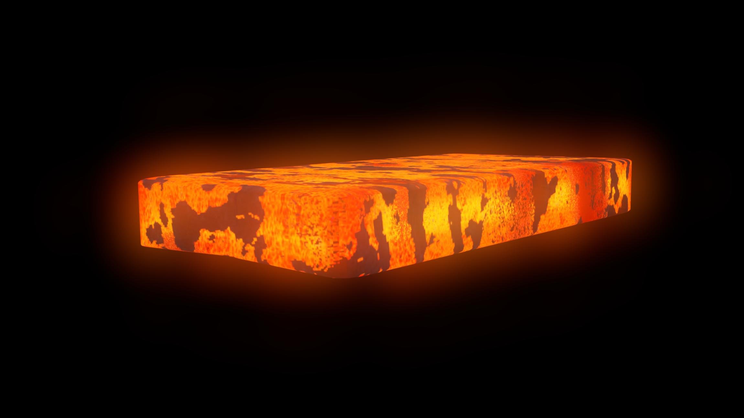
Saturday Special | Heat Treatment Process | Mechanical Engineering | By Shivam Sir
Normalising
Normalising is a heat treatment process used for relieving internal stresses caused by processes such as welding, casting, or quenching.
In this process, the metal is heated to a temperature that is 40° C above its upper critical temperature.
Normalising creates a uniform grain size and composition throughout the part.
Normalised steels are harder and stronger than annealed steel. In fact, in its normalised form, steel is tougher than in any other condition.
Join Our Paid Batch : SSC JE Batch | Mahapack Batch | Use Code Y166 For 78% of Discount

Slide 16
Saturday Special | Heat Treatment Process | Mechanical Engineering | By Shivam Sir
Normalising
Join Our Paid Batch : SSC JE Batch | Mahapack Batch | Use Code Y166 For 78% of Discount

Slide 17
Saturday Special | Heat Treatment Process | Mechanical Engineering | By Shivam Sir
Hardening/ Quenching
hardening is used to increase the hardness of a metal. In some cases, only the surface may be hardened.
A work piece is hardened by heating it to the specified temperature, then cooling it rapidly by submerging it into a cooling medium. Oil, brine or water may be used.
The resulting part will have increased hardness and strength, but the brittleness increases too simultaneously.
Case hardening is a type of hardening process in which only the outer layer of the work piece is hardened. the resultant work piece has a hard outer layer but a softer core.
Quenching is part of Hardening process : material is heated up to the suitable temperature and then quenched in water or oil to harden to full hardness according to the kind of steels.
Join Our Paid Batch : SSC JE Batch | Mahapack Batch | Use Code Y166 For 78% of Discount

Slide 18
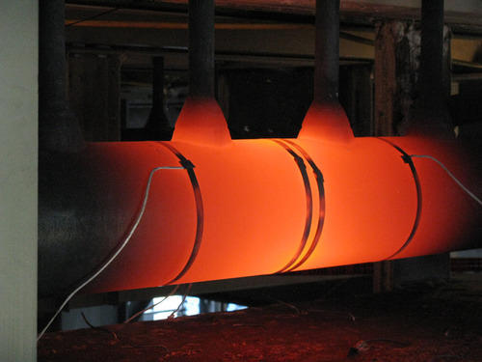
Saturday Special | Heat Treatment Process | Mechanical Engineering | By Shivam Sir
Stress Relieving
Stress relieving is especially common for boiler parts, air bottles, accumulators, etc. This method takes the metal to a temperature just below its lower critical border. The cooling process is slow and therefore uniform.
This is done to relieve stresses that have built in up in the parts due to earlier processes such as forming, machining, rolling or straightening.
Join Our Paid Batch : SSC JE Batch | Mahapack Batch | Use Code Y166 For 78% of Discount

Slide 19
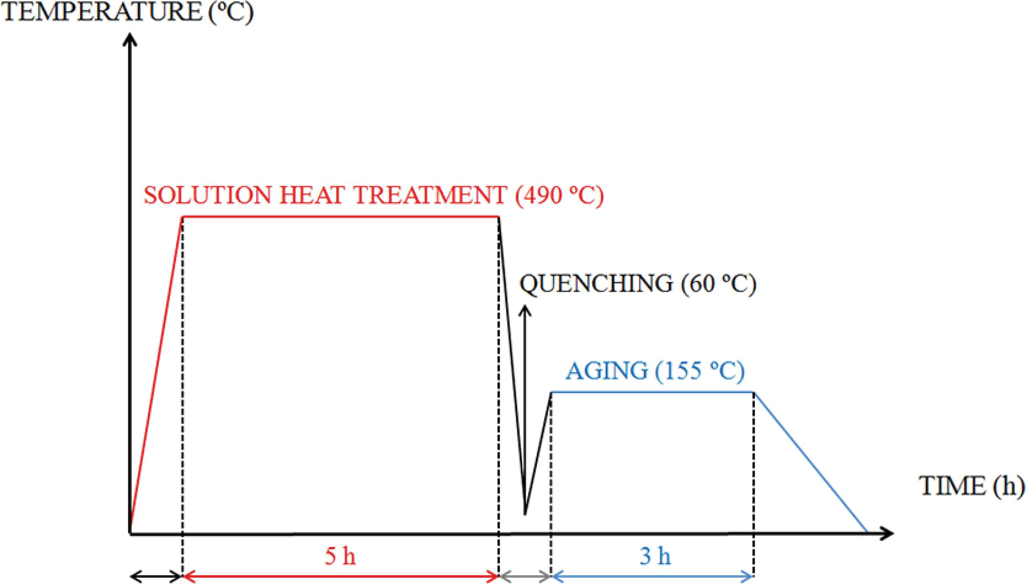
Saturday Special | Heat Treatment Process | Mechanical Engineering | By Shivam Sir
Ageing
Ageing or precipitation hardening is a heat treatment method mostly used to increase the yield strength of malleable metals. Precipitation hardening usually comes after another heat treatment process that reaches higher temperatures.
Ageing, however, only elevates the temperature to medium levels and brings it down quickly again.
For naturally ageing materials, it may be convenient to store them at lower temperatures.
Join Our Paid Batch : SSC JE Batch | Mahapack Batch | Use Code Y166 For 78% of Discount

Slide 20
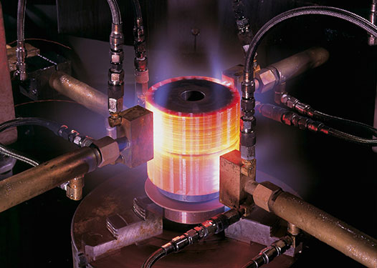
Saturday Special | Heat Treatment Process | Mechanical Engineering | By Shivam Sir
Tempering
Tempering is the process of reducing excess hardness, and therefore brittleness, induced during the hardening process. Internal stresses are also relieved. Undergoing this process can make a metal suitable for many applications that need such properties.
the temperatures are usually much lower than hardening temperatures.
. The rate of cooling does not affect the metal structure during tempering and usually, the metal cools in still air.
Join Our Paid Batch : SSC JE Batch | Mahapack Batch | Use Code Y166 For 78% of Discount

Slide 21
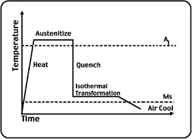
Saturday Special | Heat Treatment Process | Mechanical Engineering | By Shivam Sir
Austempering
' 'Austempering' is the process of heat treatment where the steel is heated to austenitizing temperature, held there for sufficient period of time to produce homogeneous austenite.
Join Our Paid Batch : SSC JE Batch | Mahapack Batch | Use Code Y166 For 78% of Discount

Slide 22
Saturday Special | Heat Treatment Process | Mechanical Engineering | By Shivam Sir
Join Our Paid Batch : SSC JE Batch | Mahapack Batch | Use Code Y166 For 78% of Discount

Slide 23
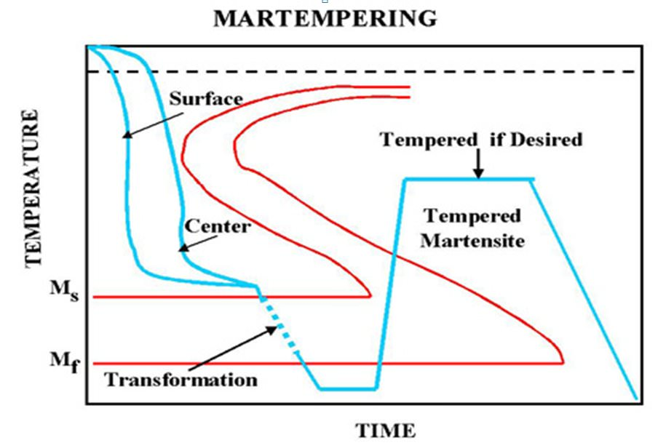
Saturday Special | Heat Treatment Process | Mechanical Engineering | By Shivam Sir
Marquenching/Martempering
Marquenching/Martempering is a form of heat treatment applied as an interrupted quench of steels typically in a molten salt bath at a temperature right above the martensite start temperature. The purpose is to delay the cooling for a length of time to equalise the temperature throughout the piece. This will minimise distortion, cracking and residual stress.
Benefits of martempering/marquenching
Reduced cracking due to thermal stress. Reduced residual stress in the quenched part section for parts with varying geometry, size, or weight.
Join Our Paid Batch : SSC JE Batch | Mahapack Batch | Use Code Y166 For 78% of Discount

Slide 24
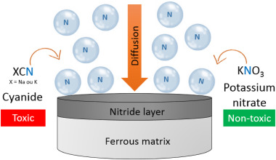
Saturday Special | Heat Treatment Process | Mechanical Engineering | By Shivam Sir
Nitriding
nitriding, process for hardening the surface of steel objects by introducing nitrogen (N) into it, where it combines with iron and other alloying elements to form hard metallic nitrides. Nitriding is usually done by heating steel objects in gaseous ammonia (NH₃) at temperatures between 500 and 550 °C (950 and 1,050 °F) for periods of 5 to 100 hours, depending upon the desired depth of diffusion of the nitrogen. An alternative or supplement to gas nitriding is ion nitriding, or plasma nitriding, in which the steel objects are bombarded with nitrogen ions in a vacuum under an electric charge.
Join Our Paid Batch : SSC JE Batch | Mahapack Batch | Use Code Y166 For 78% of Discount

Slide 25
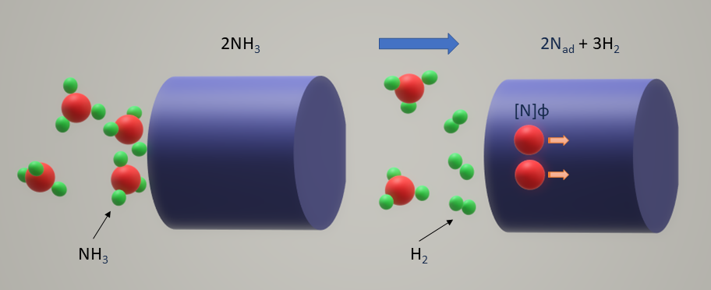
Saturday Special | Heat Treatment Process | Mechanical Engineering | By Shivam Sir
Nitriding
Join Our Paid Batch : SSC JE Batch | Mahapack Batch | Use Code Y166 For 78% of Discount

Slide 26
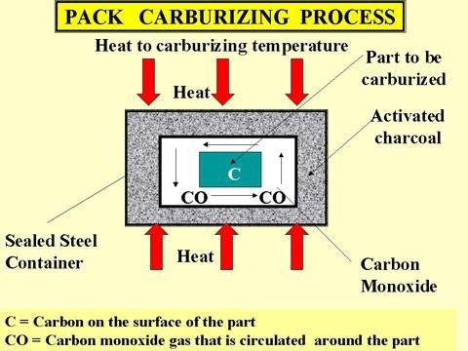
Saturday Special | Heat Treatment Process | Mechanical Engineering | By Shivam Sir
Carburisation
In this heat treatment process, the metal is heated in the presence of another material that releases carbon on decomposition.
The released carbon is absorbed into the surface of the metal. The carbon content of the surface increases, making it harder than the inner core.
Case hardening, also referred as carburizing increases carbon content of steel
Join Our Paid Batch : SSC JE Batch | Mahapack Batch | Use Code Y166 For 78% of Discount

Slide 27
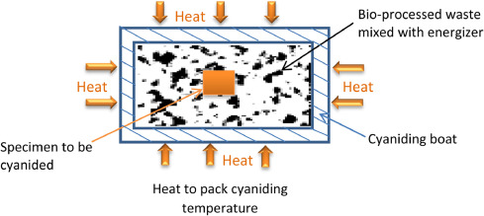
Saturday Special | Heat Treatment Process | Mechanical Engineering | By Shivam Sir
Cyaniding
Cyaniding is a case-hardening process that is fast and efficient; it is mainly used on low-carbon steels. The part is heated to 871–954 °C (1600–1750 °F) in a bath of sodium cyanide and then is quenched and rinsed, in water or oil, to remove any residual cyanide.
Join Our Paid Batch : SSC JE Batch | Mahapack Batch | Use Code Y166 For 78% of Discount

Slide 28
78% Discount Y166
Join Our Paid Batch : SSC JE Batch | Mahapack Batch | Use Code Y166 For 78% of Discount

Slide 29
78% Discount Y166
Join Our Paid Batch : SSC JE Batch | Mahapack Batch | Use Code Y166 For 78% of Discount

