Slide 1
9

Slide 3
SSC JE Mechanical Previous Year Questions + Answers | Mechanical Engineering
Mechanical Engineering
Q. When a Venturi meter is inclined, then for a given flow it will show_
Less Reading
More Reading
Same Reading
Inaccurate Reading
For 78% Discount
Use Code : “Y166”
78% Discount Y166
Join Our Paid Batch : SSC JE Batch | Mahapack Batch | Use Code Y166 For 78% of Discount

Slide 4
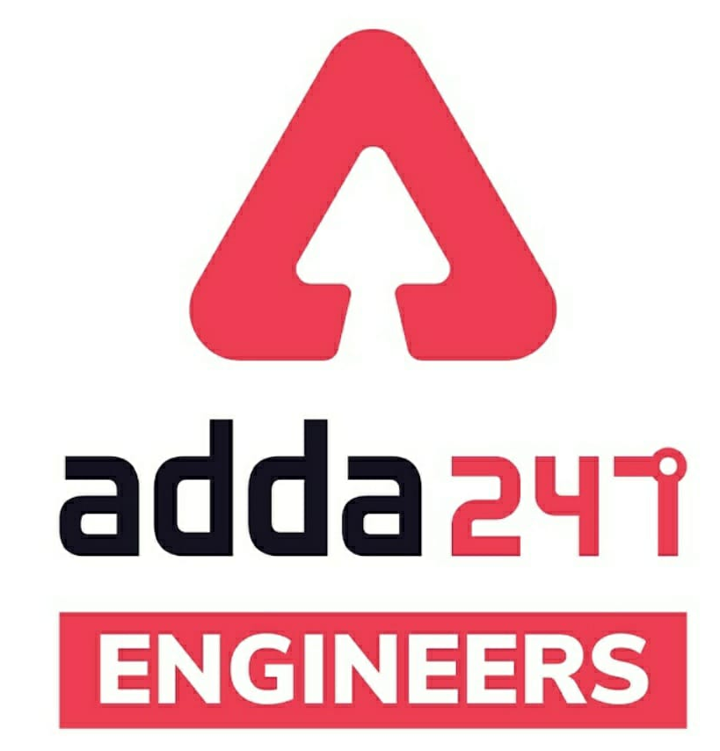
SSC JE Mechanical Previous Year Questions + Answers | Mechanical Engineering
Mechanical Soormas
Sourav Das
Ajit Singh
Rajat Bobde
Yash Menariya
Subir
Piyush Mechanical
Tathagat Science academy
Ajay Kumar
Ravi Raj
Ritick Konwar
Lokesh Varwan
Mr. Dilip Gupta
Shin Chain
Reyaz Samoon
Anchal Mishra
Aman Kumar
Pankaj Mahato
Pragya Srivastava
Amar Jyoti
Sandeep Kumar Jha
Sahil Kumar
Gurdeep Singh
Ravi Singh
Shubham Shukla
Yash Menariya
Raj Yadav
Ashish Tandon
for
Code : “Y166”

Slide 5
SSC JE Mechanical Previous Year Questions + Answers | Mechanical Engineering
Mechanical Soormas
Rahul
Eshika Rajak
Raj Yadav
Underground Challenge
Nandan Mehta
Pintu Mahato
Kumari Manisha
Deepak Yadav
Rajesh Rohila
Akhilesh Gupta
Vaibhav Naik
Kuldeet Das
Hardik Pal
Sonakshi Pulast
Khanbara Bera
Bubly Kumar
Om Prakash Chaurasiya
Ela Sahoo
Pawan Singh Rana
Shubhi Tiwari
for
Code : “Y166”

Slide 6
SSC JE Mechanical Previous Year Questions + Answers | Mechanical Engineering
Mechanical Engineering
For 78% Discount
Use Code : “Y166”
78% Discount Y166
Join Our Paid Batch : SSC JE Batch | Mahapack Batch | Use Code Y166 For 78% of Discount

Slide 7
SSC JE Mechanical Previous Year Questions + Answers | Mechanical Engineering
Mechanical Engineering
Q. Which of the following chucks in the lathe machine is known as universal chuck_
magnetic Chuck
Face Plate
Three Jaws Chuck
Four Jaws Chuck
For 78% Discount
Use Code : “Y166”
78% Discount Y166
Join Our Paid Batch : SSC JE Batch | Mahapack Batch | Use Code Y166 For 78% of Discount

Slide 8
SSC JE Mechanical Previous Year Questions + Answers | Mechanical Engineering
Mechanical Engineering
Q. Area moment of inertia of the cross section of the beam resist!
The applied normal force
Both the torque and bending moment
The applied torque
The applied bending moment of the beam
For 78% Discount
Use Code : “Y166”
78% Discount Y166
Join Our Paid Batch : SSC JE Batch | Mahapack Batch | Use Code Y166 For 78% of Discount

Slide 9
SSC JE Mechanical Previous Year Questions + Answers | Mechanical Engineering
Mechanical Engineering
Q. Hunting is a phenomenon associated with!
Flywheel
Combustion
Climbing
None of the above
For 78% Discount
Use Code : “Y166”
78% Discount Y166
Join Our Paid Batch : SSC JE Batch | Mahapack Batch | Use Code Y166 For 78% of Discount

Slide 10
SSC JE Mechanical Previous Year Questions + Answers | Mechanical Engineering
Mechanical Engineering
Q. The value of a specific entropy at a triple point is...
A. Maximum
B. Minimum
C. Zero
D. Can't be determined
For 78% Discount
Use Code : “Y166”
78% Discount Y166
Join Our Paid Batch : SSC JE Batch | Mahapack Batch | Use Code Y166 For 78% of Discount

Slide 11
SSC JE Mechanical Previous Year Questions + Answers | Mechanical Engineering
Mechanical Engineering
Q. The value of a Internal Energy at a triple point is...
A. Maximum
B. Minimum
C. Zero
D. Can't be determined
For 78% Discount
Use Code : “Y166”
78% Discount Y166
Join Our Paid Batch : SSC JE Batch | Mahapack Batch | Use Code Y166 For 78% of Discount

Slide 12
SSC JE Mechanical Previous Year Questions + Answers | Mechanical Engineering
Mechanical Engineering
Q. With the decrease in pressure the latent heat of steam is-
A. Decreases
B. Increase
C. Constant
D. Increases or decreases
For 78% Discount
Use Code : “Y166”
78% Discount Y166
Join Our Paid Batch : SSC JE Batch | Mahapack Batch | Use Code Y166 For 78% of Discount

Slide 13
SSC JE Mechanical Previous Year Questions + Answers | Mechanical Engineering
Mechanical Engineering
Q. For a triple point of water the degree of freedom is.
A. 0
B. 1
C. 2
D. 3
For 78% Discount
Use Code : “Y166”
78% Discount Y166
Join Our Paid Batch : SSC JE Batch | Mahapack Batch | Use Code Y166 For 78% of Discount

Slide 14
SSC JE Mechanical Previous Year Questions + Answers | Mechanical Engineering
Mechanical Engineering
Q. Beyond the critical temperature it is called as........ Gas-
A. Sub-heated
B. Superheated
C. Critical
D. None of the above
For 78% Discount
Use Code : “Y166”
78% Discount Y166
Join Our Paid Batch : SSC JE Batch | Mahapack Batch | Use Code Y166 For 78% of Discount

Slide 15
SSC JE Mechanical Previous Year Questions + Answers | Mechanical Engineering
Mechanical Engineering
Q. Constant pressure lines in the superheated region in the mollier diagram will having.
A. Positive slope
B. Negative slope
C. Zero slope
D. Both A and B
For 78% Discount
Use Code : “Y166”
78% Discount Y166
Join Our Paid Batch : SSC JE Batch | Mahapack Batch | Use Code Y166 For 78% of Discount

Slide 16
SSC JE Mechanical Previous Year Questions + Answers | Mechanical Engineering
Mechanical Engineering
Q. Design of thin cylinder is on which factor based.
A. Hoop stress
B. Longitudinal stress
C. Bending stress
D. Shear stress
For 78% Discount
Use Code : “Y166”
78% Discount Y166
Join Our Paid Batch : SSC JE Batch | Mahapack Batch | Use Code Y166 For 78% of Discount

Slide 17
78% Discount Y166
Join Our Paid Batch : SSC JE Batch | Mahapack Batch | Use Code Y166 For 78% of Discount

Slide 18
78% Discount Y166
Join Our Paid Batch : SSC JE Batch | Mahapack Batch | Use Code Y166 For 78% of Discount

Slide 19
SSC JE Mechanical Previous Year Questions + Answers | Mechanical Engineering
Mechanical Engineering
Hoop stress in the thin cylindrical shelled is!
A. Longitudinal stress
B. Radial stress
C. Circumferential Compressive stress
D. Circumferential tensile stress
For 78% Discount
Use Code : “Y166”
78% Discount Y166
Join Our Paid Batch : SSC JE Batch | Mahapack Batch | Use Code Y166 For 78% of Discount

Slide 20
SSC JE Mechanical Previous Year Questions + Answers | Mechanical Engineering
Mechanical Engineering
Q. Hydraulic depth is the ratio of wetting area to the its- a) Bottom width b) Top width c) Diameter d) Radius
For 78% Discount
Use Code : “Y166”
78% Discount Y166
Join Our Paid Batch : SSC JE Batch | Mahapack Batch | Use Code Y166 For 78% of Discount

Slide 21
SSC JE Mechanical Previous Year Questions + Answers | Mechanical Engineering
Mechanical Engineering
Q. Cylindrical Pr. vessel is known as thin shell when the ratio of its wall thickness of the vessel to the diameter is .............. 1/10.
A. Smaller than
B. Greater than
C. Equal to
D. None of these
For 78% Discount
Use Code : “Y166”
78% Discount Y166
Join Our Paid Batch : SSC JE Batch | Mahapack Batch | Use Code Y166 For 78% of Discount

Slide 22
SSC JE Mechanical Previous Year Questions + Answers | Mechanical Engineering
Mechanical Engineering
Q. All vectors quantities that follows.
a) Paralleo-gram law of addition b) Parallelo-gram law of multiplication c) Parallelo-gram law of addition of square root d) Parallelo-gram law of addition of square of their magnitudes and directions.
For 78% Discount
Use Code : “Y166”
78% Discount Y166
Join Our Paid Batch : SSC JE Batch | Mahapack Batch | Use Code Y166 For 78% of Discount

Slide 23
SSC JE Mechanical Previous Year Questions + Answers | Mechanical Engineering
Mechanical Engineering
Q. The tendency of rotation of body along the axis also known as the...!
A. Moment
B. acceleration
C. couple
D. torque
For 78% Discount
Use Code : “Y166”
78% Discount Y166
Join Our Paid Batch : SSC JE Batch | Mahapack Batch | Use Code Y166 For 78% of Discount

Slide 24
SSC JE Mechanical Previous Year Questions + Answers | Mechanical Engineering
Mechanical Engineering
Q. Concept of autofrettage is used in!
Solid shaft
Hollow Shaft
Thin Cylinder
None of the above
For 78% Discount
Use Code : “Y166”
78% Discount Y166
Join Our Paid Batch : SSC JE Batch | Mahapack Batch | Use Code Y166 For 78% of Discount

Slide 25
SSC JE Mechanical Previous Year Questions + Answers | Mechanical Engineering
Mechanical Engineering
Q. Keeping All the parameters same, For Flat vanes of centrifugal pump the efficiency will be_____ than forward bent vanes efficiency.
More
Less
Remains The Same
None of the above
For 78% Discount
Use Code : “Y166”
78% Discount Y166
Join Our Paid Batch : SSC JE Batch | Mahapack Batch | Use Code Y166 For 78% of Discount

Slide 26
SSC JE Mechanical Previous Year Questions + Answers | Mechanical Engineering
Mechanical Engineering
Q. Cutting Angle having more than 60 Degree the cutting will be_
Orthogonal cutting
Oblique cutting
Can be both orthogonal Or oblique cutting
Turning cutting
For 78% Discount
Use Code : “Y166”
78% Discount Y166
Join Our Paid Batch : SSC JE Batch | Mahapack Batch | Use Code Y166 For 78% of Discount

Slide 27
SSC JE Mechanical Previous Year Questions + Answers | Mechanical Engineering
Mechanical Engineering
Q. Flow occurring in a pipeline when a valve is being opened is-
Steady
Unsteady
Laminar
Vortex
For 78% Discount
Use Code : “Y166”
78% Discount Y166
Join Our Paid Batch : SSC JE Batch | Mahapack Batch | Use Code Y166 For 78% of Discount

Slide 28
SSC JE Mechanical Previous Year Questions + Answers | Mechanical Engineering
Mechanical Engineering
Q. If a particle is in static equilibrium, then the work done by the system of force acting on that particle is_
Negative
Positive
Zero
Infinity
For 78% Discount
Use Code : “Y166”
78% Discount Y166
Join Our Paid Batch : SSC JE Batch | Mahapack Batch | Use Code Y166 For 78% of Discount

Slide 29
SSC JE Mechanical Previous Year Questions + Answers | Mechanical Engineering
Mechanical Engineering
Q. Moment of inertia of an area alwys least with respect to_
Bottom most axis
Radius of gyration
Vertical Axis
Centroidal Axis
For 78% Discount
Use Code : “Y166”
78% Discount Y166
Join Our Paid Batch : SSC JE Batch | Mahapack Batch | Use Code Y166 For 78% of Discount

Slide 30
Use Code “Y166” for
maximum 78%* discount
400+ Hours Two-way Interactive Live Classes.
Syllabus is based on Recent Notification, Previous Years Exam and the same will be updated accordingly.
Enroll in this Batch, Limited Seats available.
Recorded Videos available 24/7 for quick Revision.
Solve Unlimited doubts with experts.
Get Preparation tips from the experts & Learn Time Management.
Join Our Paid Batch : SSC JE Batch | Mahapack Batch | Use Code Y166 For 78% of Discount

Slide 31
78% Discount Y166
Join Our Paid Batch : SSC JE Batch | Mahapack Batch | Use Code Y166 For 78% of Discount

Slide 32
SSC JE Mechanical Previous Year Questions + Answers | Mechanical Engineering
Mechanical Engineering
The process of removing unwanted material from the casting is called.
A. Fettling
B. Cleaning
C. Finishing
D. Blowing
For 78% Discount
Use Code : “Y166”
78% Discount Y166
Join Our Paid Batch : SSC JE Batch | Mahapack Batch | Use Code Y166 For 78% of Discount

