Slide 1
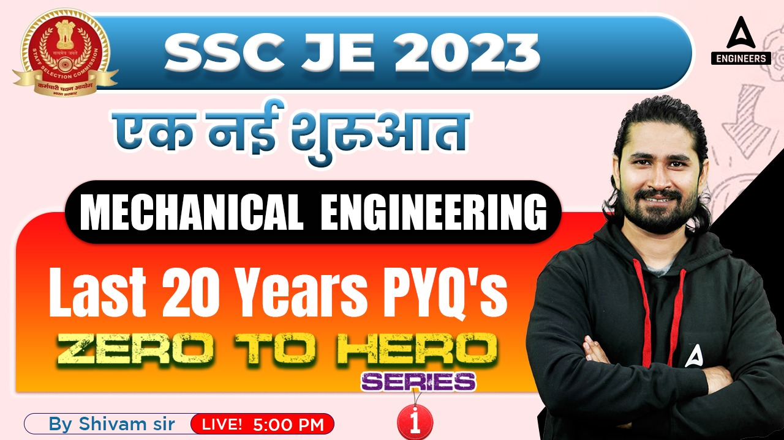
8

Slide 2


Slide 3


SSC JE Mechanical Previous Year Questions + Answers | Mechanical Engineering
Mechanical Engineering
Q. Dynamic viscosity increases with the rate of shear increase for:!
A. rheopectic fluid
B. pseudoplastic fluid
C. thixotropic fluid
D. dilatants fluid
For 78% Discount
Use Code : “Y166”
78% Discount
Y166
Join Our Paid Batch : SSC JE Batch | Mahapack Batch | Use Code Y166 For 78% of Discount

Slide 4

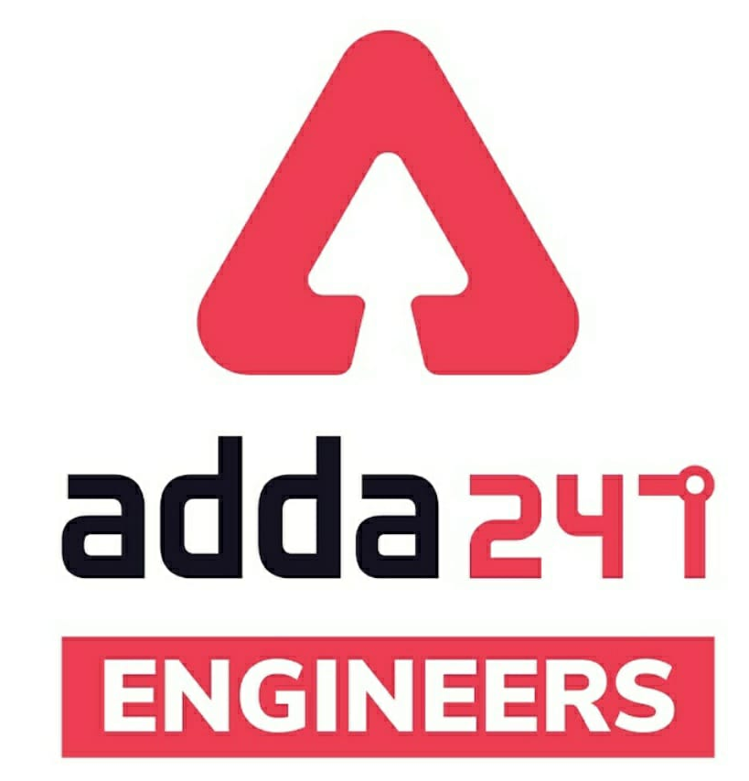

SSC JE Mechanical Previous Year Questions + Answers | Mechanical Engineering
Mechanical Soormas
Sourav Das
Subir
Piyush Mechanical
Ravi Singh
Ajit Singh
Ravi Raj
Lokesh Varwan
Prashant Bhadauria
Pragya Srivastava
Shin Chain
Sandeep Kumar jha
Dipankar Mandal
Raj Vimal
Kumari Manisha
Atit Ramteke
Anuj Kanoujiya
Gurdeep Singh
Priyanka Creativity
MS D2E
Sahil Kumar
Ajaya Suna
Nandan Mehta
Shivani Singh
Raj Yadav
Sonakshi Pulast
Amar Jyoti
Rajat Bobde
Nitin Mandaokar
for
Code : “Y166”

Slide 5
SSC JE Mechanical Previous Year Questions + Answers | Mechanical Engineering
Mechanical Soormas
Eshika Rajak
Rutba Rutba
Pankaj Mahato
Ajay Kumar
Aman Kumar
Om Prakash Chaurasiya
Pawan Singh Rana
Akhilesh Gupta
Avadhesh Yadav
Ankit Mongre
Pintu Mahato
Ram Kushwaha
for
Code : “Y166”

Slide 6

SSC JE Mechanical Previous Year Questions + Answers | Mechanical Engineering
Mechanical Engineering
For 78% Discount
Use Code : “Y166”
78% Discount
Y166
Join Our Paid Batch : SSC JE Batch | Mahapack Batch | Use Code Y166 For 78% of Discount

Slide 7
SSC JE Mechanical Previous Year Questions + Answers | Mechanical Engineering
Mechanical Engineering
Q. If the by-pass factor is 0.30, what will be the efficiency of cooling or the contact factor.?
A. 0.70
B. 0.66
C. 0.15
D. 0.30
For 78% Discount
Use Code : “Y166”
78% Discount
Y166
Join Our Paid Batch : SSC JE Batch | Mahapack Batch | Use Code Y166 For 78% of Discount

Slide 8
SSC JE Mechanical Previous Year Questions + Answers | Mechanical Engineering
Mechanical Engineering
Q. Energy of a system is defined as:!
A. point function and intensive property
B. path function and extensive property
C. path function and intensive property
D. point function and extensive property
For 78% Discount
Use Code : “Y166”
78% Discount
Y166
Join Our Paid Batch : SSC JE Batch | Mahapack Batch | Use Code Y166 For 78% of Discount

Slide 9
SSC JE Mechanical Previous Year Questions + Answers | Mechanical Engineering
Mechanical Engineering
Q. A Joint Between Two Components Lying Approximately in the same plane is called_
Corner Joint
T-Joint
Lap Joint
Butt Joint
For 78% Discount
Use Code : “Y166”
78% Discount
Y166
Join Our Paid Batch : SSC JE Batch | Mahapack Batch | Use Code Y166 For 78% of Discount

Slide 10
SSC JE Mechanical Previous Year Questions + Answers | Mechanical Engineering
Mechanical Engineering
Q. Molar Specific heats of an ideal gas depends on!
Its pressure
Its temperature
Both its pressure and temperature
Number of atoms in a molecule
For 78% Discount
Use Code : “Y166”
78% Discount
Y166
Join Our Paid Batch : SSC JE Batch | Mahapack Batch | Use Code Y166 For 78% of Discount

Slide 11
SSC JE Mechanical Previous Year Questions + Answers | Mechanical Engineering
Mechanical Engineering
Q. In a Steady Flow process,!
The rate of heat transfer is constant
The rate of work transfer is constant
The ratio of mass flow at inlet and outlet is constant
All of these
For 78% Discount
Use Code : “Y166”
78% Discount
Y166
Join Our Paid Batch : SSC JE Batch | Mahapack Batch | Use Code Y166 For 78% of Discount

Slide 12
SSC JE Mechanical Previous Year Questions + Answers | Mechanical Engineering
Mechanical Engineering
Q. The neutral axis of the beam cant be subjected to
Tensile stress
Compressive stress
Torsional stress
All of the above
For 78% Discount
Use Code : “Y166”
78% Discount
Y166
Join Our Paid Batch : SSC JE Batch | Mahapack Batch | Use Code Y166 For 78% of Discount

Slide 13
SSC JE Mechanical Previous Year Questions + Answers | Mechanical Engineering
Mechanical Engineering
Q. If a spur gear has module of 4 mm, its circular pitch will be given by!
2 mm
3 mm
6.28 mm
12.56 mm
For 78% Discount
Use Code : “Y166”
78% Discount
Y166
Join Our Paid Batch : SSC JE Batch | Mahapack Batch | Use Code Y166 For 78% of Discount

Slide 14
SSC JE Mechanical Previous Year Questions + Answers | Mechanical Engineering
Mechanical Engineering
Q. Straddle milling is used for-
A. Machining a Flat Surface at an angle
B. Machining two parallel vertical surfaces of w/p
C. Machining multiple parallel vertical surfaces of w/p
D. Non of the above
For 78% Discount
Use Code : “Y166”
78% Discount
Y166
Join Our Paid Batch : SSC JE Batch | Mahapack Batch | Use Code Y166 For 78% of Discount

Slide 15


78% Discount
Y166
Join Our Paid Batch : SSC JE Batch | Mahapack Batch | Use Code Y166 For 78% of Discount

Slide 16
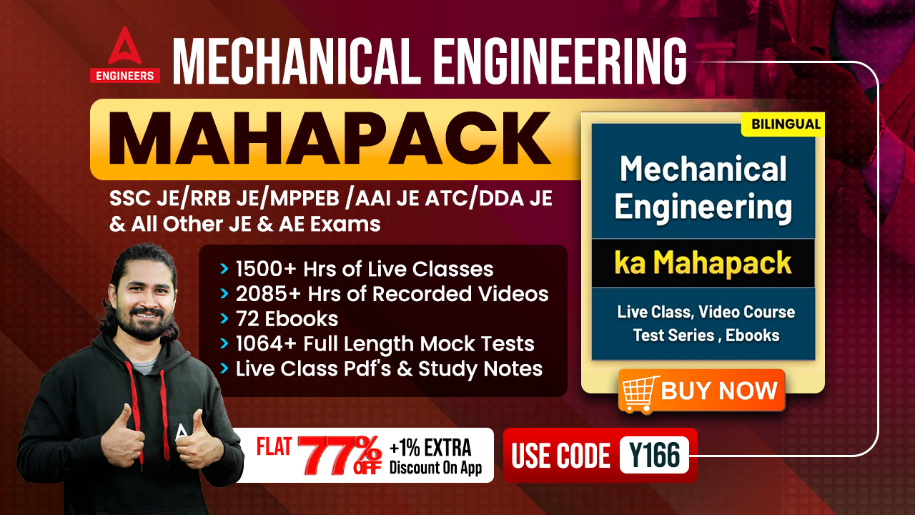

78% Discount
Y166
Join Our Paid Batch : SSC JE Batch | Mahapack Batch | Use Code Y166 For 78% of Discount

Slide 17
SSC JE Mechanical Previous Year Questions + Answers | Mechanical Engineering
Mechanical Engineering
Q. Steel Containing less than 0.15% Carbon Content is known as_
Medium Carbon Steel
Stainless Steel
Dead Mild Steel
High Carbon Steel
For 78% Discount
Use Code : “Y166”
78% Discount
Y166
Join Our Paid Batch : SSC JE Batch | Mahapack Batch | Use Code Y166 For 78% of Discount

Slide 18
SSC JE Mechanical Previous Year Questions + Answers | Mechanical Engineering
Mechanical Engineering
Q. Steam has a specific saturation temperature at.
Each pressure
Each Volume
Each Enthalpy
Each Entropy
For 78% Discount
Use Code : “Y166”
78% Discount
Y166
Join Our Paid Batch : SSC JE Batch | Mahapack Batch | Use Code Y166 For 78% of Discount

Slide 19
SSC JE Mechanical Previous Year Questions + Answers | Mechanical Engineering
Mechanical Engineering
Q. During melting, the volume of a pure substance other than water-
Decreases
Increases
Remains Constant
First Increases and then decreases
For 78% Discount
Use Code : “Y166”
78% Discount
Y166
Join Our Paid Batch : SSC JE Batch | Mahapack Batch | Use Code Y166 For 78% of Discount

Slide 20
SSC JE Mechanical Previous Year Questions + Answers | Mechanical Engineering
Mechanical Engineering
Q. The Pressure Angle and the base circle in a cam should be-
Both as big as possible
Respectively as low as possible and as big as possible
Respectively as big as possible and as low as possible
Both as low as possible
For 78% Discount
Use Code : “Y166”
78% Discount
Y166
Join Our Paid Batch : SSC JE Batch | Mahapack Batch | Use Code Y166 For 78% of Discount

Slide 21
SSC JE Mechanical Previous Year Questions + Answers | Mechanical Engineering
Mechanical Engineering
Q. When a Venturi meter is inclined, then for a given flow it will show_
Less Reading
More Reading
Same Reading
Inaccurate Reading
For 78% Discount
Use Code : “Y166”
78% Discount
Y166
Join Our Paid Batch : SSC JE Batch | Mahapack Batch | Use Code Y166 For 78% of Discount

Slide 22
SSC JE Mechanical Previous Year Questions + Answers | Mechanical Engineering
Mechanical Engineering
Q. Which of the following chucks in the lathe machine is known as universal chuck_
magnetic Chuck
Face Plate
Three Jaws Chuck
Four Jaws Chuck
For 78% Discount
Use Code : “Y166”
78% Discount
Y166
Join Our Paid Batch : SSC JE Batch | Mahapack Batch | Use Code Y166 For 78% of Discount

Slide 23
SSC JE Mechanical Previous Year Questions + Answers | Mechanical Engineering
Mechanical Engineering
Q. Area moment of inertia of the cross section of the beam resist!
The applied normal force
Both the torque and bending moment
The applied torque
The applied bending moment of the beam
For 78% Discount
Use Code : “Y166”
78% Discount
Y166
Join Our Paid Batch : SSC JE Batch | Mahapack Batch | Use Code Y166 For 78% of Discount

Slide 24
SSC JE Mechanical Previous Year Questions + Answers | Mechanical Engineering
Mechanical Engineering
Q. Flow occurring in a pipeline when a valve is being opened is-
Steady
Unsteady
Laminar
Vortex
For 78% Discount
Use Code : “Y166”
78% Discount
Y166
Join Our Paid Batch : SSC JE Batch | Mahapack Batch | Use Code Y166 For 78% of Discount

Slide 25
SSC JE Mechanical Previous Year Questions + Answers | Mechanical Engineering
Mechanical Engineering
Q. If a particle is in static equilibrium, then the work done by the system of force acting on that particle is_
Negative
Positive
Zero
Infinity
For 78% Discount
Use Code : “Y166”
78% Discount
Y166
Join Our Paid Batch : SSC JE Batch | Mahapack Batch | Use Code Y166 For 78% of Discount

Slide 26
SSC JE Mechanical Previous Year Questions + Answers | Mechanical Engineering
Mechanical Engineering
Q. Moment of inertia of an area alwys least with respect to_
Bottom most axis
Radius of gyration
Vertical Axis
Centroidal Axis
For 78% Discount
Use Code : “Y166”
78% Discount
Y166
Join Our Paid Batch : SSC JE Batch | Mahapack Batch | Use Code Y166 For 78% of Discount

Slide 27

Use Code “Y166” for
maximum 78%* discount
400+ Hours Two-way Interactive Live Classes.
Syllabus is based on Recent Notification, Previous Years Exam and the same will be updated accordingly.
Enroll in this Batch, Limited Seats available.
Recorded Videos available 24/7 for quick Revision.
Solve Unlimited doubts with experts.
Get Preparation tips from the experts & Learn Time Management.
Join Our Paid Batch : SSC JE Batch | Mahapack Batch | Use Code Y166 For 78% of Discount

Slide 28
78% Discount
Y166
Join Our Paid Batch : SSC JE Batch | Mahapack Batch | Use Code Y166 For 78% of Discount

Slide 29
SSC JE Mechanical Previous Year Questions + Answers | Mechanical Engineering
Mechanical Engineering
The process of removing unwanted material from the casting is called.
A. Fettling
B. Cleaning
C. Finishing
D. Blowing
For 78% Discount
Use Code : “Y166”
78% Discount
Y166
Join Our Paid Batch : SSC JE Batch | Mahapack Batch | Use Code Y166 For 78% of Discount

