Slide 1
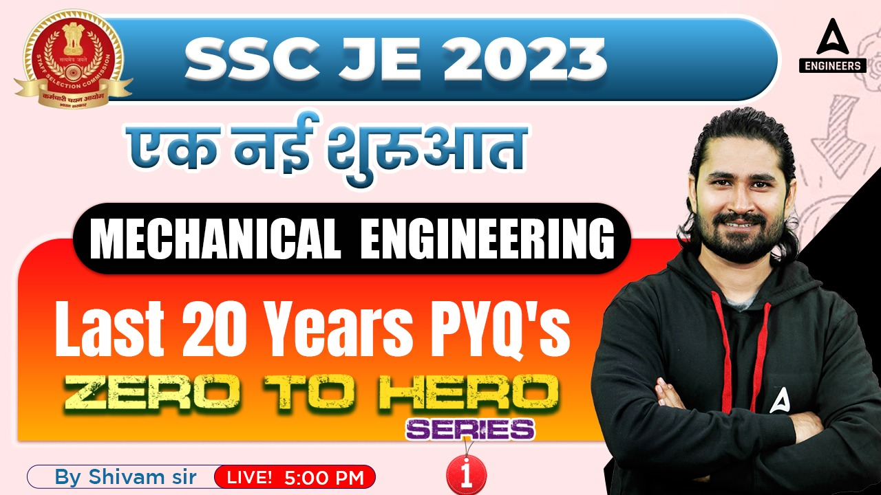
7

Slide 2


Slide 3


SSC JE Mechanical Previous Year Questions + Answers | Mechanical Engineering
Mechanical Engineering
Q. First law of thermodynamics furnishes the relationship between -
A. heat and work
B. heat, work and properties of the system
C. various properties of the system
D. various thermodynamic processes
[2009]
For 78% Discount
Use Code : “Y166”
78% Discount
Y166
Join Our Paid Batch : SSC JE Batch | Mahapack Batch | Use Code Y166 For 78% of Discount

Slide 4

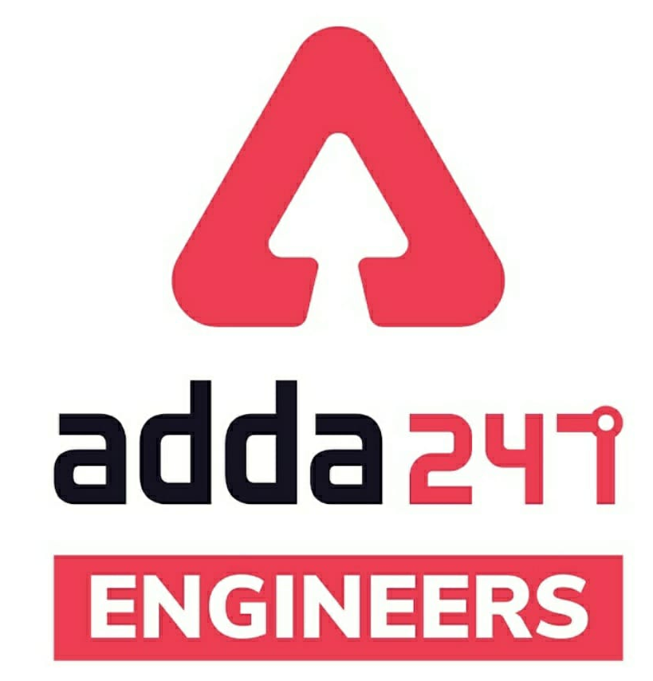

SSC JE Mechanical Previous Year Questions + Answers | Mechanical Engineering
Mechanical Soormas
Prashant Bhadauria
Jignesh Bipinbhai Shah
Pankaj Mahato
Ajit Singh
Dipankar Mandal
Lokesh Varwan
Mr. Dilip Gupta
Shubham Shukla
Ravi Raj
Aman Kumar
Amar Jyoti
Anuj Kanoujiya
Priyanka Creativity
Sandeep Kumar Jha
Yogi Tomar
Pragya Srivastava
Nandan Mehta
Ajay Kumar
Sahil Kumar
Ravi Singh
Gurdeep Singh
Shin Chain
Premananda Say
Piyush Mechanical
Sumit Singh
Subir
Pankaj Mahato
Shivanshu Kumar
for
Code : “Y166”

Slide 5
SSC JE Mechanical Previous Year Questions + Answers | Mechanical Engineering
Mechanical Soormas
Lunavath Rajesh
Shivani Singh
Raj Yadav
Entertainment Vlog
Rajnish Ajnavi
Ritick Konwar
Ajaya Suna
Raj Vimal
Deepak Yadav
Rahul Kumar
Rajesh Rohila
Rajat Bobde
Manoj Bhagat
Deepak Kumar
Akhilesh Gupta
Ela Sahoo
Er. Suhail
Sonakshi pulast
Pawan Singh Rana
Kumari Manisha
Avadhesh Yadav
Anup Kumar Sarkar
Pintu Mahato
Ashish Tandan
Om Prakash Chaurasiya
for
Code : “Y166”

Slide 6

SSC JE Mechanical Previous Year Questions + Answers | Mechanical Engineering
Mechanical Engineering
For 78% Discount
Use Code : “Y166”
78% Discount
Y166
Join Our Paid Batch : SSC JE Batch | Mahapack Batch | Use Code Y166 For 78% of Discount

Slide 7
SSC JE Mechanical Previous Year Questions + Answers | Mechanical Engineering
Mechanical Engineering
Q. Enthalpy in a free expansion process is !
A. Positive
B. Negative
C. Zero
D. Constant
For 78% Discount
Use Code : “Y166”
78% Discount
Y166
Join Our Paid Batch : SSC JE Batch | Mahapack Batch | Use Code Y166 For 78% of Discount

Slide 8
SSC JE Mechanical Previous Year Questions + Answers | Mechanical Engineering
Mechanical Engineering
Q. What is the state, in which the properties of the system change in long time, known as!?
A. Unsteady state
B. Steady state
C. Dynamic
D. Quasi static
For 78% Discount
Use Code : “Y166”
78% Discount
Y166
Join Our Paid Batch : SSC JE Batch | Mahapack Batch | Use Code Y166 For 78% of Discount

Slide 9
SSC JE Mechanical Previous Year Questions + Answers | Mechanical Engineering
Mechanical Engineering
Q. The mechanism which serve the purpose of dividing the periphery of a circular piece into a number of equal parts is known as:.
A. indexing
B. slider crank
C. oldham
D. quick return
For 78% Discount
Use Code : “Y166”
78% Discount
Y166
Join Our Paid Batch : SSC JE Batch | Mahapack Batch | Use Code Y166 For 78% of Discount

Slide 10
SSC JE Mechanical Previous Year Questions + Answers | Mechanical Engineering
Mechanical Engineering
Q. What is the Babcock and Wilcox boiler.?
A. Water tube boiler
B. Horizontal fire tube boiler
C. Transverse fire tube boiler
D. Vertical fire tube boiler
For 78% Discount
Use Code : “Y166”
78% Discount
Y166
Join Our Paid Batch : SSC JE Batch | Mahapack Batch | Use Code Y166 For 78% of Discount

Slide 11
SSC JE Mechanical Previous Year Questions + Answers | Mechanical Engineering
Mechanical Engineering
Q. A hydraulic press has a ram of 20 cm diameter and a plunger of 3 cm diameter. It is used for lifting a weight of 30 KN. Find the force required at the plunger-
A. 975 N
B. 675 N
C. 875 N
D. 1075 N
For 78% Discount
Use Code : “Y166”
78% Discount
Y166
Join Our Paid Batch : SSC JE Batch | Mahapack Batch | Use Code Y166 For 78% of Discount

Slide 12
SSC JE Mechanical Previous Year Questions + Answers | Mechanical Engineering
Mechanical Engineering
Q. Which of the following plant layout is most suitable for automobile manufacturing units.?
(A) Product layout
(B) Process layout
(C) Fixed position layout
(D) Group layout
For 78% Discount
Use Code : “Y166”
78% Discount
Y166
Join Our Paid Batch : SSC JE Batch | Mahapack Batch | Use Code Y166 For 78% of Discount

Slide 13
SSC JE Mechanical Previous Year Questions + Answers | Mechanical Engineering
Mechanical Engineering
Q. Which of the following relation is a mathematical expression of Grashof's law? S, L, P and Q denote length of the smallest, longest and other two links respectively-
(A) L+P < S+Q
(B) L+S < P+Q
(C) L+S > P+Q
(D) L+P = S+Q
For 78% Discount
Use Code : “Y166”
78% Discount
Y166
Join Our Paid Batch : SSC JE Batch | Mahapack Batch | Use Code Y166 For 78% of Discount

Slide 14
SSC JE Mechanical Previous Year Questions + Answers | Mechanical Engineering
Mechanical Engineering
Q. Chaplet is used to !
(A) Increase the cooling rate of molten metal
(B) Decrease the cooling rate of molten metal
(C) Compensate the shrinkage
(D) Support the core
For 78% Discount
Use Code : “Y166”
78% Discount
Y166
Join Our Paid Batch : SSC JE Batch | Mahapack Batch | Use Code Y166 For 78% of Discount

Slide 15
SSC JE Mechanical Previous Year Questions + Answers | Mechanical Engineering
Mechanical Engineering
Q. Chaplet is used to !
(A) Increase the cooling rate of molten metal
(B) Decrease the cooling rate of molten metal
(C) Compensate the shrinkage
(D) Support the core
For 78% Discount
Use Code : “Y166”
78% Discount
Y166
Join Our Paid Batch : SSC JE Batch | Mahapack Batch | Use Code Y166 For 78% of Discount

Slide 16
SSC JE Mechanical Previous Year Questions + Answers | Mechanical Engineering
Mechanical Engineering
Q. Acceptance sampling is normally used for_
(A) Job-shop production
(B) Batch production
(C) Mass production
(D) Just-in -time production
For 78% Discount
Use Code : “Y166”
78% Discount
Y166
Join Our Paid Batch : SSC JE Batch | Mahapack Batch | Use Code Y166 For 78% of Discount

Slide 17
SSC JE Mechanical Previous Year Questions + Answers | Mechanical Engineering
Mechanical Engineering
Q. The power transmitted by a belt is maximum when the relation between maximum tension (T) and centrifugal tension (Tc) is !
(A) T = 0.5 Tc
(B) T = Tc
(C) T = 2 Tc
(D) T = 3 Tc
For 78% Discount
Use Code : “Y166”
78% Discount
Y166
Join Our Paid Batch : SSC JE Batch | Mahapack Batch | Use Code Y166 For 78% of Discount

Slide 18
SSC JE Mechanical Previous Year Questions + Answers | Mechanical Engineering
Mechanical Engineering
Q. Isochoric process is also known as.
(A) Constant volume process
(B) Constant temperature process
(C) Constant pressure process
(D) Constant enthalpy process
For 78% Discount
Use Code : “Y166”
78% Discount
Y166
Join Our Paid Batch : SSC JE Batch | Mahapack Batch | Use Code Y166 For 78% of Discount

Slide 19
SSC JE Mechanical Previous Year Questions + Answers | Mechanical Engineering
Mechanical Engineering
Q. The ability of oil to resist oxidation that would yield acids, lacquers and sludge is called:!
A. oiliness
B. detegency
C. foaming
D. stability
For 78% Discount
Use Code : “Y166”
78% Discount
Y166
Join Our Paid Batch : SSC JE Batch | Mahapack Batch | Use Code Y166 For 78% of Discount

Slide 20
SSC JE Mechanical Previous Year Questions + Answers | Mechanical Engineering
Mechanical Engineering
Q. What does a Lagrangian description of fluid flow provide.?
A. Position of fluid particle at every time instant
B. Energy of a fluid particle at every time instant
C. Pressure at a given point at every time instant
D. Temperature at a given point at every time instant
For 78% Discount
Use Code : “Y166”
78% Discount
Y166
Join Our Paid Batch : SSC JE Batch | Mahapack Batch | Use Code Y166 For 78% of Discount

Slide 21
SSC JE Mechanical Previous Year Questions + Answers | Mechanical Engineering
Mechanical Engineering
Q. Dynamic viscosity increases with the rate of shear increase for:!
A. rheopectic fluid
B. pseudoplastic fluid
C. thixotropic fluid
D. dilatants fluid
For 78% Discount
Use Code : “Y166”
78% Discount
Y166
Join Our Paid Batch : SSC JE Batch | Mahapack Batch | Use Code Y166 For 78% of Discount

Slide 22
SSC JE Mechanical Previous Year Questions + Answers | Mechanical Engineering
Mechanical Engineering
Q. If the by-pass factor is 0.30, what will be the efficiency of cooling or the contact factor.?
A. 0.70
B. 0.66
C. 0.15
D. 0.30
For 78% Discount
Use Code : “Y166”
78% Discount
Y166
Join Our Paid Batch : SSC JE Batch | Mahapack Batch | Use Code Y166 For 78% of Discount

Slide 23
SSC JE Mechanical Previous Year Questions + Answers | Mechanical Engineering
Mechanical Engineering
Q. Energy of a system is defined as:!
A. point function and intensive property
B. path function and extensive property
C. path function and intensive property
D. point function and extensive property
For 78% Discount
Use Code : “Y166”
78% Discount
Y166
Join Our Paid Batch : SSC JE Batch | Mahapack Batch | Use Code Y166 For 78% of Discount

Slide 24

Use Code “Y166” for
maximum 78%* discount
400+ Hours Two-way Interactive Live Classes.
Syllabus is based on Recent Notification, Previous Years Exam and the same will be updated accordingly.
Enroll in this Batch, Limited Seats available.
Recorded Videos available 24/7 for quick Revision.
Solve Unlimited doubts with experts.
Get Preparation tips from the experts & Learn Time Management.
Join Our Paid Batch : SSC JE Batch | Mahapack Batch | Use Code Y166 For 78% of Discount

Slide 25
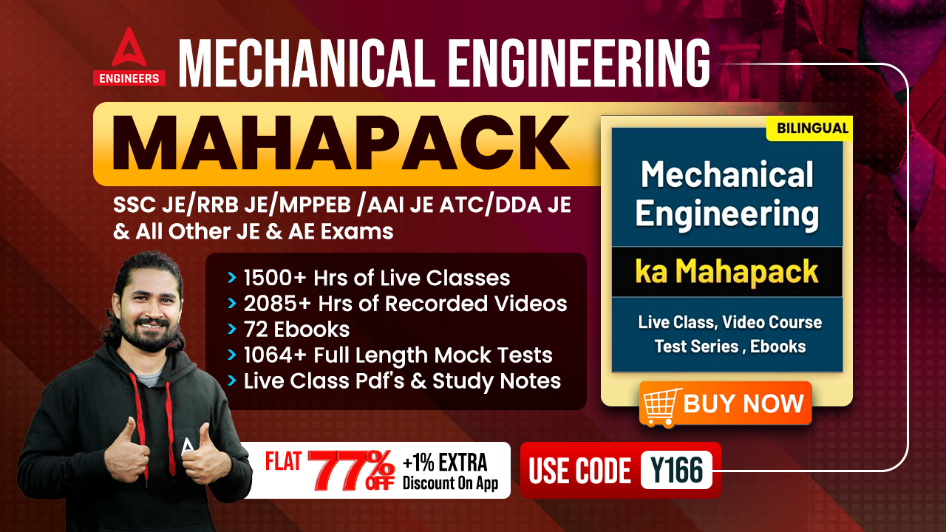

78% Discount
Y166
Join Our Paid Batch : SSC JE Batch | Mahapack Batch | Use Code Y166 For 78% of Discount

Slide 26
SSC JE Mechanical Previous Year Questions + Answers | Mechanical Engineering
Mechanical Engineering
The process of removing unwanted material from the casting is called.
A. Fettling
B. Cleaning
C. Finishing
D. Blowing
For 78% Discount
Use Code : “Y166”
78% Discount
Y166
Join Our Paid Batch : SSC JE Batch | Mahapack Batch | Use Code Y166 For 78% of Discount

