Slide 1



Slide 2


Slide 3
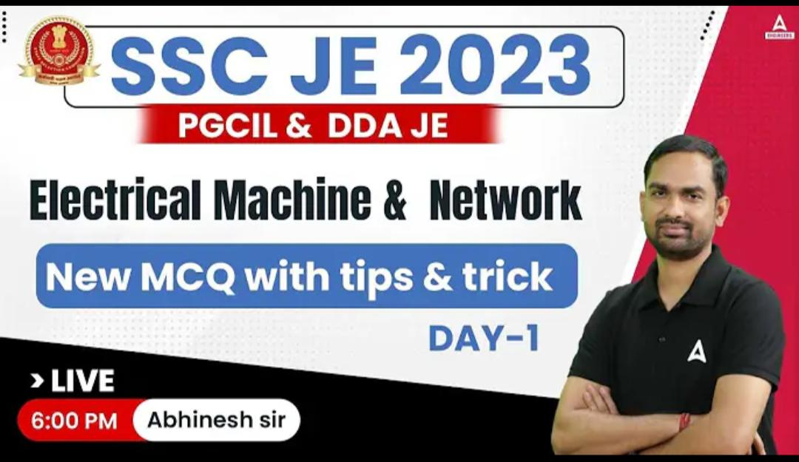

Slide 4

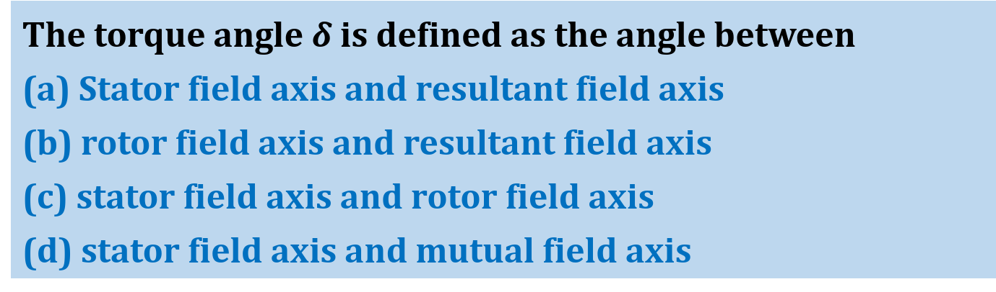
By- Abhinesh sir
USE CODE FOR DISCOUNT : Y433
The torque angle $δ$ is defined as the angle between
(a) Stator field axis and resultant field axis
(b) rotor field axis and resultant field axis
(c) stator field axis and rotor field axis
(d) stator field axis and mutual field axis
Q

Slide 5

By- Abhinesh sir
USE CODE FOR DISCOUNT : Y433
The interaction torque depends on
1. stator field strength
2. rotor field strength
3. torque angle $δ$
4. sin $δ$
5. cos $δ$
From these, the correct answer is
(a) 1, 2, 4
(b) 1, 2, 5
(c) 1, 2, 3
(d) 1, 2
Q

Slide 6
By- Abhinesh sir
USE CODE FOR DISCOUNT : Y433
Armature winding is one in which working
(a) flux is produced by field current
(b) flux is produced by the working emf
(c) emf is produced by the working flux
(d) emf is produced by the leakage flux
Q

Slide 7
By- Abhinesh sir
USE CODE FOR DISCOUNT : Y433
Large synchronous machines are constructed with armature winding on the stator because stationary armature winding
1. can be insulated satisfactorily for higher voltage
2. Can be cooled more efficiently
3. would lead to reduced slip – ring losses
4. would have no slot harmonics
5. would have reduced armature reactance
From these, the correct answer is
(a) 1, 2, 3, 4
(b) 1, 2, 3, 5
(c) 1, 2, 3, 4, 5
(d) 1, 2, 4, 5
Q

Slide 8
By- Abhinesh sir
USE CODE FOR DISCOUNT : Y433
A pole pitch in electrical machines is
(a) = 180° electrical
(b) = 180° mechanical
(c) > 180° electrical
(d) < 180° electrical
Q

Slide 9

By- Abhinesh sir
USE CODE FOR DISCOUNT : Y433
For a P-pole machine, the relation between electrical and mechanical degrees is given by
(a) $θ_{elec}$ = $\frac{2}{P}. θ_{mech}$
(b) $θ_{elec}$ = $\frac{4}{P}. θ_{mech}$
(c) $θ_{mech}$ = $\frac{P}{2}$. $θ_{elec}$
(d) $θ_{elec}$ = $\frac{P}{2}.$ $θ_{mech}$
Q

Slide 10
By- Abhinesh sir
USE CODE FOR DISCOUNT : Y433
A coil consists of
(a) two conductors
(b) two coil – sides
(c) two turns
(d) four turns
Q

Slide 11
By- Abhinesh sir
USE CODE FOR DISCOUNT : Y433
One turn consists of
(a) two coil-sides
(b) two conductors
(c) four conductors
(d) four coil-sides
Q

Slide 12
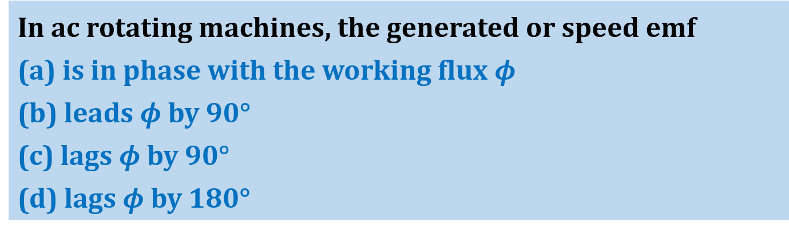
By- Abhinesh sir
USE CODE FOR DISCOUNT : Y433
In ac rotating machines, the generated or speed emf
(a) is in phase with the working flux $φ$
(b) leads $φ$ by 90°
(c) lags $φ$ by 90°
(d) lags $φ$ by 180°
Q

Slide 13
By- Abhinesh sir
USE CODE FOR DISCOUNT : Y433
A winding is distributed in the slots along the air – gap periphery
1. to add mechanical strength to the winding
2. to reduce the amount of conductor material required
3. to reduce the harmonics in the generated emf
4. to reduce the size of the machine
5. for full utilization of iron and conductor materials
From these, the correct answer is
(a) 1, 3, 4, 5
(b) 1, 2, 4, 5
(c) 1, 2, 3, 5
(d) 1, 3, 5
Q

Slide 14
By- Abhinesh sir
USE CODE FOR DISCOUNT : Y433
In dc machines, the armature windings are placed on the rotor because of the necessity for
(a) electromechanical energy conversion
(b) generation of voltage
(c) commutation
(d) development of torque
Q

Slide 15
By- Abhinesh sir
USE CODE FOR DISCOUNT : Y433
In dc machines, the field system has to be provided on stator unlike synchronous machines wherein it could be on any member, because
(a) it reduces field structure iron losses
(b) it gives more uniform air – gap flux distribution
(c) commutator action is not possible otherwise
(d) dc machines are comparatively low rating machines.
Q

Slide 16
By- Abhinesh sir
USE CODE FOR DISCOUNT : Y433
In dc machines, the space distribution of air – gap flux density wave at no load is
(a) sinusoidal
(b) co-sinusoidal
(c) flat-topped
(d) rectangular
Q

Slide 17
By- Abhinesh sir
USE CODE FOR DISCOUNT : Y433
A commutator in dc machines can
1. provide half – wave rectification
2. provide full – wave rectification
3. Convert ac to dc
4. Convert dc to ac
5. Provide controlled full – wave rectification
From these, the correct answer is
(a) 2, 3, 4
(b) 1, 2, 3
(c) 2, 3, 5
(d) 2, 3, 4, 5
Q

Slide 18
By- Abhinesh sir
USE CODE FOR DISCOUNT : Y433
In dc machines, the space waveform of the air gap flux distribution affects
(a) torque but not the voltage
(b) voltage but not the torque
(c) both the torque and voltage
(d) neither the voltage nor the torque
Q

Slide 19
By- Abhinesh sir
USE CODE FOR DISCOUNT : Y433
In dc machines, the field – flux axis and armature – mmf axis are respectively along
(a) direct axis and indirect axis
(b) direct axis and interpolar axis
(c) quadrature axis and direct axis
(d) Quadrature axis and interpolar axis
Q

Slide 20
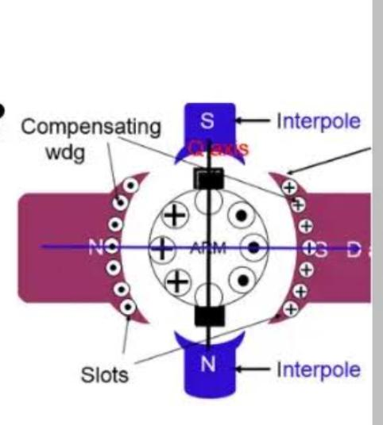

Slide 21



Slide 22

By- Abhinesh sir
USE CODE FOR DISCOUNT : Y433
The brush – axis of a bipolar dc motor is rotated by 90°. The effect of this rotation on the back emf $E_{b}$ and the torque developed $T_{d}$ would be such that
(a) both $E_{b}$ and $T_{d}$ are unchanged
(b) $E_{b}$ is zero, but $T_{d}$ is unchanged
(c) $E_{b}$ is unchanged, but $T_{d}$ is zero
(d) both $E_{b}$ and $T_{d}$ are zero
Q

Slide 23

By- Abhinesh sir
USE CODE FOR DISCOUNT : Y433
Consider the following statements regarding the magnetization characteristics of a dc generator:
1. It represents the variation of field flux with field current.
2. Variation of open – circuit terminal voltage with field current is independent of speed
3. It is non-linear from zero to rated field current
4. It helps to determine the critical field resistance at a given speed
5. It always starts from the origin
Which of these statements are correct?
(a) 1 and 4 (b) $1, 2$and 5
(c) $2, 3$and 4 (d) 3 and 5
Q

Slide 24
By- Abhinesh sir
USE CODE FOR DISCOUNT : Y433
A dc shunt generator builds up to a voltage of 220 V at no load while running at its rated speed. If the speed of the generator is raised by 25% keeping the circuit conditions unaltered, then the voltage to which the machine would build up will
(a) not change and remain at 220 V
(b) increase to 1.25 times 220 V
(c) increase to value lying between 220 V and 1.25 times 220 V
(d) increase to a value greater than 1.25 times 220 V.
Q

Slide 25
By- Abhinesh sir
USE CODE FOR DISCOUNT : Y433
The armature core of a dc machine is laminated to minimize
(a) hysteresis loss
(b) eddy-current loss
(c) mechanical loss
(d) temperature rise
Q

Slide 26
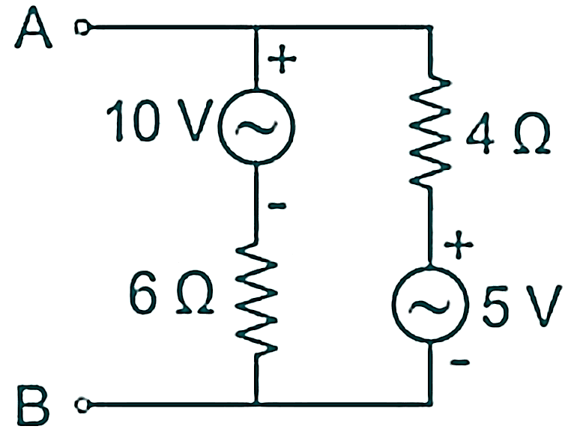
By- Abhinesh sir
USE CODE FOR DISCOUNT : Y433
In the given circuit, viewed from AB, the circuit can be reduced to an equivalent circuit as:
(a) 1 volt source in series with 10 Ω resistor
(b) 7 volts source in series with 2.4 Ω resistor
(c) 5 volts source in series with 10 Ω resistor
(d) 15 volts source in series with 2.4 Ω resistor
Q

Slide 27

By- Abhinesh sir
USE CODE FOR DISCOUNT : Y433
Consider the following as representations of reciprocity in terms of different two port network parameters:
1. Z parameters: $Z_{12}$ = $Z_{21}$
2. Y parameters : $y_{12}$ = $−y_{21}$
3. T parameters : A = D
4. H parameters: $h_{12}$ = $h_{21}$
Which of the above representations(s) is/are true?
(a) 1, 2, 3 and 4
(b) 2 and 4
(c) Only 1
(d) 1 and 3
Q

Slide 28
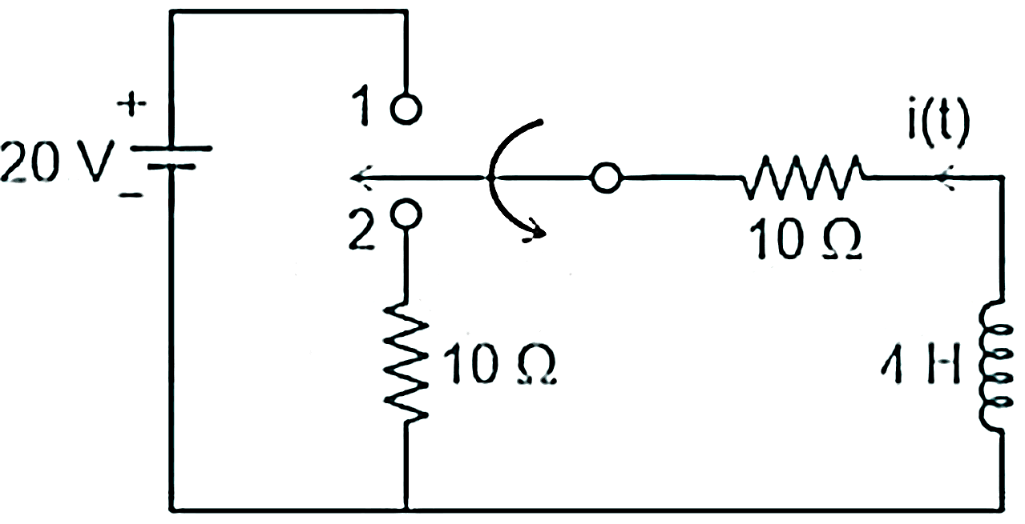

By- Abhinesh sir
USE CODE FOR DISCOUNT : Y433
For the circuit shown in figure, find current i(t) after the switch moves from position ‘1’ to position ‘2’ –
(a) $e^{−5t}$
(b) $e^{+5t}$
(c) $−2e^{−5t}$
(d) $2e^{+5t}$
Q

Slide 29

By- Abhinesh sir
USE CODE FOR DISCOUNT : Y433
Consider a 3-phase, 3-wire system with star connected load of impedance (4 + j3) Ω per phase. If the line voltage is 240 V, the power absorbed by each phase is ____________.
(a) $3072$ W
(b) $1775$ W
(c) $2944$ W
(d) $5320$ W
Q

Slide 30
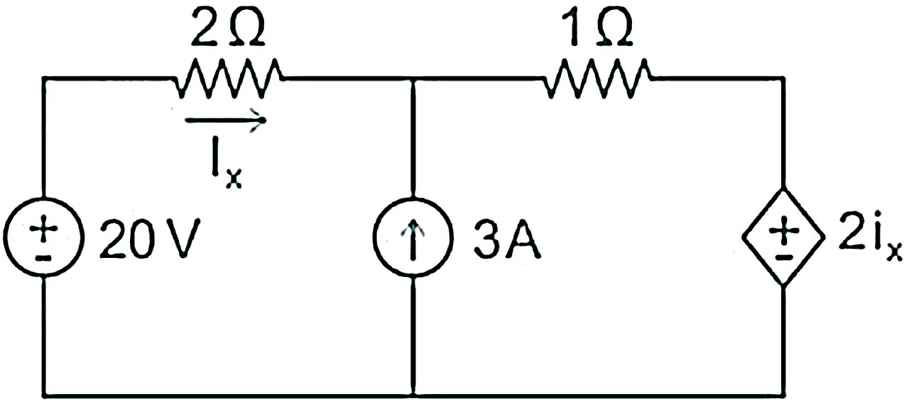

By- Abhinesh sir
USE CODE FOR DISCOUNT : Y433
In the circuit shown below, the value of the current $I_{x}$ is:
(a)
(b)
(c)
(d)
Q

