Slide 1


Slide 2
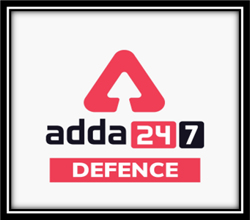
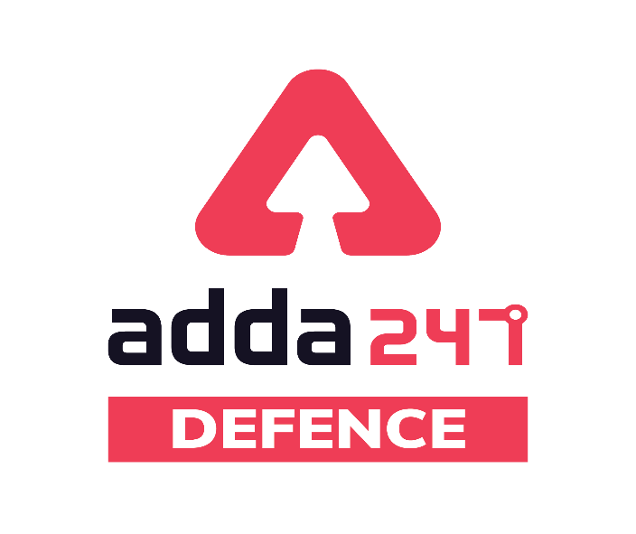
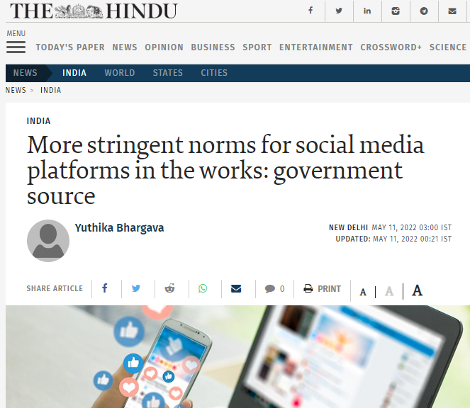
Most Important Argument Topics
Q.1
More stringent norms for social media platforms

Slide 3
Most Important Argument Topics
Q.2
Privatization

Slide 4
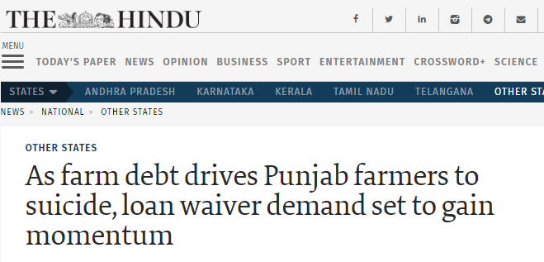
Most Important Argument Topics
Q.3
Is loan waiver beneficial for farmers?

Slide 5
Most Important Argument Topics
Q.4
Online Education vs Traditional Education?
or
Can online education replace traditional education

Slide 6
Most Important Argument Topics
Q.5
Artificial intelligence is a threat to humanity?
Elon Musk called AI “humanity’s greatest threat.”
Stephen Hawking said the technology could “spell the end of the human race.” That’s some major alarm-sounding.

Slide 7
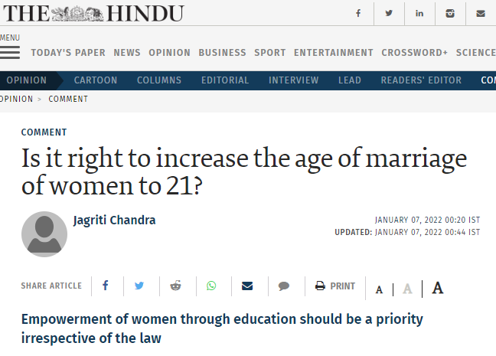
Most Important Argument Topics
Q.6
Increasing legal age of marriage to 21: Is it a boon or a bane
(वरदान है या अभिशाप)
)?

Slide 10
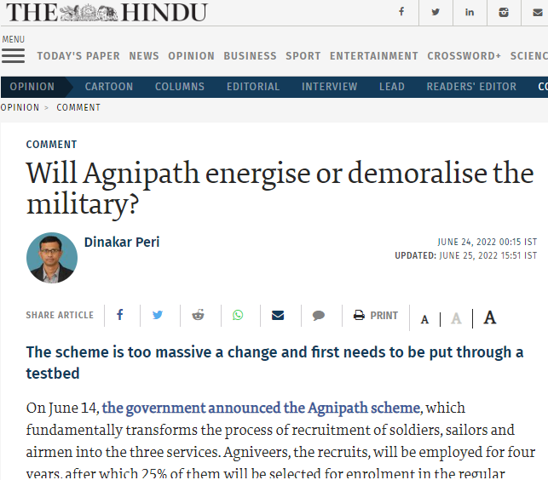
Most Important Argument Topics
Q.7
Argument for/against Agnipath scheme

Slide 11
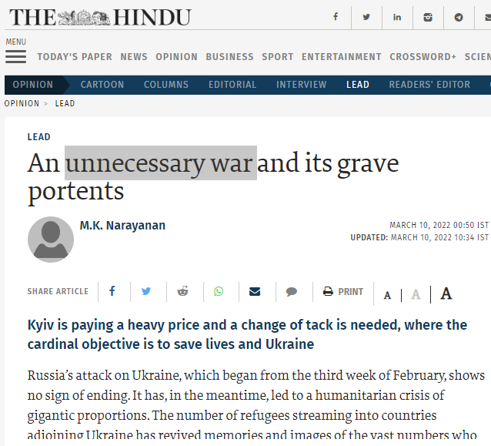
Most Important Argument Topics
Q.8
Is war the solution to conflicts?
unnecessary war ?

Slide 12
Most Important Argument Topics
Q.9
Agneepath Scheme for the Armed Forces

Slide 13
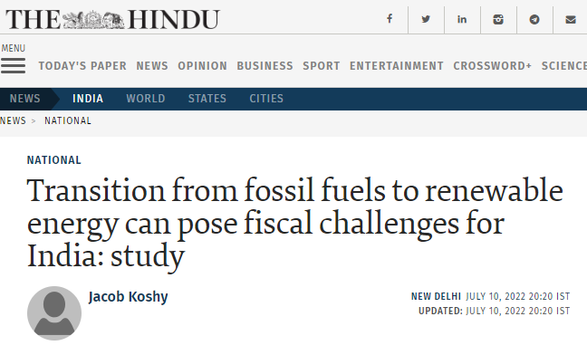
Most Important Argument Topics
Q.10
Solar Energy vs. Fossil Fuels: The Great Debate

Slide 14
thanks

Slide 15
Most Important Argument Topics
Q.9
Benefits & Risks of Artificial Intelligence?

Slide 16
Most Important Argument Topics
Q.11
Uniform civil code pros and cons

Slide 17
Most Important Argument Topics
Q.14
Is Naxalism a developmental problem?

Slide 18
Most Important Argument Topics
Q.9
Age of Marriage of women and Men should be same

Slide 19
Most Important Argument Topics
Q.15
Local reservation in private sector?

Slide 20
Most Important Argument Topics
Q.16
Death Penalty must be abolished.

Slide 22
Most Important Report Topics
Q.1
Protests Across India

Slide 23
Most Important Report Topics
Most Important Essay Topics
Q.2
Floods in assam and Bihar

Slide 24
Most Important Report Topics
Q.3
Sri Lanka economic crisis

Slide 25
Most Important Report Topics
Q.1
Death Penalty must be abolished.

Slide 26
Most Important Essay Topics
Q.4
Operation ganga

Slide 27
Most Important Essay Topics
Q.1
Russia Ukraine war

Slide 28
Most Important Essay Topics
Q.1
Heat waves

Slide 29
Most Important Essay Topics
Q.1
India’s green hydrogen policy

Slide 30
Most Important Essay Topics
Q.1
Rising Road Accidents

Slide 31
Most Important Essay Topics
Q.1
Climate Change and Water Contamination

Slide 32
Most Important Essay Topics
Q.1
Sagarmala programme

Slide 33
Most Important Essay Topics
Q.1
Net Zero by 2070 – COP26

Slide 34
Most Important Essay Topics
Q.1
Azadi ka Amrit Mahotsav

Slide 35
Most Important Essay Topics
Q.1
The road to the future of electric vehicles in India

Slide 36
Most Important Essay Topics
Q.1
ABG shipyard scam

Slide 37
Most Important Essay Topics
Q.1
Temple idols disputes

Slide 38
Most Important Essay Topics
Q.1
Unemployment

Slide 39
Most Important Essay Topics
Q.1
Disaster Management

Slide 40
Most Important Essay Topics
Q.1
Naxalism in India

Slide 41
Most Important Essay Topics
Q.1
Armed Forces Special Powers Act

Slide 42
Most Important Essay Topics
Q.1
Education System in India

Slide 43
Most Important Essay Topics
Q.1
Pollution

Slide 44
Most Important Essay Topics
Q.1
Naxalism in India

Slide 45
Most Important Essay Topics
Q.1
Death Penalty must be abolished.

